Slide 1
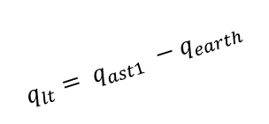

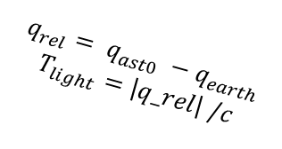
Ast t₁
$$q_{lt}= q_{ast1} −q_{earth}$$
$$dq=v_{ast} T_{light}$$
Earth t₁
$q_{rel}= q_{ast0} −q_{earth}$
$$T_{light}=\left|q_rel\right| /c$$
Ast t₀

