Slide 1
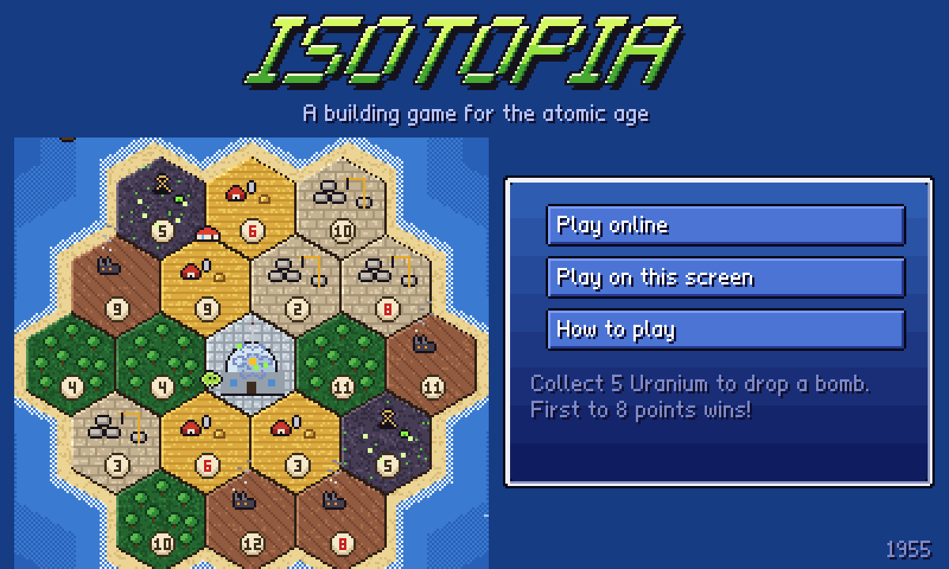
Isotopia
Our Catan remake, set in the atomic age
Saskatoon Engineering Competition 2026
Team: add your names here
Notes:
Hi everyone! We're [team]. This morning we built Isotopia: it's Catan, but set on a 1950s island where you can collect uranium and, well, drop a bomb. We'll quickly cover what Catan is, how we got from a blank whiteboard to this, then show it live.

Slide 2
First, what is Catan?
A board game from 1995 by Klaus Teuber, one of the best-selling board games ever
The board is an island of hexagon tiles: forest, hills, fields and more
Each tile has a number. Roll the dice, and tiles with that number pay resources
Spend resources on roads, settlements and cities. First to 10 points wins
Roll
Build
Collect
Trade
Every turn: roll, collect, trade, build
Notes:
Quick Catan recap for anyone who hasn't played. The whole game is this loop: roll the dice, every tile with that number pays the people living next to it, you trade for what you're missing, and you build. Roads let you expand, settlements give points, and first to 10 wins.

Slide 3
The problem we picked
Long games
Rules first
Same table
A full game easily runs over an hour.
New players read a rulebook before their first roll.
Everyone has to be in the same room.
Problem statement
Make a Catan-style game that someone can learn in a few minutes, finish in about half an hour, and play with friends online.
Notes:
We all like Catan, but we noticed the same three complaints every time we play: it takes forever, someone new always has to sit through the rules, and you can't really play it with friends who aren't in the room. So that became our problem statement.

Slide 4
Saturday morning brainstorm
Medieval kingdom
Wasteland rebuild
Power grid tycoon
✓ Atomic Age 1950s
Reactors make double
Meltdown on a 7?
✓ Uranium bomb wipes out a land
✓ Fallout shelters
Seasons change the map
✓ Bots for empty seats
✓ Play online with a link
✓ Shorter game: 8 points
Yellow: themes. Pink: the twist. Green: ways to make it easier. Then everyone got three votes.
Notes:
This was pretty much our whiteboard at 9am. We threw out a bunch of themes and twists, no idea too dumb, then everyone got three votes. The crossed out ones lost. The bomb idea won the twist vote by a mile.

Slide 5
Picking a theme
Theme | Fun (30%) | Easy to learn (30%) | Fits pixel art (20%) | Original (20%) | Score
Medieval kingdom | 4 | 4 | 5 | 2 | 3.8
Wasteland rebuild | 4 | 3 | 4 | 3 | 3.5
Power grid tycoon | 3 | 3 | 3 | 4 | 3.2
Atomic Age 1950s | 5 | 4 | 5 | 5 | 4.7
Scores out of 5, weighted. Atomic Age won on fun and originality, and it gave us uranium.
Notes:
To settle the theme argument we did a quick weighted decision matrix. We weighted fun and easy-to-learn highest because those were our objectives. Medieval was safe, but Atomic Age was more original and naturally gave us a new resource.

Slide 6
Objectives, constraints, functions
Objectives
Constraints
Functions
What we wanted
What we had to stick to
What it has to do
Easy for a first-timer
Games around 20 to 25 min
Fun to replay
Looks good
Python + pygame
Runs in a browser, no install
2 to 4 players
Free: no servers to pay for
New random board each game
Roll dice and pay out
Check every rule
Bots and online play
Notes:
Standard engineering design stuff. Objectives are the things we wanted to maximize. Constraints were hard limits: we had to use Python and pygame, it had to run in a browser so friends don't install anything, and it couldn't cost money. Functions are what the game actually has to do.

Slide 7
What we changed from Catan
Catan | Isotopia | Why
10 points to win | 8 points to win | Shorter games
5 resources | 4 resources + Uranium | Uranium is rare: only 2 mines
The robber | A radiation cloud | Same rule, fits the theme
Development cards | Cut | Less to explain
Nothing like it | The Bomb: 5 Uranium wipes out a land | Big moments, one per player
Nothing like it | Fallout shelter | A way to defend yourself
Notes:
Here's everything we changed. Mostly we cut stuff to make it faster and easier, then added one big new idea: the bomb. Collect five uranium and you can turn any land into a crater, destroying every building on it, unless it has a fallout shelter.

Slide 8
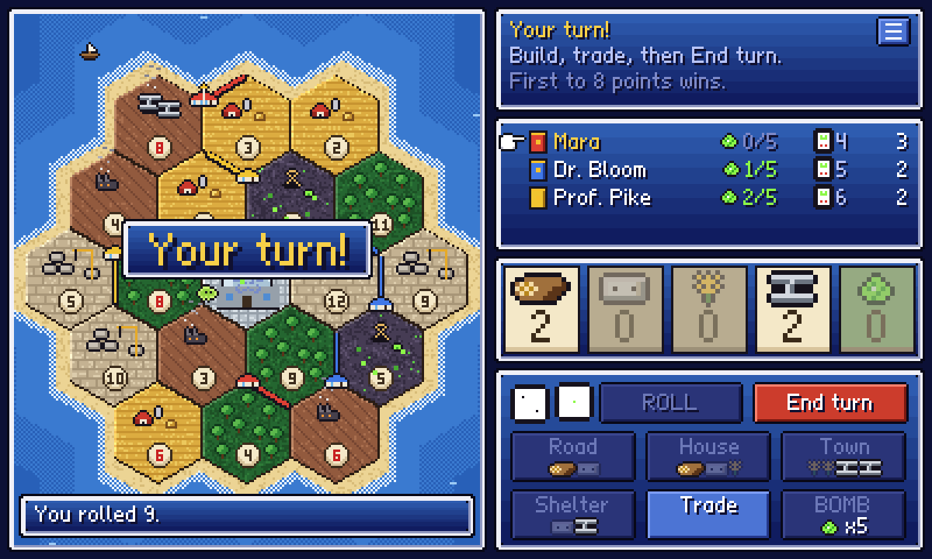
Version 1 to version 2
Morning: version 1
Afternoon: version 2
def roll_two_die():
dice_1 = random.randint(1, 6)
dice_2 = random.randint(1, 6)
return dice_1 + dice_2
Board as a grid of dots and edges (backend.py)
SPACE to roll, E to end your turn
Dice auto-roll after 10 seconds
Everything printed in the terminal
Clickable map, pixel art, bots, tips, online play
Notes:
Our first version this morning was all keyboard and terminal: SPACE to roll, E to end the turn, and the dice roll themselves after 10 seconds so nobody stalls. Once the rules worked, we rebuilt the screen so you just click on the map.

Slide 9
How it's built
app.py + view.py
The pixel screens, drawn with pygame
rules.py
Every rule of the game. No graphics
online.py
Host's browser runs the game, sends each player their view
bot.py
The bots for empty seats
Friends' browsers
Connect through PeerJS
pygbag turns the pygame code into a web page, and GitHub Pages hosts it for free.
Notes:
The key decision was keeping all the rules in one file with no graphics. That made it easy to test, and the bots and online play just use the same rules. For online, one friend's browser runs the actual game and sends everyone their own view, so you can't see other people's cards.

Slide 10
Testing, and the bug that broke it
200
460
45
bot games every time we change a rule
rounds in our longest broken game
rounds in the longest game after the fix
What happened: with unlimited bombs, the bots kept nuking the island until it was all craters and nobody could earn anything. The fix: one bomb per player. Now a typical game is about 17 rounds.
Notes:
Our favourite bug. We let the bots play 200 games, and one game lasted 460 rounds. Turns out with unlimited bombs they turned the whole island into craters, so nobody could ever win. Limiting it to one bomb each fixed it, and the longest game dropped to 45 rounds.

Slide 11

Live demo
Play along on your phone or laptop:
memara719.github.io/kingsfold/isotopia
Scan to play
Notes:
Demo plan: 1) host a table and show the invite link. 2) Someone joins from their phone. 3) Place houses, roll, build. 4) If someone has 5 uranium, drop the bomb. If the Wi-Fi dies, flip to the next slide.

Slide 12
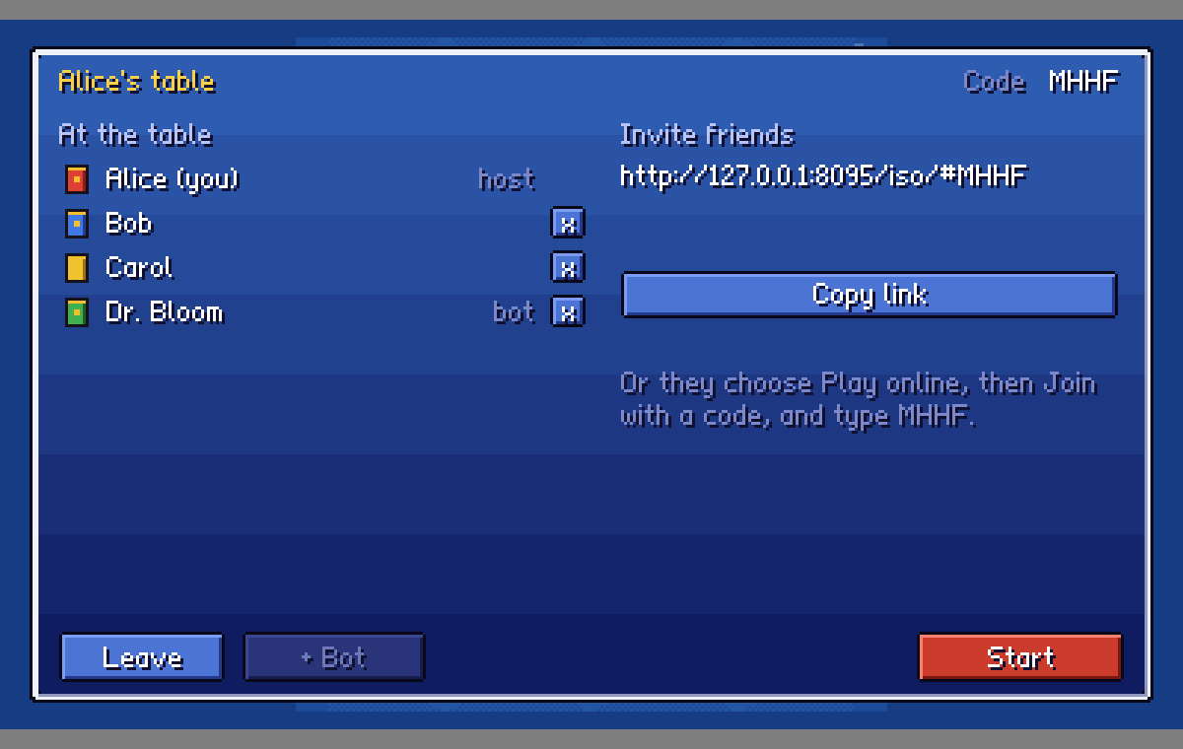
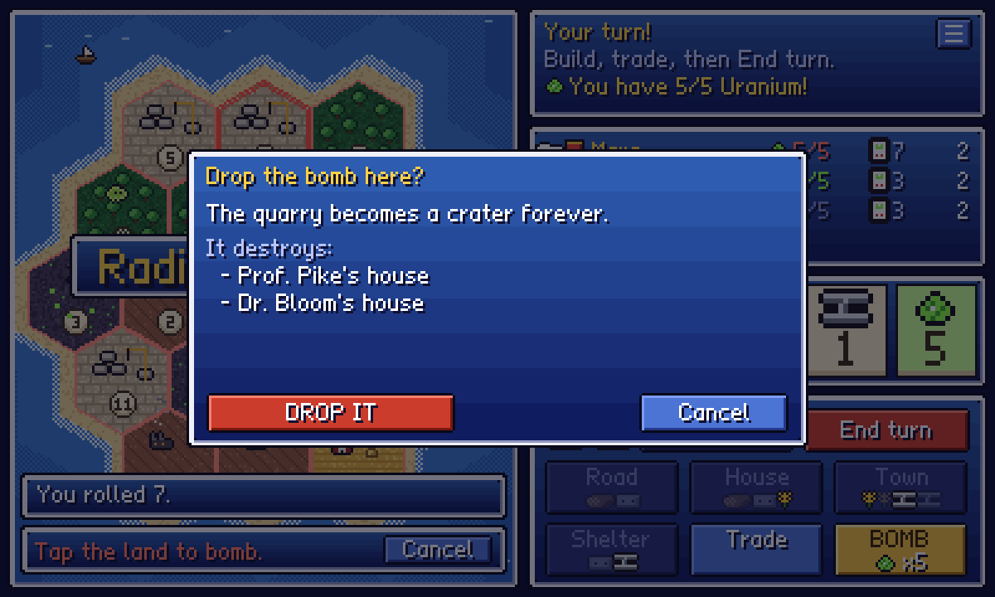
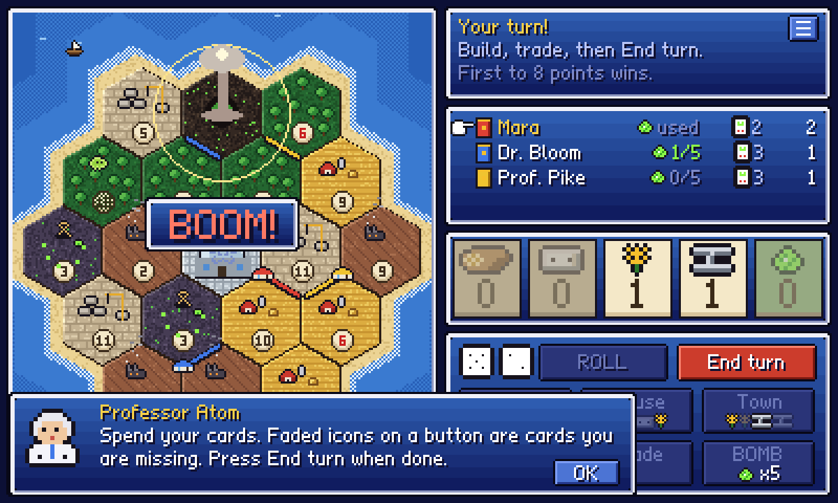
In case the Wi-Fi gives up
Host a table, send the link
Pick a land to bomb
Boom: a crater forever
Notes:
Backup screenshots: the online lobby with the invite link, the bomb confirmation that tells you exactly what gets destroyed, and the explosion.

Slide 13
What we'd do next
Player trading
Smarter bots
Phone layout
Right now you can only trade with the bank
Easy, normal and hard
Play holding your phone upright
Music
Save and resume
Colour-blind mode
A proper chiptune soundtrack
Pick a game back up later
Patterns on top of player colours
Notes:
If we had another Saturday: trading between players online is the big one, then bot difficulty levels, a portrait layout for phones, and a colour-blind friendly mode since player colours matter a lot.

Slide 14
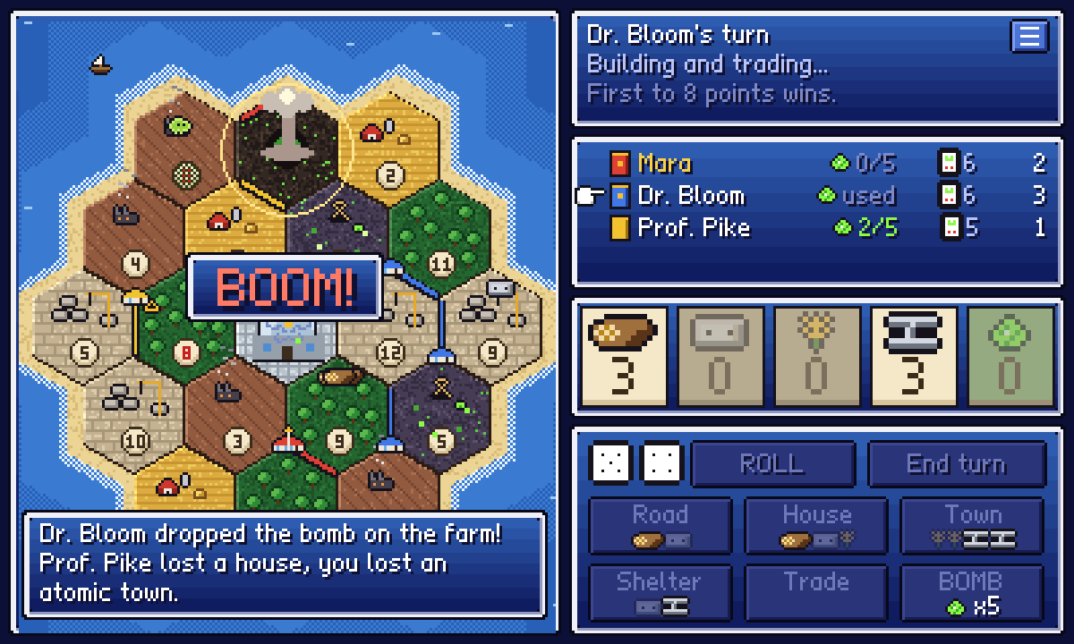
Questions?
Thanks for listening!
memara719.github.io/kingsfold/isotopia
Notes:
That's it, thanks! Happy to take questions about the game, the code, or why we thought adding nukes to Catan was a good idea.

