Slide 1
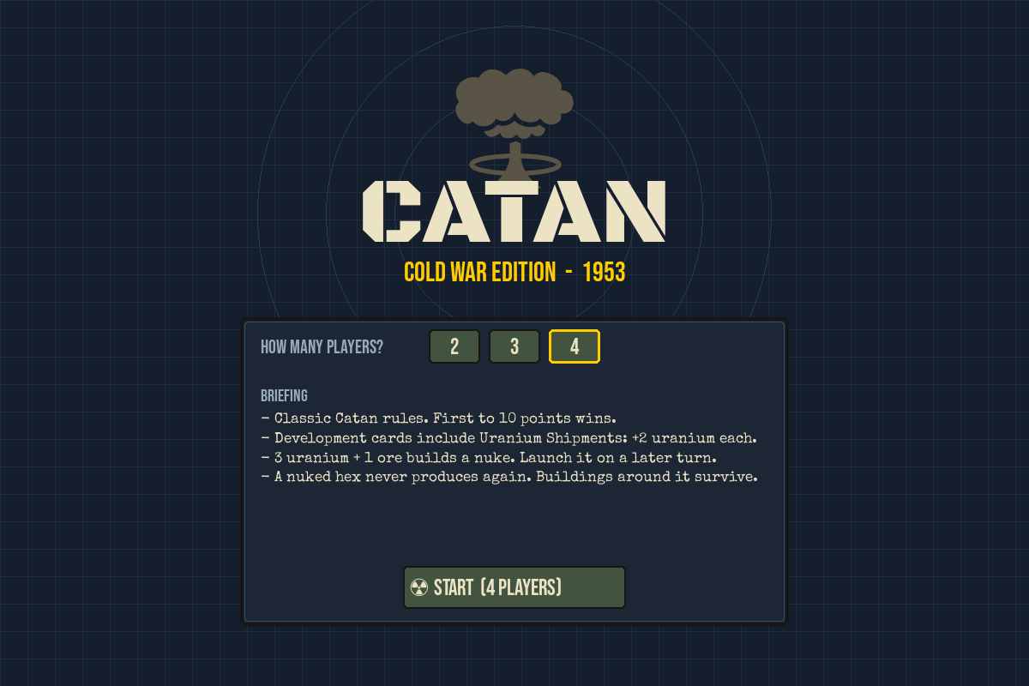
Catan: Cold War Edition
Our Catan remake, set in the atomic age
Saskatoon Engineering Competition 2026
Team: Daniyal, Mustafa, Abdullah, Taha
Notes:
Hi everyone! We're [team]. We're Daniyal, Mustafa, Abdullah and Taha. This morning we built Catan: Cold War Edition. It's classic Catan set in 1953, except you can get uranium and, well, nuke a tile. We'll quickly cover what Catan is, how we got from a blank whiteboard to this, then show it live.

Slide 2
First, what is Catan?
A board game from 1995 by Klaus Teuber, one of the best-selling board games ever
The board is an island of hexagon tiles: forest, hills, fields and more
Each tile has a number. Roll the dice, and tiles with that number pay resources
Spend resources on roads, settlements and cities. First to 10 points wins
Roll
Build
Collect
Trade
Every turn: roll, collect, trade, build
Notes:
Quick Catan recap for anyone who hasn't played. The whole game is this loop: roll the dice, every tile with that number pays the people living next to it, you trade for what you're missing, and you build. Roads let you expand, settlements give points, and first to 10 wins.

Slide 3
The problem we picked
Long games
Rules first
Same table
A full game easily runs over an hour.
New players read a rulebook before their first roll.
Everyone has to be in the same room.
Problem statement
Make the best version of Catan: keep the rules people already love, and add one twist that makes every game feel different.
Notes:
We all like Catan, but we noticed the same three complaints every time we play: it takes forever, someone new always has to sit through the rules, and you can't really play it with friends who aren't in the room. We didn't want to throw out what makes Catan good, so our problem statement was simple: make the best version of Catan, with one twist big enough to change how people play.

Slide 4
Saturday morning brainstorm
Medieval kingdom
Wasteland rebuild
Power grid tycoon
✓ Atomic Age 1950s
Reactors make double
Meltdown on a 7?
✓ Nuke wipes out a hex for good
Fallout shelters
Seasons change the map
✓ Keep the classic rules
✓ Uranium from dev cards
Shorter game: 8 points
Yellow: themes. Pink: the twist. Green: how it fits into the rules. Then everyone got three votes.
Notes:
This was pretty much our whiteboard at 9am. We threw out a bunch of themes and twists, no idea too dumb, then everyone got three votes. The crossed out ones lost. The nuke idea won the twist vote by a mile, and we decided to keep everything else from classic Catan.

Slide 5
Picking a theme
Theme | Fun (30%) | Easy to learn (30%) | Fits the look (20%) | Original (20%) | Score
Medieval kingdom | 4 | 4 | 5 | 2 | 3.8
Wasteland rebuild | 4 | 3 | 4 | 3 | 3.5
Power grid tycoon | 3 | 3 | 3 | 4 | 3.2
Atomic Age 1950s | 5 | 4 | 5 | 5 | 4.7
Scores out of 5, weighted. Atomic Age won on fun and originality, and it gave us uranium.
Notes:
To settle the theme argument we did a quick weighted decision matrix. We weighted fun and easy-to-learn highest because those were our objectives. Medieval was safe, but Atomic Age was more original and naturally gave us a new resource.

Slide 6
Objectives, constraints, functions
Objectives
Constraints
Functions
What we wanted
What we had to stick to
What it has to do
Easy if you know Catan
Nukes add drama, not chaos
Fun to replay
Looks like a 1950s war room
Python + pygame only
Runs on any laptop
2 to 4 players, one screen
Built in one day
New random board each game
Dice, robber and trading
Dev cards and nukes
Explain why a move is not allowed
Notes:
Standard engineering design stuff. Objectives are the things we wanted to maximize. Constraints were hard limits: we had to use Python and pygame, it had to run on any laptop with just pygame installed, and we only had one day. Functions are what the game actually has to do.

Slide 7
What we changed from Catan
Catan | Cold War Edition | Why
5 resources | 5 resources + Uranium | The new twist
Development cards | Uranium Shipment card: +2 uranium | Uranium stays rare
Knight, Monopoly, etc. | Secret Agent, Embargo, Marshall Plan | Fits the theme
City | Hotel: 2 wheat + 3 ore | Same rule, new look
Nothing like it | Nuke: 3 uranium + 1 ore | Wipes out a hex for good
10 points to win | 10 points to win | Kept it classic
Notes:
Here's everything we changed. We kept the classic rules and just re-themed them, then added one big idea: the nuke. Uranium comes from Uranium Shipment dev cards. With 3 uranium and 1 ore you build a nuke, and next turn you can launch it at any hex. That hex never produces again, for anyone. The buildings around it survive.

Slide 8
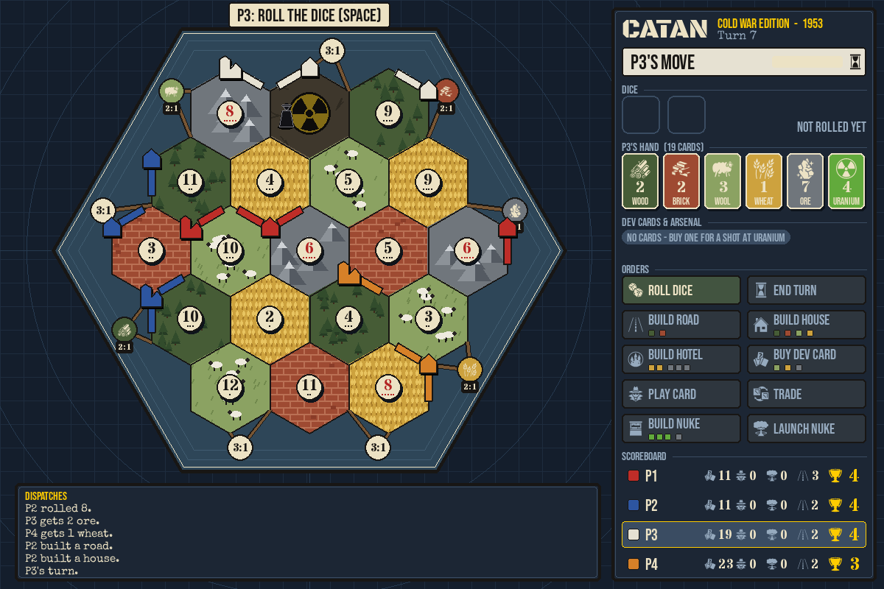
Version 1 to version 2
Morning: version 1
Afternoon: version 2
def roll_two_die():
dice_1 = random.randint(1, 6)
dice_2 = random.randint(1, 6)
return dice_1 + dice_2
Board as a grid of dots and edges
SPACE to roll, E to end your turn
Dice auto-roll after 10 seconds
Everything printed in the terminal
Clickable board, side panel, dev cards and nukes
Notes:
Our first version this morning was all keyboard and terminal: SPACE to roll, E to end the turn, and the dice roll themselves after 10 seconds so nobody stalls. Once the rules worked, we rebuilt the screen: you click on the board to build, and the side panel shows your hand, the orders and the scoreboard.

Slide 9
How it's built
main.py
Opens the window, reads clicks and keys
backend.py
Every rule of the game. No graphics
board_view.py + side_panel.py
Draw the board, hand and buttons
test_backend.py
30 tests for the rules
board_layout.py
Where every hex, corner and road goes
If a move breaks a rule, backend.py raises a RuleError with a readable message, and the game shows it on screen.
Notes:
The key decision was keeping all the rules in backend.py with no graphics at all. That made it easy to test, and the screen code only reads the game state and calls actions. If you try something illegal, the rules explain why instead of just ignoring your click.

Slide 10
Testing, and the nuke that nobody built
30
859
3
automated tests on the rules, all passing
lines of rules in backend.py
uranium for a nuke (it started at 5)
What happened: at first a nuke cost 5 uranium, and in our test games nobody ever got there. The fix: 3 uranium + 1 ore, uranium from Uranium Shipment cards (+2 each). Now it shows up most games.
Notes:
Every rule has a test, 30 in total, and they all pass. Our favourite balance problem: the first nuke cost 5 uranium and nobody ever built one, so the whole twist never happened. We dropped it to 3 uranium plus 1 ore and made uranium come from dev cards, and now it shows up in most games.

Slide 11
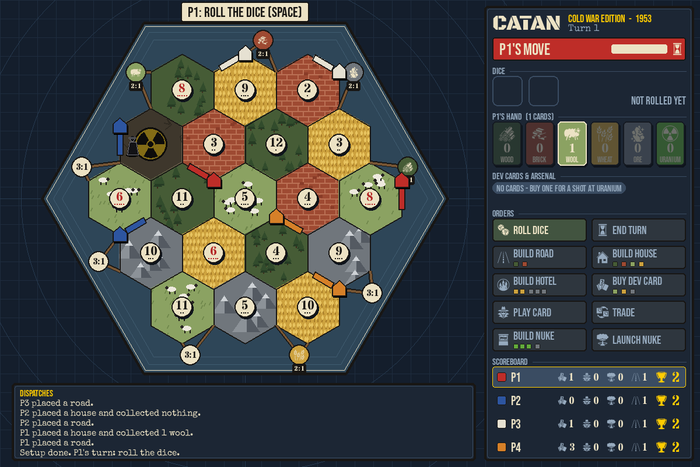
Live demo
SPACE rolls the dice, E ends your turn,
click the board to build.
python main.py
Notes:
Demo plan: 1) start a 4 player game. 2) Place the setup houses and roads. 3) Roll, collect, build. 4) Buy dev cards until someone gets a Uranium Shipment, build a nuke and launch it. If the laptop acts up, flip to the next slide.

Slide 12
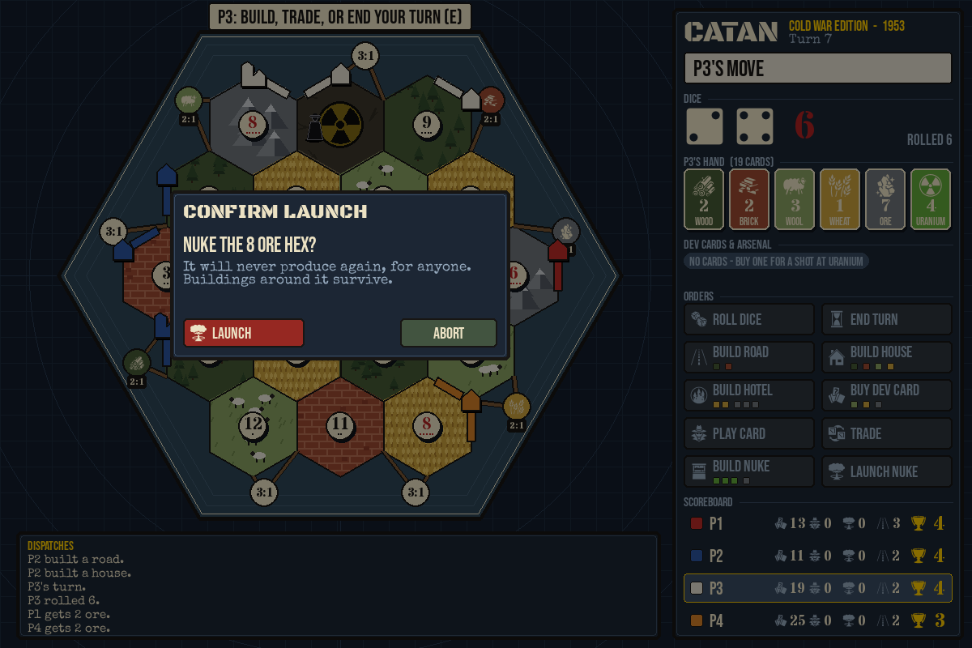
In case the demo gives up
A fresh random board
Mid-game: hand, orders, scoreboard
Confirm the launch
Notes:
Backup screenshots: a fresh board, a game in progress with the side panel, and the launch confirmation that tells you exactly which hex you're about to nuke.

Slide 13
What we'd do next
Online play
Bots
Sound and music
Friends join from their own laptops
Fill empty seats, easy to hard
Sirens, Geiger counters, 50s radio
Save and resume
Play in a browser
Colour-blind mode
Pick a game back up later
Nothing to install
Patterns on top of player colours
Notes:
If we had another Saturday: online play is the big one, so friends don't have to share one laptop. Then bots for empty seats, sound, saving games, and a colour-blind friendly mode since player colours matter a lot.

Slide 14
Questions?
Thanks for listening!
Daniyal, Mustafa, Abdullah, Taha
Notes:
That's it, thanks! Happy to take questions about the game, the code, or why we thought adding nukes to Catan was a good idea.

