Slide 1
BLUESTOCK FINTECH
Mutual Fund Analytics
Capstone Project
End-to-End Data Pipeline, EDA, Performance Metrics & Power BI Dashboard
Mauli Kukreti
B.Tech CSE (2023–2027) | Graphic Era University, Dehradun
Bluestock Fintech Capstone Internship Project | June 2026

Slide 2
Problem Statement
📊 Data Fragmentation
📉 Lack of Risk Visibility
Mutual fund data is spread across 10+ disconnected datasets — NAV, AUM, SIP, transactions, holdings — with no unified analytics layer.
Investors and fund managers lack standardized risk metrics (VaR, CVaR, Drawdown) computed from raw NAV data.
🔍 No Investor Insights
📋 No Unified Dashboard
32,000+ investor transactions lack structured demographic and behavioral analysis — age groups, geographies, SIP continuity.
Industry data, fund performance, and investor analytics are not available in one interactive visual interface.
Goal: Build a complete analytics pipeline — ETL → SQLite → EDA → Metrics → Dashboard

Slide 3
Project Objectives
01
ETL Pipeline
02
SQLite Database
03
EDA
Automate ingestion, validation, cleaning & transformation of 10 raw CSV datasets
Design a normalized relational schema and load all cleaned data via Python
Analyze NAV trends, AUM growth, SIP inflows, demographics & sector allocations
04
Performance Metrics
05
Advanced Analytics
06
Power BI Dashboard
Compute CAGR, Sharpe, Sortino, Alpha, Beta, Drawdown & Tracking Error
VaR, CVaR, Rolling Sharpe, Cohort Analysis, SIP Continuity, Recommender, HHI
Build a 4-page interactive dashboard for industry, performance & investor analytics
Tech Stack: Python · Pandas · NumPy · Matplotlib · Seaborn · Plotly · SQLite · Power BI · Git

Slide 4
Data Sources
# | Dataset | Description | Records
1 | Fund Master | 40 schemes across 10 fund houses with full metadata | 40
2 | NAV History | Daily NAV values from January 2022 to early 2026 | ~46,000
3 | AUM by Fund House | Monthly AUM per AMC (2022–2025) | 90
4 | Monthly SIP Inflows | Industry-level SIP trend data over 48 months | 48
5 | Category Inflows | Net inflows broken down by fund category | ~480
6 | Industry Folio Count | Monthly total and category-wise folio counts | ~48
7 | Scheme Performance | Pre-computed performance metrics for 40 schemes | 40
8 | Investor Transactions | Full investor transaction log across 32,778 records | 32,778
9 | Portfolio Holdings | Equity sector weights and stock compositions | ~800
10 | Benchmark Indices | Daily Nifty 50 / Nifty100 closing values | ~1,000

Slide 5
Project Architecture & ETL Pipeline
Data
Ingestion
Validation
Cleaning
SQLite Load
Analytics
Layer
data_ingestion.py
Raw CSV Load
Quality Check
amfi_validation.py
AMFI Code Check
40/40 matched
data_cleaning.py
Date parsing
Type casting
Dedup
load_to_sqlite.py
10 tables loaded
Schema defined
3 Notebooks:
EDA → Perf →
Advanced
▶
▶
▶
▶
📊 Power BI Dashboard → 4-page Interactive Report | PDF Export | GitHub Repository
10
40
46K
32K+
4
Datasets
Schemes
NAV Records
Transactions
Dashboard Pages

Slide 6
EDA Highlights — Industry & Market
🏦 SBI MF leads industry AUM. All 10 fund houses grew YoY.
📈 SIP inflows consistently rising — ₹11,000 Cr (Jan 22) → ₹30,000+ Cr (2025)

Slide 7
EDA Highlights — Investor & Portfolio
👥 26–35 age group: highest avg SIP amount | T30 cities dominate AUM
🏙️ Top states: Telangana > Delhi > West Bengal | Financial Services & Tech = largest sector weights

Slide 8
Performance Analytics
AMFI Code | Sharpe | Sortino | Max DD | Track Err
120505 | 1.18 | — | ~-20% | 0.232
100033 | 1.09 | 1.83 | -16.2% | 0.229
119094 | 1.00 | — | ~-18% | 0.238
119598 | 0.95 | — | ~-22% | 0.284
148567 | 1.45 | — | ~-15% | 0.190
Scorecard = 30% CAGR + 25% Sharpe + 20% Alpha + 15% Expense Rank + 10% Drawdown
rf = 6.5% p.a. | Daily Returns: mean 0.063%, σ = 1.03% | NIFTY100 used as benchmark

Slide 9
Advanced Analytics
01 Historical VaR (95%)
02 CVaR / Expected Shortfall
03 Rolling 90-Day Sharpe
Worst expected daily loss in 19 out of 20 days using empirical return distribution
Average loss in the worst 5% scenarios — captures tail risk beyond VaR
Time-varying risk-adjusted performance to identify improving or deteriorating funds
04 Investor Cohort Analysis
05 SIP Continuity Analysis
06 Fund Recommender
Grouped investors by entry year; 2024 cohort identified as highest-volume contributors
Flagged investors at risk of SIP discontinuation for proactive retention campaigns
Rule-based engine mapping risk tolerance + horizon + category to eligible fund schemes
07 HHI Sector Concentration
HHI computed per fund to quantify portfolio concentration risk

Slide 10
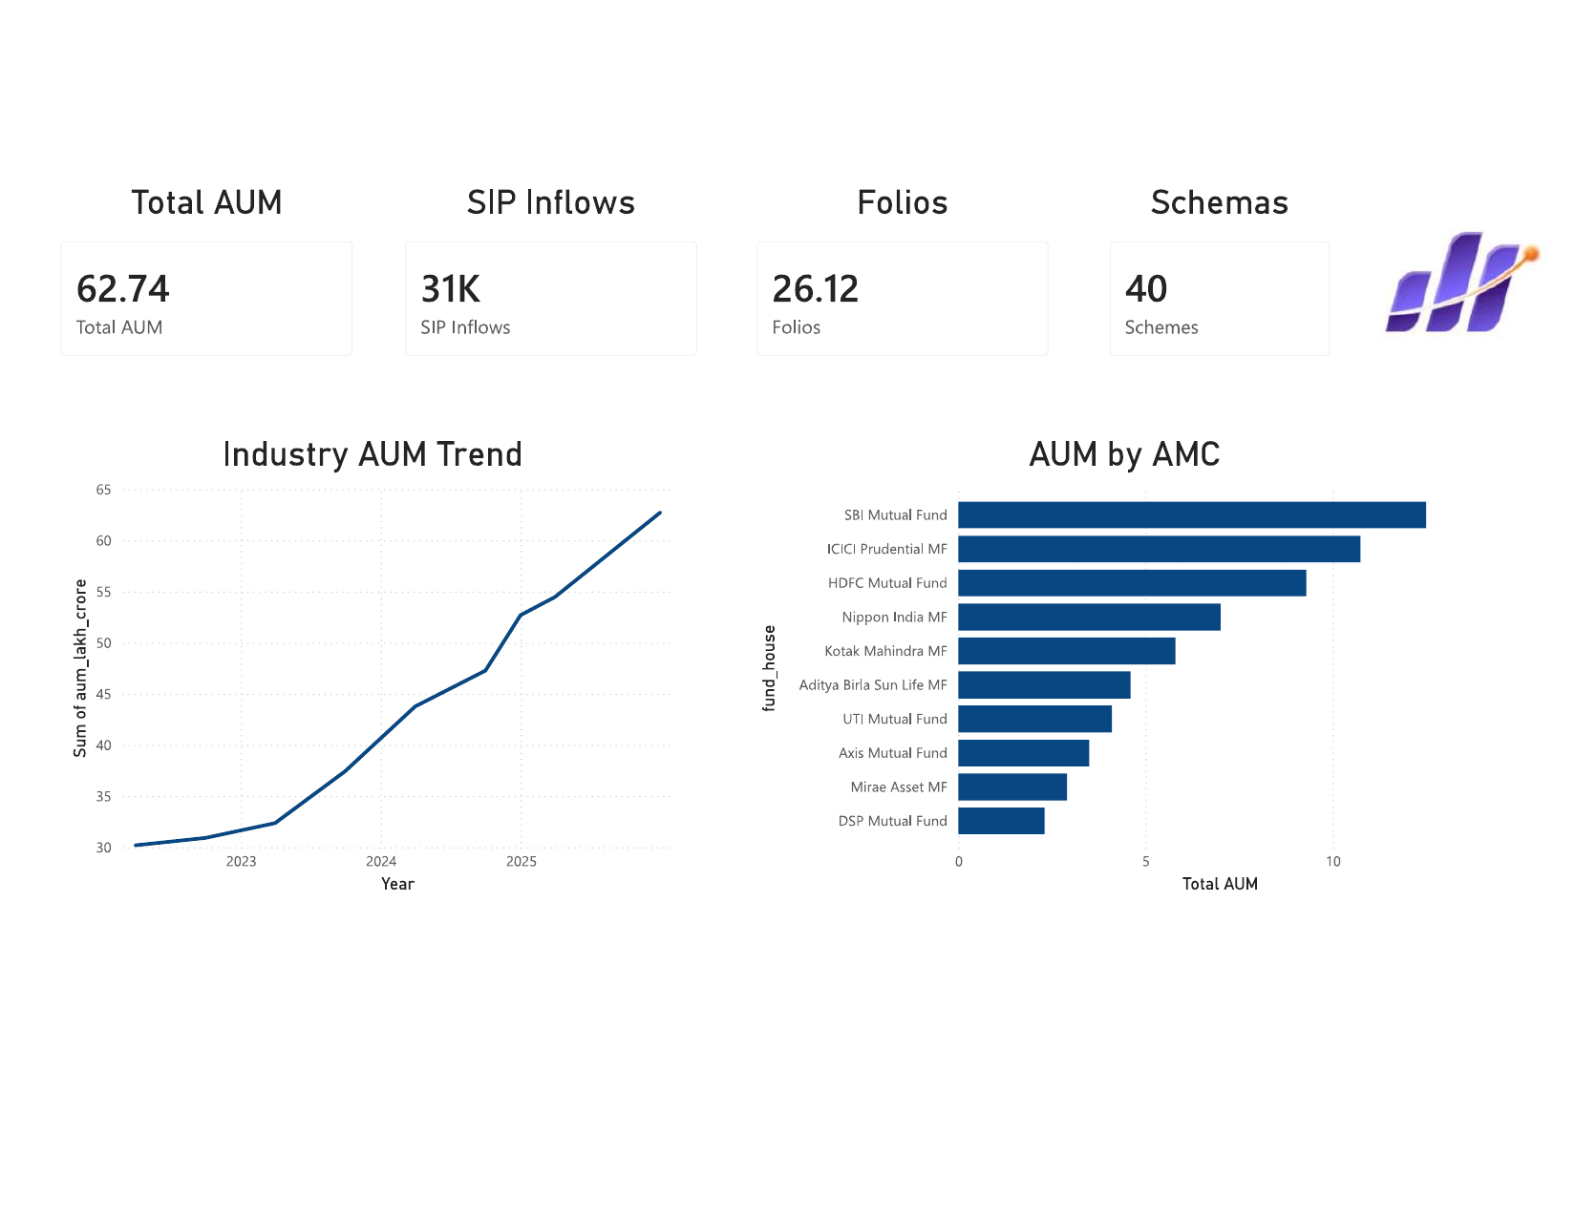
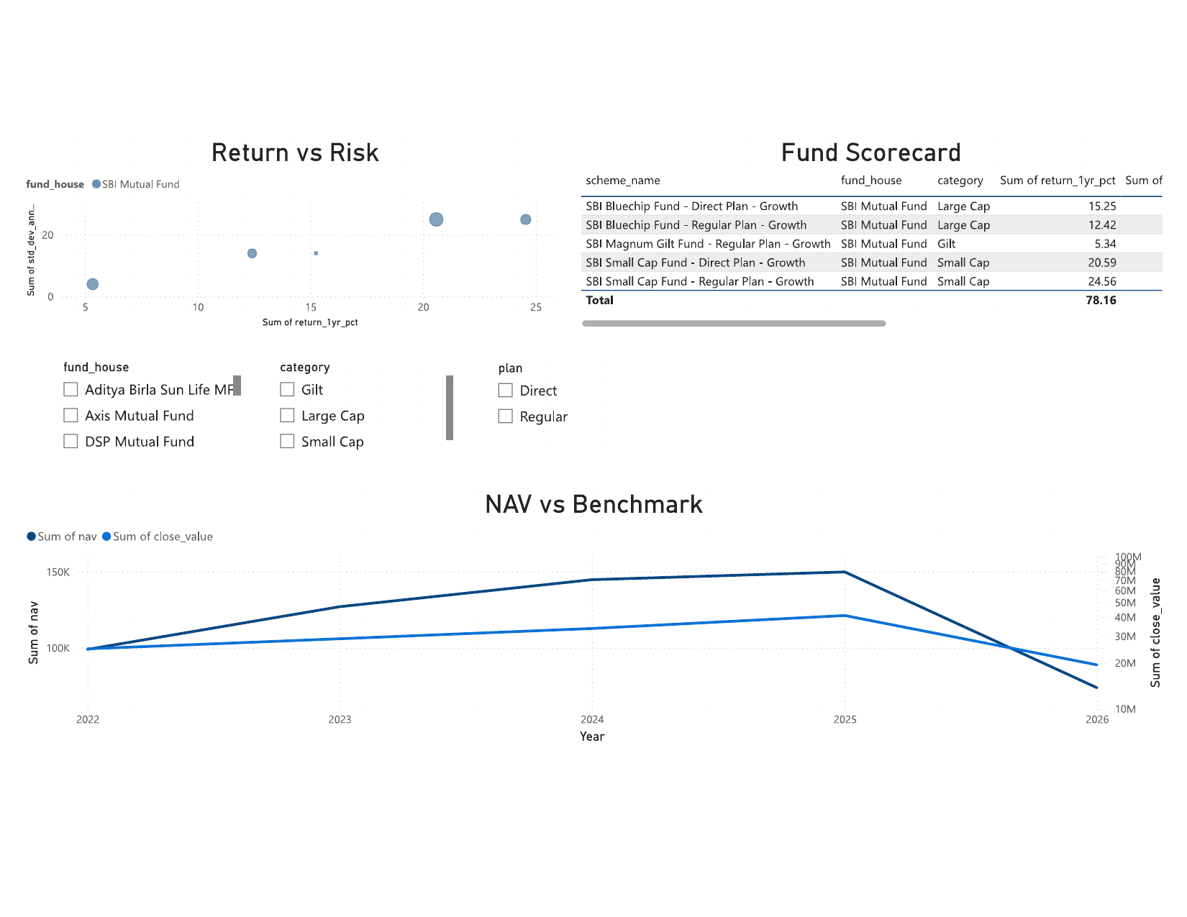
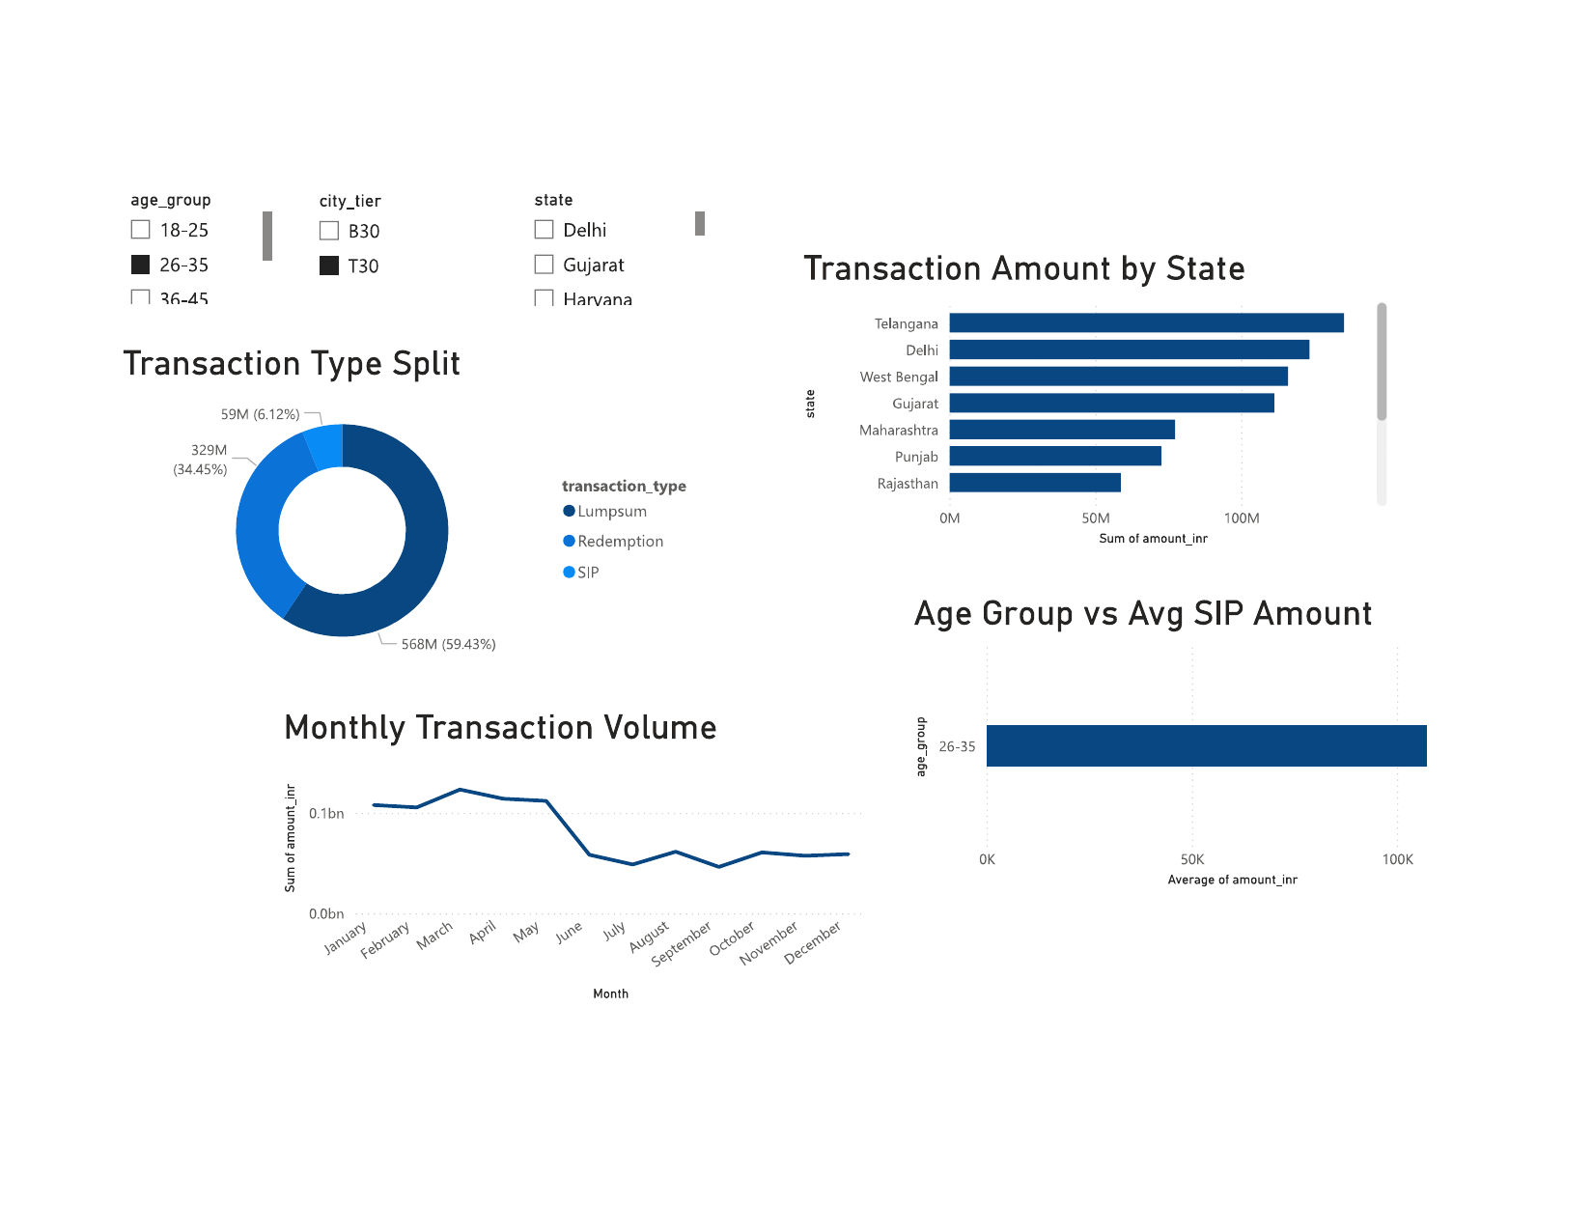
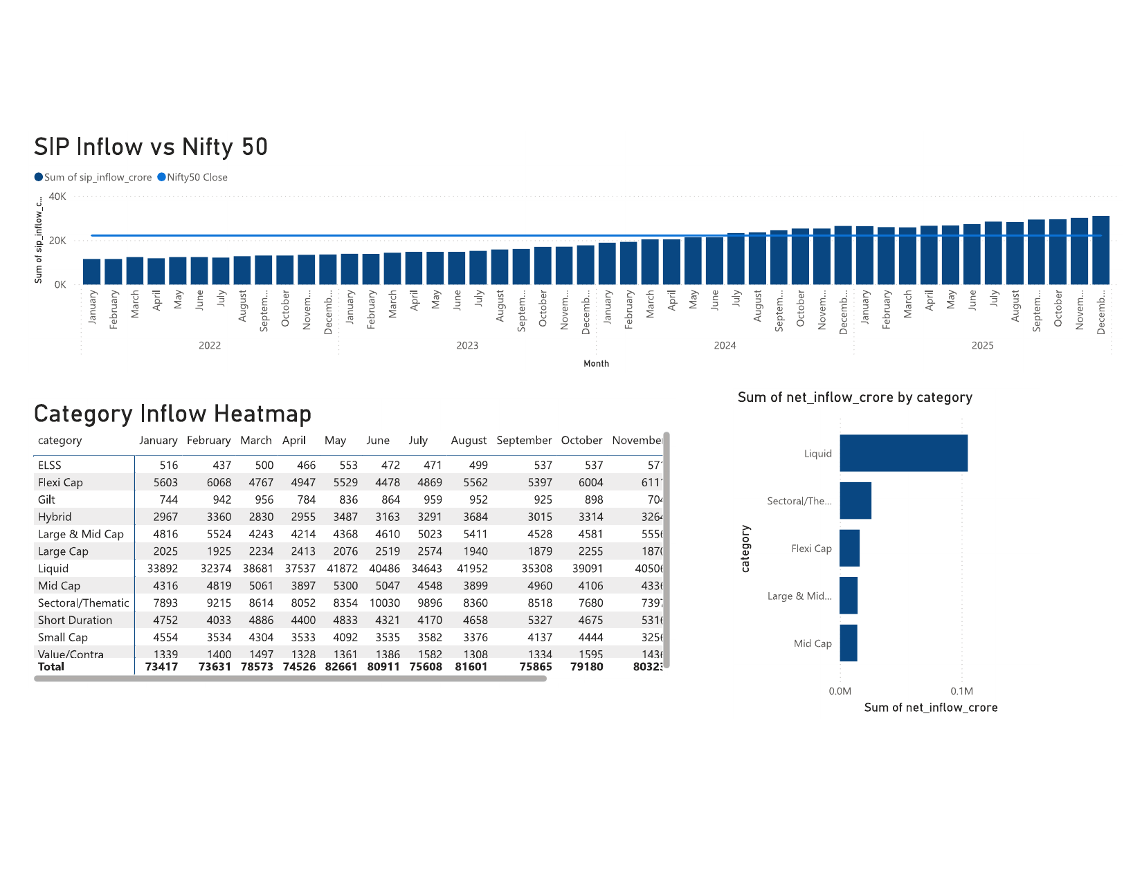
Power BI Dashboard — 4 Pages
Page 1: Industry Overview
Page 2: Fund Performance
Page 3: Investor Analytics
Page 4: SIP & Market Trends

Slide 11
Key Findings
🏦 Industry
• Total AUM grew from ~₹30 lakh crore (2023) to ₹62.74 lakh crore (2025) — over 2× growth
• SBI MF leads AUM; all 10 fund houses showed YoY growth
• SIP inflows grew consistently, reaching ~₹31,000 crore/month
📊 Performance
• Top fund (119094): 36.07% 3Y CAGR | Best Sharpe: 148567 at 1.45
• Most funds have positive return correlation — limited diversification benefit
• Active funds show 0.19–0.28 annualized tracking error vs NIFTY100
👥 Investors
• SIP = 59.43% of all transactions | 26–35 age group = highest SIP amount
• Telangana, Delhi, West Bengal = top states by investment volume
• T30 cities dominate AUM; B30 represents significant untapped potential

Slide 12
Thank You
Bluestock Fintech Capstone Internship Project
Name: Mauli Kukreti
Program: B.Tech CSE (2023–2027)
University: Graphic Era Deemed to be University, Dehradun
Stack: Python · Pandas · SQLite · Power BI · Git · Seaborn · Plotly

