Slide 1
The Rotary Foundation— Milestones in Building Better Lives

Slide 2
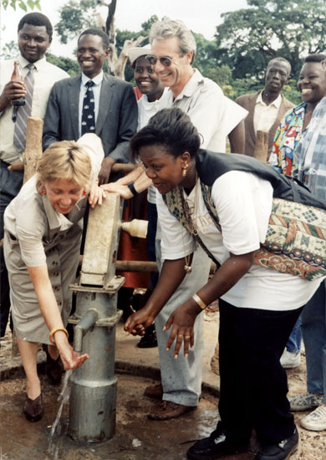
The Rotary Foundation has overcome armed conflicts, political instability, economic adversity, and other barriers to help people in need, thereby promoting world understanding and peace.

Slide 3
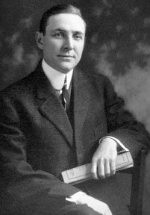
Sixth RI President Arch C. Klumph established
The Rotary Foundation
as an endowment
in 1917.

Slide 4

The Rotary Foundation
was formally named in 1928 and awarded its first grant in 1929: US$500 to the International Society for Crippled Children.

Slide 5
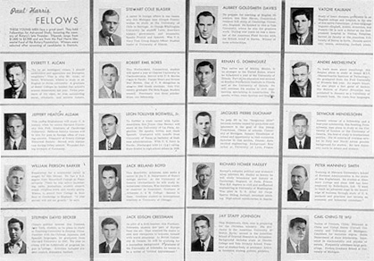
Following RI founder Paul Harris’s death in 1947,
Rotarians worldwide gave the Foundation more than US$1 million, enabling it to launch
its first program: international scholarships for graduate students.

Slide 6
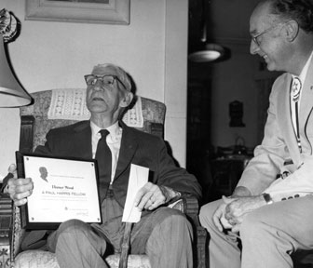
In 1957,
the Foundation began recognition of individuals as Paul Harris Fellows for contributions of US$1,000 or more to the Annual Programs Fund or restricted fund.

Slide 7
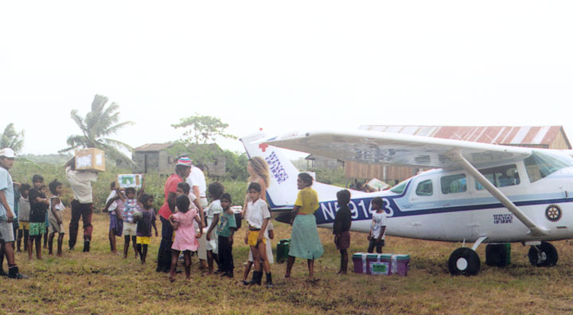
Matching Grants projects have brought hope for a better life to people since 1965, with nearly 20,000 grants awarded, totaling more than US$198 million.

Slide 8
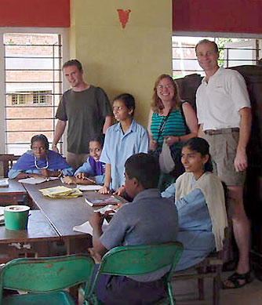
In 1965,
the Group Study Exchange program was also established, enabling business and professional men and women to participate in vocational activities in countries other than their own.

Slide 9
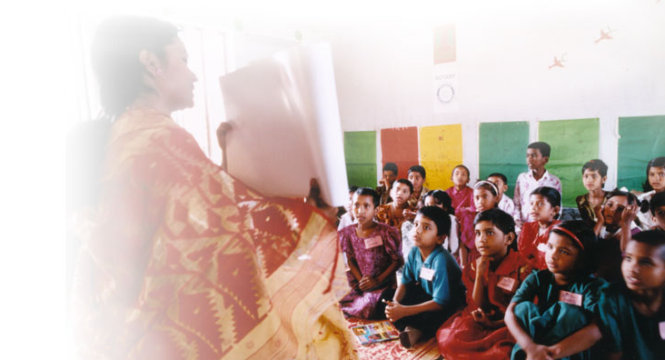

The Health, Hunger and Humanity (3-H) Grants program, created in 1978, has made possible a wide range of sustainable development projects, such as the nationwide literacy effort in Bangladesh.

Slide 10
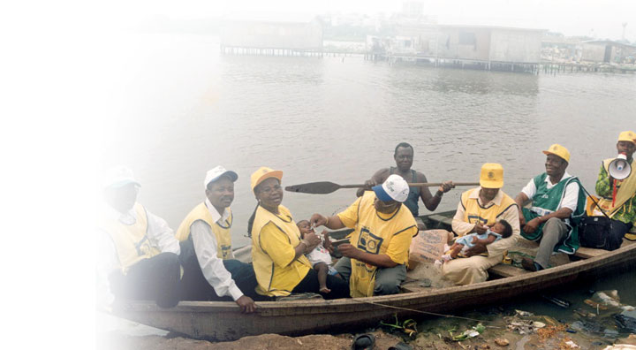

The PolioPlus program was launched in 1985. It adopted the goal in 1988 of immunizing all the world’s children against polio by 2005 and has raised more than US$537 million for polio eradication.

Slide 11
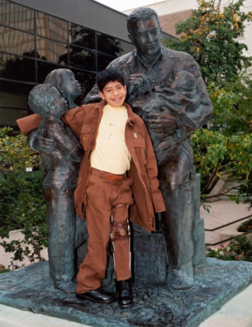
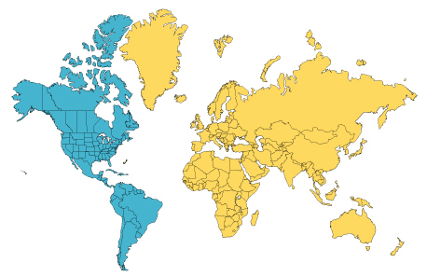
In 1994,
the Western Hemisphere was declared polio-free; the region’s last polio victim was Luis Fermín of Peru.

Slide 12


The Permanent Fund Initiative began in 1996, to build the fund’s capacity to help meet the increasing demand for the Foundation’s programs.
®

Slide 13


In 1999,
seven Rotary Centers for International Studies in peace and conflict resolution
were established.

Slide 14
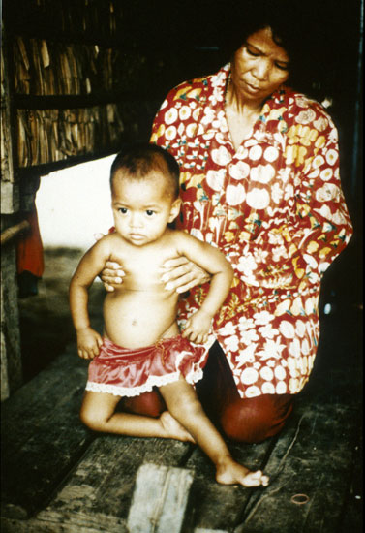
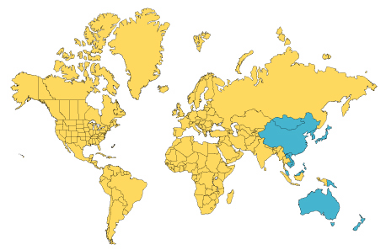
The Western Pacific region was declared polio-free in 2000; its last polio victim was Mum Chanty of Cambodia.

Slide 15
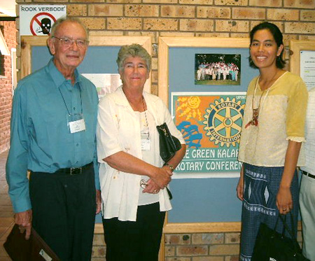
The first awards were made from the Scholarships Fund Pool for Low-Income Countries in 2001.

Slide 16
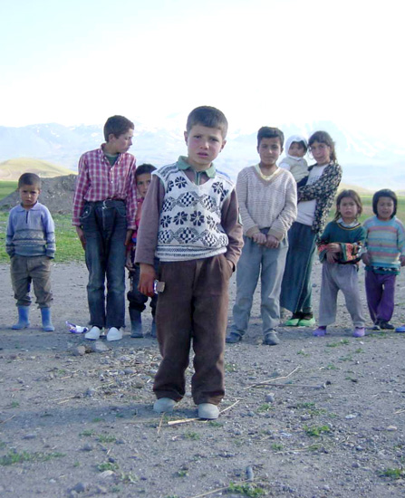
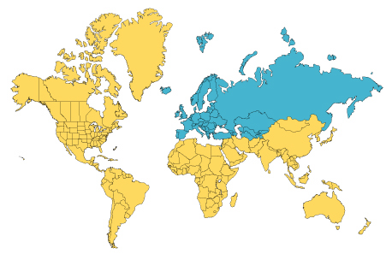
In 2002,
the European region was declared polio-free; its last victim was Melik Minas of Turkey.

Slide 17
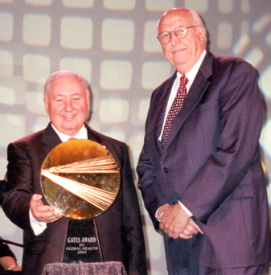
The Foundation received the US$1 million Gates Award for Global Health in 2002 from the Bill & Melinda Gates Foundation.

Slide 18
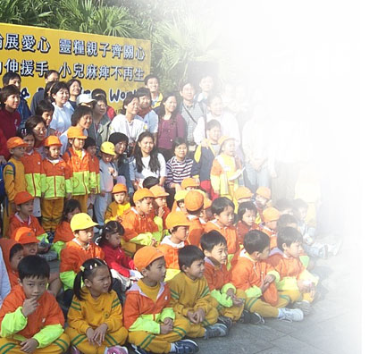

The one-year fundraising campaign—Fulfilling Our Promise: Eradicate Polio— concluded in 2003, raising more than US$130 million by August 2004.

Slide 19
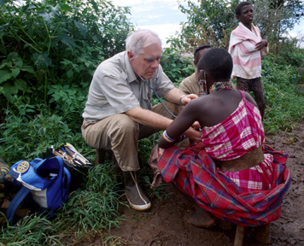
The District Simplified Grants and Individual Grants programs began
in 2003, the latter providing continued support for Rotary Volunteers and other individuals to plan and carry out service projects.

Slide 20
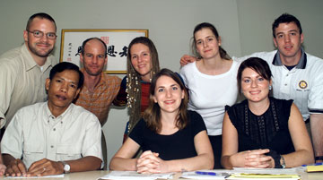
The first class of Rotary World Peace Scholars graduated in 2004, including this one from the Rotary Center for International Studies at the University of Queensland in Australia.

Slide 21
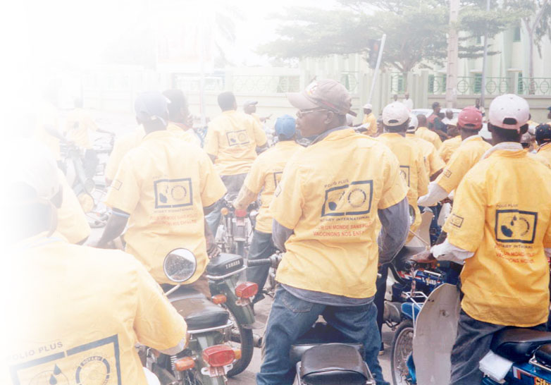
The PolioPlus Partners program was relaunched in 2004 with expanded responsibilities in support of global polio eradication.

Slide 22
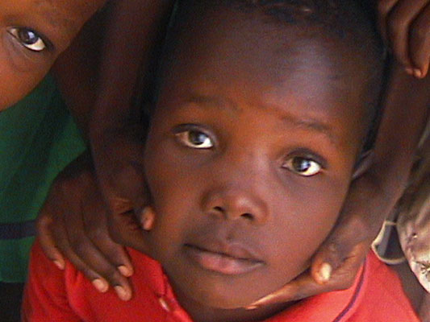
In 2004,
the Children’s Fund was established within the Permanent Fund, to encourage Rotarians to increase help for children through the Foundation’s humanitarian programs.

Slide 23
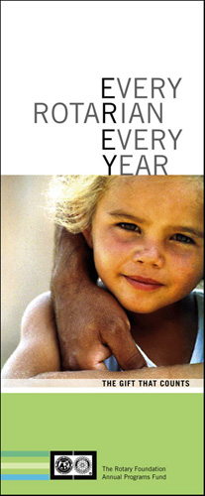
The Every Rotarian, Every Year initiative began on 1 July 2004, encouraging every Rotarian to
make an annual contribution of US$100 or more to the Foundation’s Annual Programs Fund.

Slide 24
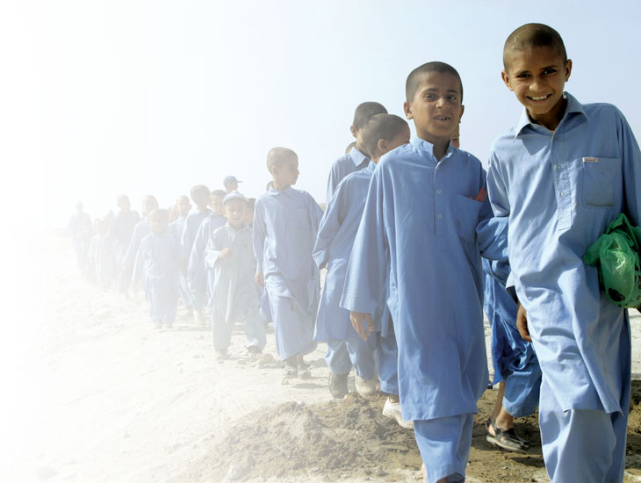
Achieving the US$100 per capita annual giving goal will enable the Foundation to meet the need for humanitarian and educational programs identified by Rotary clubs and districts worldwide.

Slide 25
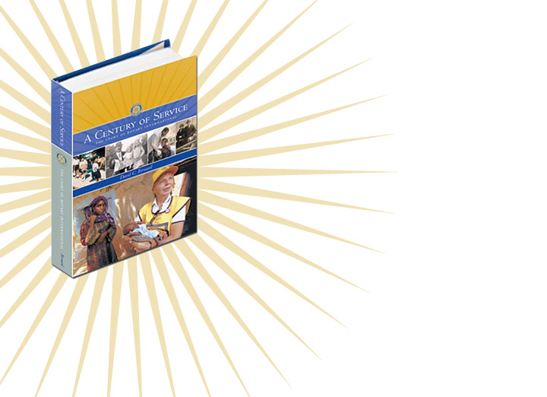
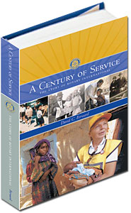
Learn more about how The Rotary Foundation has improved the lives of people worldwide by ordering
a copy of A Century of Service:
The Story of Rotary International.
Click here to order

