Slide 1

ROTARY GLOBAL
HISTORY FELLOWSHIP
PRESENTS
The Saga of Don Jim
A slide show prepared by Jorge Arman,
a member of the Rotary Club of Ventura

Slide 2
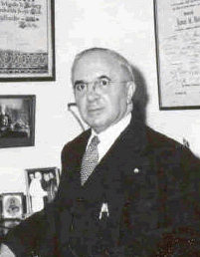
The Saga of Don Jim
This is the story of James Henry Roth,
better known in Latin America as
Don Jim.
He was born in Ventura, California, on
August 22, 1887, and died in his hometown
on August 30, 1968.
He served as Rotary International
Special Commissioner from
1925 until 1942.
See what he did during that time!

Slide 3
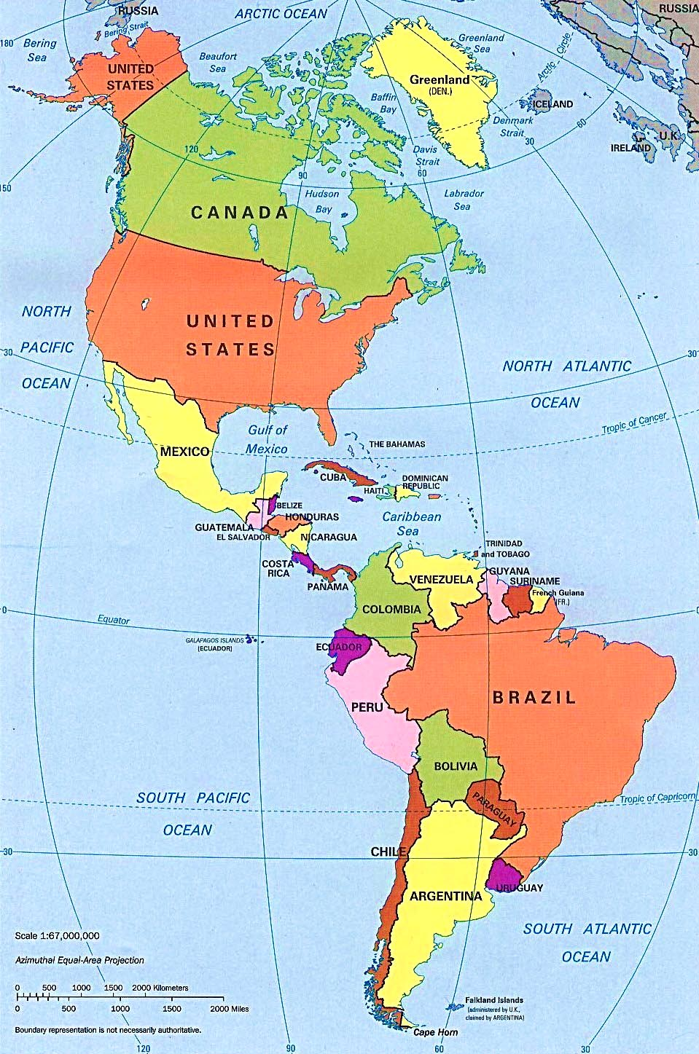
The Saga of Don Jim
VENTURA, HIS HOMETOWN

Slide 4
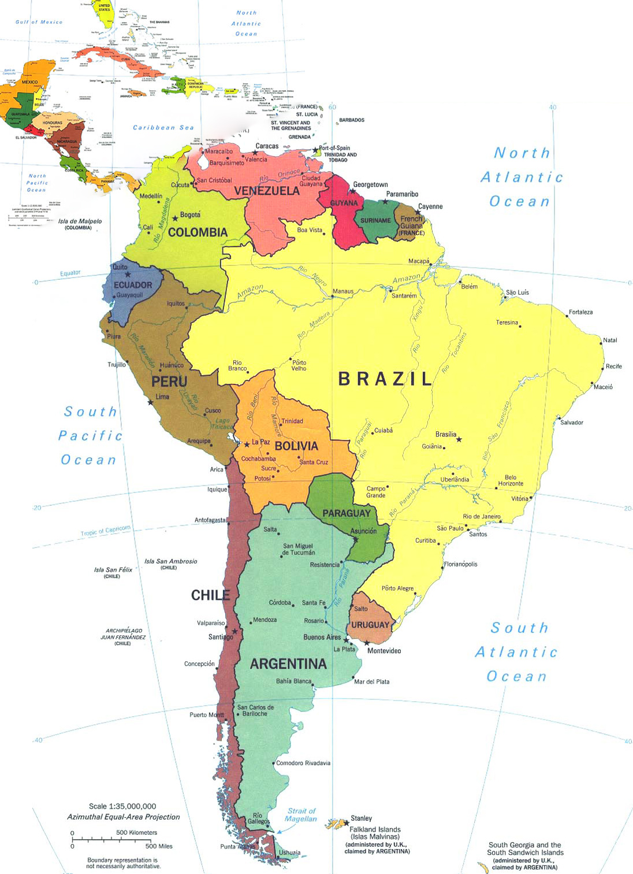

The Saga of Don Jim
1922 June 1
Charter Member
Rotary Club of Lima
This Club was organized
1920 July 18

Slide 5
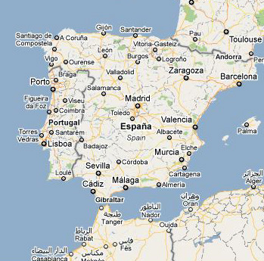

The Saga of Don Jim
1926 January 23
Charter
Rotary Club of Lisboa

Slide 6
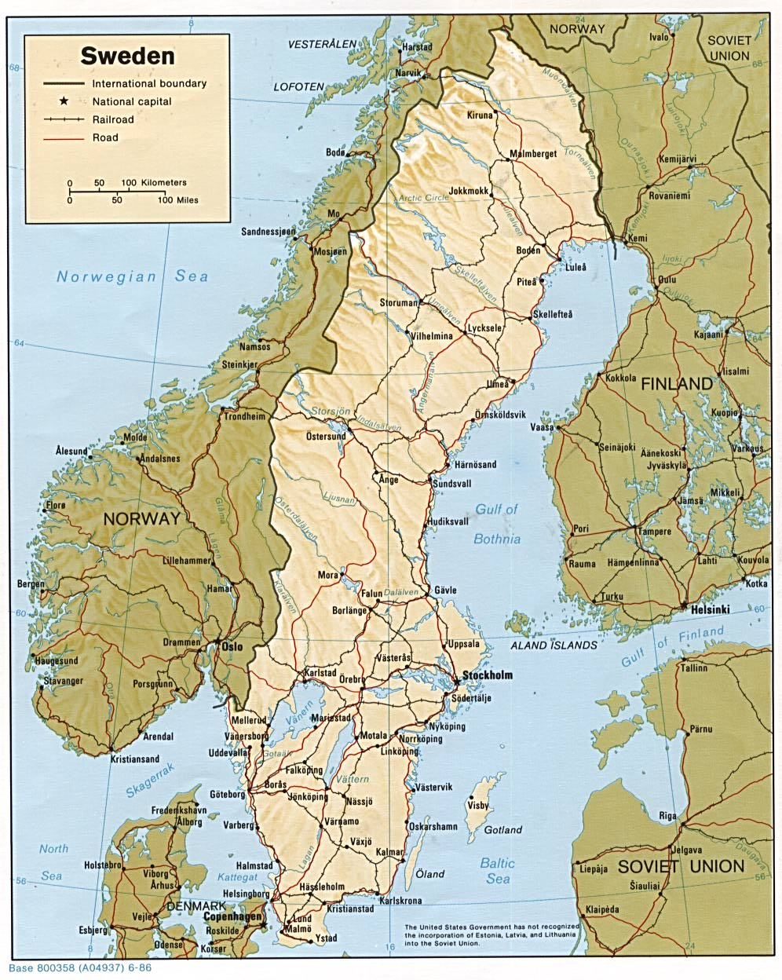
The Saga of Don Jim
1926 February 20
Charter
Rotary Club of Stockholm

Slide 7
The Saga of Don Jim
1926 May 14
Charter
Rotary Club of Zaragoza

Slide 8
The Saga of Don Jim
1926 July 1
Charter
Rotary Clubs of Santander, San Sebastian and Bilbao

Slide 9

The Saga of Don Jim
1926 October 4
Charter
Rotary Club of Caracas

Slide 10
The Saga of Don Jim
1926 October 20
Charter
Rotary Club of La Guaira

Slide 11
The Saga of Don Jim
1927 January 13
Charter
Rotary Club of Bogota

Slide 12
The Saga of Don Jim
1927 February 14
Charter
Rotary Club of Barranquilla

Slide 13
The Saga of Don Jim
1927 March 8
Charter
Rotary Club of San Jose

Slide 14
The Saga of Don Jim
1927 April 27
Charter
Rotary Club of San Salvador

Slide 15
The Saga of Don Jim
1927 May 25
Charter
Rotary Club of Quito

Slide 16
The Saga of Don Jim
1927 July 13
Charter
Rotary Club of Guayaquil

Slide 17
The Saga of Don Jim
1927 August 5
Charter
Rotary Club of Piura

Slide 18
The Saga of Don Jim
1927 August 6
Charter
Rotary Club of Chiclayo

Slide 19
The Saga of Don Jim
1927 August 6
Charter
Rotary Club of Trujillo

Slide 20
The Saga of Don Jim
1927 August 12
Charter
Rotary Club of La Paz

Slide 21
The Saga of Don Jim
1927 August 29
Charter
Rotary Club of Oruro

Slide 22
The Saga of Don Jim
1927 September 14
Charter
Rotary Club of Cuzco

Slide 23
The Saga of Don Jim
1927 September 17
Charter
Rotary Club of Cochabamba

Slide 24
The Saga of Don Jim
October 24
District Conference
Valparaiso

Slide 25
The Saga of Don Jim
1927 December 10
Charter
Rotary Club of Bahia Blanca

Slide 26
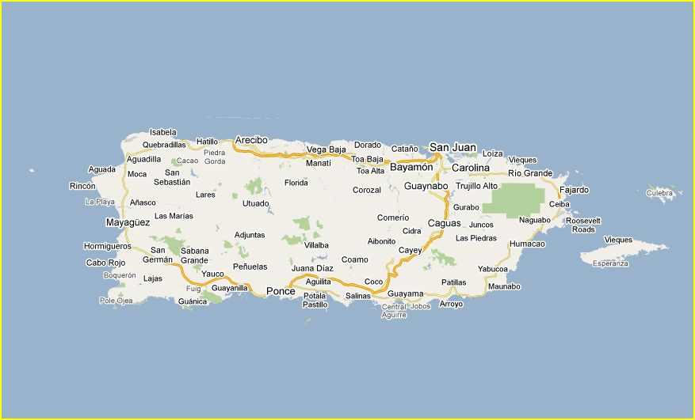
The Saga of Don Jim
1927 December 13
Charter
Rotary Club of Mayaguez
PUERTO RICO

Slide 27
The Saga of Don Jim
January 14
District Conference
Cordoba

Slide 28
The Saga of Don Jim
January 16
Charter
Rotary Club of Asuncion

Slide 29
The Saga of Don Jim
February 13
Charter
Rotary Club of Santa Fe

Slide 30
The Saga of Don Jim
February 23
Charter
Rotary Club of Medellin

Slide 31
The Saga of Don Jim
March 31
District Conference
Santiago

Slide 32
The Saga of Don Jim
April 7
Charter
Rotary Club of Paraná

Slide 33
The Saga of Don Jim
May 11
Charter
Rotary Club of Concordia

Slide 34
The Saga of Don Jim
September 4
Charter
Rotary Club of Niteroi

Slide 35
The Saga of Don Jim
September 12
Charter
Rotary Club of Petropolis

Slide 36
The Saga of Don Jim
October 10
Charter
Rotary Club of Porto Alegre

Slide 37
The Saga of Don Jim
November 19
Charter
Rotary Club of Campos

Slide 38
The Saga of Don Jim
November 24
Charter
Rotary Club of Pelotas

Slide 39
The Saga of Don Jim
December 1
Charter
Rotary Club of Rio Grande

Slide 40
The Saga of Don Jim
1929 February 4
Official Visit
Rotary Club of Buenos Aires

Slide 41
The Saga of Don Jim
1929 April 1
Official Visit
Rotary Club of Rio do Janeiro

Slide 42
The Saga of Don Jim
May 3
Charter
Rotary Club of Ribeirao Preto

Slide 43
The Saga of Don Jim
May 23
Charter
Rotary Club of Salta

Slide 44
The Saga of Don Jim
June 13
Charter
Rotary Club of Mendoza

Slide 45
The Saga of Don Jim
June 15
Charter
Rotary Club of San Juan

Slide 46
The Saga of Don Jim
June 29
Charter
Rotary Club of Tucumán

Slide 47
The Saga of Don Jim
July 15
Charter
Rotary Club of Corrientes

Slide 48
The Saga of Don Jim
July 18
Charter
Rotary Club of Resistencia

Slide 49
The Saga of Don Jim
September 16
Charter
Rotary Club of Villarrica

Slide 50
The Saga of Don Jim
September 16
Charter
Rotary Club of Posadas

Slide 51
The Saga of Don Jim
January 24
District Conference
Valdivia

Slide 52
The Saga of Don Jim
March 26
District Conference
Rosario

Slide 53
The Saga of Don Jim
1930 April 22
Charter
Rotary Club of Azul

Slide 54
The Saga of Don Jim
1930 July 12
Charter
Rotary Club of Nova Friburgo

Slide 55
The Saga of Don Jim
1930 August 14
Charter
Rotary Club of Huacho

Slide 56
The Saga of Don Jim
1930 December 27
Charter
Rotary Club of Salto

Slide 57
The Saga of Don Jim
1931 January 13
Charter
Rotary Club of Callao

Slide 58
The Saga of Don Jim
1931 January 15
Charter
Rotary Club of Tandil

Slide 59
The Saga of Don Jim
1931 February 8
Charter
Rotary Club of Paysandú

Slide 60
The Saga of Don Jim
1931 April 8
Charter
Rotary Club of Recife

Slide 61
The Saga of Don Jim
1931 April 10
Charter
Rotary Club of Campinas

Slide 62
The Saga of Don Jim
1931 April 17
Charter
Rotary Club of Potosí

Slide 63
The Saga of Don Jim
1931 May 20
Charter
Rotary Club of São Luis

Slide 64
The Saga of Don Jim
1931 June 30
Charter
Rotary Club of Belem do Pará

Slide 65
The Saga of Don Jim
1931 August 16
Charter
Rotary Club of Olavarría

Slide 66
The Saga of Don Jim
1931 September 5
Charter
Rotary Club of Santiago del Estero

Slide 67
The Saga of Don Jim
1931 October 11
Charter
Rotary Club of Concepción del Uruguay

Slide 68
The Saga of Don Jim
1931 November 6
Charter
Rotary Club of Tigre

Slide 69
The Saga of Don Jim
1932 September 29
Charter
Rotary Club of Mercedes

Slide 70
The Saga of Don Jim
1932 November 28
Charter
Rotary Club of Iquitos

Slide 71
The Saga of Don Jim
1933 February 4
Charter
Rotary Club of João Pessoa

Slide 72
The Saga of Don Jim
1933 February 21
Charter
Rotary Club of Bahia

Slide 73
The Saga of Don Jim
1933 March 12
Charter
Rotary Club of Curitiba

Slide 74
The Saga of Don Jim
April 15
Official Visit
Rotary Club of Buenos Aires

Slide 75
The Saga of Don Jim
1933 October 16
Charter
Rotary Club of San Rafael

Slide 76
The Saga of Don Jim
1934 March 12
Charter
Rotary Club of Poços de Caldas

Slide 77
The Saga of Don Jim
1934 May 7
Charter
Rotary Club of Fortaleza

Slide 78
The Saga of Don Jim
1934 May 15
Charter
Rotary Club of Manaus

Slide 79
The Saga of Don Jim
1934 August 15
Charter
Rotary Club of Rivera

Slide 80
The Saga of Don Jim
1934 August 29
Charter
Rotary Club of Vitória

Slide 81
The Saga of Don Jim
1934 October 25
Charter
Rotary Club of Joinville

Slide 82
The Saga of Don Jim
1934 December 4
Charter
Rotary Club of Aracajú

Slide 83
The Saga of Don Jim
1934 December 18
Charter
Rotary Club of Santa Maria

Slide 84
The Saga of Don Jim
1935 January 10
Charter
Rotary Club of Bagè

Slide 85
The Saga of Don Jim
1935 January 22
Charter
Rotary Club of Cañete

Slide 86
The Saga of Don Jim
1935 February 10
Charter
Rotary Club of Jaboticabal

Slide 87
The Saga of Don Jim
1935 March 10
Charter
Rotary Club of Franca

Slide 88
The Saga of Don Jim
1935 September 18
Charter
Rotary Club of Jujuy

Slide 89
The Saga of Don Jim
1935 October 5
Charter
Rotary Club of Pergamino

Slide 90
The Saga of Don Jim
1935 December 4
Charter
Rotary Club of São João do Rio Preto

Slide 91
The Saga of Don Jim
1935 December 6
Charter
Rotary Club of Florida

Slide 92
The Saga of Don Jim
1935 December 11
Charter
Rotary Club of Junín

Slide 93
The Saga of Don Jim
1935 December 12
Charter
Rotary Club of San Luis

Slide 94
The Saga of Don Jim
1935 December 16
Charter
Rotary Club of Bebedouro

Slide 95
The Saga of Don Jim
1936 January 28
Charter
Rotary Club of Baurú

Slide 96
The Saga of Don Jim
1936 February 1
Charter
Rotary Club of Uberlandia

Slide 97
The Saga of Don Jim
March 18
with Paul Harris
Rotary Club of Buenos Aires

Slide 98
The Saga of Don Jim
March 25
with Paul Harris
Rotary Club of Rosario

Slide 99
The Saga of Don Jim
March 25
with Paul Harris
Rotary Club of Montevideo

Slide 100
The Saga of Don Jim
April 4
Charter
Rotary Club of Río Gallegos

Slide 101
The Saga of Don Jim
May 2
Charter
Rotary Club of Catanduva

Slide 102
The Saga of Don Jim
May 17
Charter
Rotary Club of Villa Mercedes

Slide 103
The Saga of Don Jim
May 19
Charter
Rotary Club of San Nicolás

Slide 104
The Saga of Don Jim
June 6
Charter
Rotary Club of Barretos

Slide 105
The Saga of Don Jim
September 2
Charter
Rotary Club of Marilia

Slide 106
The Saga of Don Jim
October 29
Charter
Rotary Club of Lins

Slide 107
The Saga of Don Jim
November 12
Official Visit
Rotary Club of Buenos Aires

Slide 108
The Saga of Don Jim
January 6
Charter
Rotary Club of Limeira

Slide 109
The Saga of Don Jim
January 9
Charter
Rotary Clubs of Tacuarembó and Trinidad

Slide 110
The Saga of Don Jim
March 10
Charter
Rotary Club of Curaçao

Slide 111
The Saga of Don Jim
April 2
Charter
Rotary Club of Teresina

Slide 112
The Saga of Don Jim
May 25
Charter
Rotary Club of Jaú

Slide 113
The Saga of Don Jim
July 23
Charter
Rotary Club of Maceió

Slide 114
The Saga of Don Jim
September 16
Charter
Rotary Club of Uberaba

Slide 115
The Saga of Don Jim
September 17
Charter
Rotary Club of Cachoeiro de Itapemirim

Slide 116
The Saga of Don Jim
September 28
Second Charter
Rotary Club of Caracas

Slide 117
The Saga of Don Jim
October 25
Charter
Rotary Club of San Isidro

Slide 118
The Saga of Don Jim
December 1
Charter
Rotary Club of Vicente López

Slide 119
The Saga of Don Jim
December 8
Charter
Rotary Club of Cañada de Gómez

Slide 120
The Saga of Don Jim
December 10
Charter
Rotary Club of Venado Tuerto

Slide 121
The Saga of Don Jim
1938 January 3
Charter
Rotary Club of Santa Cruz de la Sierra

Slide 122
The Saga of Don Jim
1938 March 22
Charter
Rotary Club of Villa Constitucion

Slide 123
The Saga of Don Jim
1938 April 25
Charter
Rotary Club of San Francisco

Slide 124
The Saga of Don Jim
1938 May 18
Charter
Rotary Club of Bell Ville

Slide 125
The Saga of Don Jim
1938 May 21
Charter
Rotary Club of Camargo

Slide 126
The Saga of Don Jim
1938 August 13
Charter
Rotary Club of Aruba

Slide 127
The Saga of Don Jim
1938 September 14
Charter
Rotary Club of Maracaibo

Slide 128
The Saga of Don Jim
1938 October 5
Charter
Rotary Club of Valencia

Slide 129
The Saga of Don Jim
1938 October 19
Charter
Rotary Club of Barquisimeto

Slide 130
The Saga of Don Jim
1938 December 2
Charter
Rotary Club of Parnaiba

Slide 131
The Saga of Don Jim
1939 January 23
Charter
Rotary Club of Cruz Alta

Slide 132
The Saga of Don Jim
1939 February 28
Charter
Rotary Club of Paranaguá

Slide 133
The Saga of Don Jim
1939 June 12
Charter
Rotary Club of São João da Boa Vista

Slide 134
The Saga of Don Jim
1939 July 24
Charter
Rotary Club of Passo Fundo

Slide 135
The Saga of Don Jim
1939 August 11
Charter
Rotary Club of Cachoeira

Slide 136
The Saga of Don Jim
1939 September 1
Charter
Rotary Club of Uruguaiana

Slide 137
The Saga of Don Jim
1939 September 17
Charter
Rotary Club of Florianópolis

Slide 138
The Saga of Don Jim
1939 October 26
Charter
Rotary Club of Cambará

Slide 139
The Saga of Don Jim
1939 November 29
Charter
Rotary Club of Sorocaba

Slide 140
The Saga of Don Jim
1939 December 1
Charter
Rotary Club of Campo Grande

Slide 141
The Saga of Don Jim
1940 January 2
Charter
Rotary Club of Corumbá

Slide 142
The Saga of Don Jim
1940 January 27
Charter
Rotary Club of Botucatu

Slide 143
The Saga of Don Jim
1940 March 18
Charter
Rotary Club of Presidente Prudente

Slide 144
The Saga of Don Jim
1940 March 25
Charter
Rotary Club of Paraguassú

Slide 145
The Saga of Don Jim
1940 April 17
Charter
Rotary Club of Cachoeira São Félix

Slide 146
The Saga of Don Jim
1940 May 3
Charter
Rotary Club of Barra do Piraí

Slide 147
The Saga of Don Jim
1940 October 22
Charter
Rotary Club of Ourinhos

Slide 148
The Saga of Don Jim
1940 October 31
Charter
Rotary Club of Cornelio Procopio

Slide 149
The Saga of Don Jim
1940 November 7
Charter
Rotary Club of Araras

Slide 150
The Saga of Don Jim
1940 November 7
Charter
Rotary Club of Londrina

Slide 151
The Saga of Don Jim
1940 November 23
Charter
Rotary Club of Rio Claro

Slide 152
The Saga of Don Jim
1940 December 8
Charter
Rotary Club of Pirassununga

Slide 153
The Saga of Don Jim
1941 January 3
Charter
Rotary Club of Novo Hamburgo

Slide 154
The Saga of Don Jim
1941 January 5
Charter
Rotary Club of Sao Leopoldo

Slide 155
The Saga of Don Jim
1941 February 19
Charter
Rotary Club of Assis

Slide 156
The Saga of Don Jim
1941 February 20
Charter
Rotary Club of Caxias

Slide 157
The Saga of Don Jim
1941 March 6
Charter
Rotary Club of Alegrete

Slide 158
The Saga of Don Jim
1941 March 29
Charter
Rotary Club of Jundiaí

Slide 159
The Saga of Don Jim
1941 May 28
Charter
Rotary Club of Garça

Slide 160
The Saga of Don Jim
1941 June 12
Charter
Rotary Club of Goiania

Slide 161
The Saga of Don Jim
1941 July 9
Charter
Rotary Club of Cuiaba

Slide 162
The Saga of Don Jim
1941 August 29
Charter
Rotary Club of Barra Mansa

Slide 163
The Saga of Don Jim
1941 September 9
Charter
Rotary Club of Resende

Slide 164
The Saga of Don Jim
1941 October 4
Charter
Rotary Club of Muqui

Slide 165
The Saga of Don Jim
1941 November 3
Charter
Rotary Club of Colatina

Slide 166
The Saga of Don Jim
1941 November 9
Charter
Rotary Club of Itabuna

Slide 167
The Saga of Don Jim
1941 December 29
Charter
Rotary Club of Iratí

Slide 168
The Saga of Don Jim
1942 February 7
Charter
Rotary Club of Cumaná

Slide 169
The Saga of Don Jim
1942 April 20
Charter
Rotary Club of Itajaí

Slide 170
The Saga of Don Jim
1942 May 8
Charter
Rotary Club of Maracay

Slide 171
The Saga of Don Jim
June
Mission accomplished
Don Jim has left behind
scores of new clubs.

Slide 172
The Saga of Don Jim
This presentation is based on the information available at the time it was prepared. In Brasil, Don Jim organized Rosário do Sul (1941), Macaé (1942), Alegre and Siqueira Campos, which eventually ceased to exist and were reorganized later. Also Pinhal, of short life.
There may be other Rotary Clubs organized with the help of Don Jim, that are no longer in existence. Unfortunately, if Don Jim left any records of his accomplishments, they are unavailable at this time.
For all we know now, in his 17 years at the service of Rotary, he organized scores of Rotary Clubs in 15 countries. OUTSTANDING!

