Slide 1
Fellowship
The Cornerstone of Rotary

Slide 2
“Fellowship is wonderful; it illuminates life’s pathway, spreads good cheer, and is worth high price.”
— Paul Harris

Slide 3
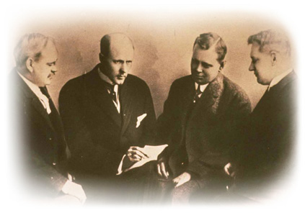
Seeking the warmth of friendship, Rotary’s four founding members met
on a cold Chicago evening and launched a 100-year-long association.

Slide 4
So integral was friendship to Rotary’s goals that in January 1906, “the promotion of good fellowship” was adopted into the club’s first constitution and bylaws.

Slide 5
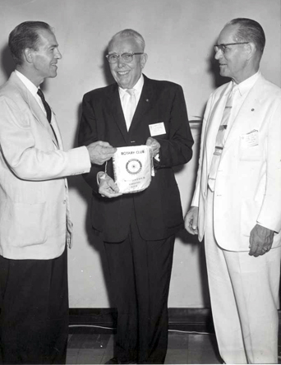
AS ROTARY GREW, SO TOO DID OPPORTUNITIES FOR FELLOWSHIP.
Rotarians traveling to faraway locations took banners to exchange at make-up meetings as a token of friendship.

Slide 6
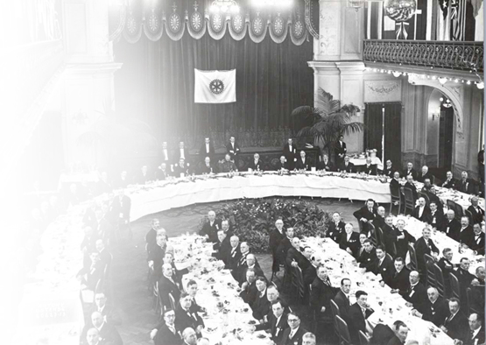
Rotary’s first international convention, held
in 1910, began
a tradition of combining work
with fellowship
on a grand scale.

Slide 7
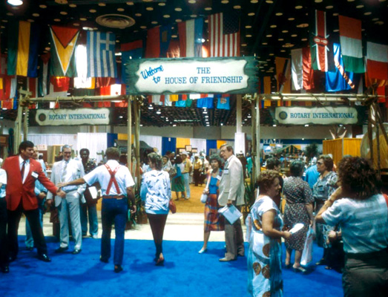
During the 1924 Toronto convention,
Rotarians gathered for the first time at what has become a cherished Rotary tradition: the House of Friendship.

Slide 8
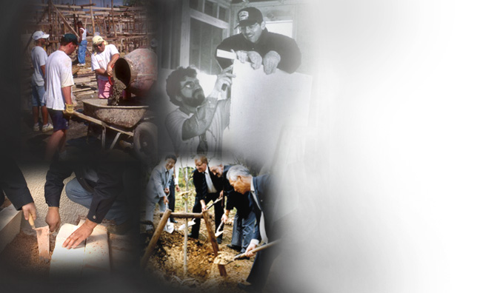
Rotary’s increased emphasis on service gave Rotarians the opportunity to discover fellowship while helping others.

Slide 9
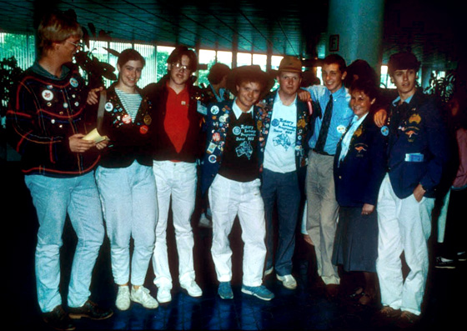

In 1927,
the Youth Exchange program — the oldest exchange program of
its kind — got underway launching global friendships among youth, ages 15-19.

Slide 10
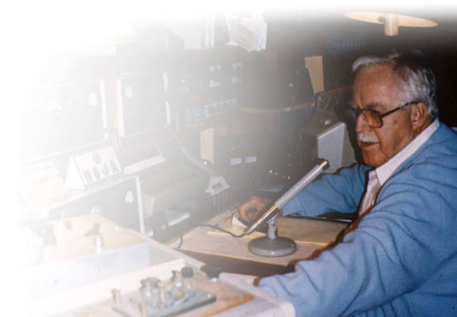
“Rotary fellowship — a wondrous thing that grows because it brings together Rotarians of like interests. It is the glue that holds us together as we Enjoy Rotary!”
— Hugh Archer, 1989-90 RI President

Slide 11





In 1928,
Esperanto became the first Rotary Fellowship. Today, more than 90 fellowships offer Rotarians with similar vocational or recreational interests the chance to enjoy Rotary together.
ESPERANTO

Slide 12
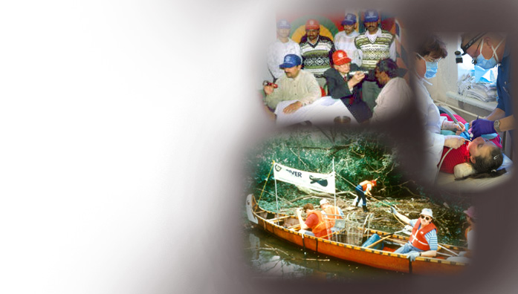
Fellowship members often use their shared skills and interests to help those in need.

Slide 13
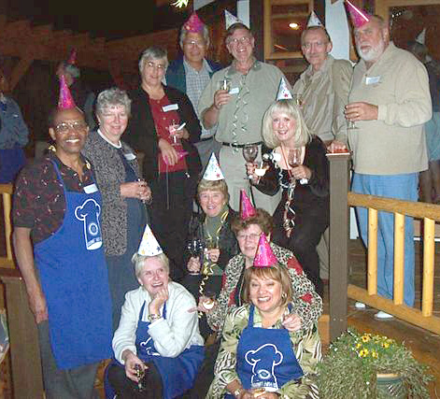
In celebration of Fellowships Month in June, fellowships are encouraged to highlight activities through projects, activities, and events.
World Fellowship of Rotarian Gourmets

Slide 14
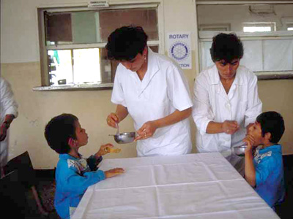
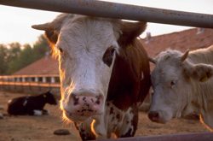
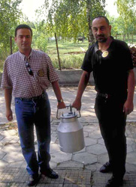
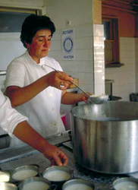
Intercountry committees, first formed in 1931, promote goodwill and friendship between Rotarians in distant countries and are especially popular in Europe.
The France-Bulgaria Intercountry Committee donated dairy cows to help feed 150 children and orphans living in Glavinitza, Bulgaria.

Slide 15
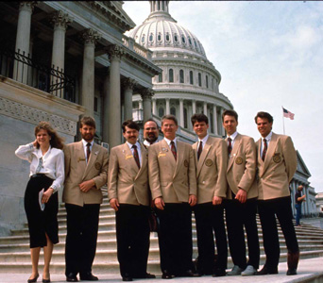
In 1965,
Group Study Exchanges took flight giving non-Rotarian professionals, age 25-40, a chance to serve as international goodwill ambassadors.

Slide 16
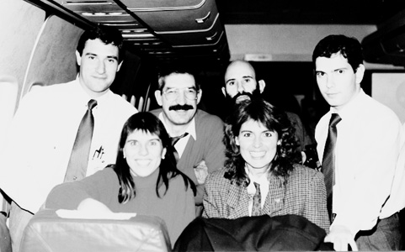
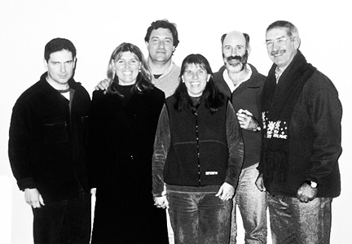
1992
The friendships often last long after the team returns home. The six members of the GSE team from District 4920 (Argentina) continue to meet 13 years after their exchange.
2002

Slide 17

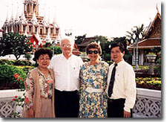
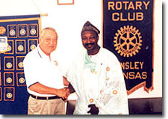
Friendship Exchanges, introduced in 1984, give Rotarians and their families the chance to experience other cultures firsthand.

Slide 18
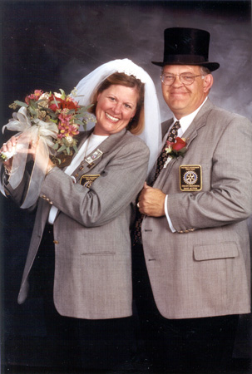
In rare cases, Rotary fellowship has even led to the exchange of wedding vows.
2000-01 district governors Mary Beth Growney (District 6250) and Alan Selene (District 5970) tie the knot on 1 January 2001.

Slide 19
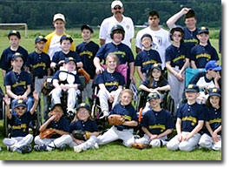
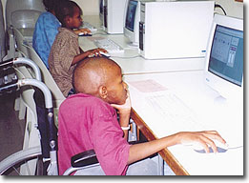
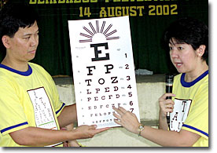
Through Centennial Community Projects and the Rotary Centennial Twin Club Program, Rotarians combined fellowship with service during Rotary’s centennial year.

Slide 20

Booking a flight to this year’s convention poses no problem for members of the Flying Rotarians fellowship. Their Centennial Fly-Away includes a layover in Chicago.

Slide 21
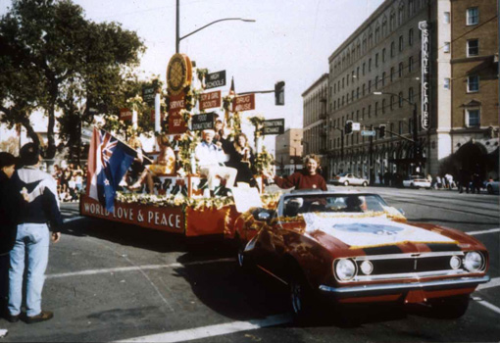
Some 15 Rotary Fellowships will take part in this year’s RI Centennial Parade.

Slide 22
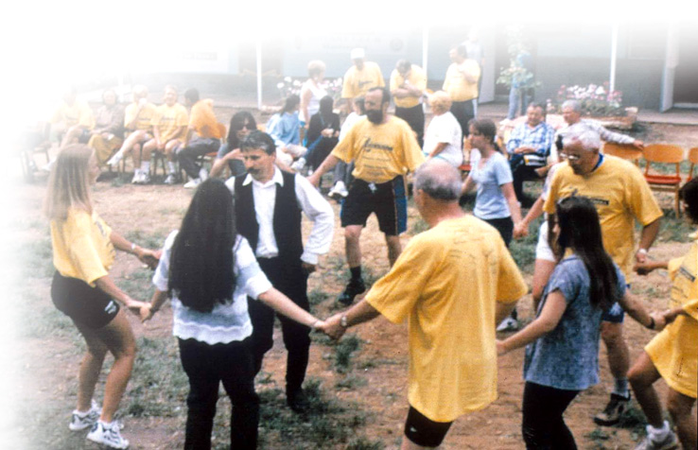
Whether fellowship begets service or vice versa, everyone benefits when Rotarians make time to Celebrate Rotary together.

Slide 23

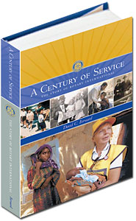
Learn more about how fellowship has played a part in Rotary’s history by ordering your copy of A Century of Service: The Story
of Rotary International.
Click here to order

