Slide 1
Customer Churn Prediction and Classification
Priya Jani AU2040004
Yansi Memdani AU2040028
Priyanshu Pathak AU2040241
Mohnish Mirchandani AU2040110
Mentor - Prof. Mehul Raval
Team - 4ier Series

Slide 2
Introduction and Problem Statement
Customer Churn refers to the level of attrition that can be seen across companies.
This churn can happen due to bad customer service, financial issues or it can be when customers switch to another competitors.
We intend to see the churn rate as low as possible at all times.
Motive: Identify “at-risk” customers and methods to lower churn.
Dataset: Customer churn data sourced by the IBM Developer Platform. It has data for 7043 clients, with 20 features.

Slide 3
Existing body of work
According to the base paper, data cleaning and preprocessing on the dataset was done.
Data was fed to make a social network in order to find betweenness centrality.
The approach led to the discovery of more diverse features.
The approach used principal component analysis in order to reduce dimensions.
Area Under the Curve (AUC) was used in order to judge performance of the model.
Four algorithms were used in order to find optimal churn prediction: Decision tree, Random forest, Gradient Boosted Machine Tree, Extreme Gradient Boosting

Slide 4
Approach
Data Cleaning (to find duplicates and missing values)
Exploratory Data Analysis (to get an idea about the features influencing churn)
Data Preprocessing (transforming data from non-numerical to numerical format)
Correlation (to find the correlation between all features)
Generalized Linear Model (to gain some statistics of independent features with the dependent variable)
Feature Scaling (Normalizing the numerical features to a specific range)
Creating a baseline model function
Running different models to find the best one has good accuracy, precision, recall and F1 score.
Models used: Logistic Regression, Support Vector Classifier, Naive Bayes Classifier

Slide 5
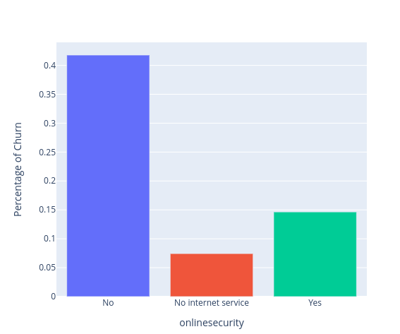
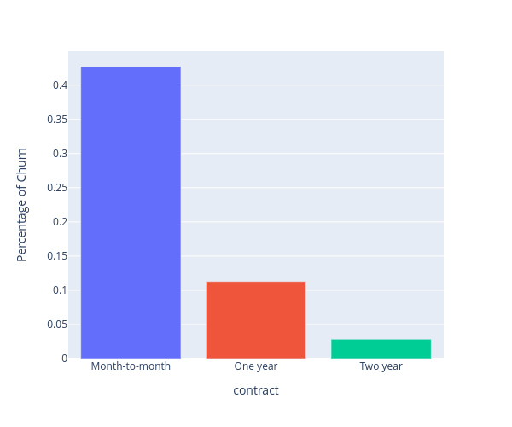
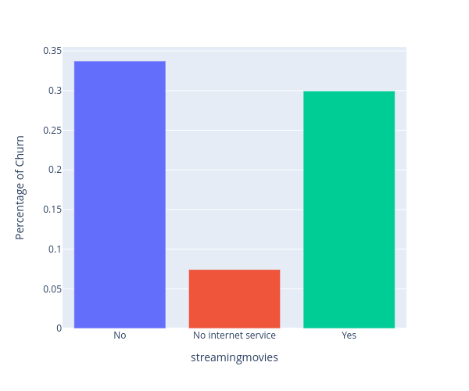
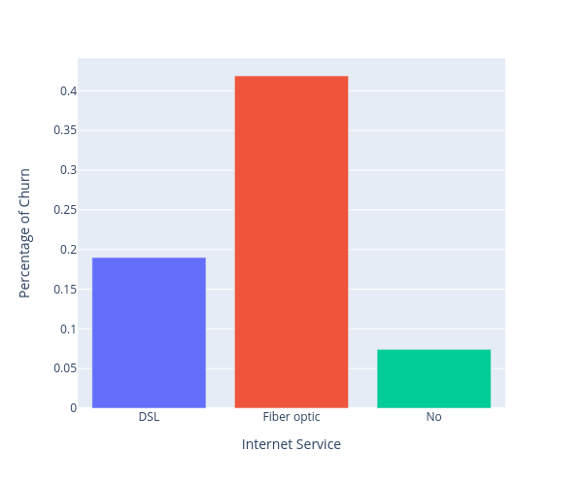
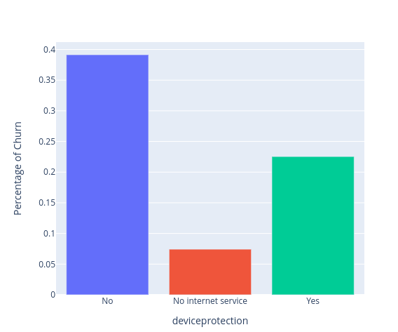
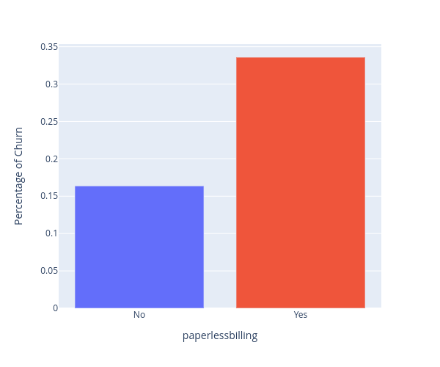
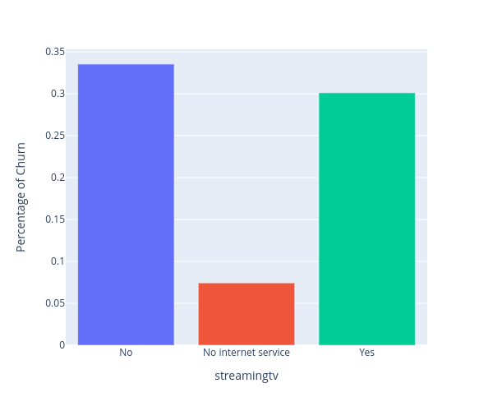
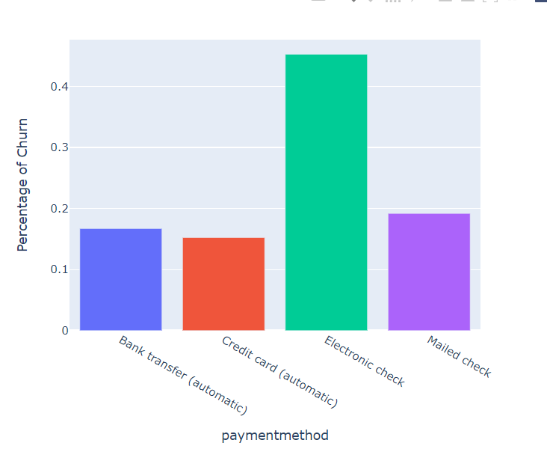
Initial Results – Exploratory Data Analysis

Slide 6
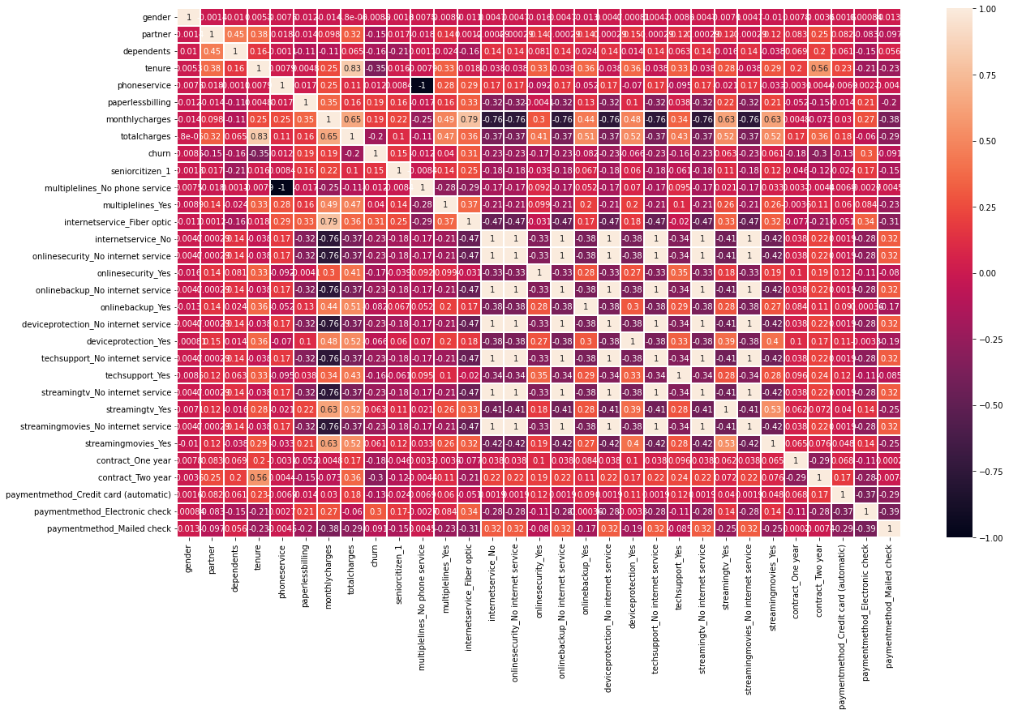
Initial Results – Correlation Matrix

Slide 7
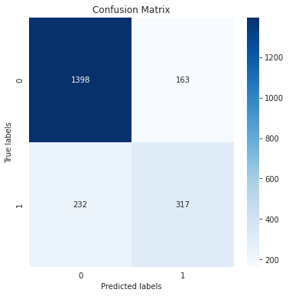

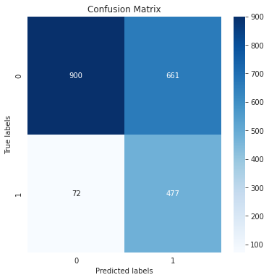
Initial Results
 | Logistic Regression | Support Vector Classifier | Naive Bayes Classifier
Accuracy | 81.27 | 80.52 | 65.26
Precision | 66.04 | 66.42 | 41.91
Recall | 57.74 | 50.81 | 86.88
F1 Score | 80.85 | 79.61 | 67.28
Logistic Regression
Support Vector Classifier
Naive Bayes Classifier

Slide 8
Role of each group member in the project and Future work
Priya- Research, Code Implementation, Report Writing
Yansi- Research, Code Implementation, Report Writing
Mohnish- Research, Code Implementation, Report Writing
Priyanshu- Research, Code Implementation, Report Writing
Future Work:
Running some new models and finding the stats for the same.
Checking the decision boundaries for each algorithm to find which algorithm separates data points in a better way
Try to change the parameters in order to find better results and if possible coming up with our own algorithm.

Slide 9
References
“12.1 - Logistic Regression | STAT 462,” 12.1 - Logistic Regression | STAT 462. [Online]. Available: https://online.stat.psu.edu/stat462/node/207/
S. R. Publishing, “Churn Prediction Using Machine Learning and Recommendations Plans for Telecoms,” Churn Prediction Using Machine Learning and Recommendations Plans for Telecoms, Nov. 05, 2019. [Online]. Available: https://www.scirp.org/html/3-1731142_96177.htm
“Naive Bayes Classifier in Machine Learning - Javatpoint,” www.javatpoint.com. [Online]. Available: https://www.javatpoint.com/machine-learning-naive-bayes-classifier
Ahmad, A. K., Jafar, A., & Aljoumaa, K. (2019, March 20). Customer churn prediction in telecom using machine learning in big data platform. Journal of Big Data, 6(1). https://doi.org/10.1186/s40537-019-0191-6

Slide 10
Thank You

