Slide 1
Customer Churn Prediction and Classification
Priya Jani AU2040004
Yansi Memdani AU2040028
Priyanshu Pathak AU2040241
Mohnish Mirchandani AU2040110
Mentor - Prof. Mehul Raval
Team - 4ier Series

Slide 2
Introduction
Customer Churn refers to the level of attrition that can be seen across companies.
This churn can happen due to bad customer service, financial issues or it can be when customers switch to another competitors.
We intend to see the churn rate as low as possible at all times.

Slide 3
Problem Statement
Motive: Identify “at-risk” customers and methods to lower churn.
It can be done by comparing different machine learning models and finding the best out of them.
(Dataset: Customer churn data sourced by the IBM Developer Platform. It has data for 7032 clients, with 21 features.)

Slide 4
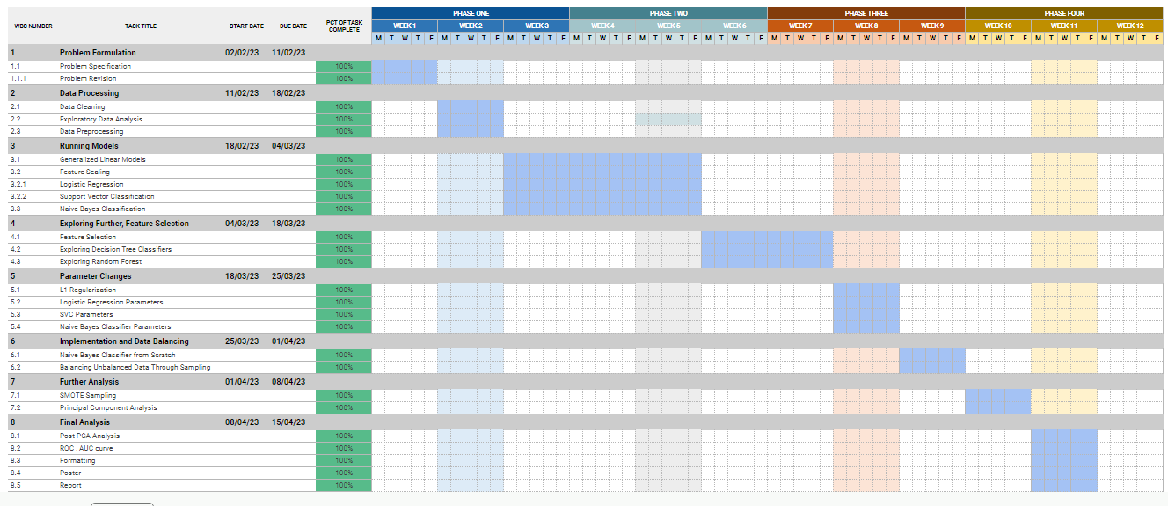
GANTT Chart
Link: https://docs.google.com/spreadsheets/d/17RF_uKF5L-P3jEiV3AKXlmLDNe21CX38pFXzGIqmEKI/edit?usp=sharing

Slide 5
Existing body of work
According to the base paper, the problem statement was specified.
Data Processing was done on the dataset which includes data cleaning, Exploratory Data Analysis and Data preprocessing.
Feature Scaling
Models like Generalised Linear Model (GLM), Logistic Regression, SVC and Naive Bayes were run and analysed.

Slide 6
Approach
Data Cleaning (to find duplicates and missing values)
Exploratory Data Analysis (to get an idea about the features influencing churn)
Data Preprocessing (transforming data from non-numerical to numerical format)
Correlation (to find the correlation between all features)
Generalized Linear Model (to gain some statistics of independent features with the dependent variable)
Feature Scaling (Normalizing the numerical features to a specific range)

Slide 7
Approach
Run Models (Naive Bayes + SVC + Logistic Regression + Random Forest)
Data Balancing (SMOTE Analysis)
Feature Selection (Using Correlation Matrix & Principal Component Analysis)
Run Models (Naive Bayes + SVC + Logistic Regression + Random Forest)
Changing parameters of Naive Bayes, Logistic Regression and SVC
ROC-AUC Curve for analysis

Slide 8
Final Results
 | Logistic Regression (%) | Support Vector Classifier (%) | Naive Bayes Classifier (%) | Random Forest Classifier (%)
Accuracy | 81.27 | 80.52 | 65.26 | 79.71
Precision | 66.04 | 66.42 | 41.91 | 64.03
Recall | 57.74 | 50.81 | 86.88 | 50.27
F1 Score | 80.85 | 79.61 | 67.28 | 78.86
 | Logistic Regression (%) | Support Vector Classifier (%) | Naive Bayes Classifier (%) | Random Forest Classifier (%)
Accuracy | 82.05 | 82.25 | 67.89 | 83.52
Precision | 64.07 | 66.66 | 39.63 | 68.02
Recall | 46.21 | 42.42 | 81.36 | 50.60
F1 Score | 80.94 | 80.73 | 70.53 | 82.60
Before Data Balancing
Dataset: (7032 x 31)
After Data Balancing
Dataset: (9769 x 31)

Slide 9
Final Results
 | Logistic Regression (%) | Support Vector Classifier (%) | Naive Bayes Classifier (%) | Random Forest Classifier (%)
Accuracy | 80.90 | 80.47 | 73.55 | 78.67
Precision | 65.40 | 66.99 | 49.47 | 61.48
Recall | 56.46 | 49.18 | 76.86 | 48.26
F1 Score | 80.42 | 79.41 | 74.99 | 77.77
 | Logistic Regression (%) | Support Vector Classifier (%) | Naive Bayes Classifier (%) | Random Forest Classifier (%)
Accuracy | 80.07 | 80.10 | 79.66 | 81.30
Precision | 59.40 | 63.50 | 55.63 | 61.52
Recall | 36.36 | 27.42 | 47.87 | 45.30
F1 Score | 78.20 | 76.92 | 79.10 | 80.22
After Feature Selection based on Correlation
After PCA

Slide 10
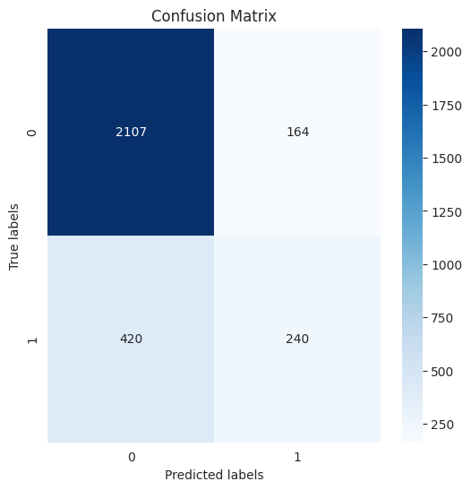
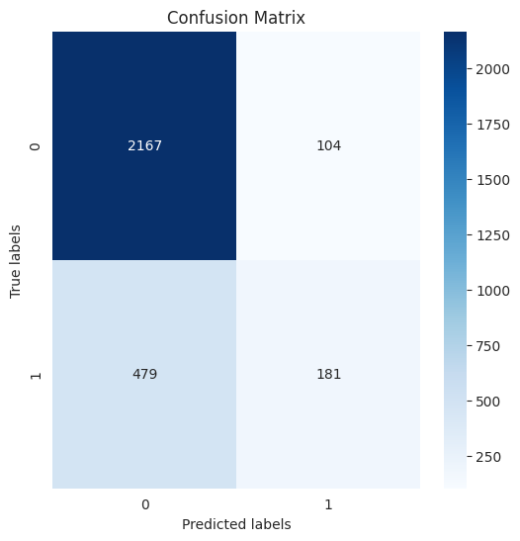
Final Results
Logistic Regression
SVC

Slide 11
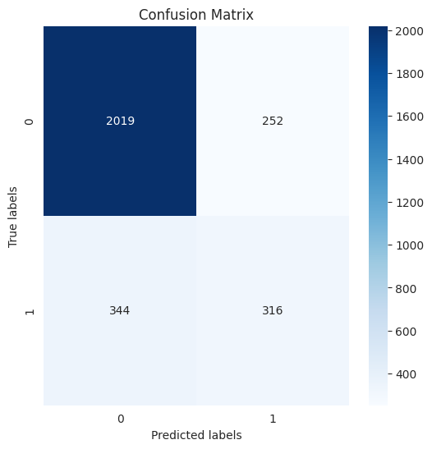
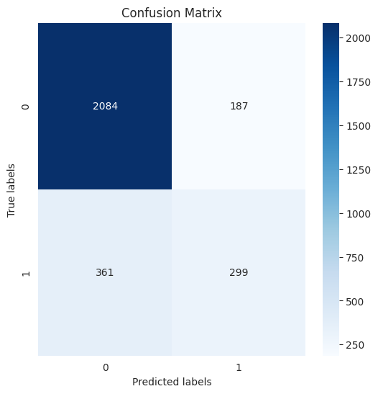
Final Results
Naive Bayes
Random Forest

Slide 12
Final Results – Logistic Regression
LR model | Training Time (9769 records) | Training Accuracy
Loss function + Gradient descent | 61.11 seconds | 73.20% (threshold=0.8)
MLE + Gradient ascent | 60.61 seconds | 5.47%
sklearn | 124.14 seconds | 66.15%

Slide 13
Final Results – SVC
Label | precision | recall | f1-score | support
0 | 0.77 | 1.00 | 0.87 | 1513
1 | 0.00 | 0.00 | 0.00 | 441
Evaluation: Polynomial kernel
Accuracy: 0.77 (Support: 1954)
Label | precision | recall | f1-score | support
0 | 0.85 | 0.94 | 0.89 | 1513
1 | 0.66 | 0.43 | 0.52 | 441
Evaluation: RBF kernel
Accuracy= 0.82 (Support: 1954)
Label | precision | recall | f1-score | support
0 | 0.86 | 0.92 | 0.89 | 1513
1 | 0.65 | 0.50 | 0.56 | 441
Evaluation: Sigmoid kernel Accuracy= 0.82 (Support: 1954)

Slide 14
Final Results – SVC
Label | precision | recall | f1-score | support
0 | 0.86 | 0.92 | 0.89 | 1513
1 | 0.65 | 0.49 | 0.56 | 441
Evaluation: Linear kernel Accuracy= 0.83 (Support: 1954)
Final SVC Classification
Accuracy= 0.82 (Support: 1954)
SVC(C=1, gamma=0.1)
Label | precision | recall | f1-score | support
0 | 0.85 | 0.94 | 0.89 | 1513
1 | 0.67 | 0.43 | 0.52 | 441

Slide 15
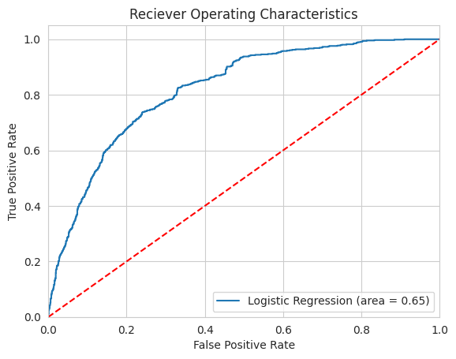
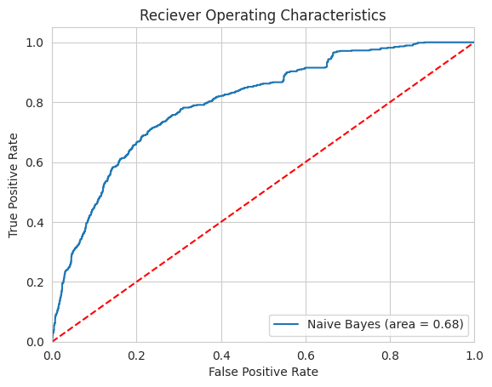

Final Results
Logistic Regression
Naive Bayes
Random Forest

Slide 16
Conclusion
Smote Analysis was quite effective in our case as we had imbalance in the churn data.
In the accuracy results of Naive Bayes -> increasing trend
In the accuracy results of Logistic Regression -> decreasing trend
After PCA, The final values of accuracy, f1 score, and precision had less impact.
For logistic regression, loss function + gradient descent works better.
For the SVC model, optimal parameters: linear kernel, C=1 & gamma=0.1 are used.
The AUC value of random forest was maximum (AUC=0.69).

Slide 17
Role of each group member in the project
Priya- Data Preprocessing, Feature scaling, SVM, Principal Component Analysis, ROC-AUC, Model Analysis
Yansi- Data Preprocessing, GLM, Logistic Regression, SMOTE Analysis, Model Analysis
Mohnish- Exploratory Data Analysis, Correlation, Naive Bayes, Model Analysis
Priyanshu- Data Cleaning, Exploratory Data Analysis, Random Forest,Model Analysis

Slide 18
References
[1]“12.1 - Logistic Regression | STAT 462,” 12.1 - Logistic Regression | STAT 462. [Online]. Available: https://online.stat.psu.edu/stat462/node/207/
[2]S. R. Publishing, “Churn Prediction Using Machine Learning and Recommendations Plans for Telecoms,” Churn Prediction Using Machine Learning and Recommendations Plans for Telecoms, Nov. 05, 2019. [Online]. Available: https://www.scirp.org/html/3-1731142_96177.htm
[3]“Naive Bayes Classifier in Machine Learning - Javatpoint,” www.javatpoint.com. [Online]. Available: https://www.javatpoint.com/machine-learning-naive-bayes-classifier
[4]Ahmad, A. K., Jafar, A., & Aljoumaa, K. (2019, March 20). Customer churn prediction in telecom using machine learning in big data platform. Journal of Big Data, 6(1). https://doi.org/10.1186/s40537-019-0191-6
[5]sklearn.model_selection.GridSearchCV. (n.d.). Scikit-learn. https://scikit-learn/stable/modules/generated/sklearn.model_selection.GridSearchCV.html
[6]Hajian-Tilaki, K. (n.d.). Receiver Operating Characteristic (ROC) Curve Analysis for Medical Diagnostic Test Evaluation. PubMed Central (PMC). https://www.ncbi.nlm.nih.gov/pmc/articles/PMC3755824/
[7]What is Random Forest? | IBM. (n.d.). What Is Random Forest? | IBM. https://www.ibm.com/in-en/topics/random-forest

Slide 19
Thank You

