Slide 1
Project-one
What makes a Hit Song?
Analyzed by Jon Wood and Meme Guerrini

Slide 2
Motivation
Project Scope:
What makes a popular song on Spotify?

Slide 3
Questions & Data
What are the top 10 Genres by utilization (pie chart)
How do genres corelate with popularity?
What correlations can be identified for popularity vs. Danceability vs. Energy vs. Valence vs. Number of times Charted vs. Highest Charting Position vs. Streams
Can we infer what metric contributes the most to a songs popularity?

Slide 4
Questions & Data
We choose to analyze spotify’s top 200 weekly charting songs from 2020-01 to 2021-08, with a dataset of 1556 rows and 23 unique columns
We will Analysis each song based on various meta data to see if any correlations exist between popularity and key attributes such as Danceability, Energy, Valence, Tempo ..
Using a Spotify database downloaded from https://www.kaggle.com/sashankpillai/spotify-top-200-charts-20202021/version/2
We made some assumptions like if a song is more danceable or has a higher stream count it will probably be more popular.

Slide 5
Data Cleanup & Exploration
The data had some issues with regards to running analysis on it to make comparisons on the popularity field (some had 0 and we felt had no bearing on "what makes a song popular").
There were also a number of records with incomplete data and so we only wanted to use information from records that were complete.
Finally the genre info was stored in such a way that it was really difficult to try and utilize matplotlib chart plotting so we had to reshape the genre data and explode it out into separate records to then be able to chart it with matplotlib.

Slide 6
Data Cleanup & Exploration
What we will explore
What are the top 10 Genres by utilization (pie chart)
How do genres corelate with popularity?
3. What correlations can be identified for popularity vs. Key Attributes such as Danceability , Energy, Valence, Tempo, Duration, Loudness..
And can we infer what metric contributes the most to a songs popularity?

Slide 7
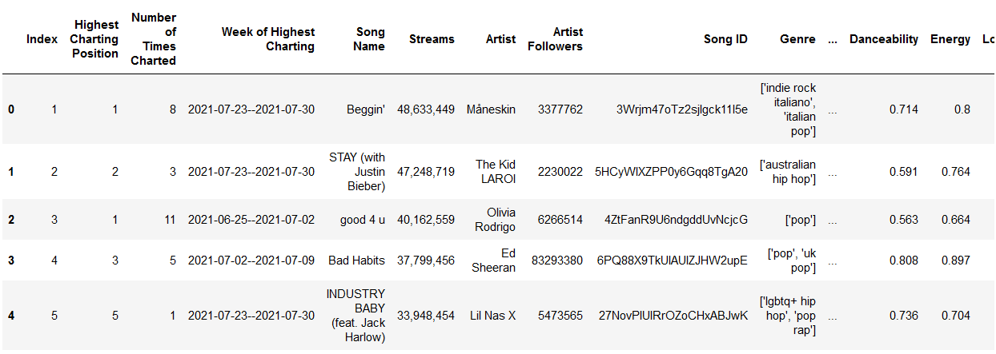
Data Analysis dataframe

Slide 8
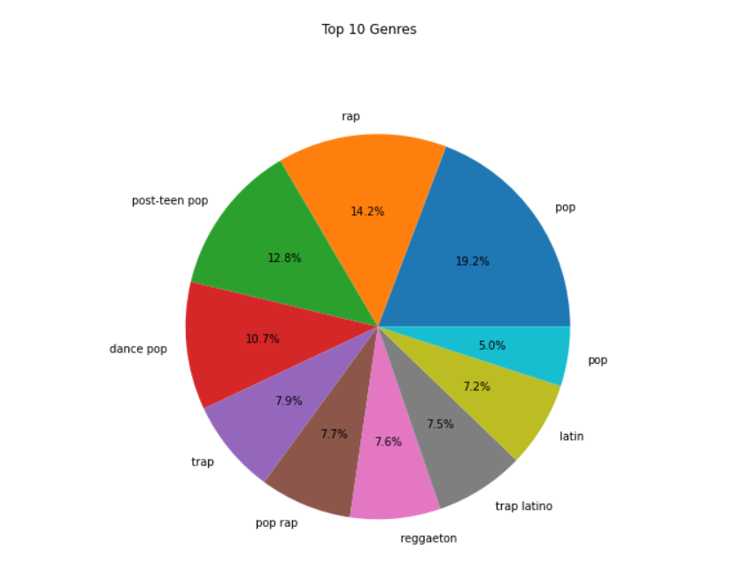
Data Analysis
Top 10 genres

Slide 9
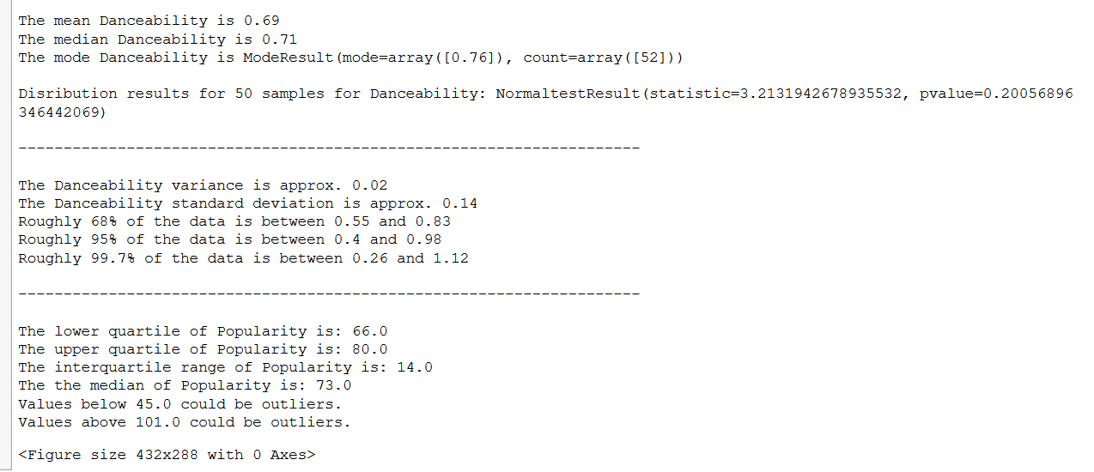
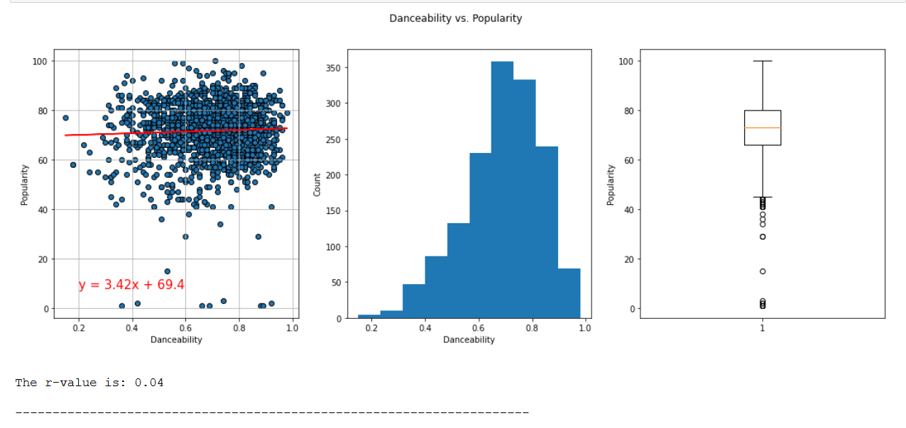
DATA Analysis danceability vs popularity

Slide 10
Data Analysis

Slide 11
Data Analysis

Slide 12
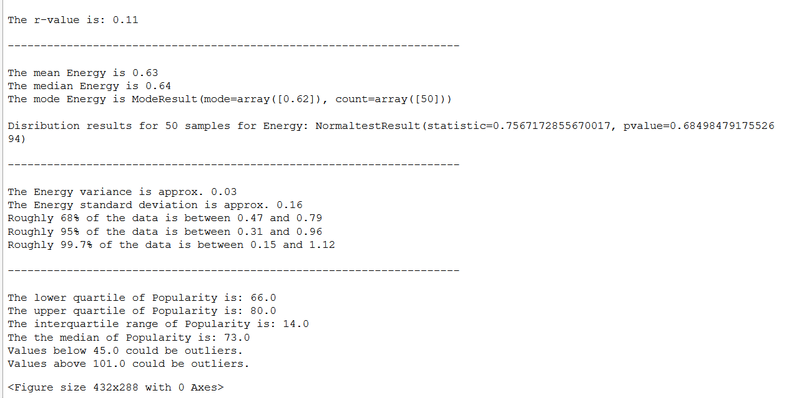
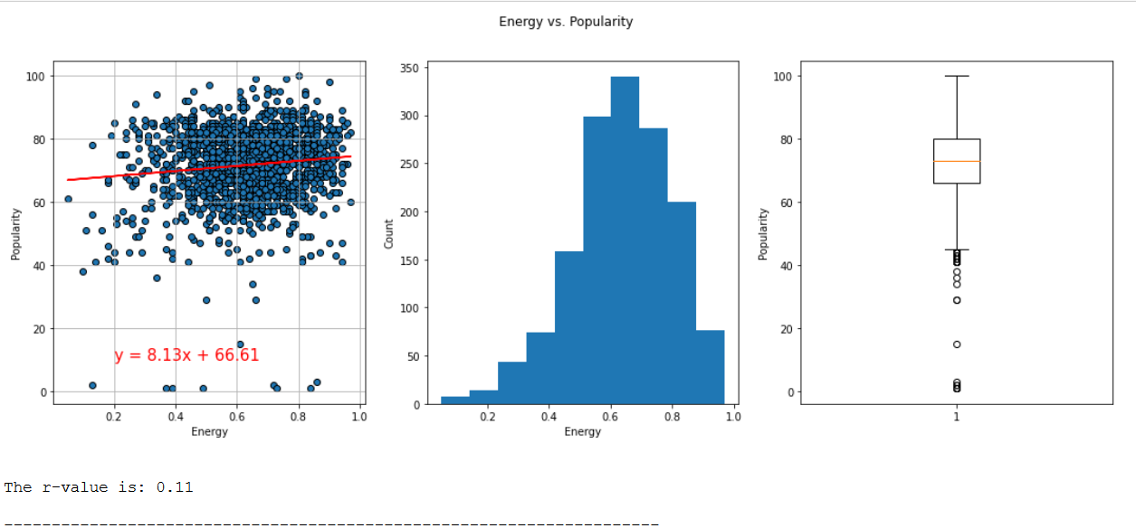
DATA Analysis energy vs popularity

Slide 15
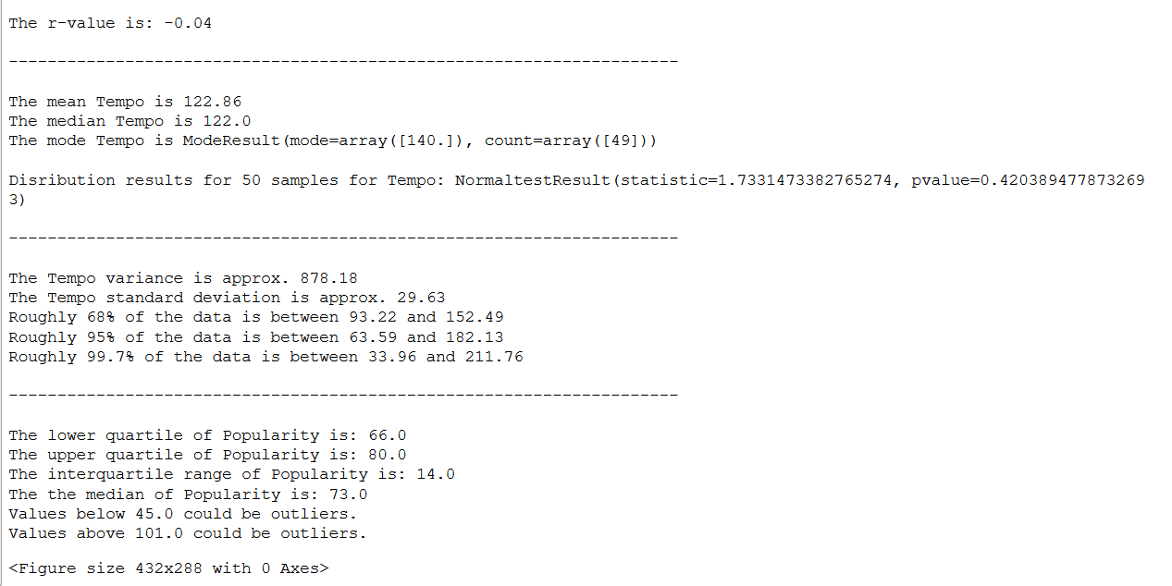
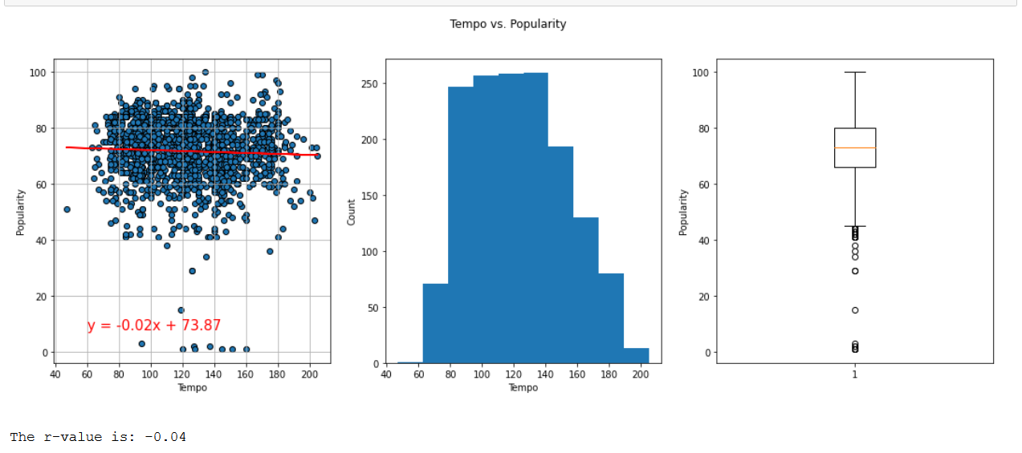
DATA Analysis tempo vs popularity

Slide 18
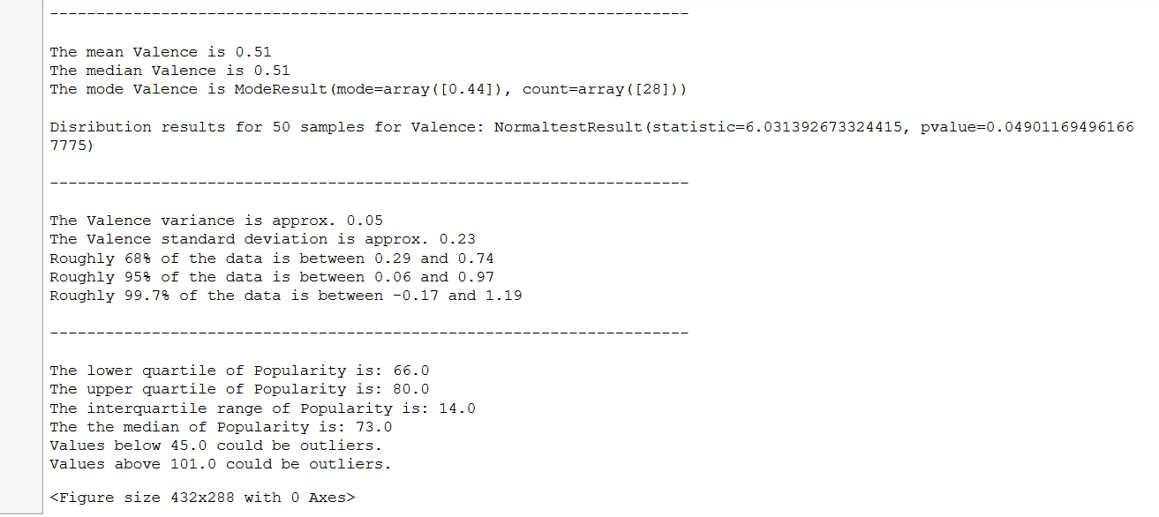
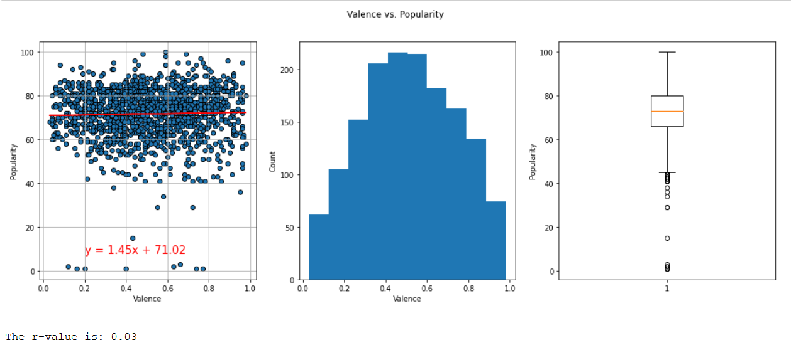
DATA Analysis valence vs popularity

Slide 21
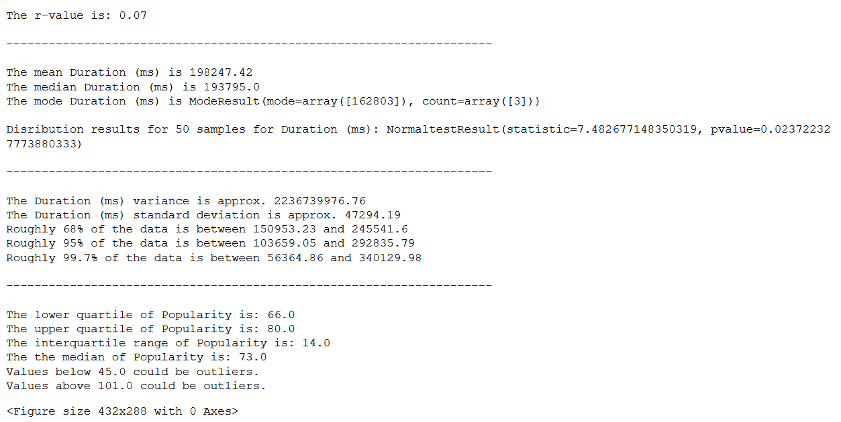
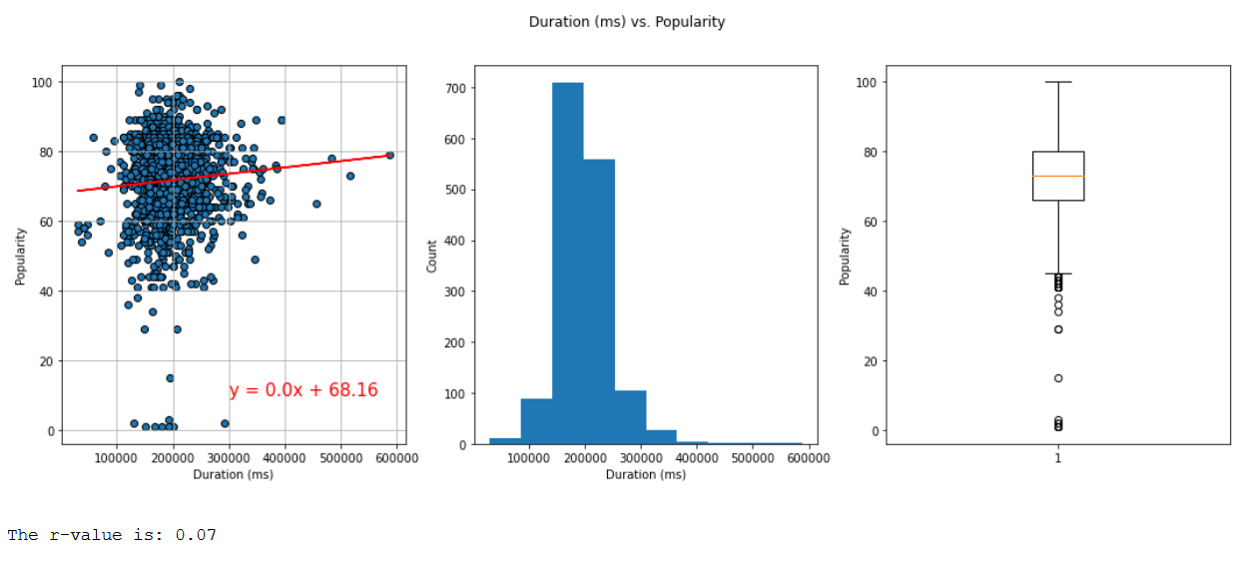
DATA Analysis duration (ms) vs popularity

Slide 24
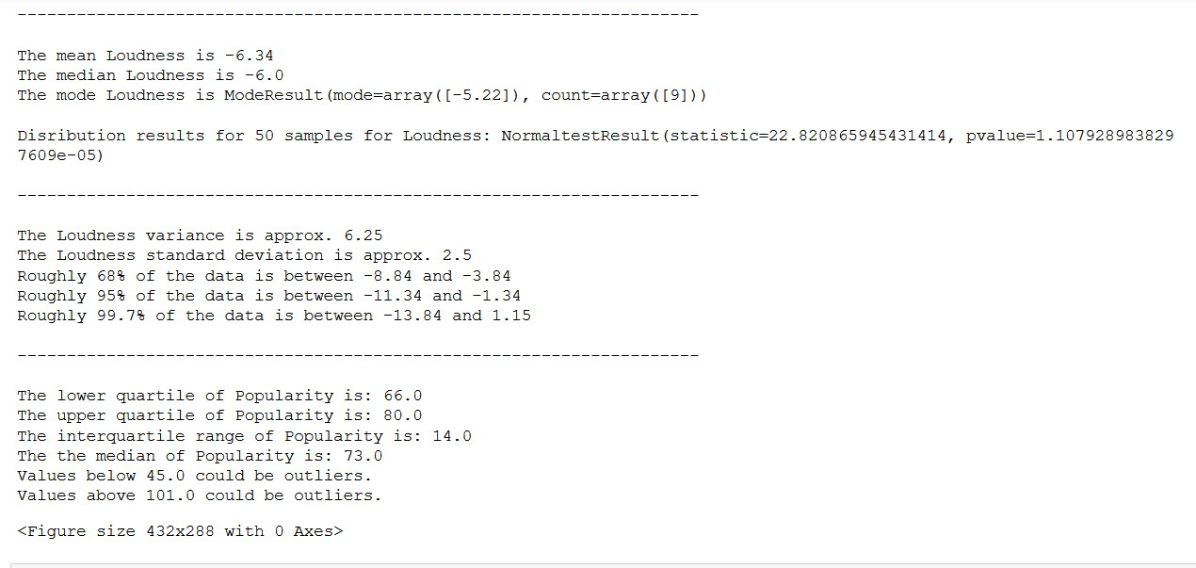
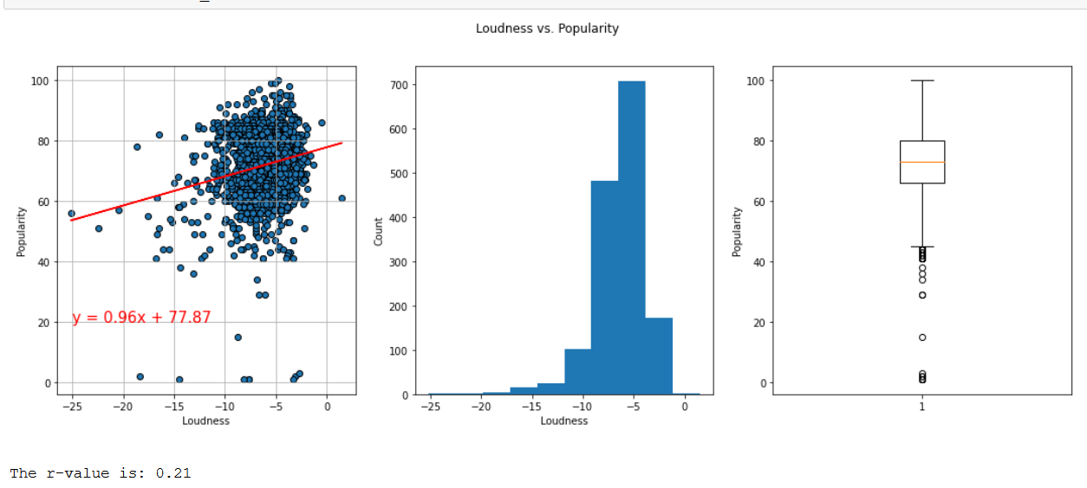
DATA Analysis Loudness vs popularity

Slide 27
After refining our dataset we found the averages (and medians) for each key attribute.
IE – ACOUSTIC 0.180 // DANCEABILITY 0.697 // ENERGY 0.689 // TEMPO 116 ….
The data told us that “popular” songs had:
High danceability and energy
Low acousticness and speechiness
Tempo around 117 BPM

Slide 28
conclusion
based on the following correlations between popularity and key attributes such as tempo, valance (musical positiveness - higher values denote the song sounded happier where as lower values denote the song sounded sad or angry), danceability, energy, we can assert that in fact our assumptions were true in that:
A song that has a shorter duration, higher tempo, higher valance, higher energy, higher danceability is more popular.

Slide 29
conclusion
THE MOST POPULAR SONGS FOR 2020-2021 TEND TO HAVE:
HIGH DANCEABILITY
HIGHER ENERGY
LOW ACOUSTINESS
POP ARTISTS APPEAR TO HAVE MORE SONGS ON THE TOP 200 SPOTIFY CHARTS.
NOTE: NON-TRADITIONAL ARTISTS SEEM TO HAVE LESS SONGS ON THE TOP 200CHARTS

Slide 30
Post Mortem
Things we could look at further and explore with ML would be to be able to predict: Once an artist has a popular song, are more of that artists songs likely to become popular?
Things to look at further to explore rational would be to look at outliers and compare their data with the majority to see what things stand out (if anything) besides the indicator in question (i.e. Danceability)

