Slide 1

Car Price Prediction using K-Nearest Neighbors (KNN)
AI-ML Project Report
Presented by:
Namdar Mohammad Mehdi -24BEI041
Lakshya Jain-24BEI043
Course: 1CS101CC22 - Introduction to AI-ML

Slide 2
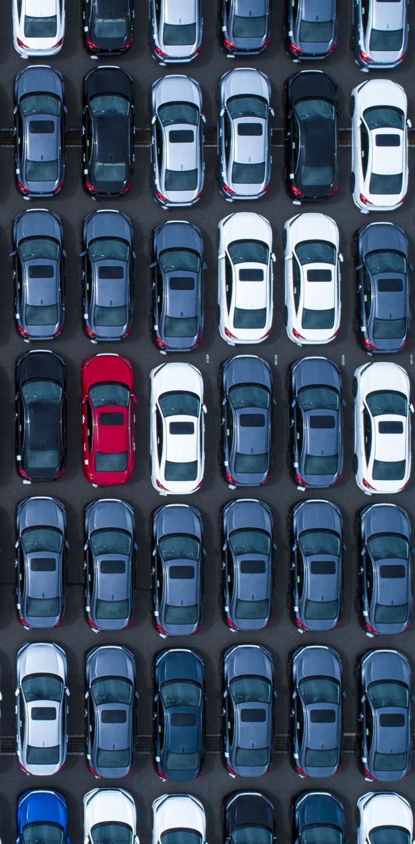
Introduction
Car price prediction helps buyers and sellers make informed decisions.
We use KNN regression for predicting car prices based on historical data.

Slide 3

Dataset Description
Dataset Used: CarDekho dataset
Features:
-Year: Manufacturing year
-Mileage: Fuel efficiency
-Engine Power: CC and HP
- Selling Price: Target variable

Slide 4
Why KNN?
Simple and effective algorithm for regression problems.
Predicts values based on similarity of data points.
Handles non-linear data effectively.

Slide 5
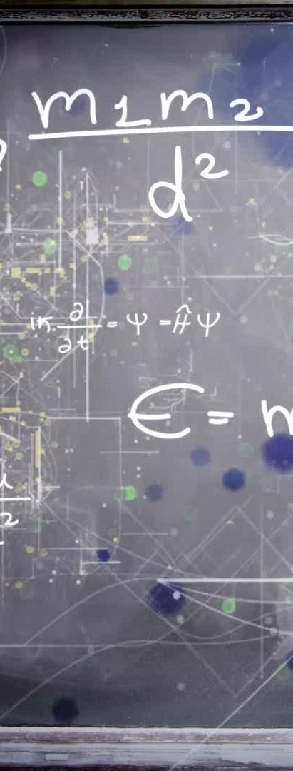
Methodology
Preprocessing:
- Handling missing values
- Feature scaling & normalization
- Splitting data (80% train, 20% test)
KNN Working:
- Select k nearest neighbors.
- Compute distances & take an average
for regression.

Slide 6
Model Evaluation Metrics
Mean Absolute Error (MAE): ₹163,251.63
Mean Squared Error (MSE): ₹236,346,207,109.23
Root Mean Squared Error (RMSE): ₹486,154.51
R-Squared Score: 0.69 (Moderate accuracy)

Slide 7
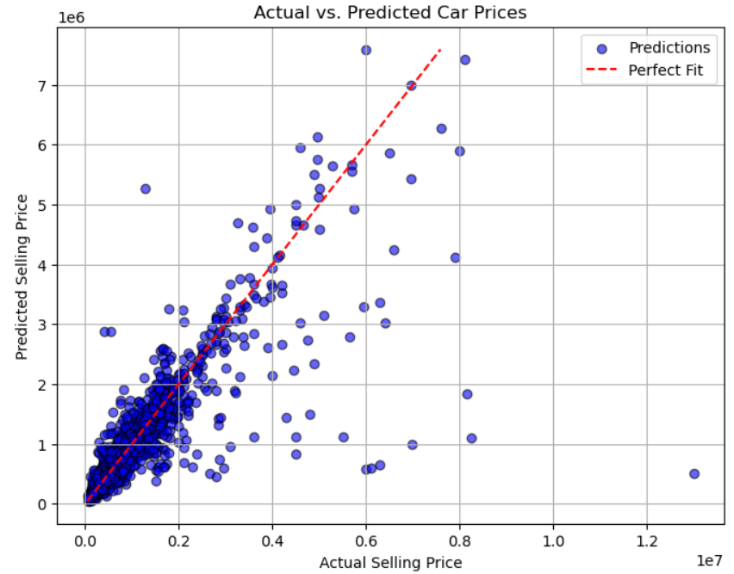
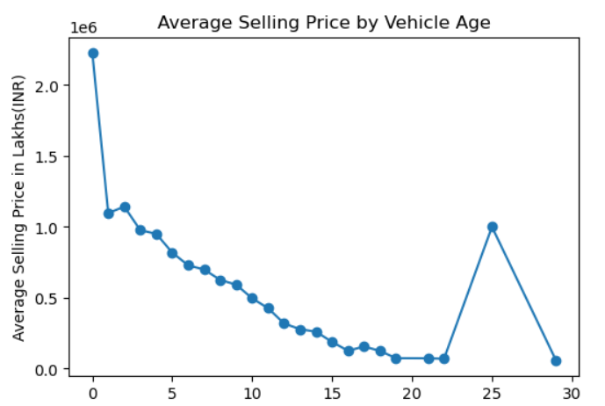
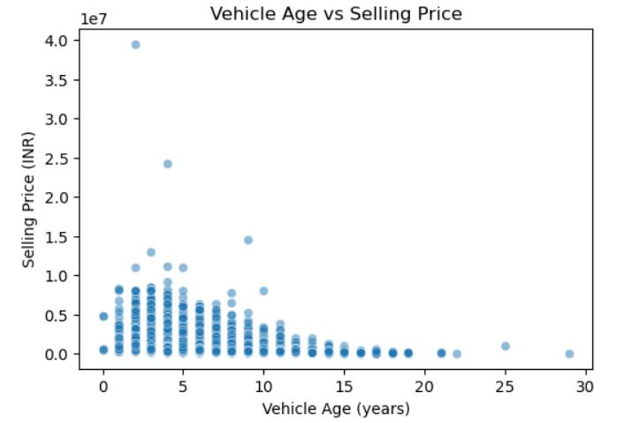
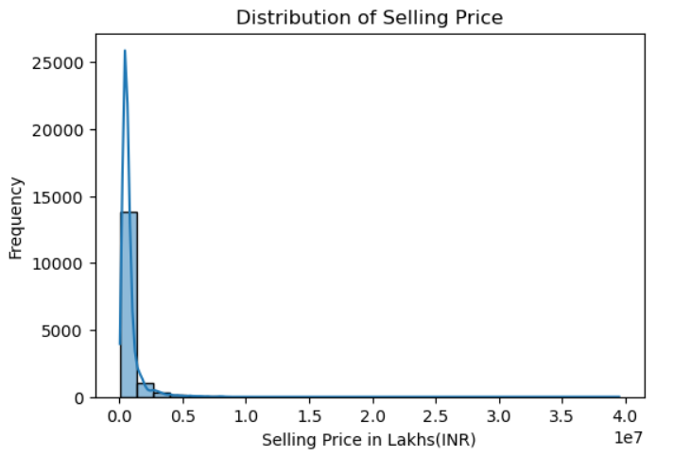
Data Visualization

Slide 8
Model Deployment
Framework: Streamlit
Steps:
- Train & save the KNN model
- Create a user-friendly UI
- Accept inputs & display predictions.

Slide 9
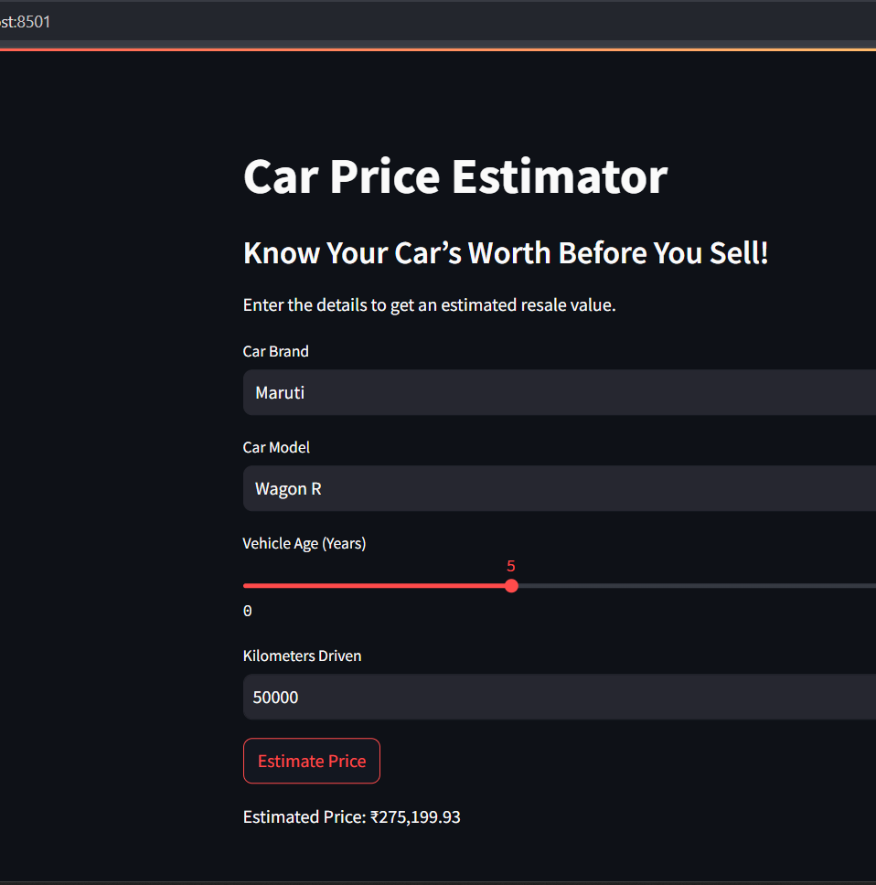
UI Integration
-Users enter car details & receive predictions.
-Command to Run: `streamlit run predictor.py`

Slide 10
Future Enhancements
• Geo-based pricing for location adjustments.
• Market trends using real-time data.
• Vehicle condition considerations.

Slide 11
Findings & Conclusion
• KNN is effective for structured datasets.
• Model achieved 69% accuracy.
• More feature engineering can improve results.
• Real-world integration possible for dealerships.

Slide 12
References
• Scikit-learn Documentation
• CarDekho Dataset (Kaggle)
• Streamlit Tutorials
• Research Papers on ML with Python

Slide 13
Thank You!
Any Questions?
Open for discussion!

