Slide 1
Data Acquisition System
Vladoiu Grigore
Nandra Mihnea

Slide 2
Introduction
What are the requirements?
How many of the requirements did we accomplish?
Future work
What is left to be done?

Slide 3
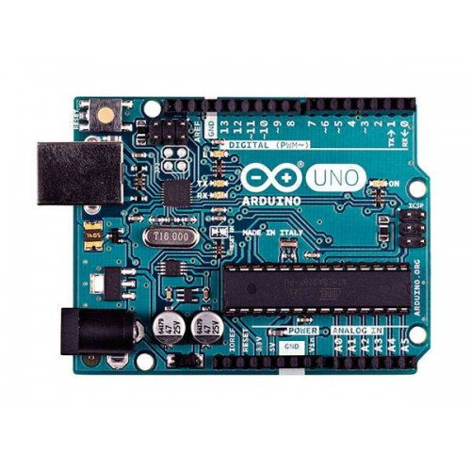
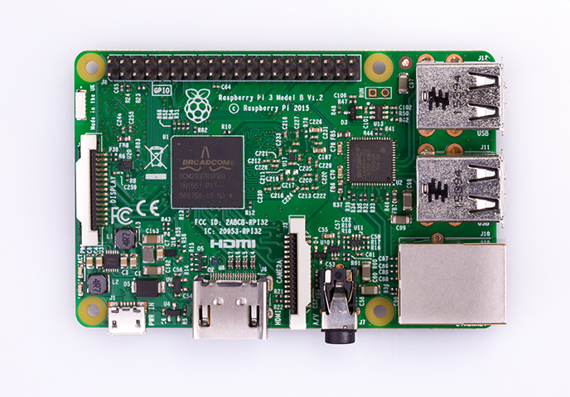
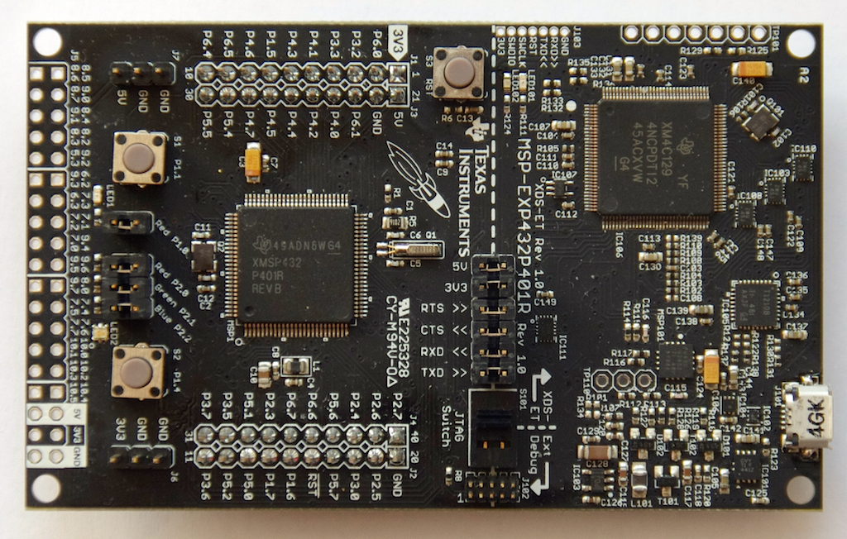
Different types of MCU’s
Wide-spread Cheap Well documented Easy to use | Wide-spread Well documented Lots of resources Versatile | Low-Power Cheap DriverLib
Not Low-Power No wireless communication | Not that cheap Uses lots of energy | Not well documented No wireless communication
Pros:
Cons:

Slide 4
Different types of sensors
DHT22
-Low cost
-2.5mA max current use during conversion (while requesting data)
-0 to 100% humidity reading with 2-5% accuracy
-0 to 80°C temperature readings ±0.5°C accuracy
CJMCU-3216 AP3216
-Low cost
-Ambient Light Photo Sensor
- 4 user selectable dynamic range
-Proximity Detector
-170-700 uA power consumption
K30
-expensive -low-power -communication through UART or I2C -4 working modes: from 0-10000 ppm +- 2% conversion accuracy

Slide 5
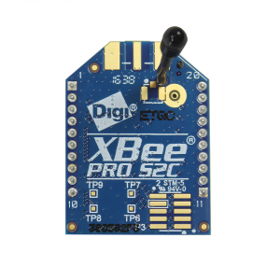
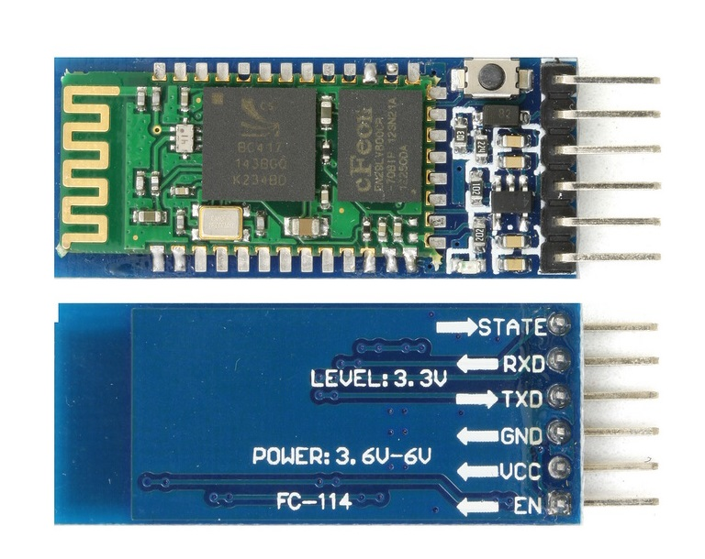
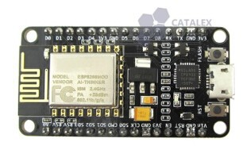
Different types of Wireless communication
Wide range (up to 1.6km) | Medium range | Easy to use Wide range (up to 4km) Cheap
Not cheap | Hard to configure Not cheap
Pros:
Cons:

Slide 6
The main components of the project
Development board
Msp432p401r
Sensors
DHT22, CJMCU-3216 AP3216,etc
Wireless device
NodeMCU ESP8266
Integrated development environment
Code Composer Studio

Slide 7
Sensors -> MCU
DHT22
Read temperature and humidity
One wire connection to the trough the 5.5 GPIO pin
MCU sends start signal - DHT22 changes state from low power to run mode - DHT22 sends back data (humidity-temperature).
CJMCU-3216 AP3216
Digital Ambient Light Sensor
I2C Interface
Description:

Slide 8
MSP432 -> NodeMCU
Hardware Connections:
-> MSP: RX -> pin 3.2
TX -> pin 3.3
-> NodeMCU: RX -> pin D5
TX -> pin D6
MSP runs a code that sends data through UART on pins 3.2 and 3.3
NodeMCU runs a code that reads data through UART on pins D5 and D6

Slide 9
NodeMCU -> Server
NodeMCU runs a code that sends data through Wi-Fi to a remote Server
The Server code is running and awaits for clients
The Client already knows the host name and the password
Once the connection is established, the data sent by the NodeMCU is received by the Server and printed in the terminal.

Slide 10
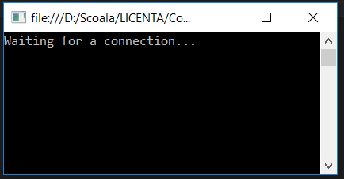
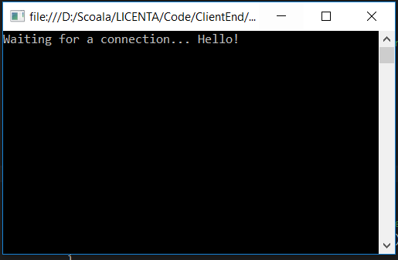
NodeMCU -> Server
1
…
HostName
2
Password
data

Slide 11
Thank you!

