Slide 1
Data Acquisition System
Vladoiu Grigore
Nandra Mihnea

Slide 2
Introduction
What are the requirements?
How many of the requirements did we accomplish?
Future work
What is left to be done?

Slide 3
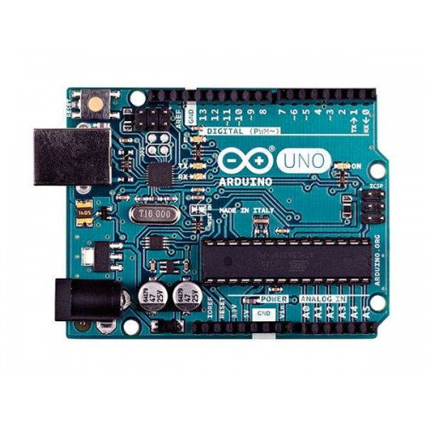
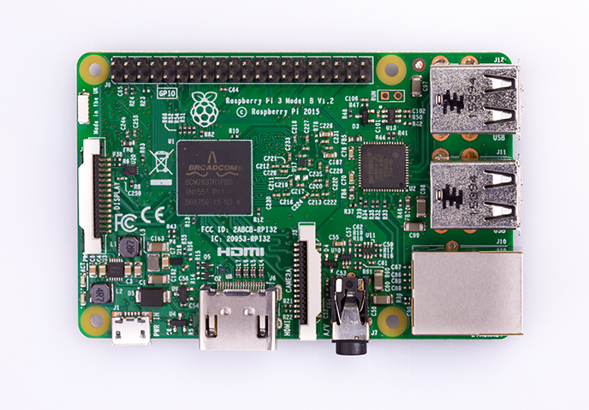
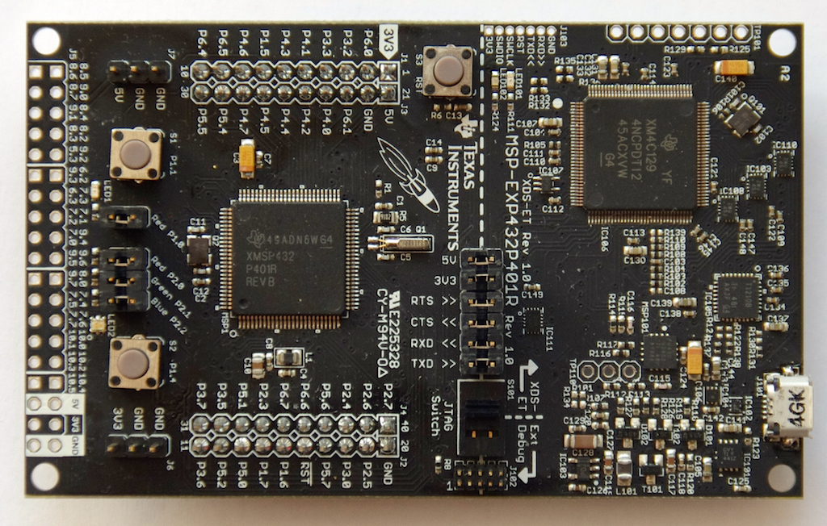
Different types of devboards
A
Wide-spread Cheap Well documented Easy to use | Wide-spread Well documented Lots of resources Versatile | Low-Power Cheap DriverLib
Not Low-Power No wireless communication | Not that cheap Uses lots of energy | Not a lot of examples No wireless communication
Pros:
Cons:

Slide 4
MSP432 Sleep Modes
Active Mode -> 80 μA/MHz
Low-Frequency Active -> 83 μA at 128 kHz
LPM3(with RTC) -> 660 nA
LPM3.5(with RTC) -> 630 nA
LPM4 -> 500 nA
LPM4.5 -> 25 nA

Slide 5
Used sensors
DHT22
-Low cost
-2.5mA max current use during conversion (while requesting data)
-0 to 100% humidity reading with 2-5% accuracy
-0 to 80°C temperature readings ±0.5°C accuracy
CJMCU-3216 AP3216
-Low cost
-Ambient Light Photo Sensor
- 4 user selectable dynamic range
-Proximity Detector
-170-700 uA power consumption

Slide 6
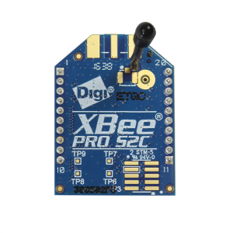
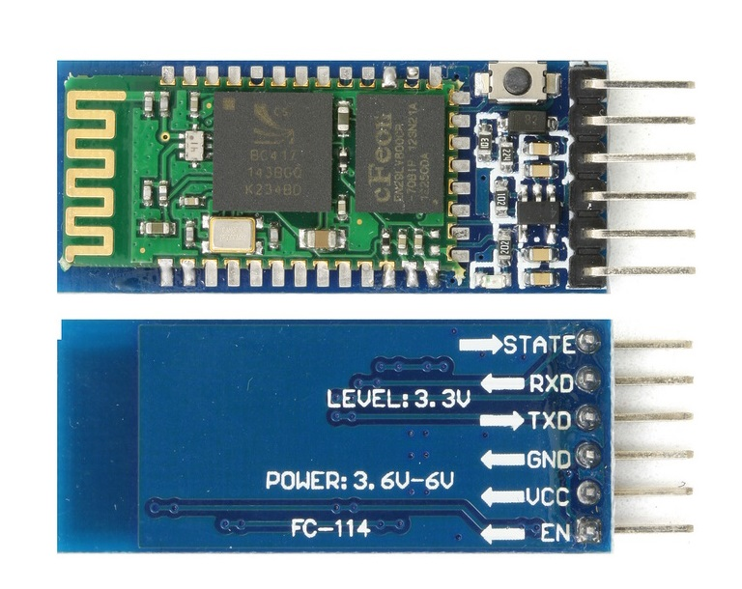
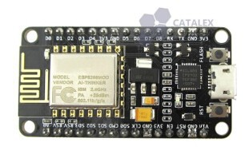
Available solutions for Wireless communication
Wide range (up to 1.6km) Uses Wi-Fi | Medium range (up to 30m) | Easy to use Wide range (up to 4km) Cheap
Not cheap Consumes a lot of energy | Hard to configure Not cheap | Consumes a lot of energy
Pros:
Cons:

Slide 7
Comparisons

Slide 8
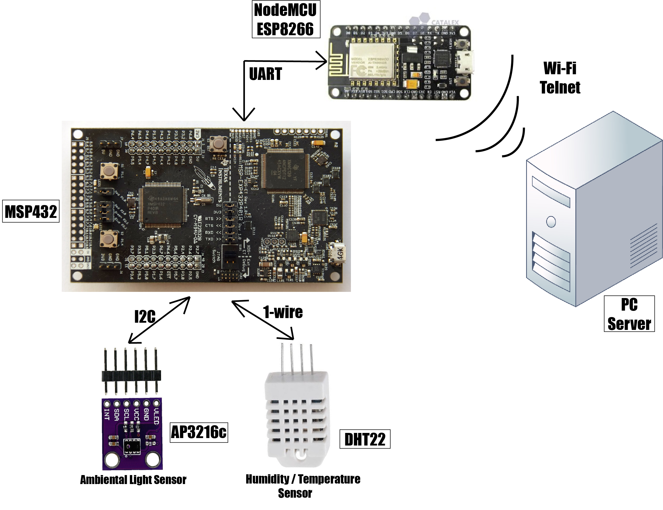
System Overview

Slide 9
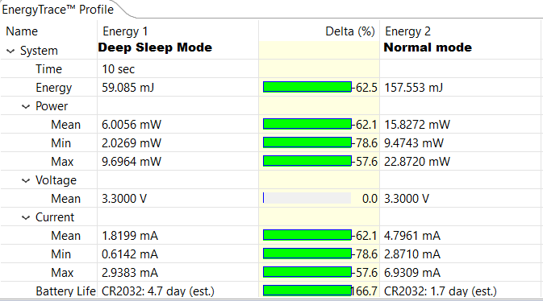
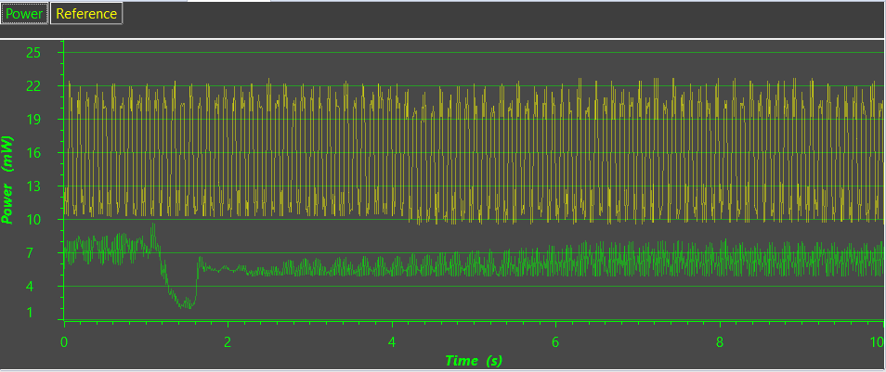
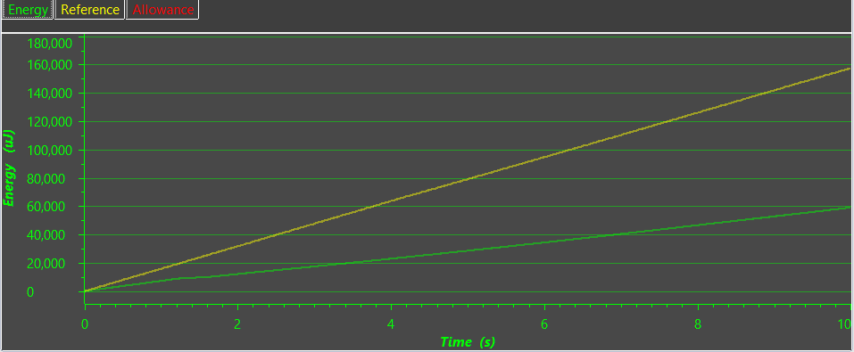
Power Consumption Measurement

Slide 10
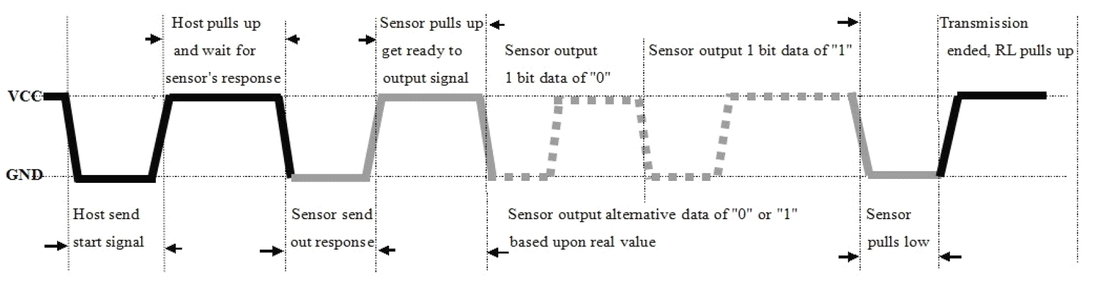
Sensors -> MCU
DHT22
Read temperature and humidity
1-wire connection
MCU sends start signal - DHT22 changes state from low power to run mode - DHT22 sends back data (humidity-temperature).
CJMCU-3216 AP3216
Digital Ambient Light Sensor
I2C Interface
Description:

Slide 11
MSP432 -> NodeMCU
Hardware Connections:
-> MSP: RX -> pin 3.2
TX -> pin 3.3
-> NodeMCU: RX -> pin D5
TX -> pin D6
MSP runs a code that sends data through UART on pins 3.2 and 3.3
NodeMCU runs a code that reads data through UART on pins D5 and D6

Slide 12

NodeMCU -> Server
NodeMCU runs a code that sends data through Wi-Fi to a remote Server
The Server code is running and awaits for clients
The Client already knows the host name and the password
Once the connection is established, the data sent by the NodeMCU is received by the Server and printed in the terminal.
…
HostName
1
Password
2
data

Slide 13
Summary
The system gathers information from the environment about light, temperature and humidity from 2 sensors.
The data is read from the sensors to the Microcontroller on I2C(AP3216) or 1-wire(DHT22)
After this, the MCU sends the data on UART to the ESP8266
Once the data is stored in the ESP8266 RAM, it will be sent via Wi-Fi to the server running on the PC
The server reads the data and stores it in a .csv file

