Slide 1
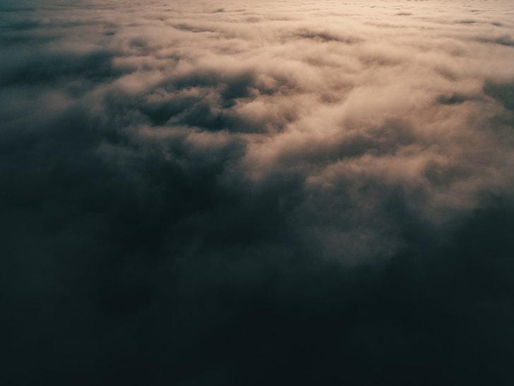
This Is My Father’s World
Words by Maltbie D. Babcock
Music by Franklin L. Sheppard
Words and Music public domain

Slide 2
This is my Father’s world, and to my list’ning ears

Slide 3
All nature sings and round me rings the music of the spheres.

Slide 4
This is my Father’s world. I rest me in the thought

Slide 5
Of rocks and trees, of skies and seas, His hand the wonders wrought.

Slide 6
This is my Father’s world. The birds their carols raise.

Slide 7
The morning light, the lily white, Declare their Maker’s praise.

Slide 8
This is my Father’s world. He shines in all that’s fair.

Slide 9
In the rustling grass, I hear Him pass. He speaks to me ev’rywhere.

Slide 10
This is my Father’s world! O let me ne’er forget

Slide 11
That tho’ the wrong seems oft so strong, God is the Ruler yet.

Slide 12
This is my Father’s world. The battle is not done.

Slide 13
Jesus who died shall be satisfied and earth and heaven be one.

Slide 14
This is my Father’s world. The battle is not done.

Slide 15
Jesus who died shall be satisfied and earth and heaven be one. (repeat)

