Slide 1
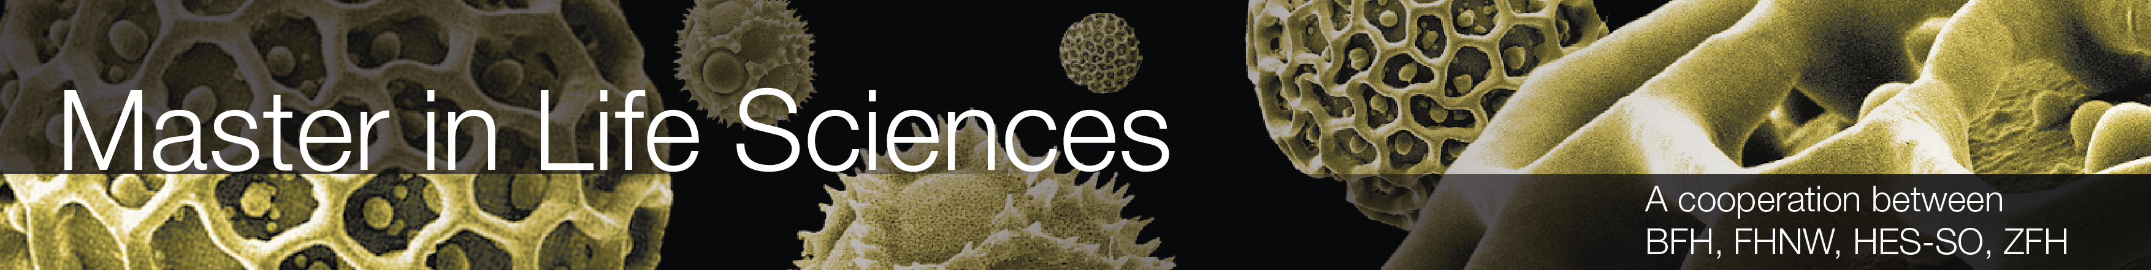
Presentation of day 1
By group 3:
Näf Adrian, Pesen Pelin, Polini Elisa, Schürch Stefanie, Späne Philipp, Genilloud Franck, Lemus Rodriguez Jony Alejandro, Nicollier Alexandre, Noël Jérémie, Pantelidis Alexandros, Khan Salman Khan, Kölbener Christa, Kreuzer Jan, Kuleta Natalia Karolina, Lopez Sosa Alejandra, Memeti Nurdzane, Zuković Dženneta, Müller Benjamin, Nedic Maja, Xaaji Yusuf
Design of Biopharmaceutical Production Facilities

Slide 2
Calculations

Slide 3
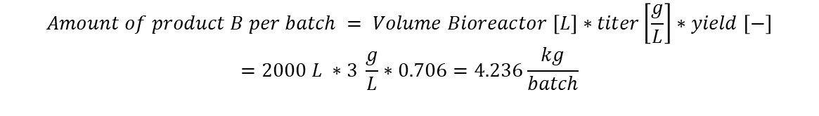
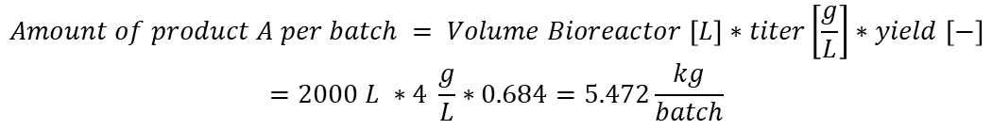
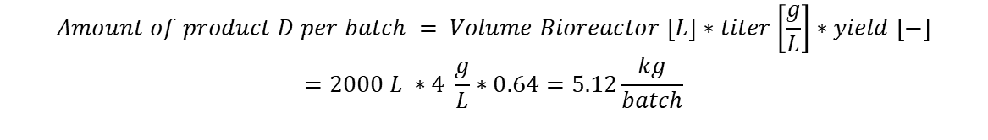
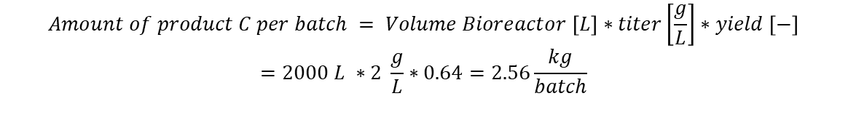
Amount of product per batch
$$Amount of product A per batch = Volume Bioreactor \left[L\right]∗titer\left[\frac{g}{L}\right]∗yield \left[−\right]$$
$$=2000 L ∗4 \frac{g}{L}∗0.684=5.472\frac{kg}{batch}$$
$$Amount of product B per batch = Volume Bioreactor \left[L\right]∗titer\left[\frac{g}{L}\right]∗yield \left[−\right]$$
$$=2000 L ∗3 \frac{g}{L}∗0.706=4.236\frac{kg}{batch}$$
$$Amount of product C per batch = Volume Bioreactor \left[L\right]∗titer\left[\frac{g}{L}\right]∗yield \left[−\right]$$
$$=2000 L ∗2 \frac{g}{L}∗0.64=2.56\frac{kg}{batch}$$
$$Amount of product D per batch = Volume Bioreactor \left[L\right]∗titer\left[\frac{g}{L}\right]∗yield \left[−\right]$$
$$=2000 L ∗4 \frac{g}{L}∗0.64=5.12\frac{kg}{batch}$$

Slide 4

Sum of batches for 320 days production
$$Total batches per year=\sum{\frac{Amount of product per batch \left[\frac{kg}{batch}\right]}{Required amount per year \left[\frac{kg}{year}\right]}}= \frac{5.472 kg}{100 kg}+\frac{4.236 kg}{70 kg}+\frac{2.56 kg}{70 kg}+\frac{5.12 kg}{40 kg}=19+17+28+8=72$$

Slide 5
Calculations for USP
Addition of 1 day in each step is for the cleaning and preparation of the utilities
$$Number of batches \left[−\right]=\frac{operational readiness \left[d\right] }{length of production in bioreactor\left[d\right]}=\frac{320 d −13 d}{11 d}=27.909 ≈28$$
$$Number of bioreactor lines\left[−\right]=\frac{number of batches \left[−\right]∗length of a batch \left[d\right]}{operational readiness \left[d\right]}=\frac{28 ∗24. 075 d}{320 d}=2.099 ≈3$$
$$Number of seed lines\left[−\right]=\frac{number of bioreactor lines\left[−\right]∗length of a seeding process \left[d\right]}{length of production in bioreactor\left[d\right]}=\frac{3 ∗(3+1) d}{(11+1) d}=1$$
$$Number of inoculum lines\left[−\right]=\frac{number of bioreactor lines\left[−\right]∗length of an inoculum process \left[d\right]}{length of production in bioreactor\left[d\right]}=\frac{3 ∗(7+1) d}{(11+1) d}=2$$

Slide 6
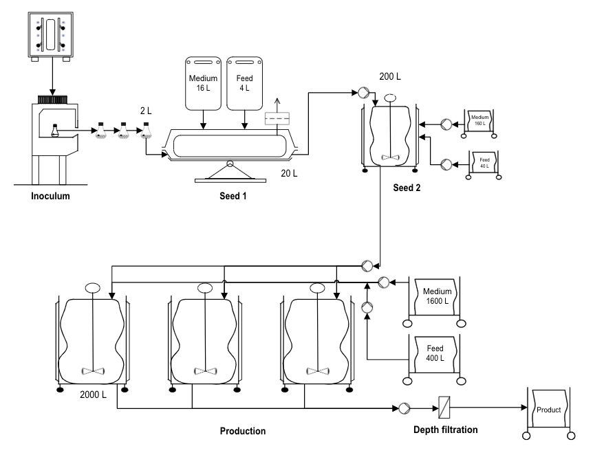
USP - Plant on a Page

Slide 7
Plant on a Page – Blockflow diagram
1 |  | Volume L |  | Inoculum production | Duration (day) | Equipment
 | Medium | 2 |  | Passage 1 | 2 | Shake flasks
 |  |  |  | Passage 2 | 2
 |  |  |  | Passage 3 | 3
 | Total | 2 |  |  | 7
2 |  |  |  | Seed 1
 | Medium | 16 |  |  | 3 | Seed bioreactor (Wave 50 L)
 | Feed medium | 4
 | Total | 20 |  |  | 10
3 |  |  |  | Seed 2
 | Medium | 160 |  |  | 3 | Seed bioreactor (STR 200L)
 | Feed medium | 40
 | Total | 200 |  |  | 13
4 |  |  |  | Production | 11 | STR 2000 L Single-Use
 | Medium | 1600
 | Feed medium | 400
 | Total | 2000 |  |  | 24
5 |  |  |  | Depth filtration | 0.075 | Depth filter
 | Total |  |  |  | 24.075

Slide 8
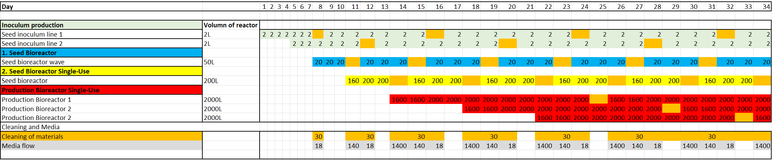
Occupancy List
Occupancy list is made for 34 days
Staggered production
The required amount of medium and cleansers are written

Slide 9
List of necessary facility utilites
Clean Utilities | Technical Utilities (Black Utilities)
Water for Injection (WFI) | Wastewater Collection/ Inactivation (Bio / non-Bio)
Purified Water (PW) | Water (Portable, Cooling, Heating and Fire Water)
Clean Steam | Compressed Air
Clean Compressed air | HVAC
Process Air | Electrical Power
Process Gases (N₂, H₂O₂, O₂, CO_{2^}) | Technical Steam (Black Steam – Fresh / Used)
 | Waste (Plastics / Paper / Other)
 | Gasoline
 | Nitrogen Liquid

Slide 10
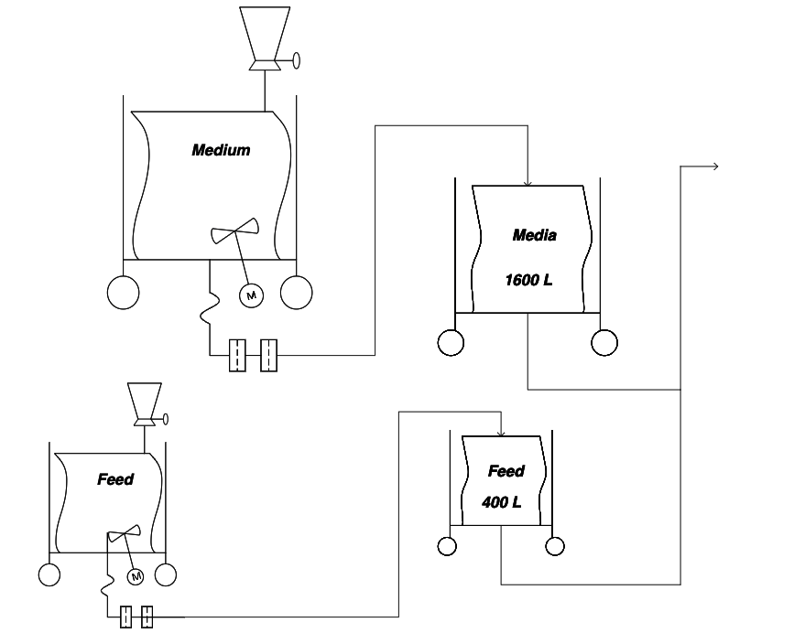
Media preparation

Slide 11
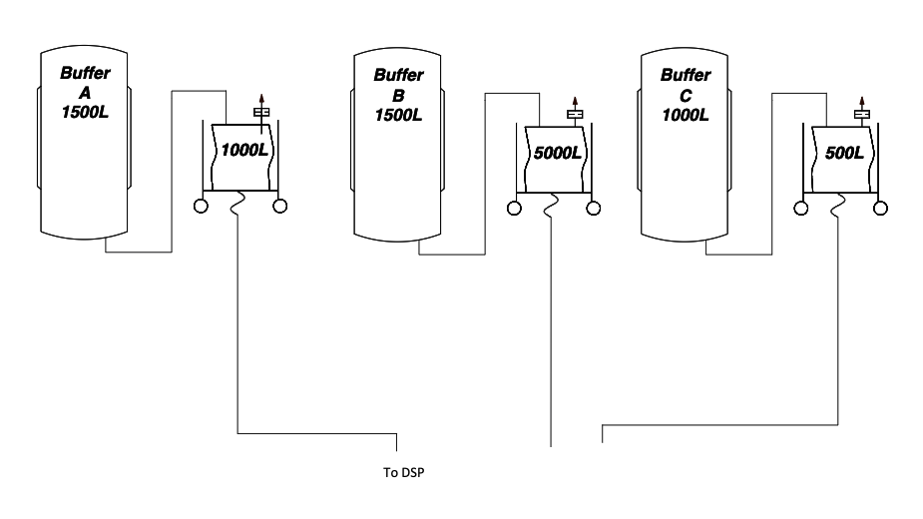
Buffer preparation

