Slide 1

Presentation of day 2
By group 3:
Näf Adrian, Pesen Pelin, Polini Elisa, Schürch Stefanie, Späne Philipp, Genilloud Franck, Lemus Rodriguez Jony Alejandro, Nicollier Alexandre, Noël Jérémie, Pantelidis Alexandros, Khan Salman Khan, Kölbener Christa, Kreuzer Jan, Kuleta Natalia Karolina, Lopez Sosa Alejandra, Memeti Nurdzane, Zuković Dženneta, Müller Benjamin, Nedic Maja, Xaaji Yusuf
Design of Biopharmaceutical Production Facilities

Slide 2
Area schedule
Area | Room | Equipment | BSL | Hygienic zone | Level
Utilities | Heating/Cooling system |  | - | - | Basement
Utilities | Waste treatment |  | - | - | Basement
Utilities | WFI/Steam Production |  | - | - | Basement
Utilities | Gas Room |  | - | - | Basement
Utilities | Emergency Generators |  | - | - | Basement
Media | Medium preparation | 1000L tank, 2000L tank |  | D | Ground floor
Media | Medium cold storage |  |  | D | Ground floor
Media | Buffer preparation | 50L, 100L, 500L, 1000L, 1500L, 2000L, 3000L tanks |  | D | Ground floor
Media | Buffer cold storage |  |  | D | Ground floor
USP | Material Airlock Inoculation Lab |  |  | C | Ground floor
USP | Personnel Airlock Inoculation Lab |  |  | C | Ground floor
USP | Inoculum Production lab | Freezer -80°C, laminar flow hood, incubator | 1 | C | Ground floor
USP | Cell expansion, Production | 20L Wave , 200L STR (SU), 2000 STR (SU) bioreactors | 1 | D | Ground floor
USP | Material Airlock USP |  | - | D | Ground floor
USP | Personnel Airlock Men USP |  | - | D | Ground floor
USP | Personnel Airlock Women USP |  | - | D | Ground floor
USP | Corridor |  |  | D | Ground floor
DSP | Personnel Airlock men DSP V+ |  | -
DSP | Personnel Airlock women DSP V+ |  | -
DSP | Personnel Airlock men DSP V- |  | -
DSP | Personnel Airlock women DSP V- |  | -
DSP | DSP room V+ |  | -
DSP | DSP room V-
Warehouse | Warehouse |  |  | -
Raw material lab | Raw material lab |  | - | -
HVAC | HVAC |  | - | -
Facility Management | Reception |  | - | -
Facility Management | Offices |  | - | -
Facility Management | Cafeteria |  | - | -
Facility Management | Toilets Men |  | - | -
Facility Management | Toilets Women |  | - | -
Facility Management | Stairs |  | - | -
Facility Management | Elevator |  | - | -
Facility Management | Data Storage |  | - | - | Basement

Slide 3
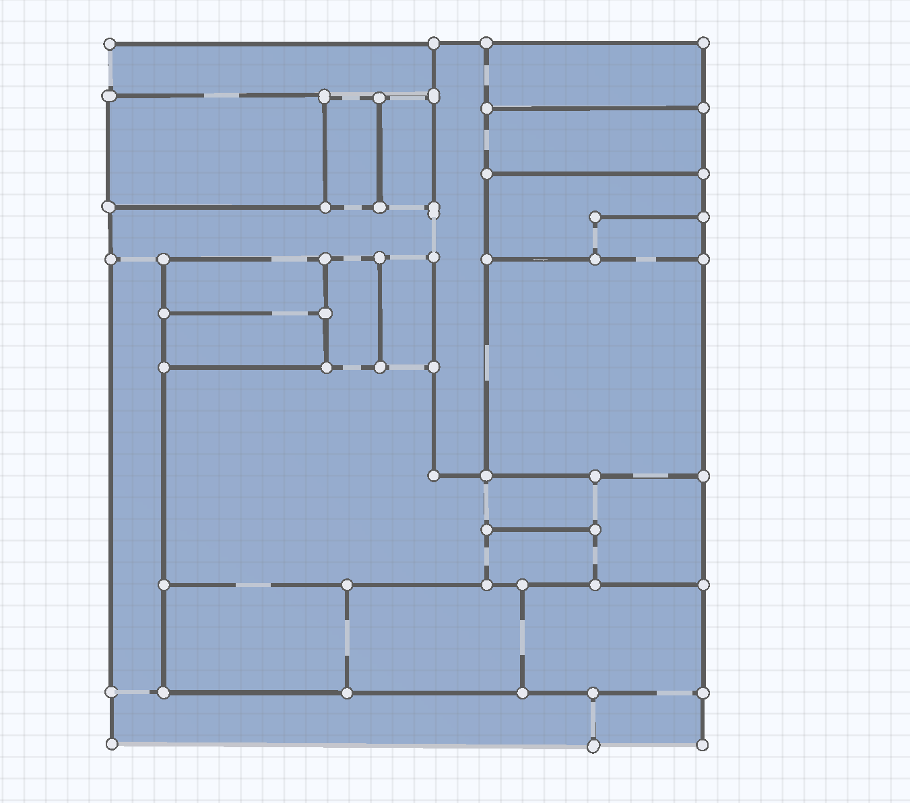
Corridor (CnC)
Mediaprep (D)
Zone concept
Administration (CnC)
Mediastorage (D)
Airl.
Airl.
Corridor (D)
Innokulum (C)
Corridor (D)
Airl.
Bufferprep (D)
Airl.
Airl.
Bufferstorage (D)
USP Production (D)
Corridor (D)
DSP V+ (C)
Airl.
Qualitycontrol (D)
Airl.
DSP V- (C)
DSP washing V- (C)
DSP storage V- (C)
Corridor (D)
Airl.

Slide 4
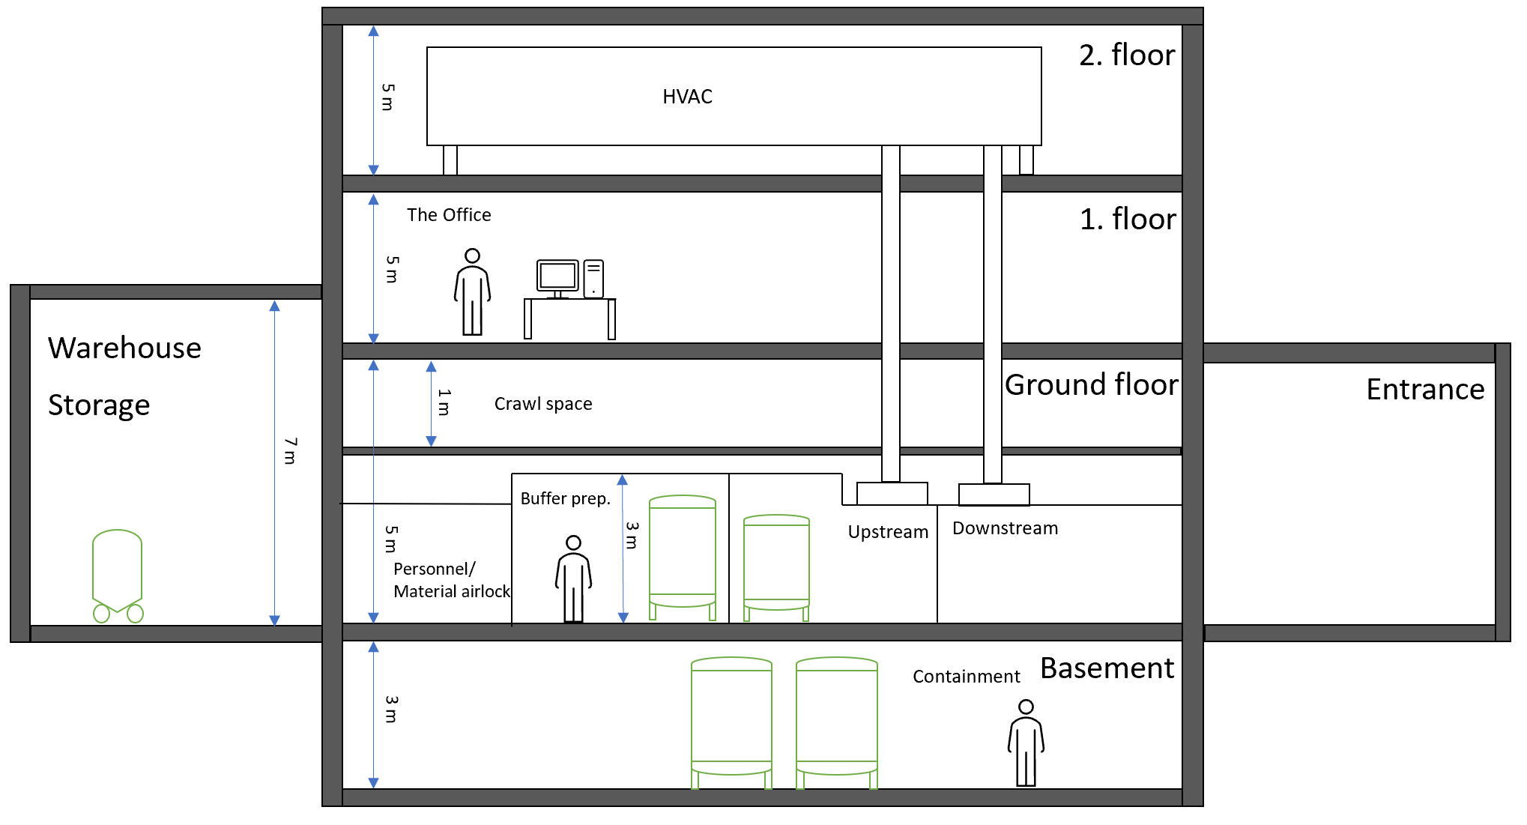
Height concept

