Slide 1

Presentation of day 3
By group 3:
Näf Adrian, Pesen Pelin, Polini Elisa, Schürch Stefanie, Späne Philipp, Genilloud Franck, Lemus Rodriguez Jony Alejandro, Nicollier Alexandre, Noël Jérémie, Pantelidis Alexandros, Khan Salman Khan, Kölbener Christa, Kreuzer Jan, Kuleta Natalia Karolina, Lopez Sosa Alejandra, Memeti Nurdzane, Zuković Dženneta, Müller Benjamin, Nedic Maja, Xaaji Yusuf
BP3 Design of Biopharmaceutical Production Facilities

Slide 2
Zone concepts part 2

Slide 3

D Class
Entrance
Elevator
Stairs
C Class
Media prep
Media
storage
CNC
Administration
Personnel Airlock
Material Airlock
Corridor
NC
Warehouse
Inokulum
Personal
Material Airlock
Product
Corridor
Personnel Airlock
Waste
Material
USP Production
Buffer prep
Buffer storage
DSP V+
Material Airlock
USP harvest
Text hinzufügen
Personnel Airlock
Corridor
Personnel Airlock
DSP Polishing V+
DSP storage
Quality Control
Stairs
Elevator
Personnel Airlock
DSP V-
Personnel Airlock

Slide 4
Size of systems and functions

Slide 5
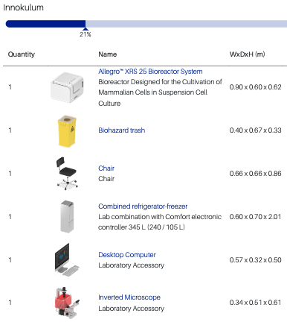
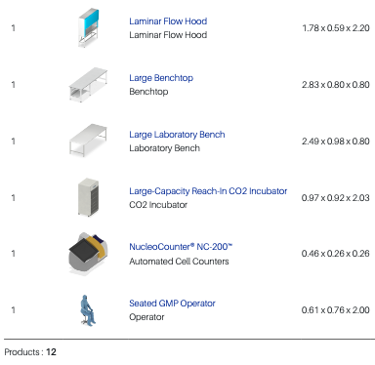

Slide 6
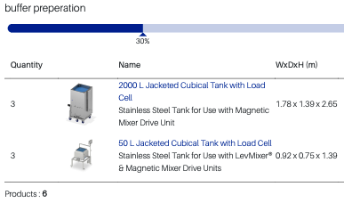
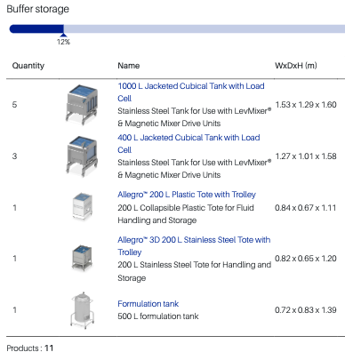

Slide 7
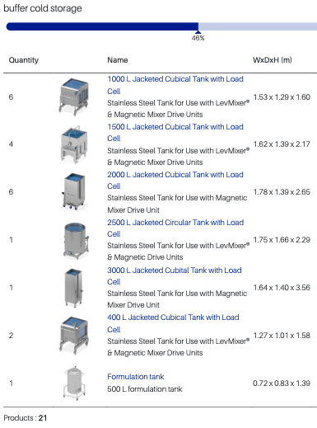

Slide 8
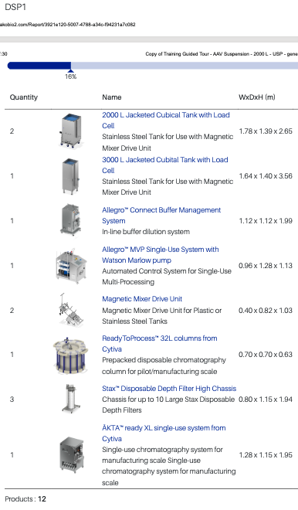
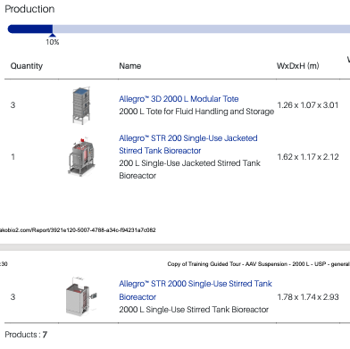

Slide 9
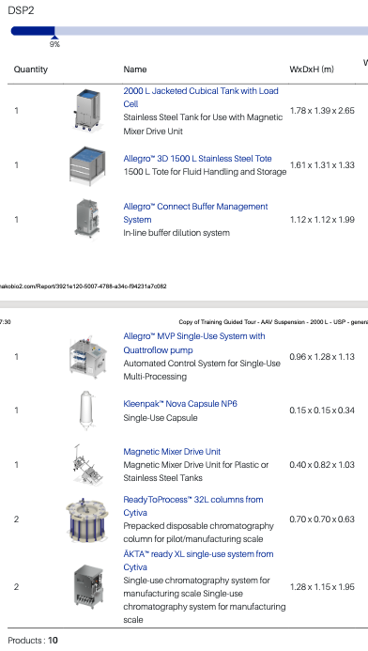
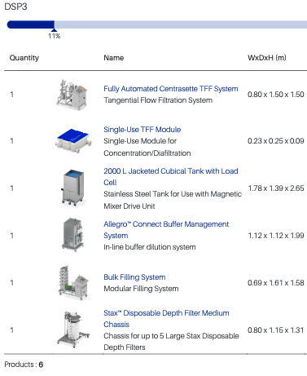

Slide 10
Accelerator Vision Platform (HakoBio)

Slide 11
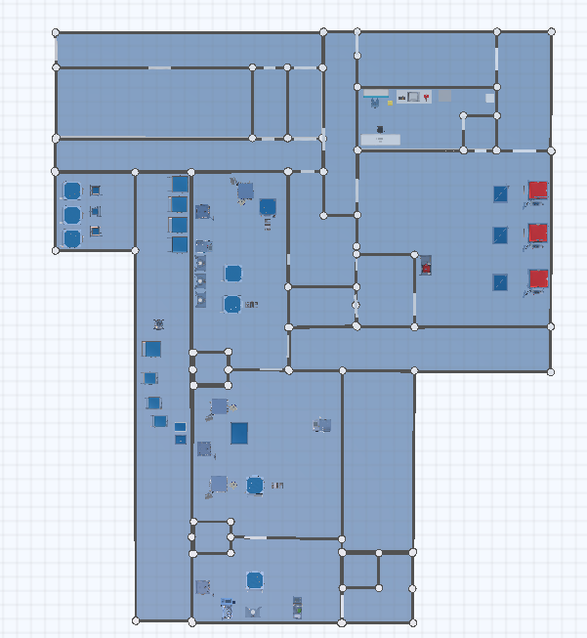
Accelerator Vision Platform (HakoBio)

Slide 12
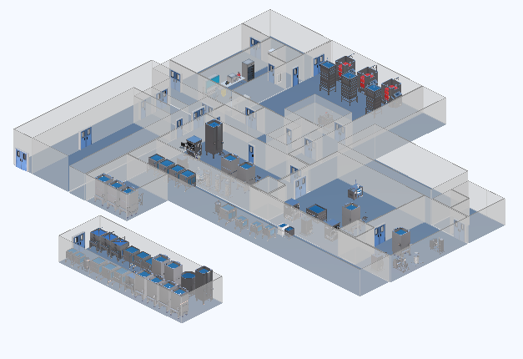
Accelerator Vision Platform (HakoBio)

Slide 13
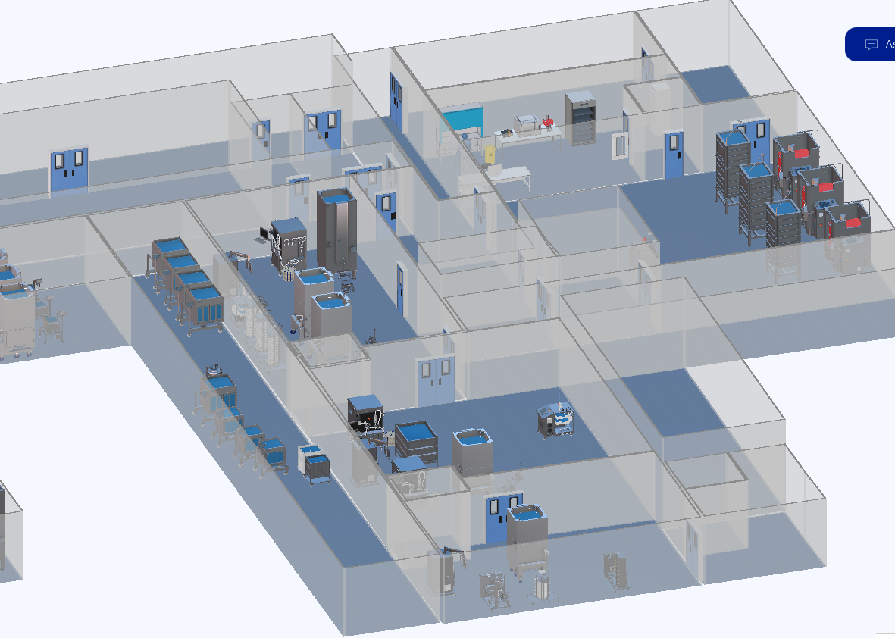
Accelerator Vision Platform (HakoBio)

