Slide 1

Presentation of day 4
By group 3:
Näf Adrian, Pesen Pelin, Polini Elisa, Schürch Stefanie, Späne Philipp, Genilloud Franck, Lemus Rodriguez Jony Alejandro, Nicollier Alexandre, Noël Jérémie, Pantelidis Alexandros, Khan Salman, Kölbener Christa, Kreuzer Jan, Kuleta Natalia Karolina, Lopez Sosa Alejandra, Memeti Nurdzane, Zuković Dženneta, Müller Benjamin, Nedic Maja, Xaaji Yusuf
BP3 Design of Biopharmaceutical Production Facilities

Slide 2
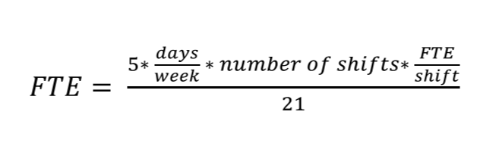
Staff estimation

Slide 3
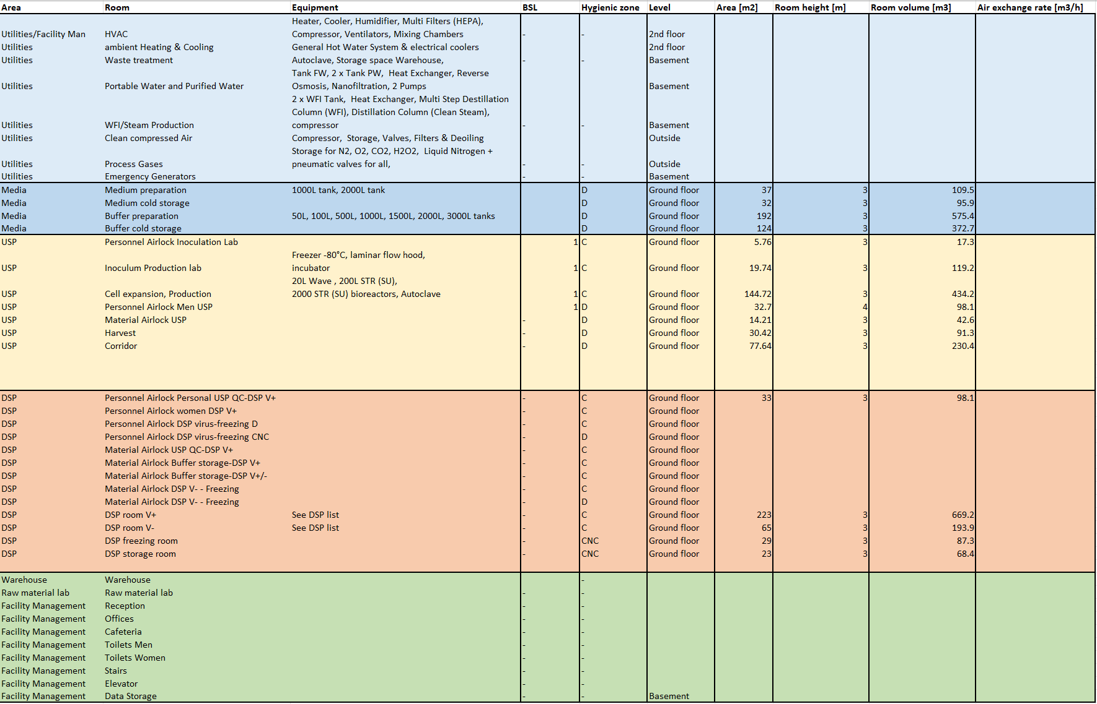
Room list

