Slide 1
Case Study: Machine Learning Model Regression – Real State
María E. Martín Fuentes
Data Analytics – Full Time
Ironhack Berlin
20th November 2020

Slide 2
Agenda
The project
Me facing the project
Conclusions
About the data
About myself

Slide 3
The project
Data Analyst at a real state company
Dataset: Sampling of sold houses during a year
Goals:
Machine learning model to predict the selling prices of houses
Which factors are responsible for higher property value - $650K and above?
Tools:
SQL – MySQLWorkbench
Python – Jupyter Notebook
Tableau
Trello/KANBAN
Time for the project: 4 days (16th – 19th Nov 2020)
The project
Me facing the project
Conclusions

Slide 4



Me facing the project
How I imagined it would go:
First day: SQL queries
Second day: Tableau
Third day: Python
Fourth day: Presentation and reviewing everything
How it actually went:
First day: SQL queries and started with Tableau
Second day: Tableau almost done and started with Python
Third day: Python
Fourth day: More Python, readme.md, reviewing
The project
Me facing the project
Conclusions

Slide 5
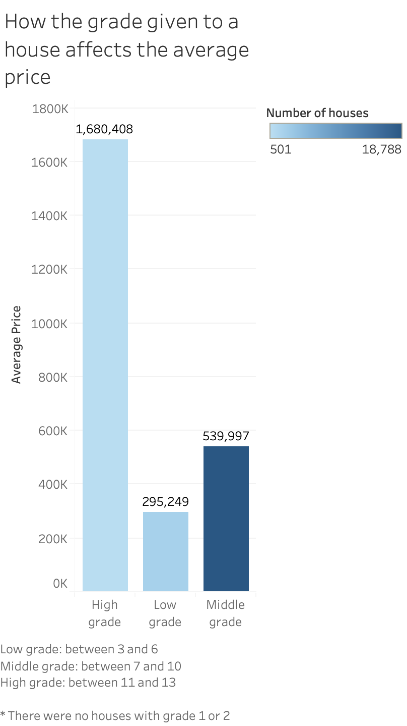
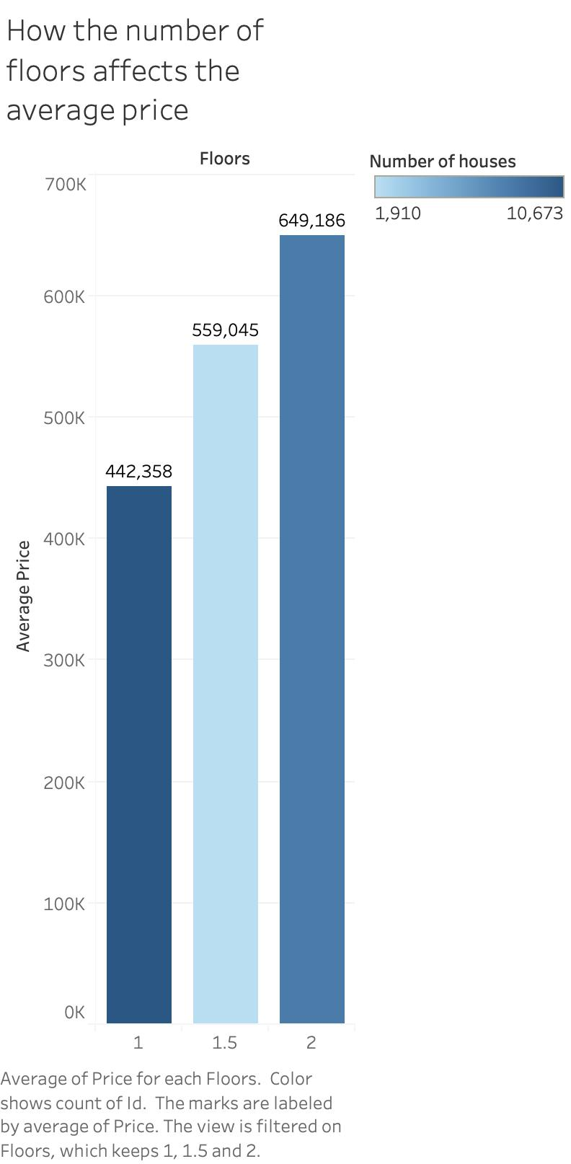
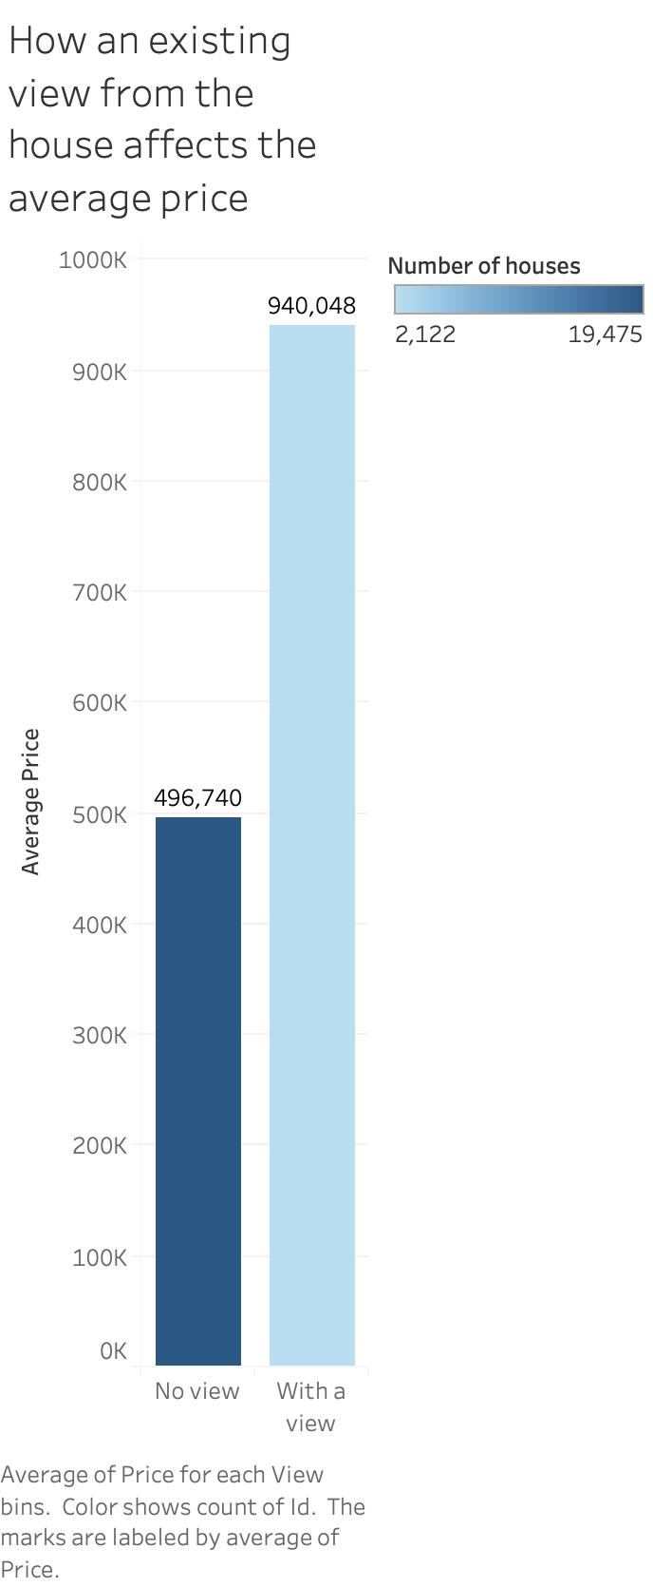
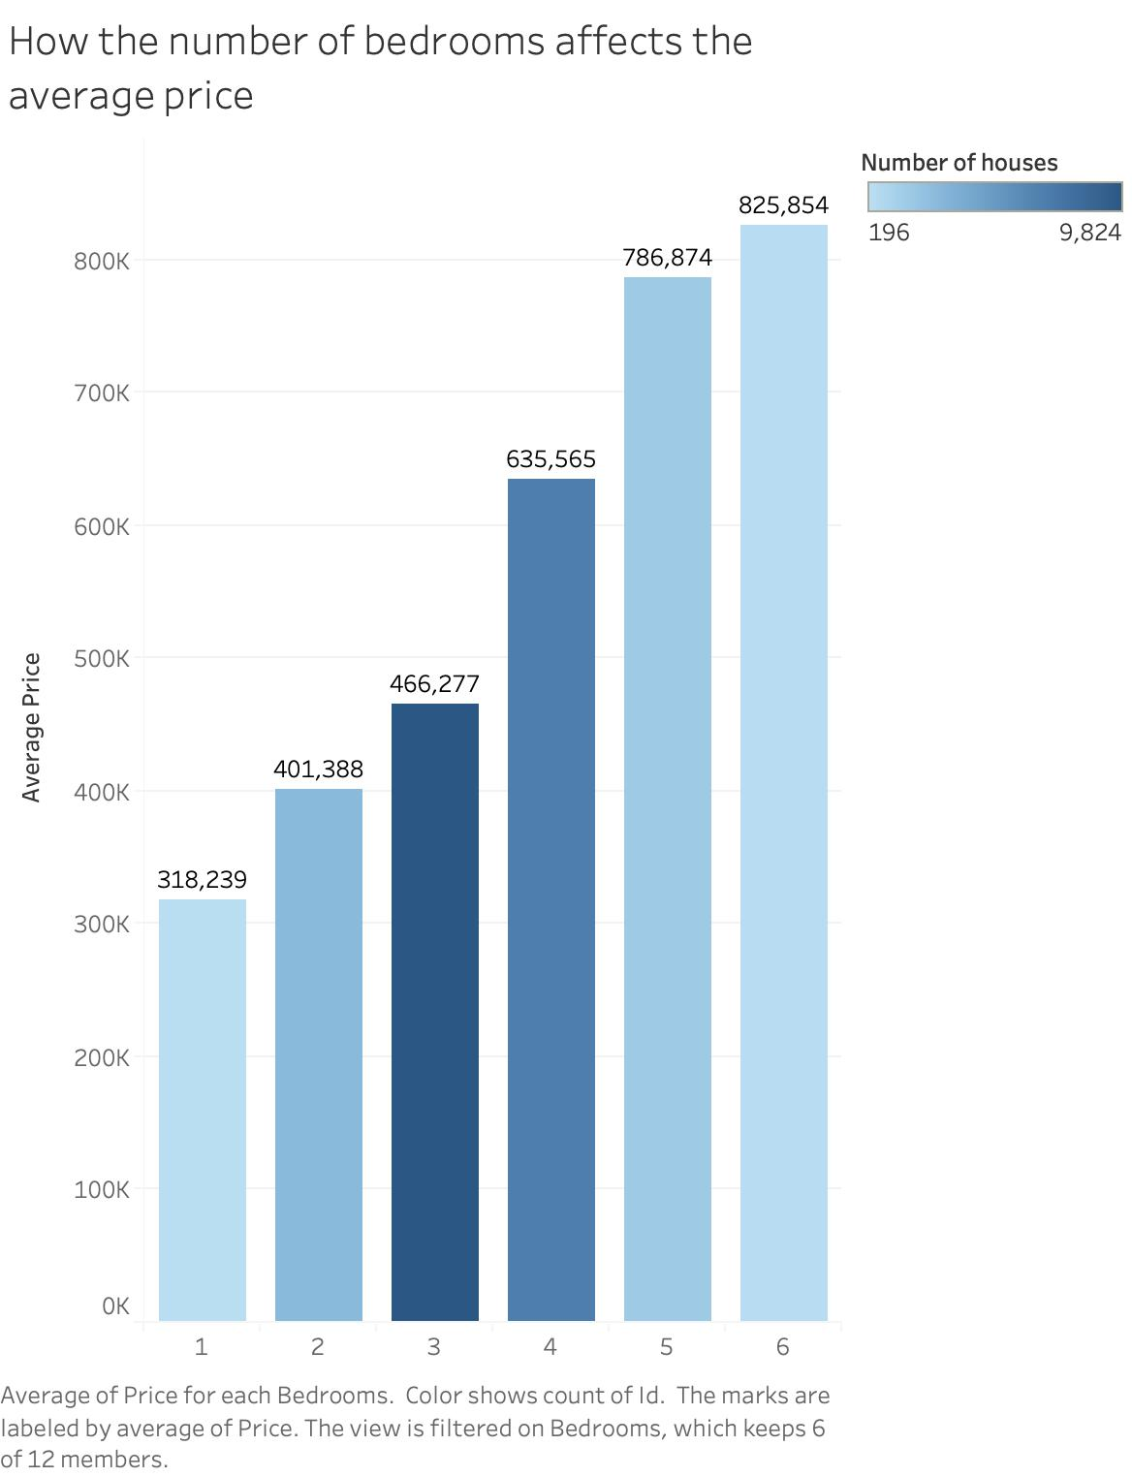
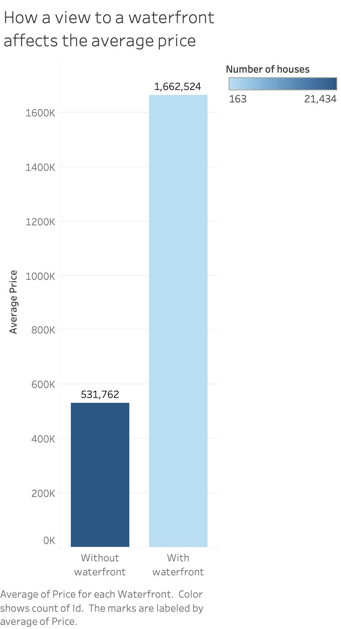
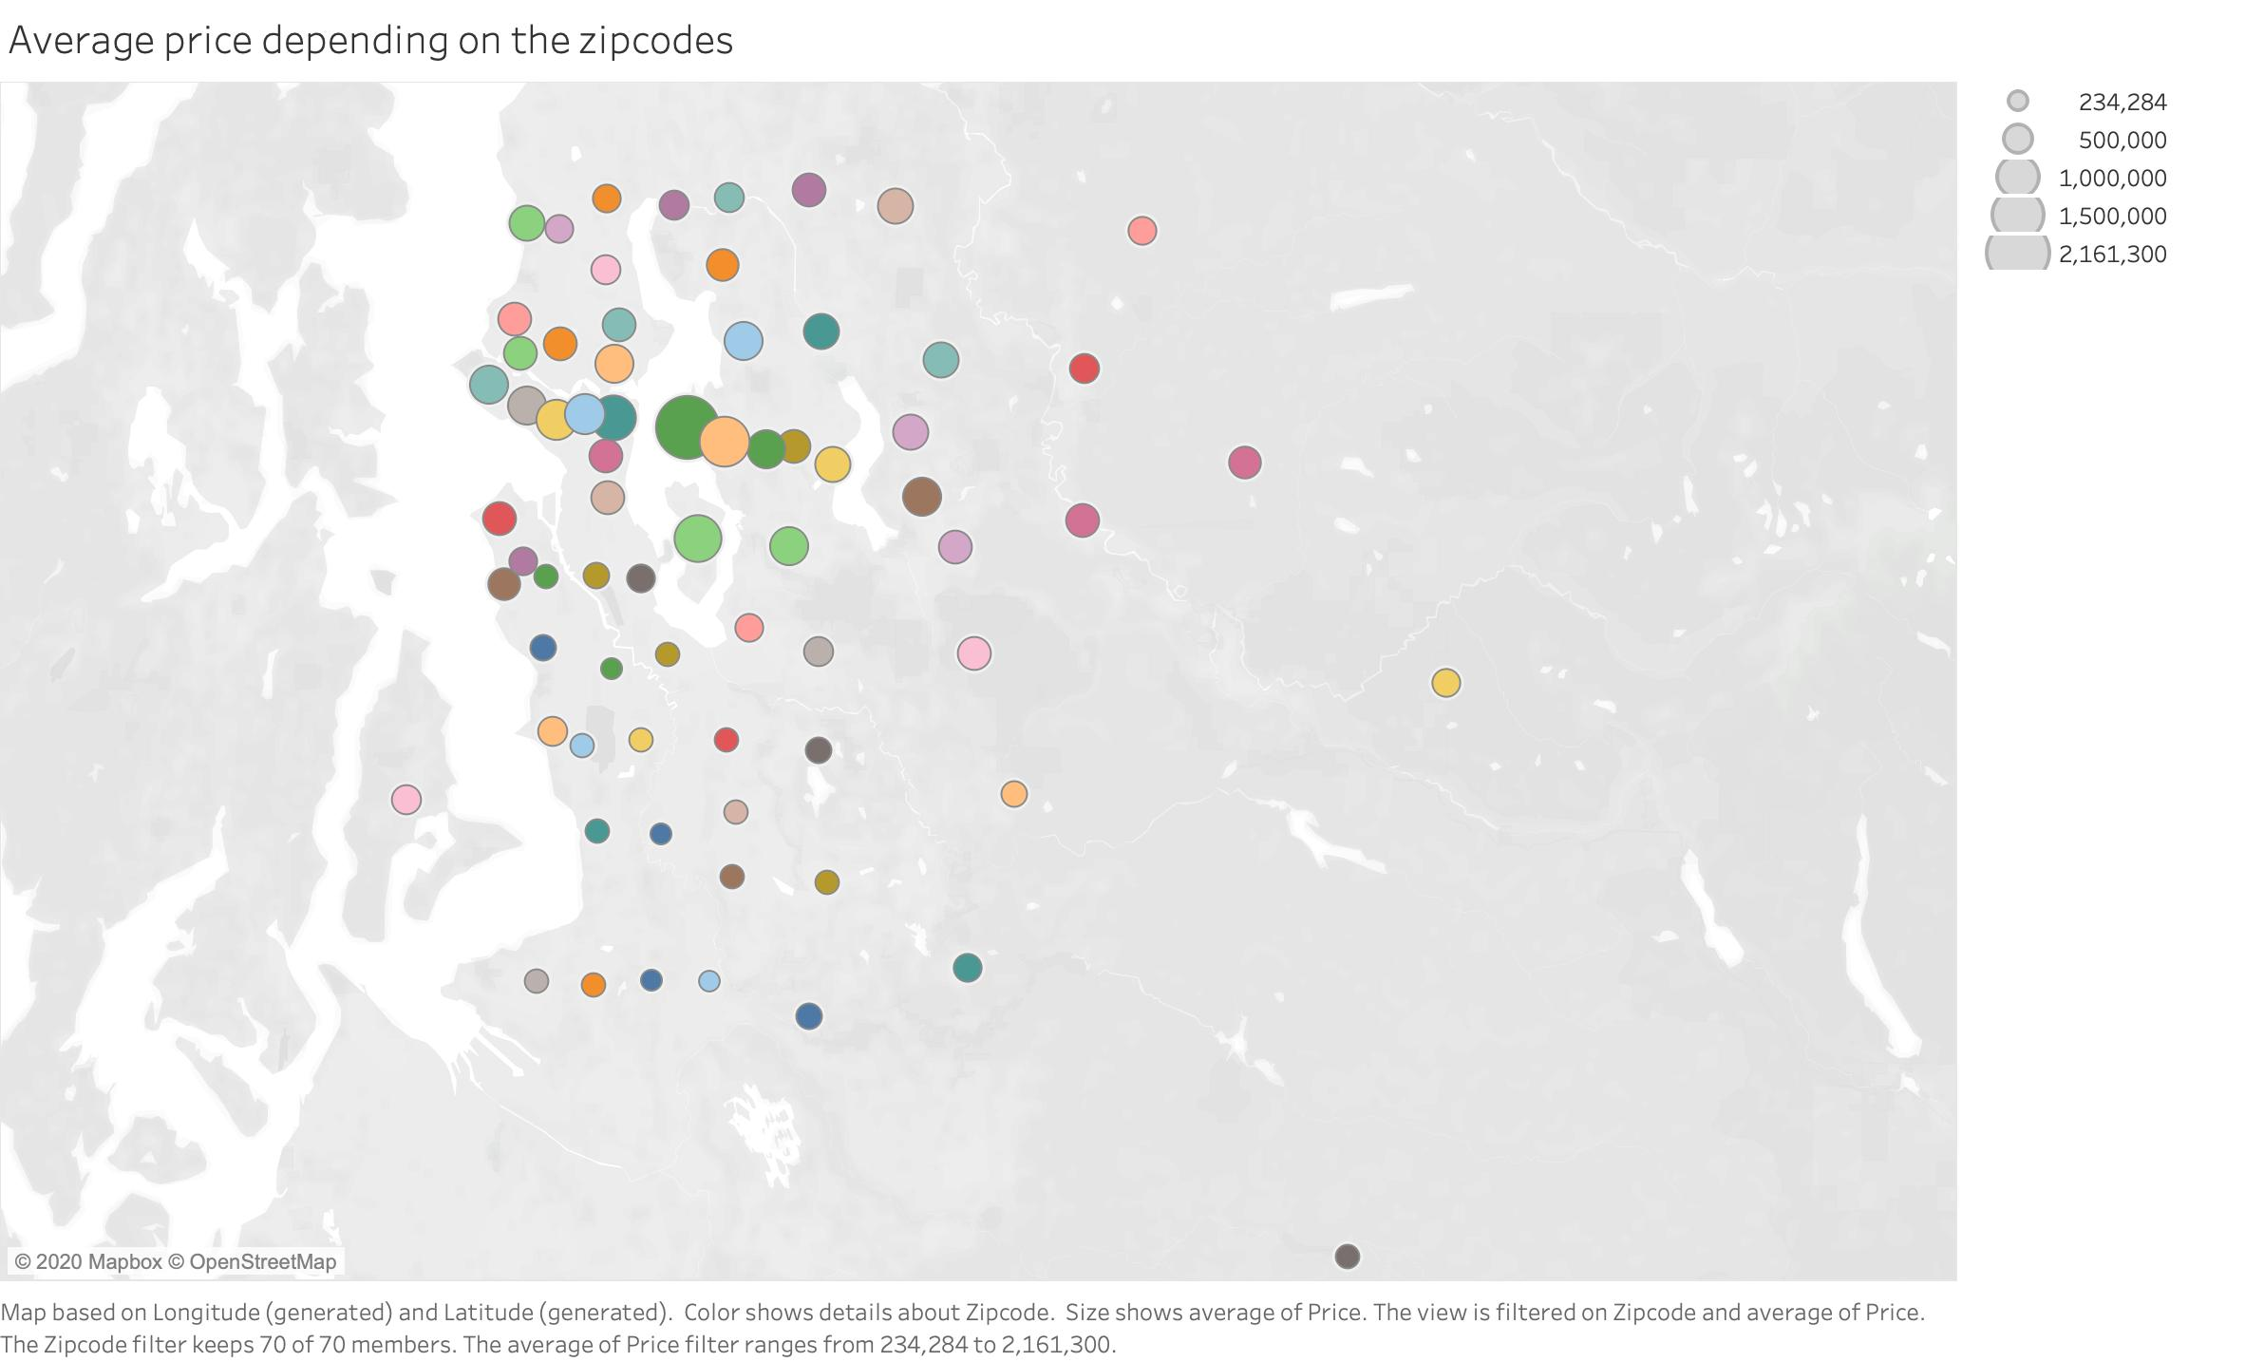
Conclusions about the data Factors affecting the housing prices: - grade - view - bedrooms - waterfront - floors - zip code
The project
Me facing the project
Conclusions
Notes:
The factors that affect the housing prices are:
Overall grade given to the housing unit, based on the King County grading system
Existing view from the house
Number of bedrooms
Existing view to a waterfront
Number of floors
Location (zip code)

Slide 6
Conclusions about myself
Full time project was challenging and great
Be kind to myself: knowledge is there (somewhere)
More comfortable with Python
Time buffers are important
Community is essential
The project
Me facing the project
Conclusions
Notes:
I know more than I thought
I really enjoy dedicating the whole time to a project
I don‘t feel so overwhelmed with Python as I did before the project
Time buffers are important

Slide 7


