Slide 1
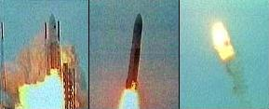
*Testing During Implementation (Schach, Chap 15)
Once Source Code Available, can test code's Execution
  Worst way — Random Testing: Plug in Arbitrary Input and see what happens.
  Needed — a Systematic Way of Developing Test Cases
Why make a big deal about testing? Why not just release software and fix it after delivery?
F-16 autopilot inverted aircraft when crossing the equator (found in simulator) (Neumann 86)
ESA lost Ariane 5 rocket due to numerical precision in inertial reference system (Gleick 96)
  64 bit floating point num for horizontal velocity converted to a 16 bit signed int. Conversion over 32,767 failed 37 seconds after liftoff ($500 Million).

Slide 2
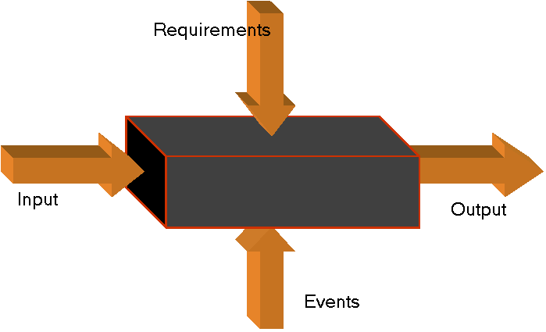
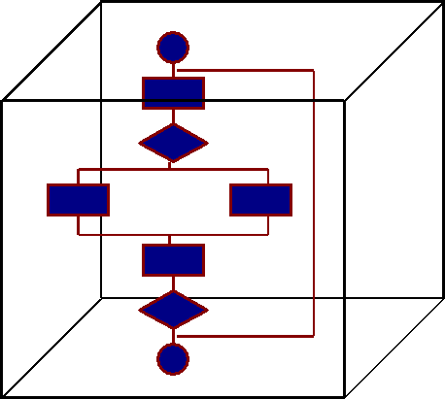
Two Approaches to Test Case Selection
Testing To Specifications (a.k.a Black-Box Testing aka functional testing) Focus: what module is supposed to do, not how it does it.
Testing To Code (aka Glass-Box Testing, logic-driven, or path-oriented testing).
  Focus: how code in module is structured, not what its supposed to do
  Only info used in design of test cases is the spec doc
Events: External Conditions that set the Context of the module
  The code itself is tested, w/o regard to specifications

Slide 3
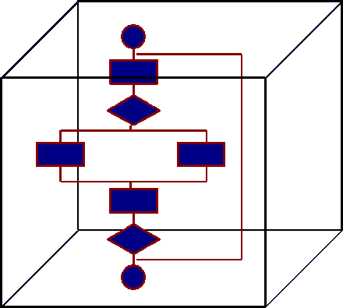
Role of Black/Glass Box focus in Test Case Dev
Once actual test case data set determined, what next?
Regardless as to whether black or glass box based, need the identify the following for each test case:
  What is being tested. Ex: myATM.deposit();
  How test data id’d Ex: User Scenario: deposit $10
  The actual input data. ????????
  The expected output. ????????
  The actual output. ????????
    Need to inspect what the software actually produces as output and compare with what was expected.

Slide 4
*Feasibility of Testing to Specifications
Combinatorial Explosion Makes Completely Testing to Specifications Impossible
  Example: Specifications For Data Processing Product Include 5 Types of Commission And 7 Types of Discount. How Many Total Test Cases are needed?
  Doesn’t matter if Commission and Discount computed in two entirely separate modules—the structure is irrelevant

Slide 5
*ICE: Feasibility of Completely Testing to Specifications
Suppose Specification Includes 20 Factors, Each of Which can Take On any of 4 Values
  Determine how many test cases would be needed to completely test to specification.

Slide 6
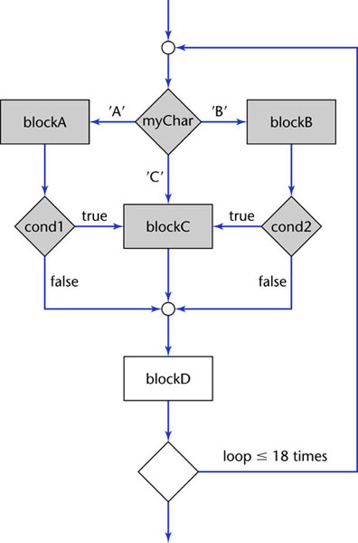
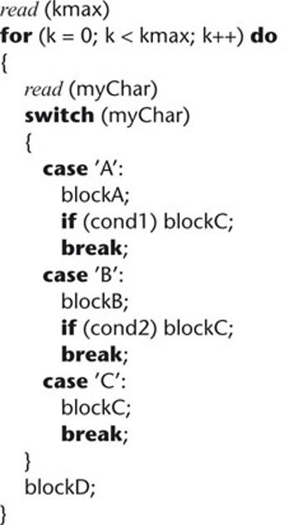
*What about the Feasibility of Testing to Code?
If it is desired that each Path through Module be executed at least once, Combinatorial Explosion May Result
// kmax in an int between 1..18
// myChar is A, or B, or C

Slide 7
*What Does Exercising Every Path Promise?
Is it Possible to exercise Every Path w/o detecting Every Fault? if ((x + y + z) / 3 == x)
  println ("x, y, z are equal in value");
  else
  println ("x, y, z are not equal");

Slide 8
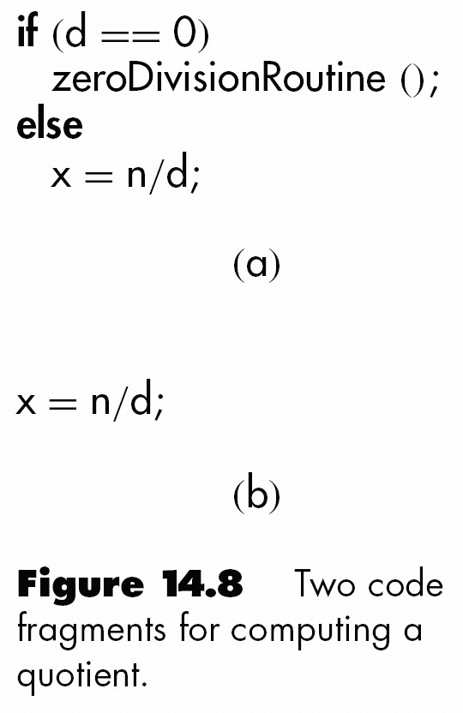
*More on the Feasibility of Testing to Code
A Path can be tested only if it is present
Weaker Criteria exist besides Path coverage:
  Branch Coverage: Exercise all branches of all conditional statements
  Statement Coverage: Execute every statement
How many paths through this code?

Slide 9
Complexity Metrics: Making Testing Manageable
Goal of Using a Software Complexity Metric:
  Highlight Modules Mostly Likely To Have Faults
Quality Assurance approach to Glass-Box Testing
  Would be beneficial to be able to say, “Module M1 is More “Complex” than Module M2”
Problem: what do you do when you discover an unreasonably high Complexity Value for a Module?

Slide 10
Lines of Code as a Complexity Metric
Simplest Complexity Measure; Underlying Assumption:
  There exists a Constant Probability p that Line of Code Contains Fault. Based on the idea that the past can be used to predict the future.
  Example:
    Tester Believes Line of Code Has 2% Chance of Containing Fault.
    Module Under Test is 100 Lines Long, Probably Contains 2 Faults

Slide 11
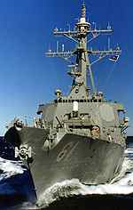
McCabe's Cyclomatic Complexity Metric
Cyclomatic Complexity Metric M (McCabe, 76)
  Essentially the Number of Decisions (branches) in Module
    M = #edges - #nodes +2
  Can be used as a Metric for predicting the # of Test Cases needed for Branch Coverage
M Value for Aegis System (Walsh,79)
  276 modules in Aegis
  23% of modules with M > 10 contained 53% of detected faults
  Modules with M > 10 had 21% more faults per line of code

Slide 12
ICE: Applying McCabe’s Metric
switch a {
case 1: x =3;
break;
case 2: if (b == 0)
x=2;
else
x=4;
break;
case 3: while (c>0)
process(c);
break;
}
Use statement to graph conversions
Count num edges (#e), num nodes (#n)
Compute McCabe’s Metric M = #e-#n+2
M > 10 is overly complex. Consider Re-designing Module
M value gives the recommended number of test cases needed for branch coverage.

Slide 13
Is Complete Black-Box/Glass-Box Testing Feasible?
The Art of Testing (after reducing complexity via analysis of McCabe’s metric and others):
  Want: A Small, Manageable Set Of Test Cases:
    Maximize Chances of Detecting Fault, While
    Minimizing Chances of Wasting Test Case
What relative (Black/Glass Box) ordering of Test Cases will highlight as Many Faults As Possible?

Slide 14
*Equivalence Testing and Boundary Value Analysis
Equivalence testing, combined with boundary value analysis, is a black-box technique of selecting test cases
  Goal: New test cases chosen to detect previously undetected faults.
  An equivalence class is a set of test cases such that any one member of the class is representative of any other member of the class.
    Assumes that any one member of the equivalence class is as good a test case as any other member of the class.
    Is this a good assumption? How are test cases selected?

Slide 15
*Equivalence Classes Example
Suppose Specifications For DBMS State that product must handle any number of Records between 1 and 16,383.
  Example: if System can handle 34 Records and 14,870 Records, then probably will work fine for 8,252 Records
Basic idea: If system works for a test case in range (1..16,383), then will probably work for any other test case in range; don’t bother with nearly redundant testing.

Slide 16
*Boundary-Value Analysis
Probability of detecting a fault increases when test case on/next to boundary of an equivalence class is selected.
  Thus, when testing the database product, the following cases could be selected for the Range 1..16,383
Combining Equivalence Classes With Boundary Value Analysis Yields a (relatively) small set of Test Data with the potential of uncovering a large # of Faults.
Test Case | # records | Equivalence class? Boundary value?
1 | 0 records
2 | 1 record
3 | 2 records
4 | 723 records
5 | 16,382 records
6 | 16,383 records
7 | 16,384 records
Equivalence class 1 (& adjacent to boundary value)
Eq Class 2; Boundary value
Eq Class 2; Adjacent to boundary value

Slide 17
*Boundary Value Analysis of Output Specs
ICE: In 2001, Minimum Social Security (OASDI) Deduction From any one Paycheck was $0.00, and the Maximum was $4,984.80
  Using Boundary Value Analysis, what Input Data should be used to Test the Software that Implements the above deduction?

Slide 18
*Functional Testing
An alternative (lower-level) form of black-box testing is to base the test data on the functionality of the module.
  In functional testing, each function in module is identified; test data are devised to test each function separately.
Functional testing can be difficult:
  The functions within a module may consist of lower-level functions, each of which must be tested first.
  Lower-level functions may be not be independent.
  What problems arise when applying functional testing to OO?

Slide 19
Shifting to Glass-Box Testing
After black box testing:
  The requirements are shown to be fulfilled for test cases considered.
  The interfaces are available and working.
So ... Why bother with glass-box testing? After all, the source code was tested by the black-box test cases.

Slide 20
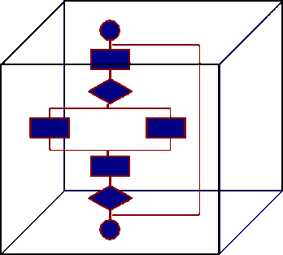
Glass-Box Testing
Can be oriented towards
  Statement Coverage (Execute every Statement at least once)
  Branch Coverage (Execute every Branch at least once)
  Path Coverage (Execute every Path at least once)
The code at hand is used to determine a test suite.
  Ideally, you want Test Data that Exercises all Possible Paths through your Code:
    However, as previously discussed, likely is not possible
    Can Approximate by ensuring that each Path is Visited at least once, and considering equivalence classes.

Slide 21
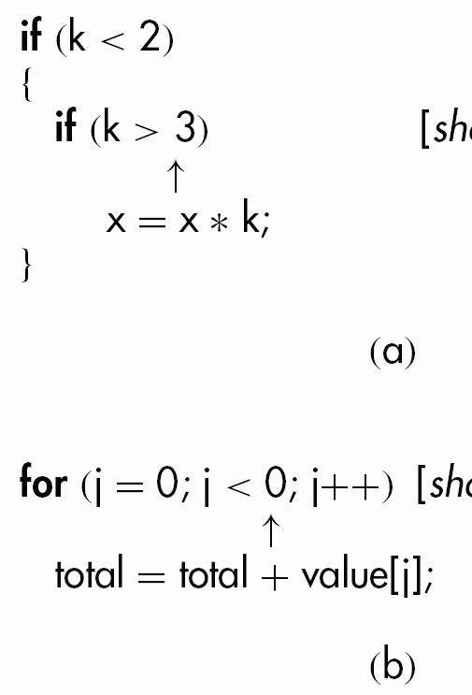
*Infeasible Code
It may not be possible to test a specific statement
  May have an infeasible path (“dead code”) in the module
Frequently this is evidence of a fault
Many compilers can detect unreachable code as part of the parsing process

Slide 22
Example: Testing a Tax Computation System
#include <iostream.h>
int main(void) {
int numDependents, exemption;
float income, taxSubTotal, taxTotal;
cout<<"Enter yearly income: ";
cin >> income;
// first if - check income
if (income < 0) {
cout << “Cannot have ”
<< “negative income.";
return 0;
}
cout<< “Give # dependents+self";
cin >> numDependents;
// second if - check dependents
if (numDependents <= 0) {
cout<<“Need at least one dependant";
return 0;
}
// third if (else-if) - compute tax subtotal
if (income < 10000)
taxSubTotal = .02 * income; //bracket 1
else if (income < 50000) //bracket 2
taxSubTotal = 200+.03*(income-10000);
else //bracket 3
taxSubTotal =1400+.04*(income-50000);
exemption = numDependents * 50;
taxTotal = taxSubTotal - exemption;
// last if - check negative tax
if (taxTotal<0) //In case of negative tax
taxTotal=0;
cout << income <<‘ ‘ <<taxSubTotal;
cout << numDependents << ‘ ‘;
cout << exemption << ‘ ‘ <<taxTotal;
}

Slide 23
Test Case Development for Path Coverage
There are four if statements in the code (and no loops), resulting in how many paths through the code?
First Few Test Cases:
 | 1st if | 2nd if | If-else-if | Last if | Result
1 | inc < 0 | doesn't matter | doesn't matter | doesn't matter | negative income error
2 | inc >= 0 | numDep <= 0 | doesn't matter | doesn't matter | invalid dependents error
3 | inc >= 0 | numDep > 0 | income < 10000 | taxTotal < 0 | .02 bracket 0 tax due tax
4 | inc>= 0 | numDep > 0 | 10000 <= income < 50000 | taxTotal < 0 | .03 bracket 0 tax due tax

Slide 24
*ICE: Determine the Remaining 4 Test Cases

Slide 25
Test Data Sets
To test the above, we need eight sets of data (values for income and number of dependents), one to test each possible path.
  Ranges for income are fairly evident for each case; we need only select an appropriate number of dependents for each case.
  Below shows 4 test data sets corresponding to the first four test cases described above, and the expected results (TaxTotal):
 | Income | Num Dependents | Expected Result
1 | -5 | Don’t care | negative income error
2 | 0 | 0 | invalid dependents error
3 | 100 | 1 | 0 (bracket .02, negative tax)
4 | 20000 | 11 | 0 (bracket .03, negative tax)

Slide 26
*ICE: The remaining Equivalence Classes
if (income < 0) {
cout << “Cannot have ”
<< “negative income.";
return 0;
}
cout<< “Give # dependents+self";
cin >> numDependents;
#include <iostream.h>
int main(void) {
int numDependents, exemption;
float income, taxSubTotal, taxTotal;
cout<<"Enter yearly income: ";
cin >> income;
// first if - check income
// third if (else-if) - compute tax subtotal
if (income < 10000)
taxSubTotal = .02 * income;
else if (income < 50000)
taxSubTotal = 200+.03*(income-10000);
else
taxSubTotal =1400+.04*(income-50000);
exemption = numDependents * 50;
taxTotal = taxSubTotal - exemption;
// last if - check negative tax
if (taxTotal<0) //In case of negative tax
taxTotal=0;
cout << income <<‘ ‘ <<taxSubTotal;
cout << numDependents << ‘ ‘;
cout << exemption << ‘ ‘ <<taxTotal;
}
// second if - check dependents
if (numDependents <= 0) {
cout<<“Need at least one dependant";
return 0;
}

Slide 27
*ICE: Compute M value for Tax Software System
#include <iostream.h>
int main(void) {
int numDependents, exemption;
float income, taxSubTotal, taxTotal;
cout<<"Enter yearly income: ";
cin >> income;
// first if - check income
if (income < 0) {
cout << “Cannot have ”
<< “negative income.";
return 0;
}
cout<< “Give # dependents+self";
cin >> numDependents;
// second if - check dependents
if (numDependents <= 0) {
cout<<“Need at least one dependant";
return 0;
}
// third if (else-if) - compute tax subtotal
if (income < 10000)
taxSubTotal = .02 * income;
else if (income < 50000)
taxSubTotal = 200+.03*(income-10000);
else
taxSubTotal =1400+.04*(income-50000);
exemption = numDependents * 50;
taxTotal = taxSubTotal - exemption;
// last if - check negative tax
if (taxTotal<0) //In case of negative tax
taxTotal=0;
cout << income <<‘ ‘ <<taxSubTotal;
cout << numDependents << ‘ ‘;
cout << exemption << ‘ ‘ <<taxTotal;
}

Slide 28
*Fault Distribution In Modules Is Not Uniform
[Myers]: 47% of faults in OS/370 were in only 4% of the modules
[Endres]: DOS/VS (Release 28):
  512 faults in a total of 202 modules
    112 of the modules had only one fault
    There were modules with 14, 15, 19 and 28 faults, respectively
      The latter three were the largest modules in the product, with over 3000 lines of DOS macro assembler language
      The module with 14 faults was relatively small, and very unstable. What should be done with this module?

Slide 29
* What does the detection of a fault tell us?
What does the detection of a fault within a module tell us about the probability of the existence of additional faults in the same module?
  Does finding a fault have any bearing on whether other faults are present?
[Myers]: When a module has too many faults =>
  It is cheaper to redesign, recode module than to try to fix its faults

Slide 30
Comparison: Black-Box, Glass-Box, Code Review
(Hwang, 1981): All three methods equally effective
(Basili and Selby, 1987) 32 professional programmers, 42 advanced students
  Professional programmers
    code reading detected more faults
    code reading had faster fault detection rate
  Advanced students
    code reading and black-box testing equally good
    both outperformed glass-box testing
What Conclusions can be drawn from the above?

Slide 31
Information to Maintain on Formal Test Cases:
What program unit was tested
How test set data was arrived at: equivalence classes, boundary values;
Type of coverage : branch coverage, etc.
  Actual inputs (Include global variables, files, other state information when relevant)
  Expected outputs
  Actual outputs
Value in running test set is in comparing expected outputs with actual outputs!

Slide 32
*ICE: Test Case Development
Give branch coverage test cases for the switch code (note: recall the previously computed M value)
Provide the following for each test case:
What is being tested
How test data was arrived at
Give the
  Actual input data set
  The expected output
  The actual output (simulate by executing by hand here)
switch a {
case 1: x =3;
break;
case 2: if (b == 0)
x=2;
else
x=4;
break;
case 3: while (c>0)
process(c);
break;
}

