Slide 1
Faculty of Engineering & Information Technology Al-AZHAR UNIVERSITY-GAZA Digital Signal Processing (DSP) (ITCC 4325)
Image processing
Teacher Assistant: Eng. Dalia Tariq Alhindi Supervised by: Dr. Ali Awad

Slide 2

What is Image Processing?
Image processing is a method to convert an image into digital form and perform some operations on it.
ADC
processing

Slide 3
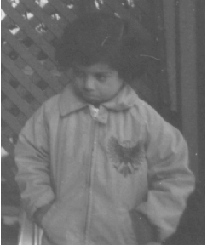
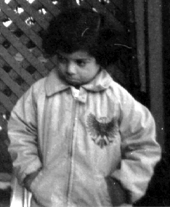
What are the purposes of image processing?
Enhancement
Before
After

Slide 4
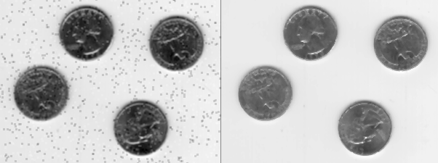
Remove Noise Using an Averaging Filter and a Median Filter
Before
After
Compression .
Segmentation.

Slide 5
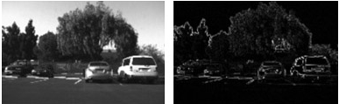
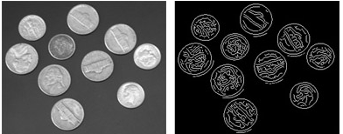
Edge detection
Edge detection is an image processing technique for finding the boundaries of objects within images
Before
After
Before
After

Slide 6
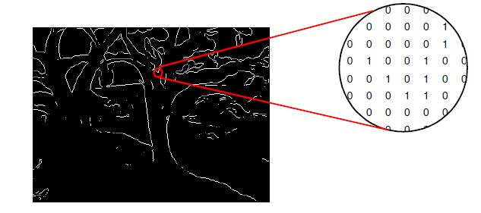
Images in MATLAB:
Binary images {0,1}:
A binary image is represented by an M×N matrix where pixel values are 1 (white) or 0 (black).

Slide 7
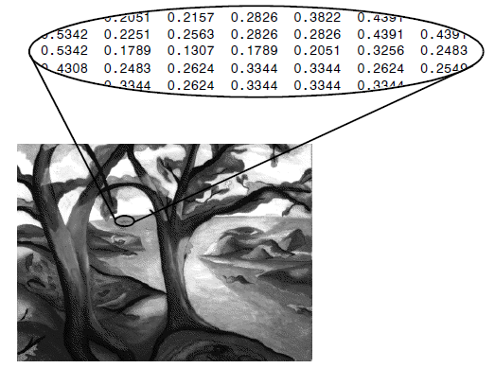
Grayscale Image
A grayscale image M pixels tall and N pixels wide is represented as a matrix of double datatype of size [M X N]. Element values denote the pixel grayscale intensities in [0,1] with 0=black and 1=white.

Slide 8
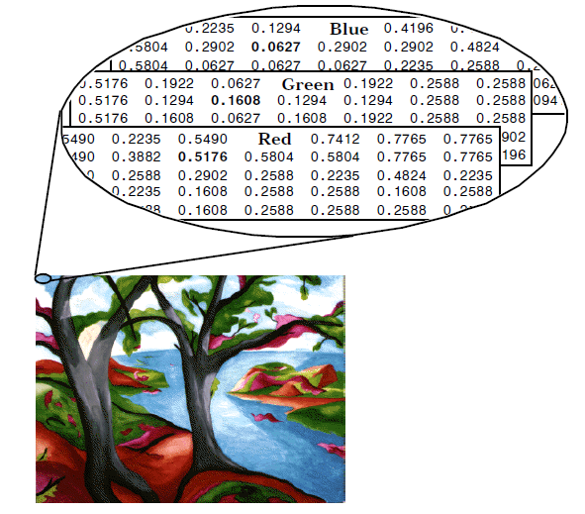
RGB color:
red-green-blue (RGB) image is represented as a three-dimensional M×N×3 double matrix. Each pixel has red, green, blue components along the third dimension with values in [0,1].
for example, the color components of pixel (m,n) are MyImage(m,n,1) = red, MyImage(m,n,2) = green, MyImage(m,n,3) = blue.

Slide 9
Unit8 Image
8-bit images are the most common representations found in practice.
Where values in the range of [0-255], which is useful for storage because of its size is low compared to the other image types.

Slide 10
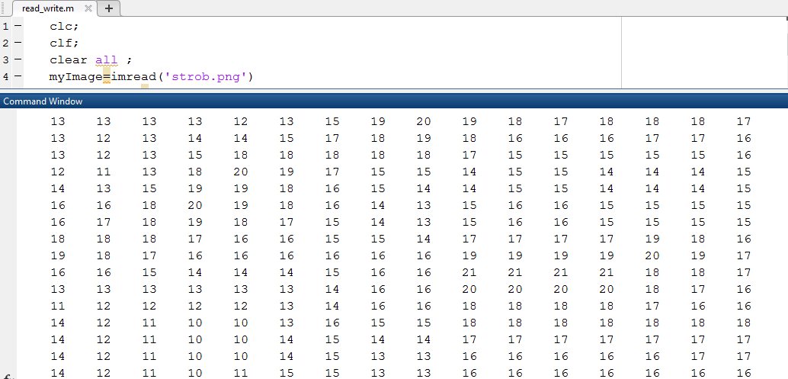
MATLAB Command :
Read images in MATLAB:
img = imread(image path');
Example: img = imread('apple.jpg');

Slide 11
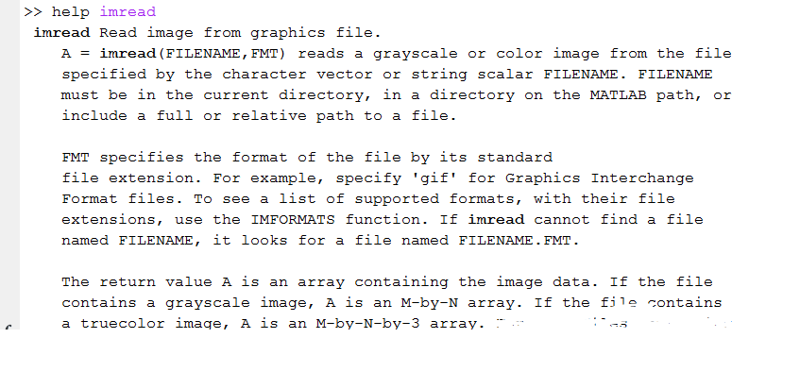

Slide 12
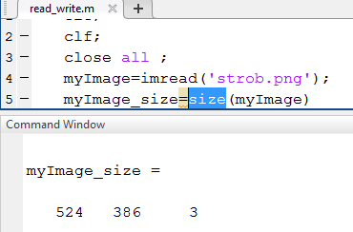
Size of Image:
myImage_size=size(myImage)
# of row
# of columns
# of layers

Slide 13
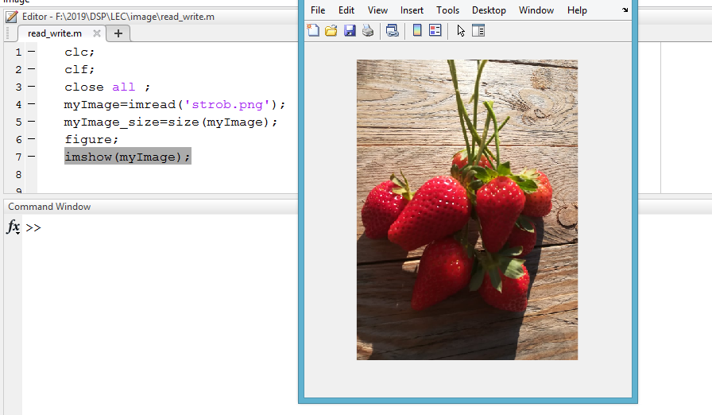
Display Image:
imshow(myImage);
%% Display the image as image processing.

Slide 14
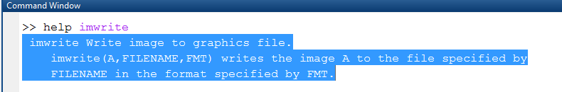
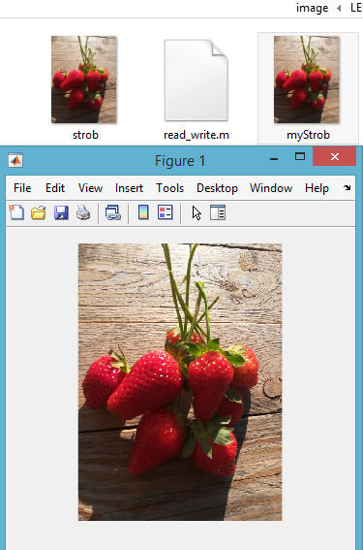
Write Image:
Example: imwrite(myImage, 'myStrob.png', 'png');
myImage>> the original iamge.
'myStrob.png>> the saved image

Slide 15
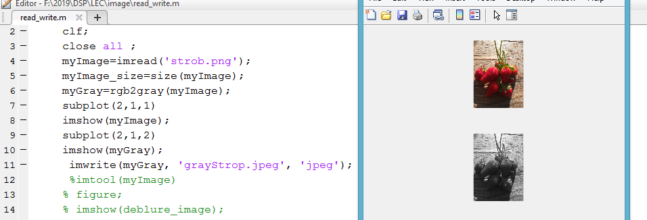
Image Conversion
Convert RGB image to black-white image :
I = rgb2gray(RGB) converts the truecolor image RGB to the grayscale intensity image I.

Slide 16
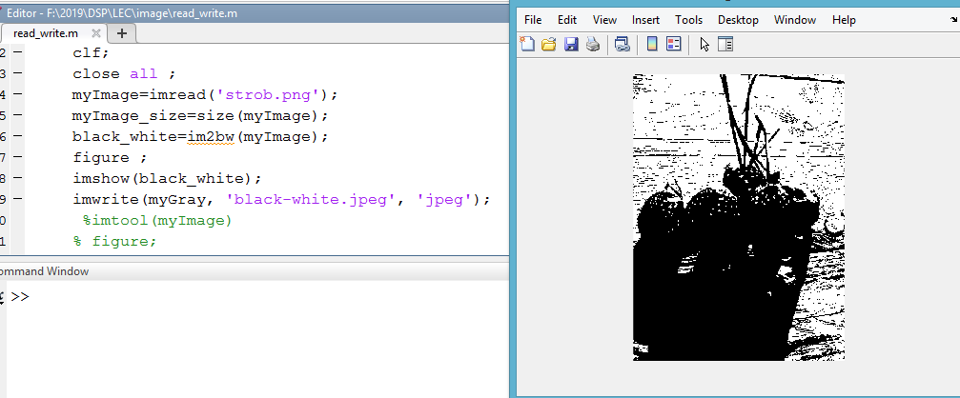
Convert Image to binary:
im2bw Convert image to binary image by thresholding.

Slide 17
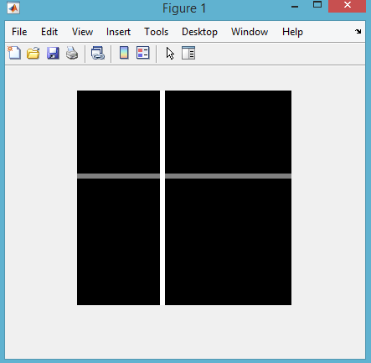
How to build a matrix (or image)?
clf;
clc;
row = 256;
col = 256;
img = zeros(row, col);
img(100:105, :) = 0.5;
img(:, 100:110) = 1;
figure;
imshow(img);

Slide 18
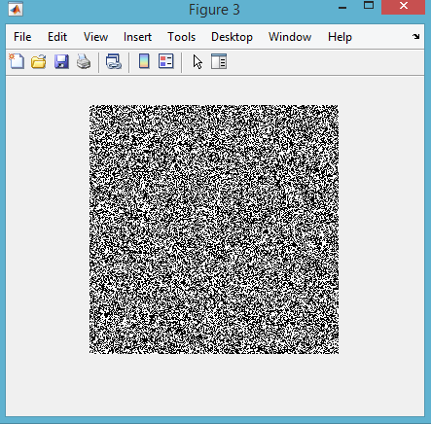
How to build Binary Image?

