Slide 1
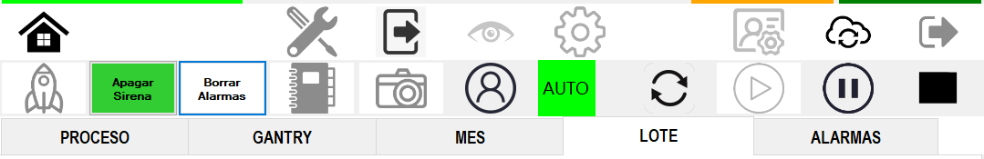
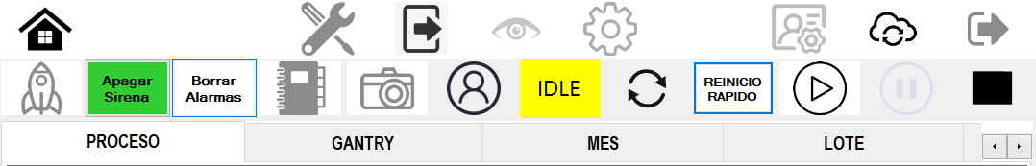
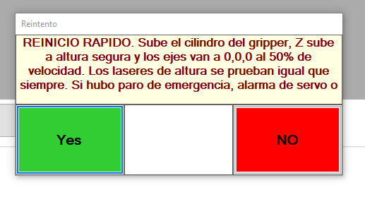
Fast restart function deployed across the camera line
전파 | 광학 | 기판 | 전장 | CTO | 전자 | 생기 | 품질
 | ○ | △ | △ | △ | △ | X | X
■ Date : 18/09/2026 ■ Writer : Guillermo Carrillo ■ Division: CM ■ Team: Production Engineering
개선 영역 | Analog BP | DX BP
이물/생산성
성능/품질 | ○
프로세스
안전환경
고객가치
Install PCB, Fastening , Top Unloader and Top Cover
DX Level 구분
A2D | 정보화 | 지능화
Before improvement
Breakthrough
After improvement
PHENOMENON
IMPROVEMENTS
EFFECT:
Recovery after a stop went from 2.5-3 minutes to 10-15 seconds, a reduction of over 90%. Deployed on 7 stations. All changes tagged MOD@@ Guillermo Carrillo in the source code.
After any stop the operator had to run the full initialization, 2.5 to 3 minutes depending on the station, which reconnects the scanner, tests the cameras and restarts support processes that were already connected and verified.
REINICIO RAPIDO button added to the main toolbar of each station. It calls the vendor's own initialization path, so all modules, the MES handshake and the pallet dialog behave identically.
A flag makes only 3 of the 24 nodes return immediately: FilesMonitor, scanner connection and camera test. Everything else runs unchanged, including robot reset and NG discharge.
IMPACT:
Restart time reduced from 2.5-3 min to 10-15 s on each of the 7 stations.
Recovered machine time on every stop, across the whole camera line.
Solution replicable to any station using the same SDK, around 30 min per station.
PROBLEM
The vendor's initialization always runs its complete 24-node chain, with no path to resume without repeating checks that had already passed.
Bottom Station has a restart feature, but it relies on a RestartProcess() method that the AcuraLibrary.dll of these stations does not declare.
MES nodes are deliberately not skipped: skipping them left the station reporting ONLINE before the MES confirmed, and they cost no time.

