Slide 1
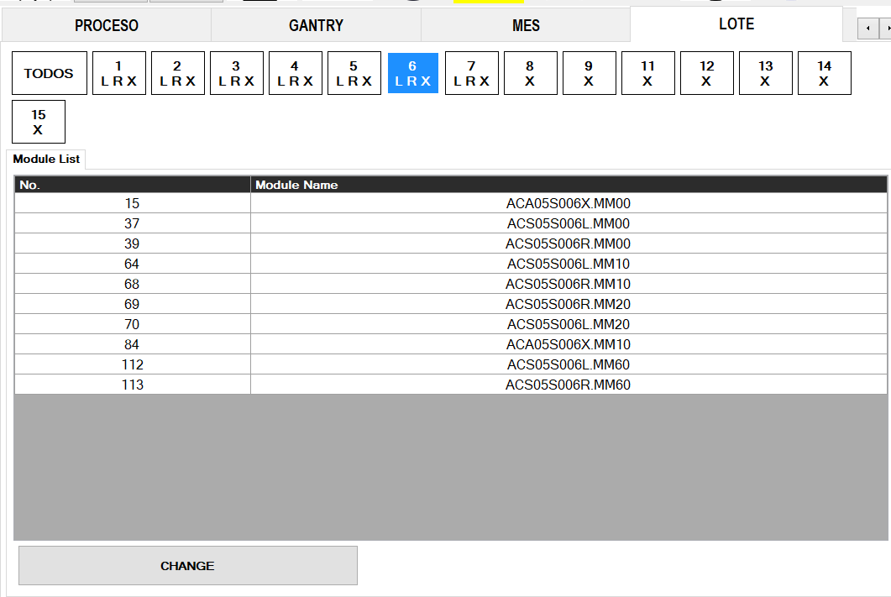
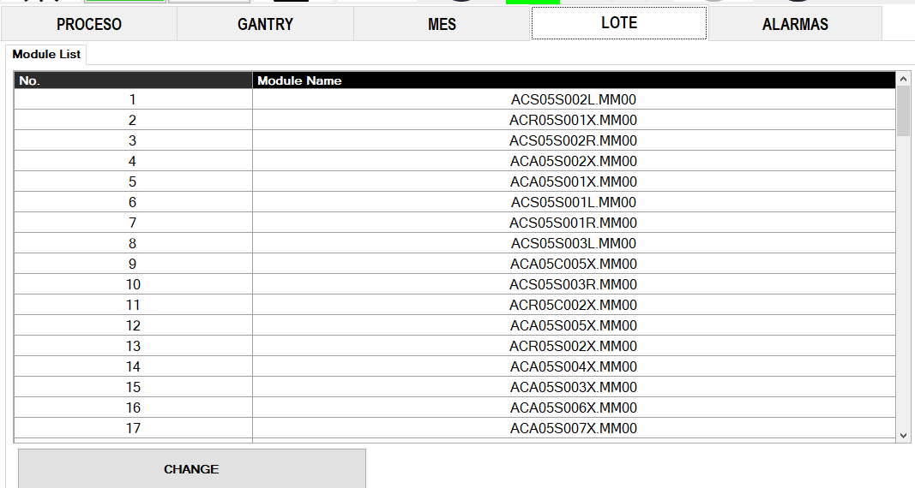
Module list ordered by number on the Lot screen
전파 | 광학 | 기판 | 전장 | CTO | 전자 | 생기 | 품질
 | ○ | △ | △ | △ | △ | X | X
■ Date : 18/09/2026 ■ Writer : Guillermo Carrillo ■ Division: CM ■ Team: Production Engineering
개선 영역 | Analog BP | DX BP
이물/생산성
성능/품질 | ○
프로세스
안전환경
고객가치
Install PCB - model selection at changeover
DX Level 구분
A2D | 정보화 | 지능화
Before improvement
Breakthrough
After improvement
PHENOMENON
IMPROVEMENTS
EFFECT:
Model selection at changeover is now immediate and predictable, with no scrolling through unordered entries.
The module list showed more than 70 entries with no order, so at every changeover the operator had to scroll through the whole list looking for the model.
The module list is now ordered by number, so the operator finds the model directly.
IMPACT:
Shorter changeover time.
Lower risk of selecting the wrong model.
Applicable to the other stations that show the same list.
PROBLEM
Entries were displayed in load order, with no sorting. Finding a model took time and made it easy to select the wrong one.
At changeover this adds time to a step that is already on the critical path of the line.

