Slide 1
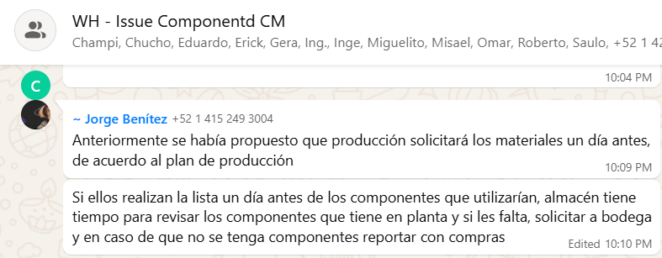
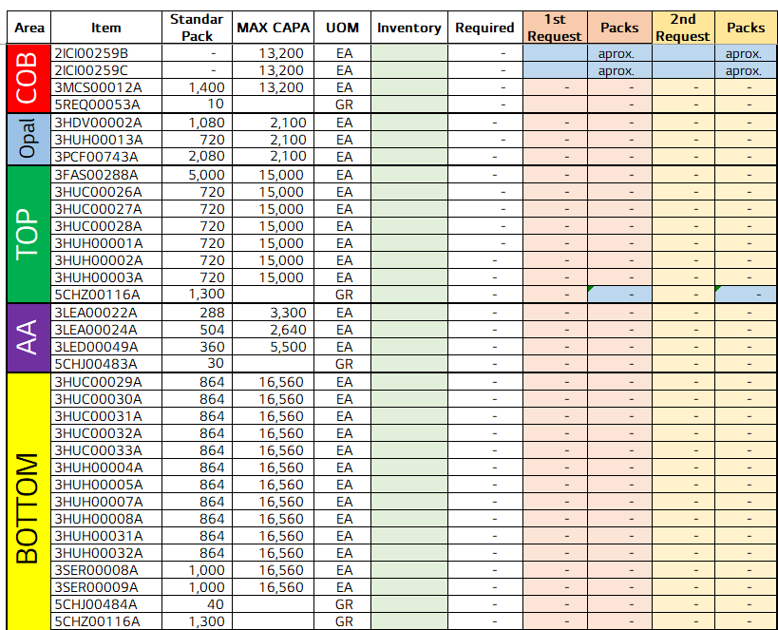
Raw Material PPT and Evaluation Test
전파 | 광학 | 기판 | 전장 | CTO | 전자 | 생기 | 품질
 | ○ | △ | △ | △ | △ | X | X
■ Date : 10/09/2025 ■ Writer : Manuel Oballe Dorantes ■ Division: CM ■ Team: Manufacture
개선 영역 | Analog BP | DX BP
이물/생산성
성능/품질 | ○
프로세스
안전환경
고객가치
Material to train personnel in charge of Raw Material
DX Level 구분
A2D | 정보화 | 지능화
Before improvement
Breakthrough
After improvement
PHENOMENON
IMPROVEMENTS
EFFECT:
Likewise, we pressure the warehouse to maintain the necessary stock of critical materials for production, as well as to provide us with information on stock shortages or the release of materials by quality control.
Constant conflicts due to late requests for raw materials from the warehouse, as well as late responses from the warehouse when there is a lack of stock.
Development of a Raw Material calculator based on the production plan and hourly capacity of each of the areas and models in the camera line.
The aim is to bring forward requests and enable the warehouse to anticipate stock levels of critical materials before the actual request for production.
IMPACT:
Reduction in line stoppages due to late material requests.
Ensuring daily production.
Anticipating shortages of critical materials, as well as streamlining changes to the plan and adjustments to the production line.
PROBLEM
The production of materials is complicated because the production plan is constantly changing.
Furthermore, the warehouse does not have a kanban system for materials within its area, which leads to a lack of knowledge about its stocks.
The calculator is flexible to any changes in the BOM, part number, or daily inventories for daily updating.

