Slide 1
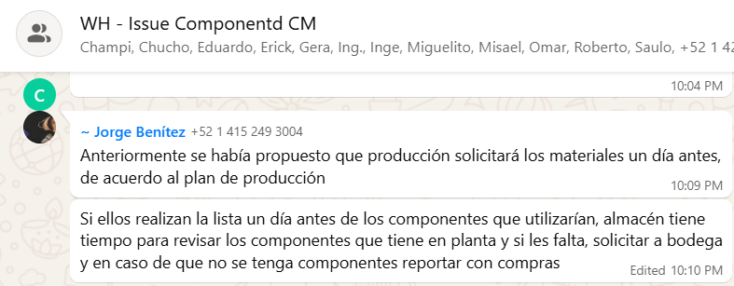
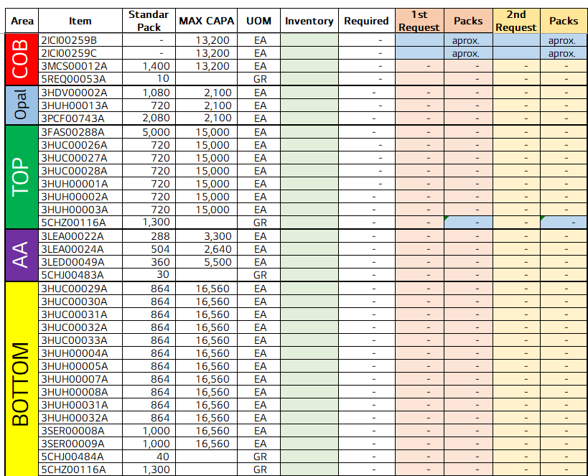
Index validation in GantryForm to prevent crashes
전파 | 광학 | 기판 | 전장 | CTO | 전자 | 생기 | 품질
 | ○ | △ | △ | △ | △ | X | X
■ Date : 18/09/2026 ■ Writer : Guillermo Carrillo ■ Division: CM ■ Team: Production
개선 영역 | Analog BP | DX BP
이물/생산성
성능/품질 | ○
프로세스
안전환경
고객가치
Install PCB - vendor software AlphaRap-SRM 1.1.0.18
DX Level 구분
A2D | 정보화 | 지능화
Before improvement
Breakthrough
After improvement
PHENOMENON
IMPROVEMENTS
EFFECT:
Pallets with position 12 unregistered: from nearly every pallet to none.
The piece in position 12 was never registered as processed, so the pallet travelled all the way to the Unloader before being released. Sporadic 50014 unhandled-exception alarms also appeared, with no line or method in the log.
21 index guards added to GantryForm.cs, covering arrays and lists, including the four on palletResultCopy that caused the position-12 failure.
Unloader (pcs) | 12 Aug | 1 Oct | 2 Oct | Δ
#01 per day | 7,881 | 9,418 | 9,725 | +23.4%
#01 rate/h* | 372.1 | 409.1 | 412.2 | +10.8%
#01 stop hours | 4 | 2 | 1 | -3
#02 per day | 8,797 | 8,031 | 10,402 | +18.2%
#02 rate/h* | 379.5 | 399.6 | 441.4 | +16.3%
Line per day | 16,678 | 17,449 | 20,127 | +20.7%
Last piece of the pallet (pos. 12)
Read index of palletResultCopy
Baseline before the guards
1211 alarm now confirmed by voting: 5 readings 150 ms apart, alarm raised only when 3 or more agree. Threshold configurable and recorded in the log.
Nearly all
pallets w/o pos. 12
24-36
1211 alarms / 12 h
4 h
#01 stops, 12 Aug
Index guard: is it in range?
21 guards in GantryForm.cs
PROBLEM
In range → piece processed
Out of range → handled + logged
IMPACT:
2 Oct: both Unloaders above 9,700 pcs; Line 1 at 20,127 pcs (+20.7%).
1 Oct: controlled material run (17,449 pcs), peak of 1,003 pcs/h.
1211 alarms: baseline 24-36 per 12 h shift; new figure pending.
The vendor accesses arrays and lists without validating bounds. On the last piece of the pallet the index falls out of range and the exception aborts the flowchart node before the piece is reported.
The 1211 "Cover is tilted" alarm is raised from a single camera reading, so capture noise is read as a real tilted cover.
Piece reported
flowchart node completes
Pallet released complete
Retry dialog added on QR read failure (alarm 1302), so the operator can reposition the PCBs instead of losing the group.
* Run rate = average of hours without stops. Δ = 2 Oct vs 12 Aug. Source: hourly production report, TOP TLA Line 1. 1 Oct ran a tightly controlled material (05-07 h estimated). Results reflect all updates combined.

