Slide 1
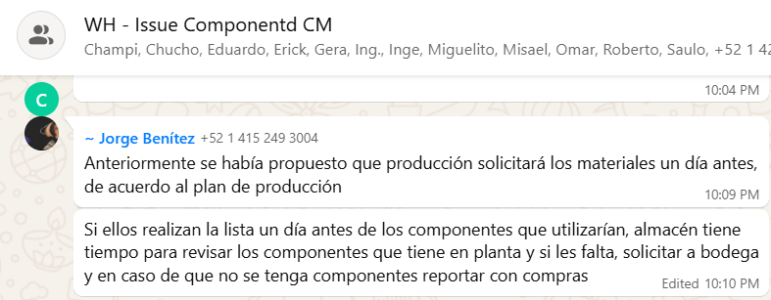
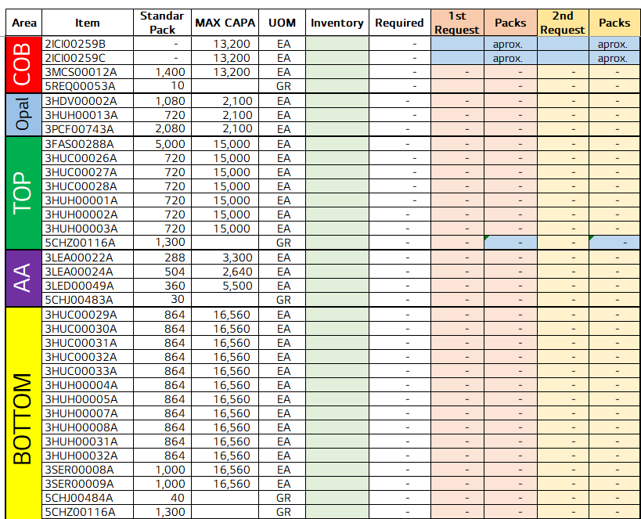
Fast restart function deployed across the camera line
전파 | 광학 | 기판 | 전장 | CTO | 전자 | 생기 | 품질
 | ○ | △ | △ | △ | △ | X | X
■ Date : 18/09/2026 ■ Writer : Guillermo Carrillo ■ Division: CM ■ Team: Production
개선 영역 | Analog BP | DX BP
이물/생산성
성능/품질 | ○
프로세스
안전환경
고객가치
Install PCB, Fastening 1/3/4, AVI, Top Unloader and Top Cover
DX Level 구분
A2D | 정보화 | 지능화
Before improvement
Breakthrough
After improvement
PHENOMENON
IMPROVEMENTS
EFFECT:
Restart after a stop: 2.5-3 min → 10-15 s (-90%+) on 7 stations.
After any stop the operator had to run the full initialization, 2.5 to 3 minutes depending on the station, which reconnects the scanner, tests the cameras and restarts support processes that were already connected and verified.
REINICIO RAPIDO button added to the main toolbar of each station. It calls the vendor's own initialization path, so all modules, the MES handshake and the pallet dialog behave identically.
Line 1 (pcs) | 12 Aug | 1 Oct | 2 Oct | Δ
Output/day | 16,678 | 17,449 | 20,127 | +20.7%
Run rate/h* | 738.5 | 785.5 | 838.6 | +13.6%
Best hour | 869 | 1,003 | 977 | +12.4%
Hours ≥ 900 | 0 | 5 | 8 | +8
Stop hours | 3 | 3 | 0 | -3
Lost to stops | ~1,889 | ~2,442 | ~900 | -52%
Restart sequence after a stop
Baseline · Line 1, 12 Aug 2026
Stop / alarm cleared
A flag makes only 3 of the 24 nodes return immediately: FilesMonitor, scanner connection and camera test. Everything else runs unchanged, including robot reset and NG discharge.
2.5-3 min
lost on every restart
~1,889 pcs
lost to stops / day
869 pcs
best hour of the day
REINICIO RAPIDO
one click on the toolbar
IMPACT:
2 Oct: 20,127 pcs (+20.7% vs 12 Aug) with no stop hours.
1 Oct: controlled material run (17,449 pcs), yet the best hour of all: 1,003 pcs.
Replicable to any station on the same SDK, ~30 min each.
PROBLEM
3 of 24 nodes skipped
FilesMonitor · scanner · camera test
The vendor's initialization always runs its complete 24-node chain, with no path to resume without repeating checks that had already passed.
Bottom Station has a restart feature, but it relies on a RestartProcess() method that the AcuraLibrary.dll of these stations does not declare.
21 nodes run as usual
MES · robot reset · NG discharge
Running in 10-15 s
Next step
Confirm the trend with a full week of data and update the ideal TC used by the dashboards.
MES nodes are deliberately not skipped: skipping them left the station reporting ONLINE before the MES confirmed, and they cost no time.
* Run rate = average of hours without stops. Δ = 2 Oct vs 12 Aug. Source: hourly production report, TOP TLA Line 1. 1 Oct ran a tightly controlled material (05-07 h estimated). Results reflect all updates combined.

