Slide 1
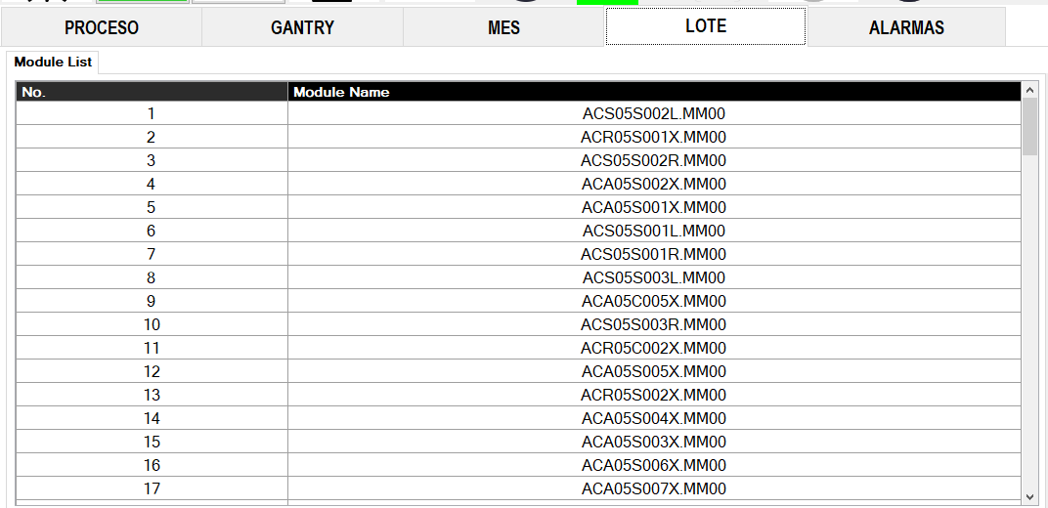
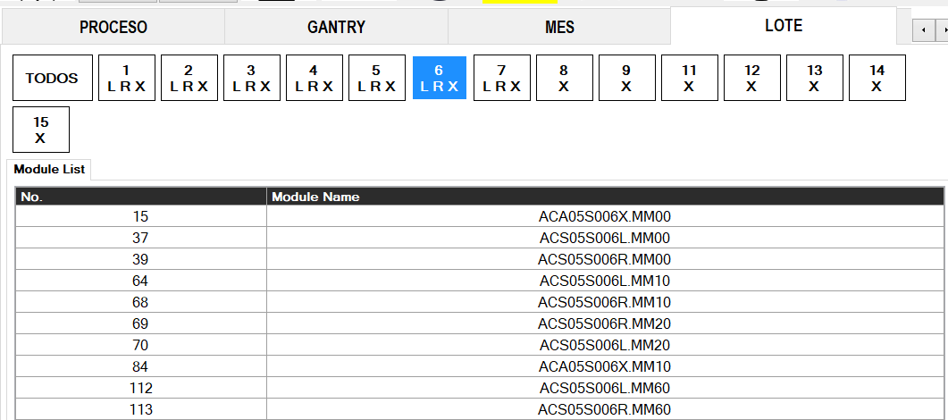
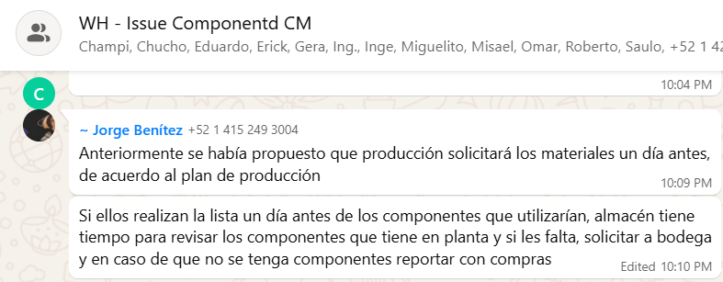
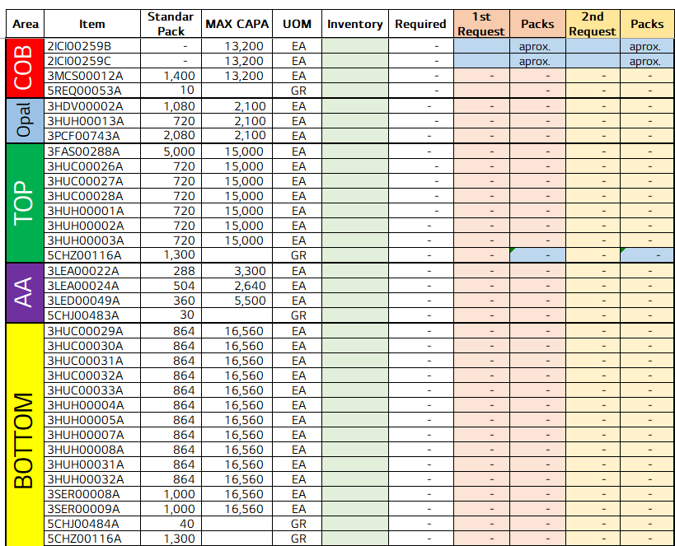
Model filter buttons on the Lot screen module list
전파 | 광학 | 기판 | 전장 | CTO | 전자 | 생기 | 품질
 | ○ | △ | △ | △ | △ | X | X
■ Date : 18/09/2026 ■ Writer : Guillermo Carrillo ■ Division: CM ■ Team: Production
개선 영역 | Analog BP | DX BP
이물/생산성
성능/품질 | ○
프로세스
안전환경
고객가치
Install PCB - model selection at changeover (Lot screen)
DX Level 구분
A2D | 정보화 | 지능화
Before improvement
Breakthrough
After improvement
PHENOMENON
IMPROVEMENTS
EFFECT:
Finding the model at changeover now takes one tap plus a short list.
At every changeover the operator had to scroll through a flat list of 113+ modules, in load order, to find the model to run.
Model filter buttons added above the module list. Each button is a model number (1-15) and shows the variants it has (L, R, X). One tap shows only that model; TODOS shows the full list.
~45 s
search before
~10 s
search after
-78%
search time
Before: one flat list, load order (113+ entries)
After: filter by model number (model 6 selected → 10 entries)
113+
entries to scan before
~10
entries per model
IMPACT:
About 35 s saved per changeover in the model search.
Lower risk of picking the wrong model: only its variants are shown.
Applicable to other stations with the same Lot screen.
PROBLEM
No grouping by model: variants of the same model (L, R, X and revisions MM00, MM10, MM20...) were scattered across the list.
The search was slow and it was easy to pick a similar name by mistake, on a step that is on the critical path of the changeover.
How the module name maps to the buttons
ACS05S
006
L
.MM00
family
model → button
L / R / X
revision
Line 1 with all updates
20,127 pcs on 2 Oct vs 16,678 on 12 Aug (+20.7%). 1 Oct: 17,449 pcs (controlled material), best hour 1,003.
TODOS keeps the full list available and CHANGE works as before, so the operator workflow stays the same.
Search times are approximate operator observations; effect on total changeover time still to be measured. Line data: hourly production report, TOP TLA Line 1.

