Slide 1
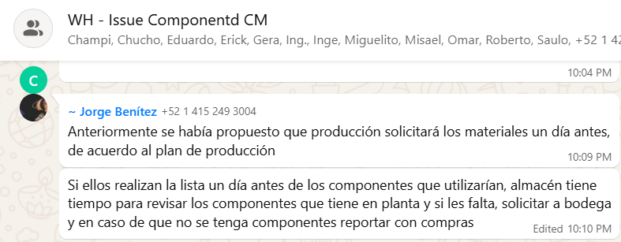
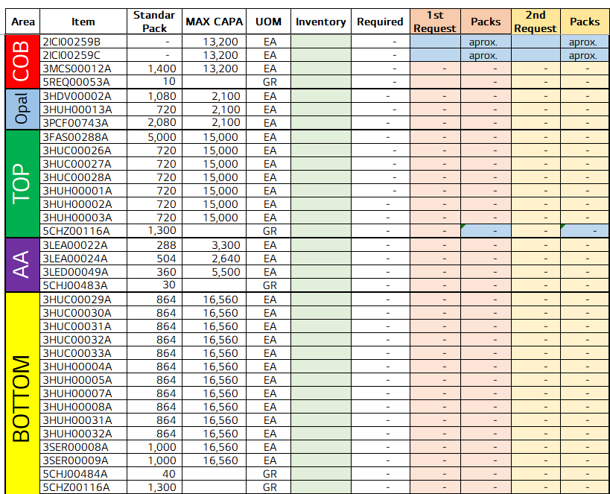
Fast restart function deployed across the camera line
전파 | 광학 | 기판 | 전장 | CTO | 전자 | 생기 | 품질
 | ○ | △ | △ | △ | △ | X | X
■ Date : 18/09/2026 ■ Writer : Guillermo Carrillo ■ Division: CM ■ Team: Production
개선 영역 | Analog BP | DX BP
이물/생산성
성능/품질 | ○
프로세스
안전환경
고객가치
Install PCB, Fastening 1/3/4, AVI, Top Unloader and Top Cover
DX Level 구분
A2D | 정보화 | 지능화
Before improvement
Breakthrough
After improvement
PHENOMENON
IMPROVEMENTS
EFFECT:
Recovery after a stop: 2.5-3 min → 10-15 s (over 90% less) on 7 stations.
After any stop the operator had to run the full initialization, 2.5 to 3 minutes depending on the station, which reconnects the scanner, tests the cameras and restarts support processes that were already connected and verified.
REINICIO RAPIDO button added to the main toolbar of each station. It calls the vendor's own initialization path, so all modules, the MES handshake and the pallet dialog behave identically.
Line 1 KPI | 12 Aug | 1 Oct | Change
Output/day (pcs) | 16,678 | 17,449 | +4.6%
Run rate (pcs/h)* | 738.5 | 785.5 | +6.4%
Best hour (pcs) | 869 | 1,003 | +15.4%
Hours ≥ 900 pcs | 0 | 5 | +5
Restart sequence after a stop
Baseline · Line 1, 12 Aug 2026
Stop / alarm cleared
A flag makes only 3 of the 24 nodes return immediately: FilesMonitor, scanner connection and camera test. Everything else runs unchanged, including robot reset and NG discharge.
2.5-3 min
lost on every restart
~1,889 pcs
lost to stops / day
869 pcs
best hour of the day
REINICIO RAPIDO
one click on the toolbar
IMPACT:
+771 pcs per day on Line 1; the line now runs faster when it is not stopped.
Stops still cost ~2,442 pcs/day, mostly at Unloader #02. Without them the line could reach ~18,850 pcs/day.
Replicable to any station with the same SDK, about 30 min per station.
PROBLEM
3 of 24 nodes skipped
FilesMonitor · scanner · camera test
The vendor's initialization always runs its complete 24-node chain, with no path to resume without repeating checks that had already passed.
Bottom Station has a restart feature, but it relies on a RestartProcess() method that the AcuraLibrary.dll of these stations does not declare.
21 nodes run as usual
MES · robot reset · NG discharge
Running in 10-15 s
Next step
Find the root cause of the Unloader #02 stops in the event log.
MES nodes are deliberately not skipped: skipping them left the station reporting ONLINE before the MES confirmed, and they cost no time.
* Run rate = average of hours without stops. Source: hourly production report, TOP TLA Line 1 (12 Aug vs 1 Oct 2026). One-day comparison; reflects all updates combined; 05-07 h of 1 Oct estimated.

