Slide 1
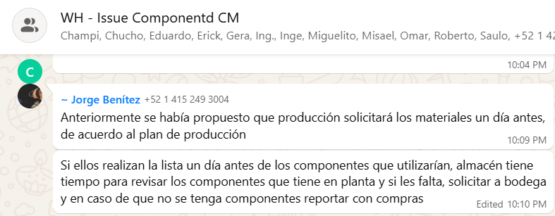
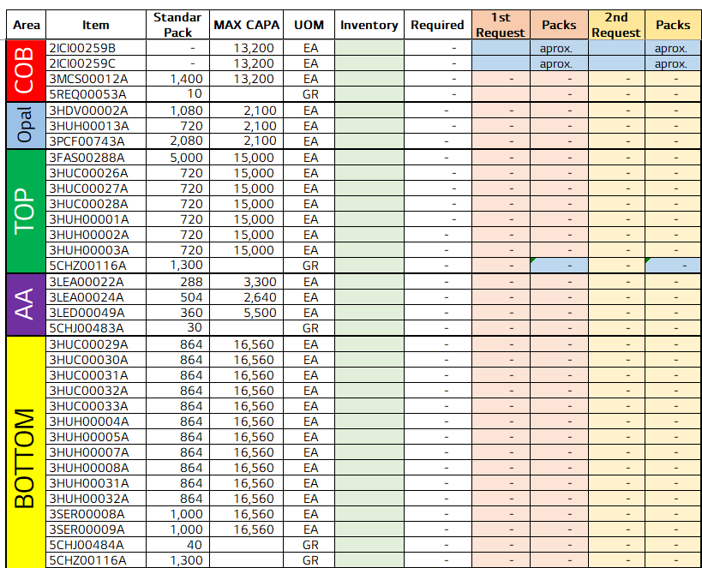
Index validation in GantryForm to prevent crashes
전파 | 광학 | 기판 | 전장 | CTO | 전자 | 생기 | 품질
 | ○ | △ | △ | △ | △ | X | X
■ Date : 18/09/2026 ■ Writer : Guillermo Carrillo ■ Division: CM ■ Team: Production
개선 영역 | Analog BP | DX BP
이물/생산성
성능/품질 | ○
프로세스
안전환경
고객가치
Install PCB - vendor software AlphaRap-SRM 1.1.0.18
DX Level 구분
A2D | 정보화 | 지능화
Before improvement
Breakthrough
After improvement
PHENOMENON
IMPROVEMENTS
EFFECT:
Pallets with an unregistered piece in position 12: from nearly every pallet to none in the validation shift.
The piece in position 12 was never registered as processed, so the pallet travelled all the way to the Unloader before being released. Sporadic 50014 unhandled-exception alarms also appeared, with no line or method in the log.
21 index guards added to GantryForm.cs, covering arrays and lists, including the four on palletResultCopy that caused the position-12 failure.
Last piece of the pallet (pos. 12)
Unloader KPI | 12 Aug | 1 Oct | Change
#01 output/day (pcs) | 7,881 | 9,418 | +19.5%
#01 run rate (pcs/h)* | 372.1 | 409.1 | +10.0%
#01 best hour (pcs) | 467 | 524 | +12.2%
#01 stop hours | 4 | 2 | -2
#02 run rate (pcs/h)* | 379.5 | 399.6 | +5.3%
Read index of palletResultCopy
Baseline before the guards
1211 alarm now confirmed by voting: 5 readings 150 ms apart, alarm raised only when 3 or more agree. Threshold configurable and recorded in the log.
Nearly all
pallets w/o pos. 12
24-36
1211 alarms / 12 h
4 h
#01 stops, 12 Aug
Index guard: is it in range?
21 guards in GantryForm.cs
PROBLEM
In range → piece processed
Out of range → handled + logged
IMPACT:
Line 1 output +4.6% (16,678 → 17,449 pcs/day).
Unloader #02: 6 stop hours on 1 Oct (day output down 8.7%); causes under review in the event log.
1211 alarms: baseline 24-36 per 12 h shift, new figure pending. Guards portable to other stations.
The vendor accesses arrays and lists without validating bounds. On the last piece of the pallet the index falls out of range and the exception aborts the flowchart node before the piece is reported.
The 1211 "Cover is tilted" alarm is raised from a single camera reading, so capture noise is read as a real tilted cover.
Piece reported
flowchart node completes
Pallet released complete
Retry dialog added on QR read failure (alarm 1302), so the operator can reposition the PCBs instead of losing the group.
* Run rate = average of hours without stops. Source: hourly production report, TOP TLA Line 1 (12 Aug vs 1 Oct 2026). One-day comparison; reflects all updates combined; 05-07 h of 1 Oct estimated.

