Slide 1
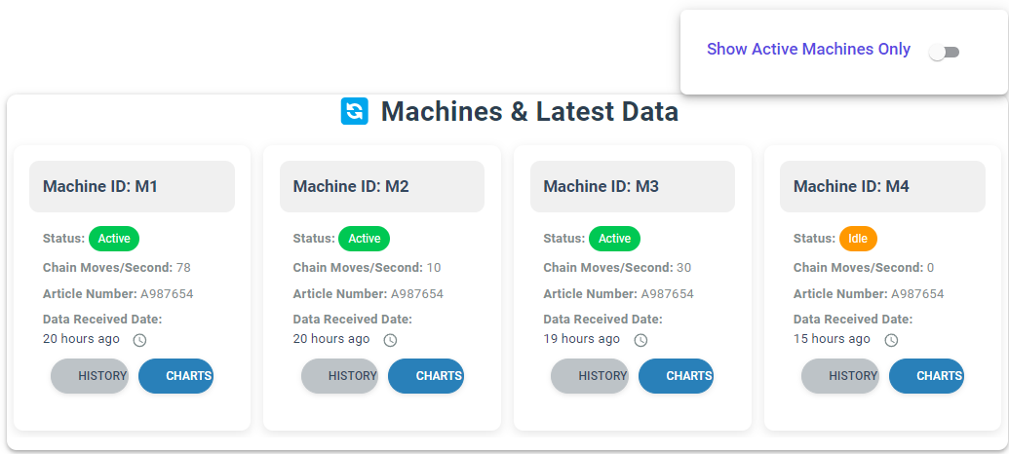
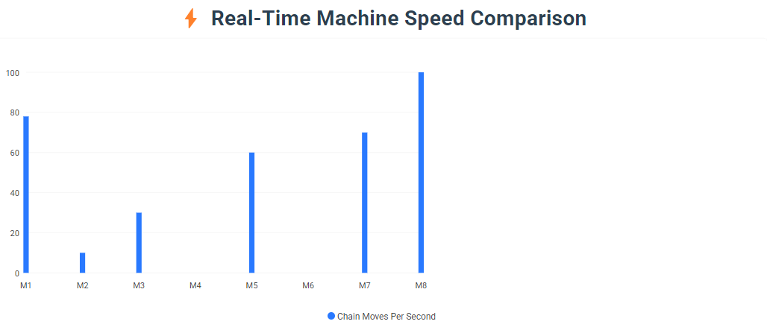
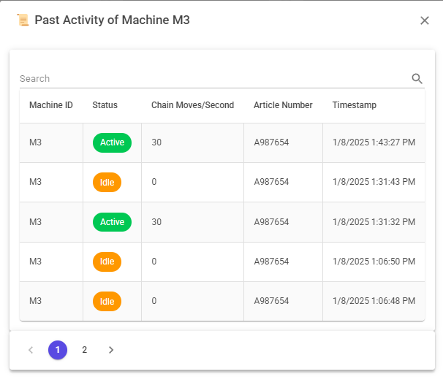
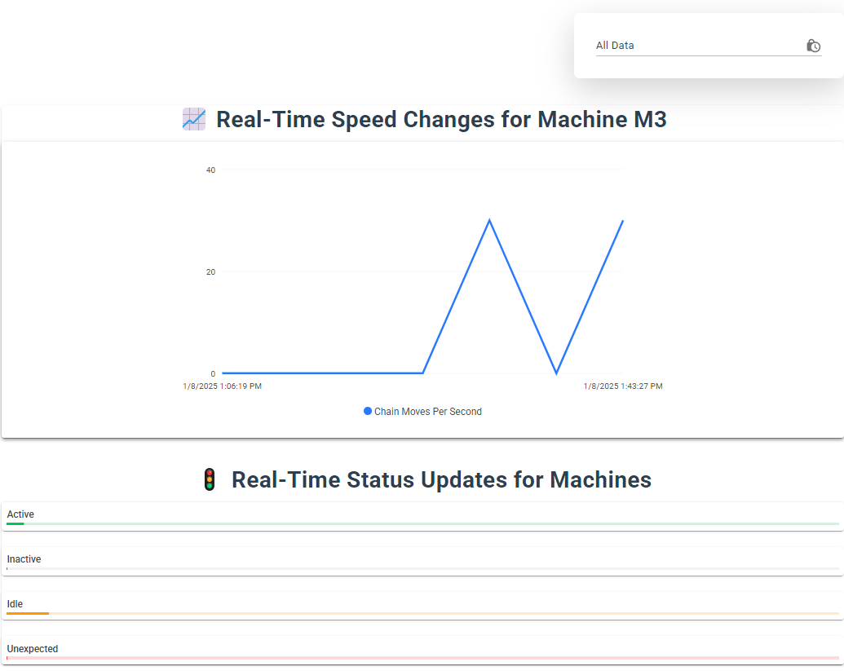
Machine Monitoring

Slide 2
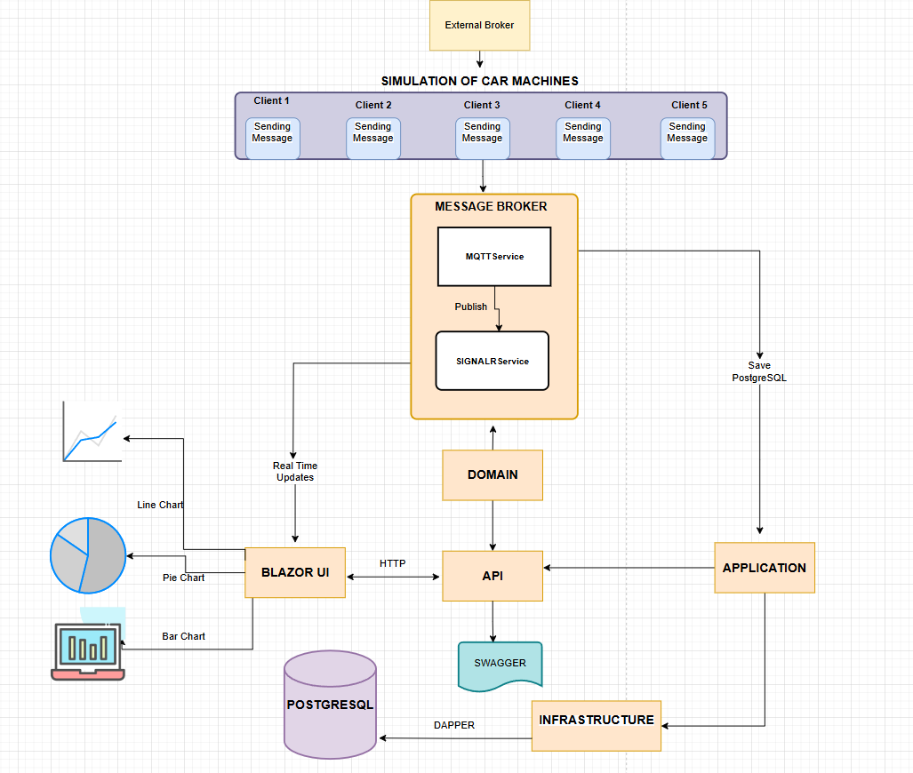
Project Architecture

Slide 3
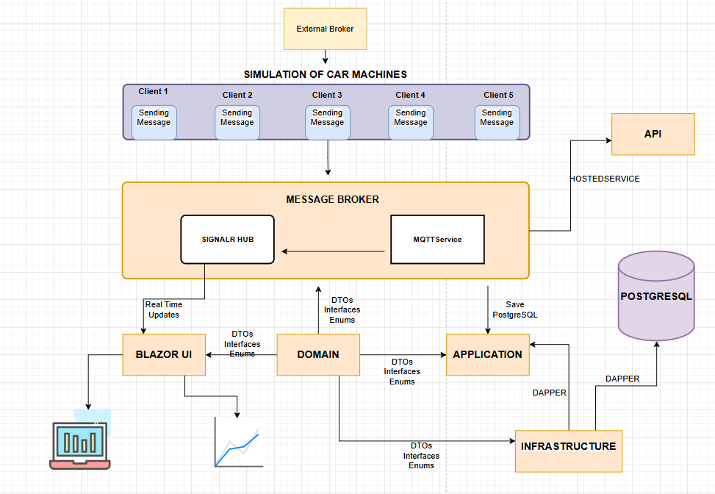
Message Broker Module
Core Responsibilities
Subscribe to external broker for data
Stores data in PostgreSQL using Dapper
Publishes real-time data with SignalR
Key Technologies
MQTTNet, Dapper, SignalR

Slide 4
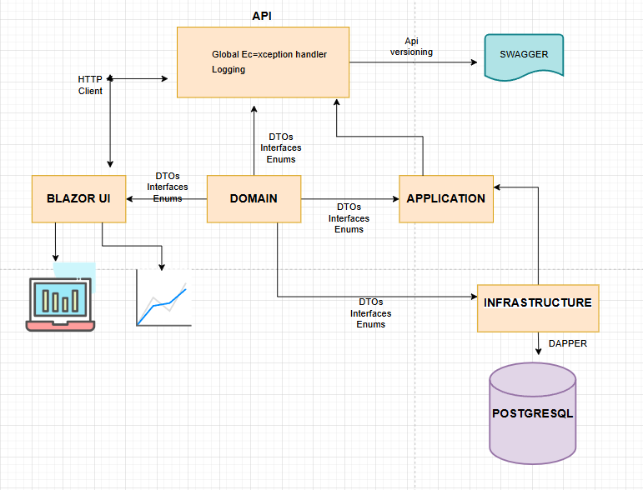
API Module
Core Responsibilities
Provides RESTful endpoints for accessing
historical data from PostgreSQL for Client.
Acts as a bridge for Cleint and SignalR
Utilizes middleware for logging, and error handling
during API interactions.
Dotnet 8 , Dapper , PostgreSQL, Serilog
Key Technologies

Slide 5
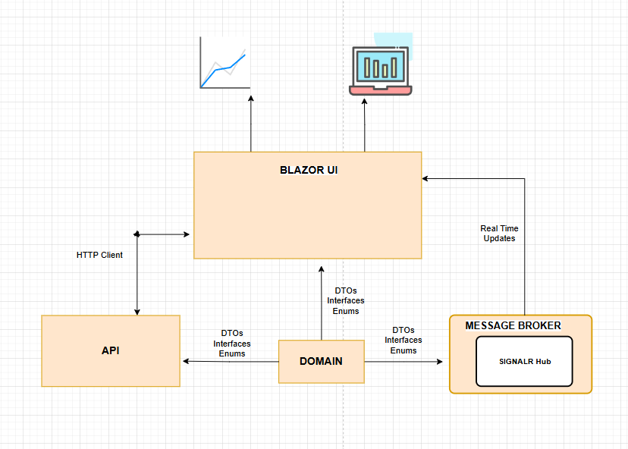
Client Module
Core Responsibilities
Communicates with the API for historical data.
Subscribes to SignalR for real-time updates.
Dashboard with real-time charts and graphs.
List of machines and their data metrics.
Blazor WebAssembly and MudBlazor.
Key Technologies

Slide 6
Future Enhancements
Message gueue like Rabbitmq and Kafka
Caching
Implement a cleanup mechanism for outdated or redundant data in the database by using background service like hangfire
Monitoring tools like Grafana , Prometheus, Azure Monitor
Authentication and authorization
Microservice architecture
Unit and integration tests

Slide 7
Thank you!
MEHMET AKSAK
DOTNET DEVELOPER
1995mehmetaksak@gmail.com
Source :
https://github.com/memo330102/MachineTracking

