Slide 1
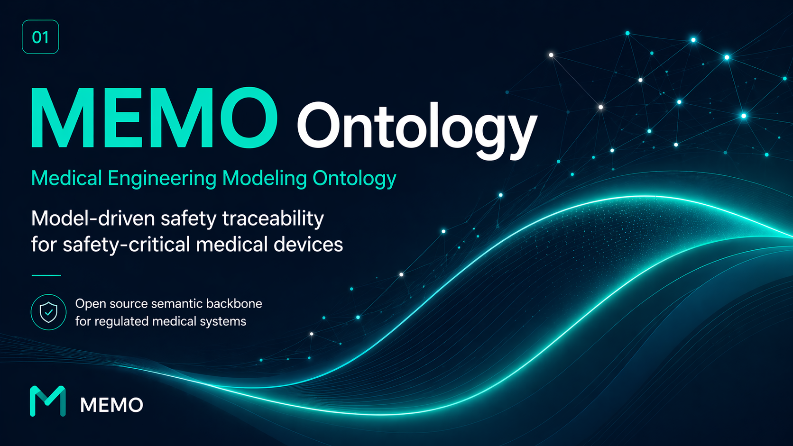

Slide 2
02
STORY
It is 11 p.m. before an audit. An engineer changes one line in REQ-145. The next morning, no one in the room can answer the question that follows: "What evidence is still valid?"
A small change. A clean diff. And a safety case that quietly stopped meaning what it said.
— A familiar story across regulated medical engineering

Slide 3
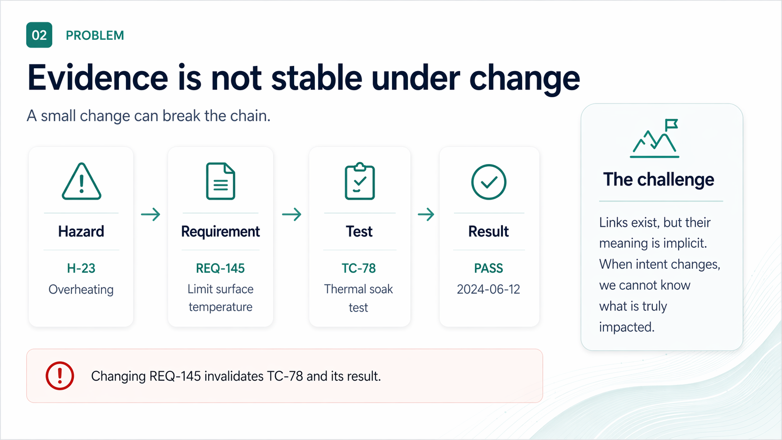

Slide 4
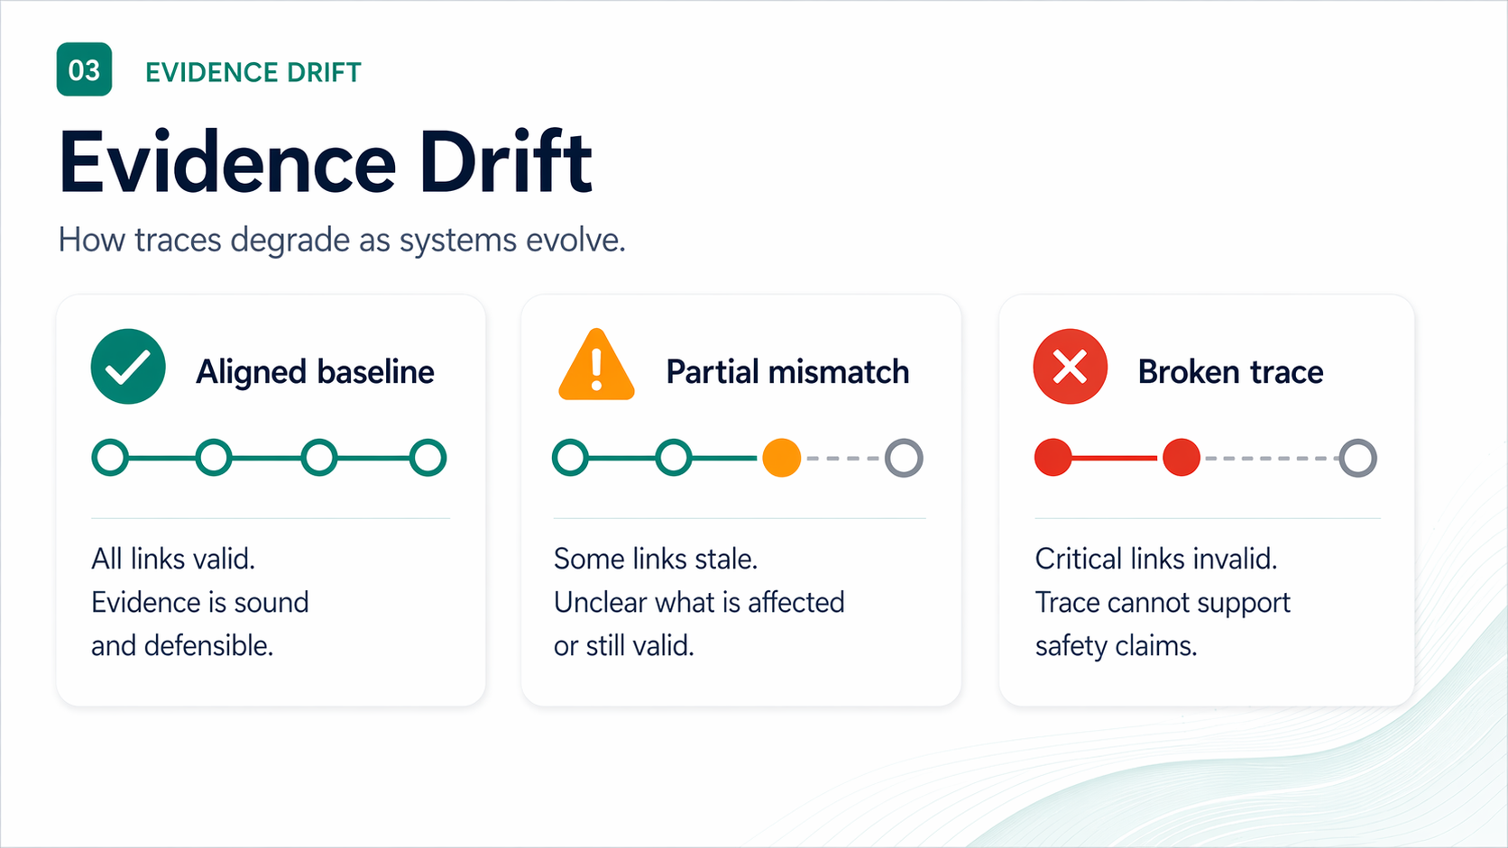

Slide 5
05
WHY IT MATTERS
Drift is expensive — and quiet
Unverified change is the silent driver of recalls, rework, and audit findings.
21%
~40%
DAYS
↻
FDA recalls
Rework cost
Audit time
Lost confidence
Software & traceability flagged in roughly one-fifth of Class II/III recalls (FDA MAUDE, 2023).
Late-stage requirement and risk rework absorbs 30–45% of typical V&V budgets.
Reconstructing a single broken trace before audit: days, not minutes.
Each silent break weakens the safety case the next reviewer reads.
The cost is not the link. It is the doubt every broken link injects into the case.
MEMO ONTOLOGY · INCOSE 2026
05 / 20

Slide 6
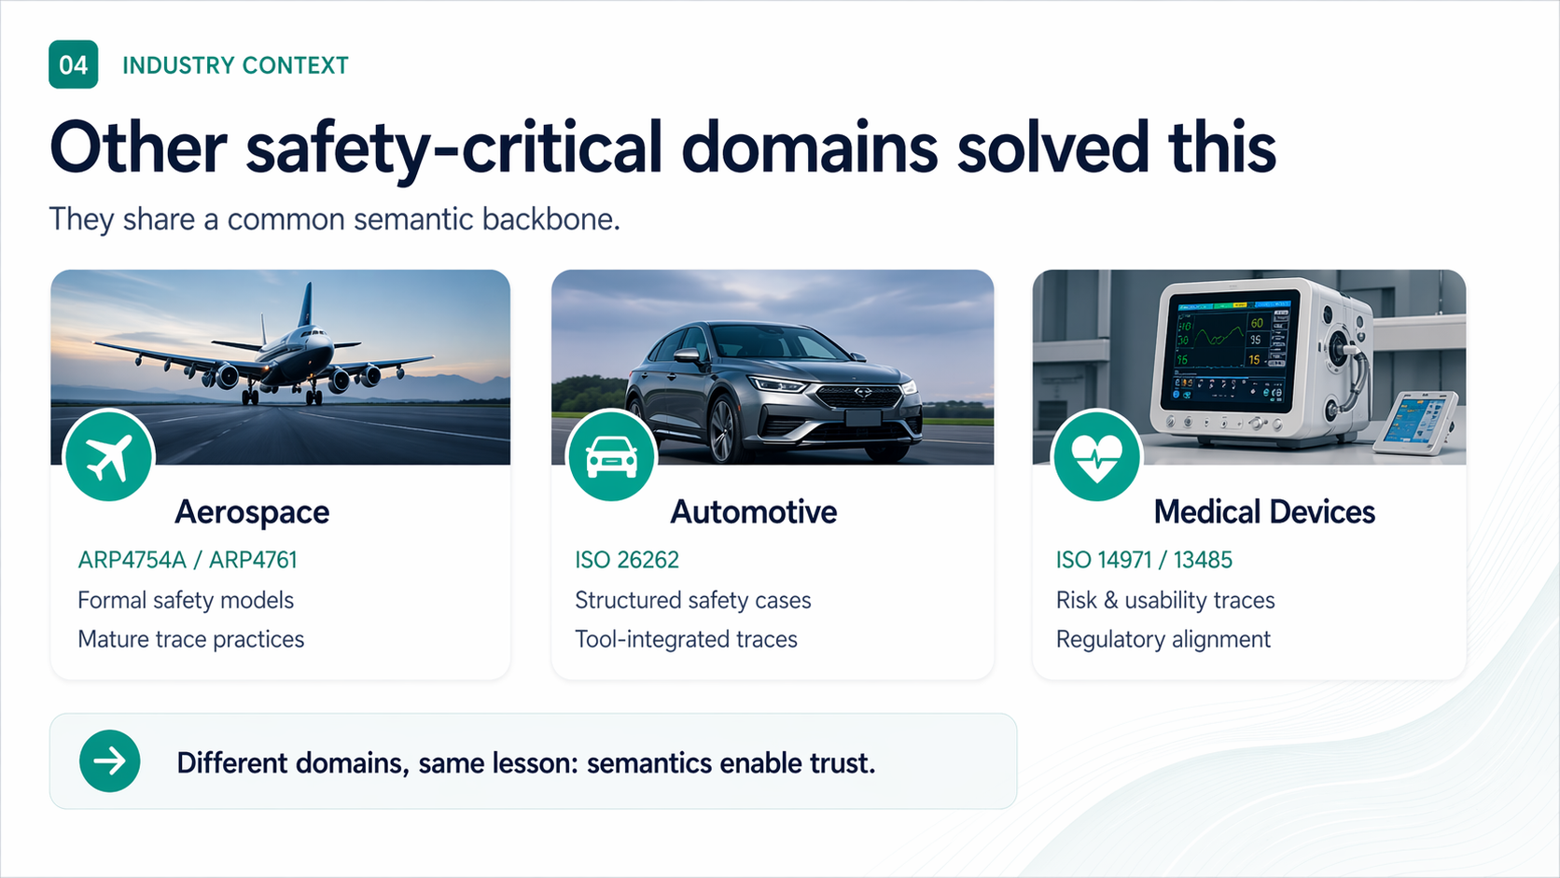

Slide 7
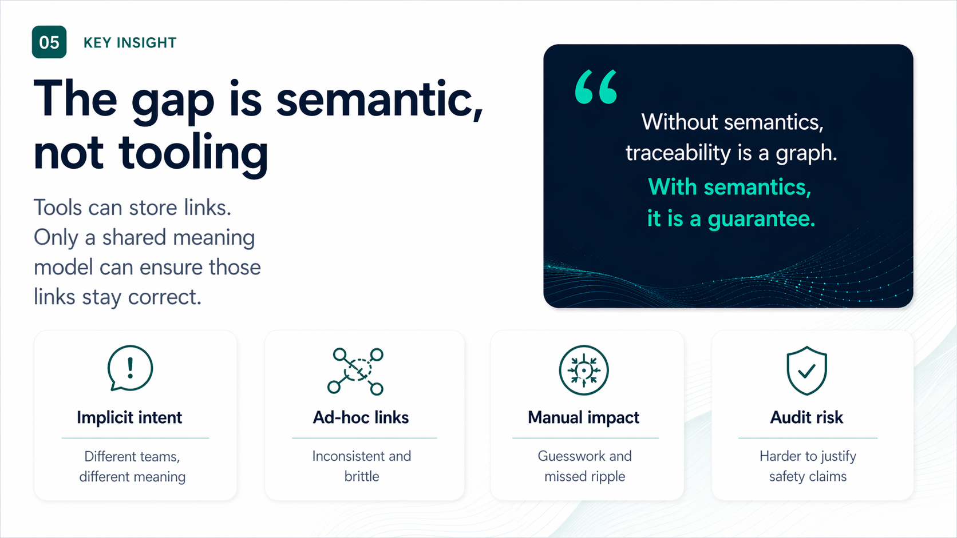

Slide 8
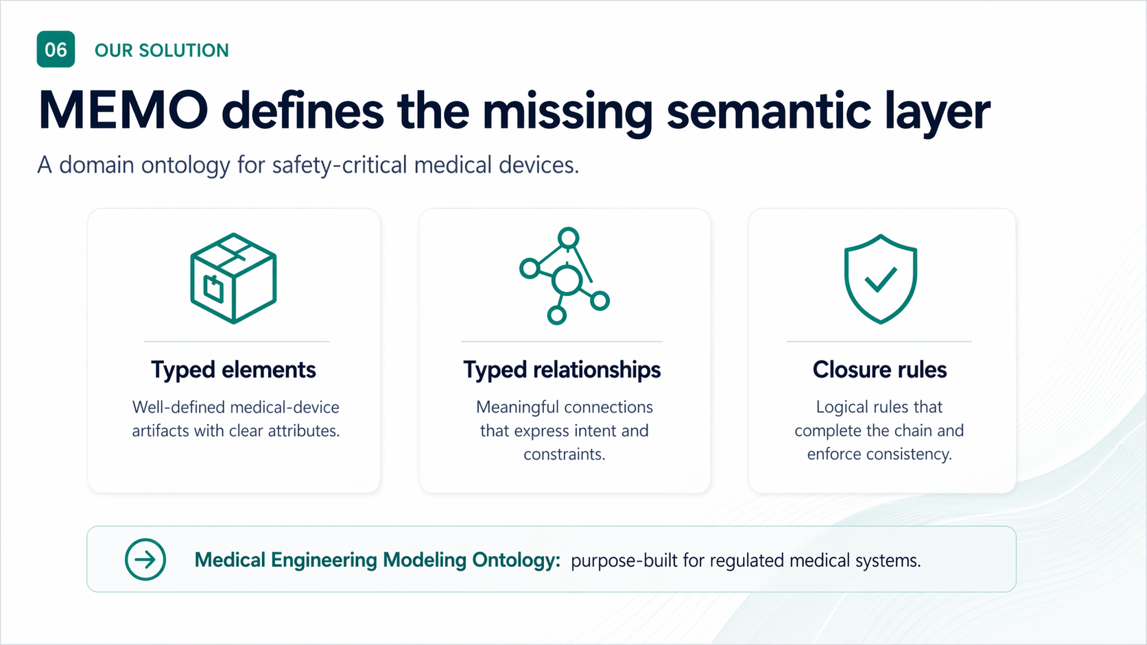

Slide 9
09
FRAMING · INCOSE
Built on what you already practice
MEMO is not a new methodology. It is a semantic layer underneath the methodologies your teams already use.
ISO
SE
v2
ISO/IEC/IEEE 42010
Arcadia / MBSE
SysML v2
Concerns → Viewpoints → Views → Models. MEMO supplies the typed elements that views reference.
Operational → System → Logical → Physical. MEMO names the layers, links them, and keeps them consistent.
Kinds and links live in SysML v2 source — parsed, version-controlled, diffable. The model is the artifact.
Position. MEMO sits between the standards (ISO 14971, IEC 62304) and the modeling tools — a domain ontology, not a new tool stack.
MEMO ONTOLOGY · INCOSE 2026
09 / 20

Slide 10
10
STORYLINE
Architecture-centered MEMO loop
Behavior
+ scenarios
modes, contracts
Use MEMO as an iterative engineering loop — not a one-way checklist.
CONTEXT
Assurance
verification
Architecture
stable design backbone
Risk
hazard chains
VIEWS / DOCUMENTS
stakeholders, care setting, intended use
RMF · SDD · V&V · compiled views
Requirements
needs + obligations
Practitioner sequence. Architecture → behavior/scenarios → risk → requirements + assurance, then iterate back through architecture.
MEMO ONTOLOGY · INCOSE 2026
10 / 20

Slide 11
11
ONTOLOGY HIERARCHY
Keep the mental model small
A stable core. Architecture, process, extensions, and examples around it.
Core
traceable elements + typed links
stable semantics
Architecture
context, behavior, risk, requirements, assurance
model the system
Process
viewpoints, rules, gates, document views
apply the method
Extensions
cybersecurity, usability, AI/ML, device-specific
add domain depth
Examples
GPCA-style worked trace threads
learn by reference
Rule. Extend by packages and profiles. Do not keep expanding the core vocabulary.
MEMO ONTOLOGY · INCOSE 2026
11 / 20

Slide 12
12
ARCHITECTURE LAYER
Start with architecture viewpoints
Arcadia-inspired flow: separate need from solution, then move from context to functions, logical architecture, and realization.
Viewpoints
MEMO elements
Architect questions
context and operational intent
functional chains and flows
logical structure and interfaces
software / hardware realization
constraint definitions
Actor, UseContext
LogicalFunction, LogicalFlow
LogicalComponent, Interface
SoftwareComponent, HardwareAssembly
constraints & allocations
who owns each responsibility?
where do interfaces and timing matter?
which elements implement safety controls?
what changes when a design decision changes?
Takeaway. Architecture is the backbone that behavior, risk, requirements, and evidence attach to.
MEMO ONTOLOGY · INCOSE 2026
12 / 20

Slide 13
13
BEHAVIOR + SCENARIOS
Walk scenarios before formalizing behavior
Scenario analysis turns abstract architecture into observable system behavior.
Scenario view
Behavior model
Architectural value
actor + stimulus
system response
environment / assumptions
response measure
BehaviorMachine
ModeState, Transition
behavior properties
contracts
reveals missing interactions
surfaces timing assumptions
feeds hazard analysis
creates verification anchors
Normal scenario
→
Alternate flow
→
Off-nominal behavior
→
Behavior property
MEMO ONTOLOGY · INCOSE 2026
13 / 20

Slide 14
14
RISK LAYER · ISO 14971
Analyze risk from behavior and architecture
Risk is most useful when the hazard chain points to scenarios, interfaces, allocations, and controls.
Hazard
→
Sequence
→
Situation
→
Harm
→
Control
→
Residual
Risk elements
Architect questions
GPCA example
Hazard, Harm
SequenceOfEvents
HazardousSituation
RiskBefore / RiskAfter
RiskControl
which scenario creates exposure?
which element implements the control?
what must be segregated?
what must be verified?
overdose hazard
frequent bolus sequence
excess infusion situation
lockout control
MEMO ONTOLOGY · INCOSE 2026
14 / 20

Slide 15
15
REQUIREMENTS LAYER
Stabilize intent after design and risk insight
Requirements capture agreed obligations — but their quality depends on architecture, behavior, and risk analysis.
Inputs
Requirement model
Typed links
stakeholder needs
scenario findings
risk controls
architecture decisions
Requirement
SystemRequirement
SoftwareRequirement
HardwareRequirement
acceptance criteria
source link
satisfaction link
allocation link
verification link
Need
→
Design insight
→
Risk driver
→
Requirement
→
Verification intent
MEMO ONTOLOGY · INCOSE 2026
15 / 20

Slide 16
16
ASSURANCE + CLOSURE
Close the safety thread with current evidence
The goal is not more links. The goal is a checkable path from claim to current evidence.
Claim
→
Realization
→
VerificationCase
→
Evidence
→
Document view
Assurance elements
Closure check
Architectural value
VerificationCase
TestArtifact
Evidence
VerificationLink
EvidenceProductionLink
claim is allocated
control is realized
case is defined
evidence is current
impact analysis
stale evidence detection
audit-ready reasoning
MEMO ONTOLOGY · INCOSE 2026
16 / 20

Slide 17
17
ONTOLOGY IN ACTION
One GPCA-style closed thread
Small enough to follow. Complete enough to prove the semantic backbone.
Need
needSafeTherapy
Why this works
↓
Requirement
reqLockout
Path crosses architecture, behavior, risk, and evidence.
Change impact is computed — not reconstructed.
Document views compile from the same baseline.
↓
Architecture
infusionMgr
↓
Behavior
guaranteeLockoutPreventsBolus
↓
Risk control
prevent overdose during lockout
Slide takeaway. MEMO becomes useful when the safety argument and the architecture model live in the same semantic system.
↓
Verification
vcLockout
↓
Evidence
evidenceLockout
↓
Document view
rmfView
MEMO ONTOLOGY · INCOSE 2026
17 / 20

Slide 18
18
ADOPTION STRATEGY
Three horizons, one trajectory
An adoption-first roadmap that earns trust before it grows scope.
NOW · 2026
H1
2026–2027
H2
2027+
H3
Prove the backbone
Compile compliance
Ecosystem & assurance
open-source ontology + reference models (GPCA, infusion pump)
SysML v2 source-of-truth, CLI + viewer
worked safety threads as proof artifacts
seed adoption with one design partner per modality
auto-compiled RMF, SDD, V&V views from one model
typed-link impact analysis & stale-evidence detection
profiles: cybersecurity, usability, AI/ML, alarms
integrate with existing PLM & ALM via export adapters
device-specific profile registry
auditor-readable assurance cases
cross-domain bridges to ARP4761 / ISO 26262 patterns
community-governed ontology evolution
Sequence. Unified model first, then compliance outputs, then ecosystem — never the other way around.
MEMO ONTOLOGY · INCOSE 2026
18 / 20

Slide 19
19
WHAT CHANGES
Documents → Models → Computable evidence
Same regulations. Same engineers. A different substrate underneath them.
Today: documents drift
With MEMO: a semantic backbone
Word, Excel, DOORS, Polarion — links across silos
SysML v2 source — diffable, versioned, machine-checkable
Trace meaning is implicit, owned by individuals
Typed links carry intent — satisfaction, allocation, verification
Change impact is reconstructed by hand, before audit
Closure rules compute impact & flag stale evidence on every change
RMF, SDD, V&V evolve in parallel — and disagree
RMF, SDD, V&V compile from one model — they cannot disagree
Evidence is "true" only at submission time
Evidence currency is a property, not a snapshot
MEMO ONTOLOGY · INCOSE 2026
19 / 20

Slide 20
20
NEXT STEP
Adopt the
semantic backbone.
Build safer medical devices. Prove it with confidence.
FASTER CHANGES
STRONGER CASES
BETTER QUALITY
with lower risk
with for regulators
with less rework
GET INVOLVED
M
MEMO
github.com/memo-ontology · INCOSE Medical SE WG · Open source · SysML v2 · ISO 42010 aligned

