Slide 1


Slide 2
02
STORY
It is 11 p.m. before an audit. An engineer changes one line in REQ-145. The next morning, no one in the room can answer the question that follows: "What evidence is still valid?"
A small change. A clean diff. And a safety case that quietly stopped meaning what it said.
— A familiar story across regulated medical engineering

Slide 3
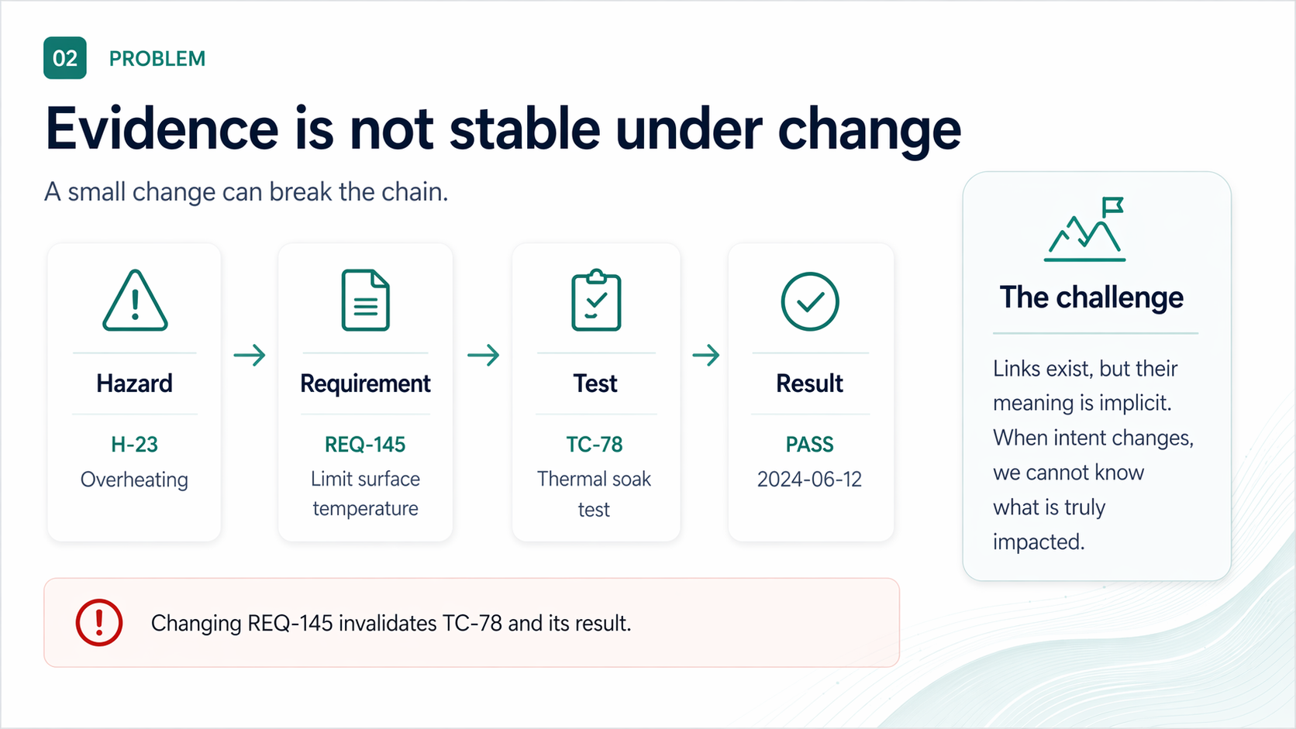

Slide 4
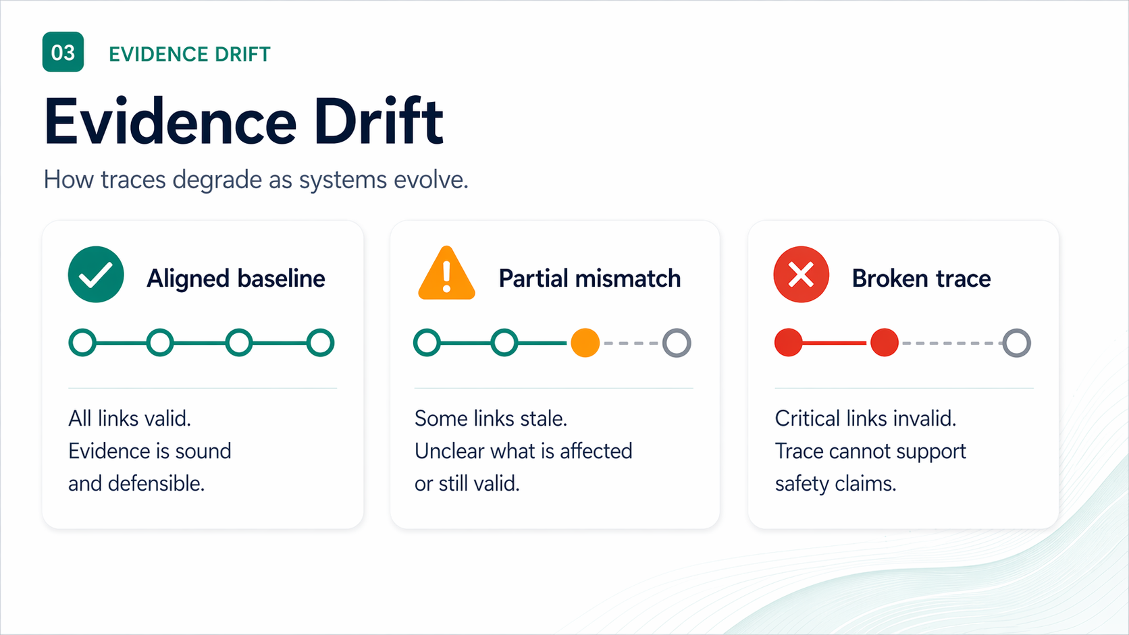

Slide 5
05
WHY IT MATTERS
Drift is expensive — and quiet
Unverified change is the silent driver of recalls, rework, and audit findings.
21%
~40%
DAYS
↻
FDA recalls
Rework cost
Audit time
Lost confidence
Software & traceability flagged in roughly one-fifth of Class II/III recalls (FDA MAUDE, 2023).
Late-stage requirement and risk rework absorbs 30–45% of typical V&V budgets.
Reconstructing a single broken trace before audit: days, not minutes.
Each silent break weakens the safety case the next reviewer reads.
The cost is not the link. It is the doubt every broken link injects into the case.
MEMO ONTOLOGY · INCOSE 2026
05 / 28

Slide 6
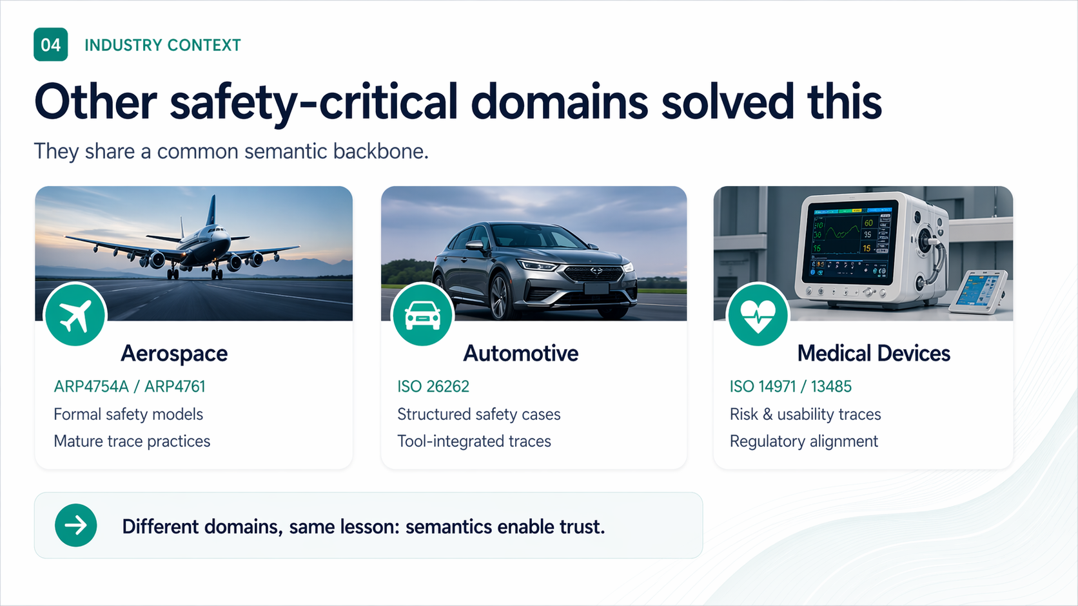

Slide 7
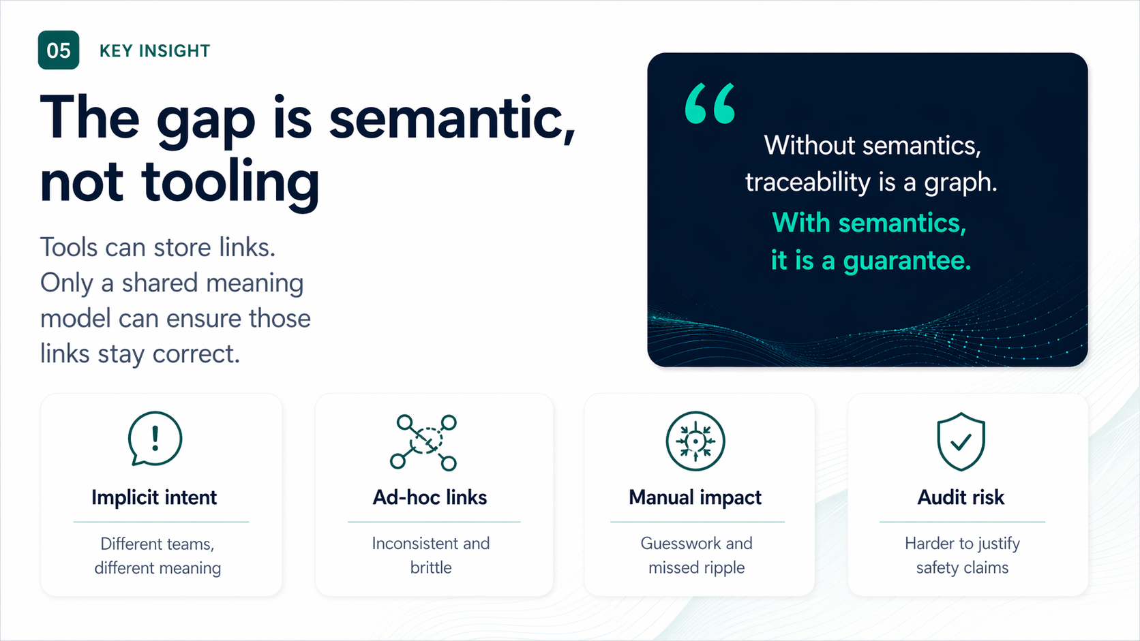

Slide 8
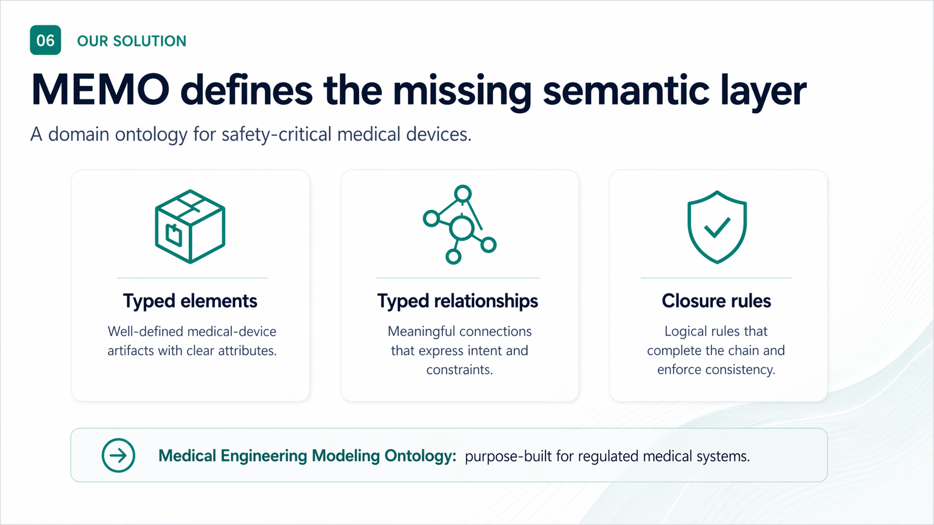

Slide 9
09
FRAMING · INCOSE
Built on what you already practice
MEMO is not a new methodology. It is a semantic layer underneath the methodologies your teams use.
ISO
SE
v2
ISO/IEC/IEEE 42010
Arcadia / MBSE
SysML v2
Concerns → Viewpoints → Views → Models. MEMO supplies the typed elements that views reference.
Operational → System → Logical → Physical. MEMO names the layers, links them, and keeps them consistent.
Kinds and links live in SysML v2 source — parsed, version-controlled, diffable. The model is the artifact.
Position. MEMO sits between the standards (ISO 14971, IEC 62304) and the modeling tools — a domain ontology, not a new tool stack.
MEMO ONTOLOGY · INCOSE 2026
09 / 28

Slide 10
10
STORYLINE
Architecture-centered MEMO loop
Behavior
+ scenarios
modes, contracts
Use MEMO as an iterative engineering loop — not a one-way checklist.
CONTEXT
Assurance
verification
Architecture
stable design backbone
Risk
hazard chains
VIEWS / DOCUMENTS
stakeholders, care setting, intended use
RMF · SDD · V&V · compiled views
Requirements
needs + obligations
Practitioner sequence. Architecture → behavior/scenarios → risk → requirements + assurance, then iterate back through architecture.
MEMO ONTOLOGY · INCOSE 2026
10 / 28

Slide 11
11
ONTOLOGY HIERARCHY
Keep the mental model small
A stable core. Architecture, process, extensions, and examples around it.
Core
traceable elements + typed links
stable semantics
Architecture
context, behavior, risk, requirements, assurance
model the system
Process
viewpoints, rules, gates, document views
apply the method
Extensions
cybersecurity, usability, AI/ML, device-specific
add domain depth
Examples
GPCA-style worked trace threads
learn by reference
Rule. Extend by packages and profiles. Do not keep expanding the core vocabulary.
MEMO ONTOLOGY · INCOSE 2026
11 / 28

Slide 12
12
ONTOLOGY DEPTH
MEMO ontology — by the numbers
What the open-source release ships today. Real, parseable, version-controlled.
11
56
42
8
ARCHITECTURE LAYERS
TYPED KINDS
TYPED RELATIONSHIPS
PROCESS STANDARDS
Operational → Verification, Apollo-11 pattern
part def in ontology-arch SysML packages
connection def — structural + traceability + safety
ISO 14971 · IEC 62304 · ISO 13485 · 14155 · 60601 · 27001/27701 · FDA · MDR
9
35
5
3
VIEWPOINTS
CLOSURE RULES
DEVICE TEMPLATES
PROFILE SIZES
risk · safety · software · security · privacy · clinical · hardware · ROS · QMS
Declarative validation; ISO 14971 + IEC 62304 baked in
infusion-pump · ventilator · monitoring · SaMD · connected
minimal · standard · full — pick scope for class
MEMO ONTOLOGY · INCOSE 2026
12 / 28

Slide 13
13
ARCHITECTURE ONTOLOGY
Eleven layers, one Apollo-11 pattern
Directory = layer. Drop a .sysml file under sysml/<layer>/ and the architecture layer is derived from its path.
Operational
5 kinds
Actor, UseContext, OperationalActivity
Behavioral
7 kinds
BehaviorMachine, ModeState, Transition
Functional
3 kinds
LogicalFunction, LogicalFlow
Logical
3 kinds
LogicalComponent, Interface
Software
4 kinds
SoftwareComponent, SoftwareInterface
Software-Ext (ROS)
5 kinds
Node, Topic, Service — ROS 2 middleware
Hardware
5 kinds
HardwareAssembly, Sensor, Actuator
Safety
7 kinds
Hazard, Harm, Risk, Mitigation (ISO 14971)
Security
4 kinds
ThreatModel, SecurityControl
Privacy
5 kinds
PersonalData, ProcessingActivity
Verification
5 kinds
VerificationCase, TestArtifact, Evidence
+ Relationships
42 connection defs
Composition, Dependency, Realization, TraceTo, Refines, Allocates, Mitigates, Causes, Verifies, …
MEMO ONTOLOGY · INCOSE 2026
13 / 28

Slide 14
14
PROCESS ONTOLOGY
Eight regulatory standards as first-class kinds
Process artifacts (plans, reports, activities) live next to the architecture they govern.
ISO 14971
7 kinds
IEC 62304
12 kinds
Risk management
RiskManagementPlan, HazardAnalysisActivity, ResidualRiskEvaluation, BenefitRiskAssessment …
Software lifecycle
SoftwarePlan, SoftwareSafetyClass, ProblemReport, AnomalyResolution, ChangeRequest …
ISO 13485
13 kinds
ISO 14155
7 kinds
Quality management
QualityPolicy, ManagementReview, DesignReview, CAPAActivity, DesignHistoryFile …
Clinical investigation
ClinicalInvestigationPlan, InvestigatorBrochure, CRF, AdverseEvent …
IEC 60601
4 kinds
ISO 27001 / 27701
6 kinds
Electrical safety
EssentialPerformance, BasicSafetyTest, ElectromagneticTest …
Security & privacy
ISMSScope, RiskTreatmentPlan, PIMSPolicy, DataSubjectRequest …
FDA 21 CFR 820
5 kinds
EU MDR
5 kinds
QSR
DesignControlActivity, DeviceMasterRecord, DesignHistoryFile (US) …
Conformity
TechnicalDocumentation, ClinicalEvaluation, PMSPlan, DeclarationOfConformity …
MEMO ONTOLOGY · INCOSE 2026
14 / 28

Slide 15
15
ARCHITECTURE LAYER
Start with architecture viewpoints
Arcadia-inspired flow: separate need from solution; then context → functions → logical → realization.
Viewpoints
MEMO elements
Architect questions
context and operational intent
functional chains and flows
logical structure and interfaces
software / hardware realization
constraint definitions
Actor, UseContext
LogicalFunction, LogicalFlow
LogicalComponent, Interface
SoftwareComponent, HardwareAssembly
constraints & allocations
who owns each responsibility?
where do interfaces and timing matter?
which elements implement safety controls?
what changes when a design decision changes?
Takeaway. Architecture is the backbone that behavior, risk, requirements, and evidence attach to.
MEMO ONTOLOGY · INCOSE 2026
15 / 28

Slide 16
16
BEHAVIOR + SCENARIOS
Walk scenarios before formalizing behavior
Scenario analysis turns abstract architecture into observable system behavior.
Scenario view
Behavior model
Architectural value
actor + stimulus
system response
environment / assumptions
response measure
BehaviorMachine
ModeState, Transition
behavior properties
contracts
reveals missing interactions
surfaces timing assumptions
feeds hazard analysis
creates verification anchors
Normal scenario
→
Alternate flow
→
Off-nominal behavior
→
Behavior property
MEMO ONTOLOGY · INCOSE 2026
16 / 28

Slide 17
17
RISK LAYER · ISO 14971
Analyze risk from behavior and architecture
Risk is most useful when the hazard chain points to scenarios, interfaces, allocations, and controls.
Hazard
→
Sequence
→
Situation
→
Harm
→
Control
→
Residual
Risk elements
Architect questions
GPCA example
Hazard, Harm
SequenceOfEvents
HazardousSituation
RiskBefore / RiskAfter
RiskControl
which scenario creates exposure?
which element implements the control?
what must be segregated?
what must be verified?
overdose hazard
frequent bolus sequence
excess infusion situation
lockout control
MEMO ONTOLOGY · INCOSE 2026
17 / 28

Slide 18
18
REQUIREMENTS LAYER
Stabilize intent after design and risk insight
Requirements capture agreed obligations — quality depends on architecture, behavior, and risk analysis.
Inputs
Requirement model
Typed links
stakeholder needs
scenario findings
risk controls
architecture decisions
Requirement
SystemRequirement
SoftwareRequirement
HardwareRequirement
acceptance criteria
source link
satisfaction link
allocation link
verification link
Need
→
Design insight
→
Risk driver
→
Requirement
→
Verification intent
MEMO ONTOLOGY · INCOSE 2026
18 / 28

Slide 19
19
ASSURANCE + CLOSURE
Close the safety thread with current evidence
Goal: a checkable path from claim to current evidence — not more links.
Claim
→
Realization
→
VerificationCase
→
Evidence
→
Document view
Assurance elements
Closure check
Architectural value
VerificationCase
TestArtifact
Evidence
VerificationLink
EvidenceProductionLink
claim is allocated
control is realized
case is defined
evidence is current
impact analysis
stale evidence detection
audit-ready reasoning
MEMO ONTOLOGY · INCOSE 2026
19 / 28

Slide 20
20
ANATOMY OF A KIND
A kind is just SysML v2 — diffable, parseable, owned
Apollo-11 pattern: file path determines layer. Attributes define what the audit asks for.
sysml/safety/safety.sysml
Path = layer
package MEMO_Ontology_Arch_Safety {
// path = sysml/safety/safety.sysml
// → layer derived = safety
part def Hazard {
attribute hazardId : String;
attribute title : String;
attribute category : String;
}
part def Risk {
attribute initialSeverity : SeverityLevel;
attribute initialProbability: ProbabilityLevel;
attribute residualSeverity : SeverityLevel;
attribute acceptability : RiskAcceptability;
}
}
sysml/safety/ → layer:safety. No layer field needed; the directory says it.
Attributes drive views
severity, probability, acceptability — the columns the RMF view compiles from.
SysML v2, not YAML
Diffable in git. Works with any v2 parser. The model is the source of truth.
Inheritance built in
:> SuperType to refine kinds. Profiles extend Hazard with cybersecurity, usability, etc.
MEMO ONTOLOGY · INCOSE 2026
20 / 28

Slide 21
21
CLOSURE RULES
Encode the standard, not the prose
35 declarative rules. ISO 14971 + IEC 62304 obligations enforced on every build — no manual checklists.
memo.rules.yaml
RULE TYPES
closureRules:
- id: CR-MED-001
description: "Every Hazard must have at least one
mitigates relationship (ISO 14971 §6)"
entity: Hazard
rule:
type: requireRelationship
relationship: mitigates
direction: incoming
relatedKinds: [Mitigation]
min: 1
severity: error
- id: CR-MED-004
description: "Every Risk must identify ≥1 Hazard"
requireRelationship
minimum incoming/outgoing connections of a given kind
requireAttribute
attribute is present and within enum/range
forbidRelationship
specific connection types must not exist
uniqueness
id or pair must be unique within scope
transitiveClosure
trace must reach a target kind via N hops
Why YAML. Lawyers, auditors, and engineers can all read the rules. Diff the file → diff the policy.
MEMO ONTOLOGY · INCOSE 2026
21 / 28

Slide 22
22
VIEWPOINTS
Viewpoints: declarative views over the same model
9 ships in the box. Each viewpoint is a YAML document — visible kinds, relationships, layers, diagrams.
memo.viewpoints.yaml
SHIPS WITH MEMO
viewpoints:
- id: risk-overview
label: Risk Overview (ISO 14971)
supportedDiagramTypes: [risk, req, pkg]
visibleKinds:
- Hazard
- HazardousSituation
- Harm
- Risk
- Mitigation
- VerificationCase
- Evidence
visibleRelationships:
- mitigates
- causes
- leadsTo
- identifiesRisk
- verifies
- producesEvidence
visibleLayers: [safety, verification]
risk-overview
ISO 14971
safety-view
ISO 14971 + 60601
software-view
IEC 62304
security-view
ISO 27001 / 81001-5-1
privacy-view
ISO 27701 / GDPR
clinical-evidence-view
ISO 14155 / MDR
hardware-view
IEC 60601
ros-view
Software-extension (ROS)
qms-dhf-view
ISO 13485 / 21 CFR 820
MEMO ONTOLOGY · INCOSE 2026
22 / 28

Slide 23
23
ONTOLOGY IN ACTION
One GPCA-style closed thread
Small enough to follow. Complete enough to prove the semantic backbone.
Need
needSafeTherapy
Why this works
↓
Requirement
reqLockout
Path crosses architecture, behavior, risk, and evidence.
Change impact is computed — not reconstructed.
Document views compile from the same baseline.
↓
Architecture
infusionMgr
↓
Behavior
guaranteeLockoutPreventsBolus
↓
Risk control
prevent overdose during lockout
Slide takeaway. MEMO becomes useful when the safety argument and the architecture model live in the same semantic system.
↓
Verification
vcLockout
↓
Evidence
evidenceLockout
↓
Document view
rmfView
MEMO ONTOLOGY · INCOSE 2026
23 / 28

Slide 24
24
CUSTOMIZATION
Four ways to make MEMO yours
Touch the layer that fits your need. The core stays stable; depth lives outside it.
01
02
03
04
Pick a profile size
Start from a device template
Author a viewpoint
Author closure rules
WHAT
WHAT
WHAT
WHAT
minimal · standard · full
5 starter SysML packages
YAML — kinds, relations, layers
YAML — declarative validation
HOW
HOW
HOW
HOW
Set extends in memo.config.yaml. Selects which ontology packages get pulled in.
memo init --template ventilator. Drops a working architecture, scenarios, and risk skeleton.
Add to memo.viewpoints.yaml. Compiler renders a new diagram type and document view.
Add to memo.rules.yaml. Run on every build; CI fails if policy is violated.
WHO
WHO
WHO
WHO
Class I prototype → Class III combination product.
Teams shipping infusion pumps, ventilators, monitors, SaMD, connected devices.
Reviewers who need a custom slice (e.g. cybersecurity-only DHF).
Quality leads encoding company-specific gates.
Plus. Add new kinds — drop a .sysml in your own package; Apollo-11 path determines layer; importable as a profile.
MEMO ONTOLOGY · INCOSE 2026
24 / 28

Slide 25
25
PROFILES + TEMPLATES
Pick the scope. Pick the device. Start modeling.
Profile size selects the regulatory surface. Device template seeds the model.
PROFILE SIZES
DEVICE TEMPLATES
Minimal
FOR
infusion-pump
GPCA-style; bolus modes, lockout safety
~53 kinds
Class I, prototypes
PACKAGES
ventilator
ventilation modes, alarm priorities
ontology-arch only
Standard
FOR
monitoring-device
physiological sensing, alarm chains
~120 kinds
Class II, regulated SW
PACKAGES
+ process + IEC 62304
samd
Software as a Medical Device, no hardware
Full
FOR
200+ kinds
Class III, combination
connected-device
BLE/Wi-Fi, MDS², cybersecurity baseline
PACKAGES
+ cybersecurity + clinical
memo init --profile standard --template ventilator → working SysML model + risk skeleton + viewpoints + closure rules in seconds.
MEMO ONTOLOGY · INCOSE 2026
25 / 28

Slide 26
26
WORKED CUSTOMIZATION
Adding a ventilator-modes viewpoint
Four steps. No tool plugin. Pure YAML + SysML.
1
2
3
4
Choose template
Add a kind (SysML)
Author a closure rule
Define the viewpoint
memo init --template ventilator
sysml/behavioral/ventilation_modes.sysml
memo.rules.yaml
memo.viewpoints.yaml
Seeds ventilation modes, alarm chains, safety classes.
part def VentilationMode :> BehaviorMachine { … }
Every VentilationMode must have ≥1 SafetyAlarm via raisesAlarm.
id: ventilator-modes-view → visibleKinds: [VentilationMode, SafetyAlarm, …]
Result. memo dev compiles the viewpoint, validates closure rules, and renders the new diagram type. No code change in MEMO core.
MEMO ONTOLOGY · INCOSE 2026
26 / 28

Slide 27
27
ADOPTION STRATEGY
Three horizons, one trajectory
An adoption-first roadmap that earns trust before it grows scope.
NOW · 2026
H1
2026–2027
H2
2027+
H3
Prove the backbone
Compile compliance
Ecosystem & assurance
open-source ontology + reference models (GPCA, infusion pump)
SysML v2 source-of-truth, CLI + viewer
worked safety threads as proof artifacts
seed adoption with one design partner per modality
auto-compiled RMF, SDD, V&V views from one model
typed-link impact analysis & stale-evidence detection
profiles: cybersecurity, usability, AI/ML, alarms
integrate with existing PLM & ALM via export adapters
device-specific profile registry
auditor-readable assurance cases
cross-domain bridges to ARP4761 / ISO 26262 patterns
community-governed ontology evolution
Sequence. Unified model first, then compliance outputs, then ecosystem — never the other way around.
MEMO ONTOLOGY · INCOSE 2026
27 / 28

Slide 28
28
NEXT STEP
Adopt the
semantic backbone.
Build safer medical devices. Prove it with confidence.
FASTER CHANGES
STRONGER CASES
BETTER QUALITY
with lower risk
with for regulators
with less rework
GET INVOLVED
M
MEMO
github.com/memo-ontology · INCOSE Medical SE WG · Open source · SysML v2 · ISO 42010 aligned

