Slide 1
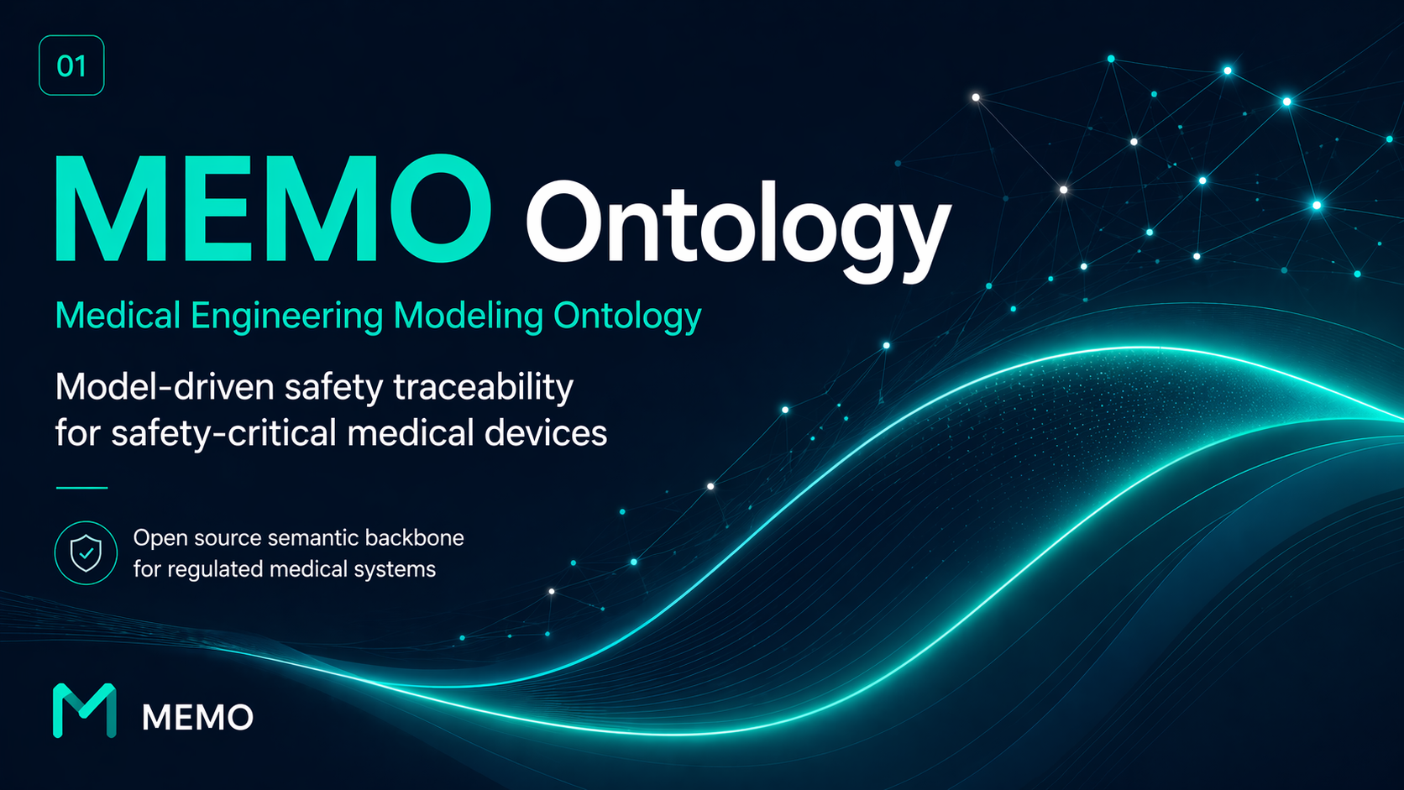

Slide 2
02
STORY
It is 11 p.m. before an audit. An engineer changes one line in REQ-145. The next morning, no one in the room can answer the question that follows: "What evidence is still valid?"
A small change. A clean diff. And a safety case that quietly stopped meaning what it said.
— A familiar story across regulated medical engineering

Slide 3
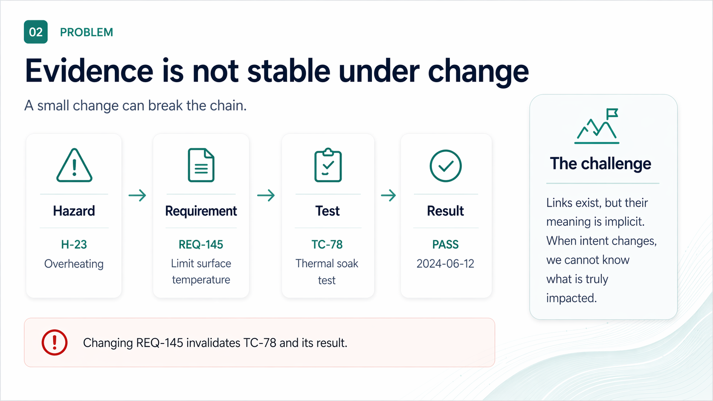

Slide 4
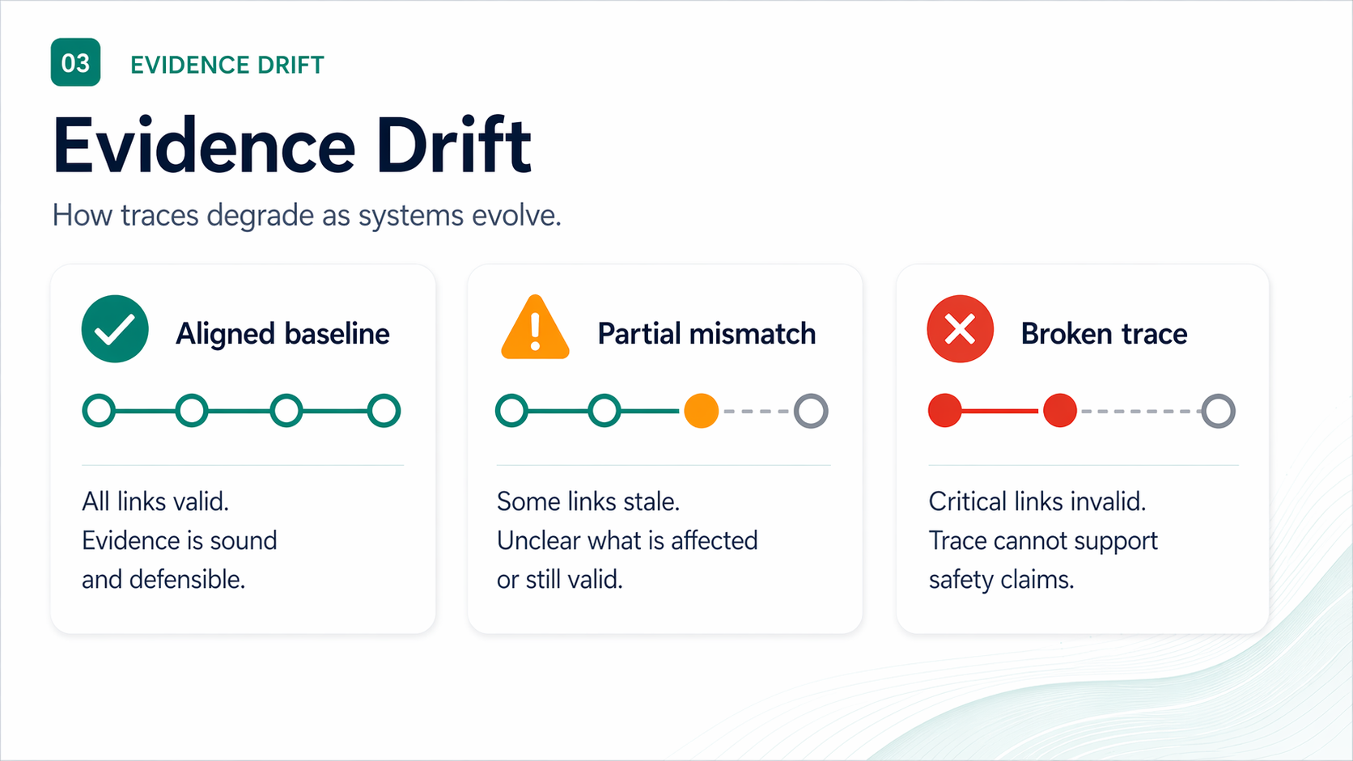

Slide 5
05
WHY IT MATTERS
Drift is expensive — and quiet
Unverified change is the silent driver of recalls, rework, and audit findings.
21%
~40%
DAYS
↻
FDA recalls
Rework cost
Audit time
Lost confidence
Software & traceability flagged in roughly one-fifth of Class II/III recalls (FDA MAUDE, 2023).
Late-stage requirement and risk rework absorbs 30–45% of typical V&V budgets.
Reconstructing a single broken trace before audit: days, not minutes.
Each silent break weakens the safety case the next reviewer reads.
The cost is not the link. It is the doubt every broken link injects into the case.
MEMO ONTOLOGY · INCOSE 2026
05 / 26

Slide 6
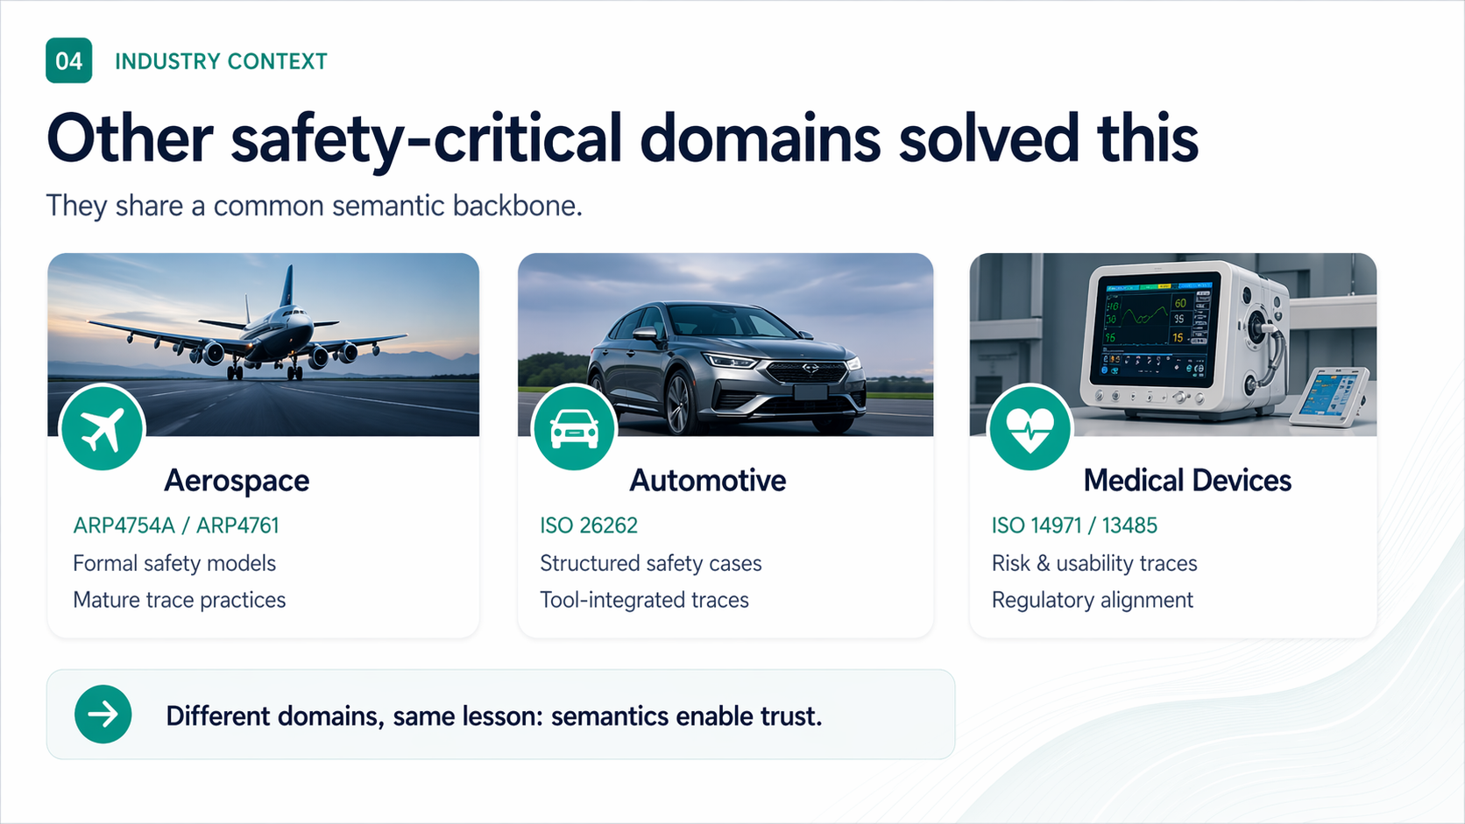

Slide 7
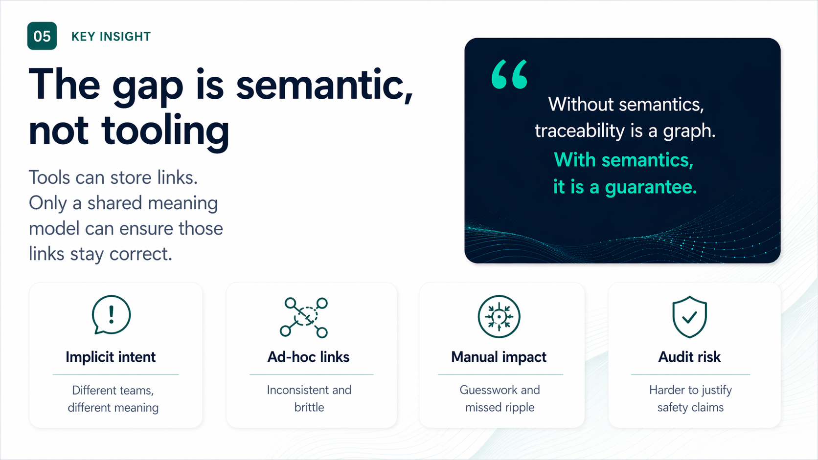

Slide 8
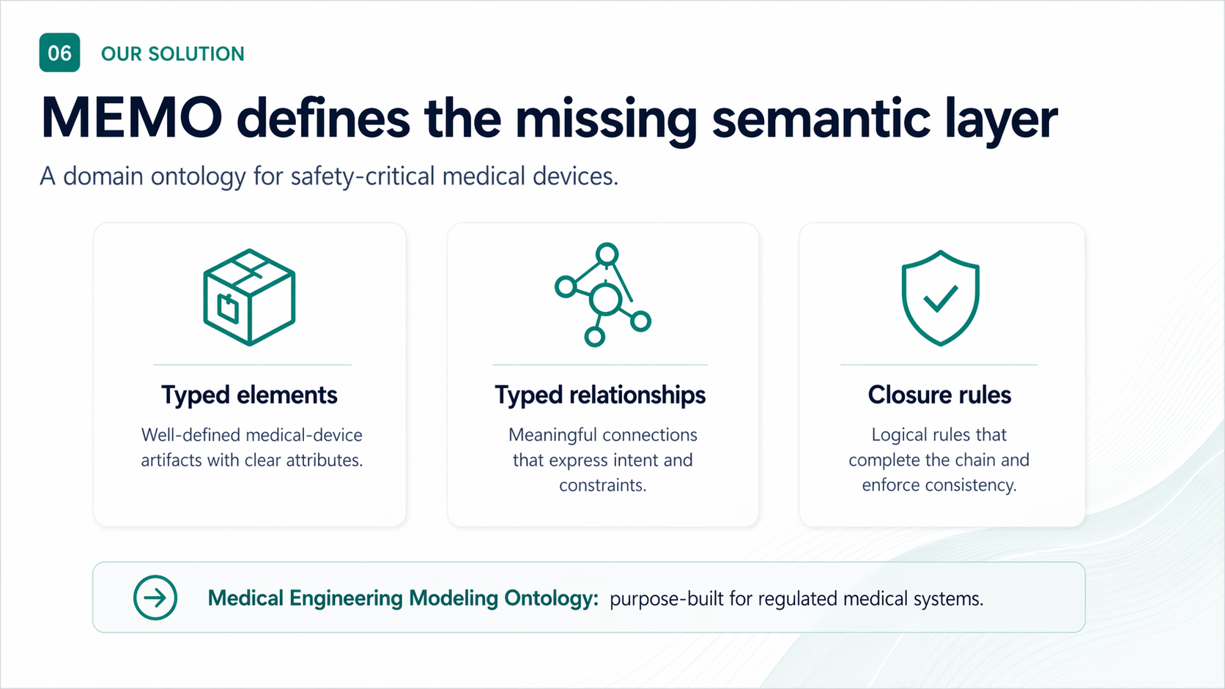

Slide 9
09
FRAMING · INCOSE
Built on what you already practice
MEMO is not a new methodology. It is a semantic layer underneath the methodologies your teams use.
ISO
MBSE
v2
ISO/IEC/IEEE 42010
Arcadia-inspired
SysML v2
Concerns → Viewpoints → Views → Models. MEMO supplies the typed elements that views reference.
Operational → System → Logical → Physical. MEMO names the layers; SysML v2 expresses them.
Kinds and links live in SysML v2 source — parsed, version-controlled, diffable. The model is the artifact.
Position. MEMO sits between the standards (ISO 14971, IEC 62304) and the modeling tools — a domain ontology, not a new tool stack.
MEMO ONTOLOGY · INCOSE 2026
09 / 26

Slide 10
10
STORYLINE
Architecture-centered MEMO loop
Behavior
+ scenarios
modes, contracts
Use MEMO as an iterative engineering loop — not a one-way checklist.
CONTEXT
Assurance
verification
Architecture
stable design backbone
Risk
hazard chains
VIEWS / DOCUMENTS
stakeholders, care setting, intended use
RMF · SDD · V&V · compiled views
Requirements
needs + obligations
Practitioner sequence. Architecture → behavior/scenarios → risk → requirements + assurance, then iterate back through architecture.
MEMO ONTOLOGY · INCOSE 2026
10 / 26

Slide 11
11
MEMO PACKAGES
MEMO ships two ontology packages
One for what the device is. One for what the regulator demands. They are decoupled by design.
@memo/ontology-arch
@memo/ontology-process
THE SYSTEM YOU'RE BUILDING
THE OBLIGATIONS YOU MUST MEET
Architecture vocabulary
Regulatory vocabulary
System, Function, Component, Interface, State, Hazard, Risk, Requirement, VerificationCase, Evidence — and the typed relationships that connect them.
Plans, activities, work products, and records demanded by each standard — modeled as first-class kinds, not buried in templates.
11 LAYERS
8 STANDARDS
operational · functional · logical · behavioral · software · hardware · safety · security · privacy · verification (+ ROS extension)
ISO 14971 · IEC 62304 · ISO 13485 · ISO 14155 · IEC 60601 · ISO 27001/27701 · FDA 21 CFR 820 · EU MDR
Why split. Architecture evolves with the device. Standards evolve on their own clock. Decoupling lets either change without rewriting the other.
MEMO ONTOLOGY · INCOSE 2026
11 / 26

Slide 12
12
ONTOLOGY-ARCH · LAYERS
Architecture ontology: 11 layers from intent to evidence
Layers progress from problem space to solution space. Each layer has its own kinds; relationships span layers.
Operational
System, Actor, IntendedUse, UserNeed
Functional
Function, DataObject, ConstraintDefinition
Behavioral
Scenario, StateMachine, State, Action, Event, Transition
Logical
LogicalComponent, Interface, Port
Software
SoftwareComponent, SoftwareModule, ExecutionThread
Software-Ext
ROS Node, Topic, Service (middleware)
Hardware
HardwareAssembly, Sensor, Actuator, Microcontroller
Safety
Hazard, HazardousSituation, Harm, Risk, Mitigation
Security
ThreatModel, ThreatScenario, SecurityControl
Privacy
PersonalData, ProcessingActivity, DataSubjectRight
Verification
Requirement, VerificationCase, TestArtifact, Evidence
Reading. Operational + Functional describe intent. Logical + Software + Hardware describe solution. Safety/Security/Privacy/Verification describe concerns and evidence that span both.
MEMO ONTOLOGY · INCOSE 2026
12 / 26

Slide 13
13
ARCH ELEMENTS · STRUCTURE
Real elements from operational, functional, logical layers
Each layer is a SysML v2 package. Drop a .sysml in sysml/<layer>/ and you have added kinds.
sysml/operational/operational.sysml
sysml/functional/ + sysml/logical/
package MEMO_Ontology_Arch_Operational {
part def Actor {
attribute name :
String;
attribute role :
String;
}
part def IntendedUse {
attribute statement : String;
attribute patientPopulation: String;
attribute useEnvironment : String;
attribute indications : String;
attribute contraindications: String;
}
}
package MEMO_Ontology_Arch_Functional {
// SysML v2 idiom: Function = action def
action def Function {
attribute functionId :
String;
attribute safetyClass:
String;
}
}
package MEMO_Ontology_Arch_Logical {
part def LogicalComponent { … }
part def Interface { … }
part def Port { protocol, direction }
}
SysML v2 idiom. Structure → part def. Function → action def. Both inherit attributes; both compose via connection def.
MEMO ONTOLOGY · INCOSE 2026
13 / 26

Slide 14
14
ARCH ELEMENTS · BEHAVIOR
Behavior is first-class — scenarios, states, transitions
State machines compose. Transitions are typed connections between states, with trigger / guard / effect.
sysml/behavioral/behavioral.sysml
Scenario = part def
package MEMO_Ontology_Arch_Behavioral {
part def Scenario {
attribute scenarioId : String;
attribute precondition : String;
attribute postcondition: String;
}
action def Action { attribute duration : String; }
action def ClinicalAction :> Action {
attribute clinicalContext : String;
attribute appliedPartType : String;
}
part def State {
attribute name : String;
attribute isInitial : Boolean;
attribute invariant : String;
}
// Transition is a typed connection
connection def Transition {
end source : State [1];
end target : State [1];
attribute trigger : String;
attribute guard : String;
attribute effect : String;
}
}
A named slice of behavior with pre/post conditions. Compose with action sequences.
Action = action def
Inheritance built in: ClinicalAction :> Action picks up duration; adds clinical context.
State = part def
States carry invariants. Hierarchical machines compose by part containment.
Transition = connection def
Trigger/guard/effect on the relationship — not buried in a state body.
MEMO ONTOLOGY · INCOSE 2026
14 / 26

Slide 15
15
ARCH ELEMENTS · SAFETY + EVIDENCE
Hazard chain and verification chain are typed kinds
Severity / probability / acceptability are enums. Audit columns compile from these attributes.
sysml/safety/safety.sysml
sysml/verification/verification.sysml
package MEMO_Ontology_Arch_Safety {
enum def SeverityLevel {
enum Negligible; enum Minor;
enum Serious; enum Critical;
enum Catastrophic;
}
part def Hazard {
attribute hazardId : String;
attribute category : String;
}
part def Risk {
attribute initialSeverity : SeverityLevel;
attribute initialProbability: ProbabilityLevel;
attribute residualSeverity : SeverityLevel;
attribute acceptability : RiskAcceptability;
}
}
package MEMO_Ontology_Arch_Verification {
part def Requirement {
attribute reqId : String;
attribute statement : String;
attribute verificationMethod : String;
}
part def VerificationCase {
attribute method : String;
attribute status : String;
attribute result : String;
}
part def Evidence {
attribute artifactType : String;
attribute version : String;
attribute location : String;
}
// Inheritance: Security/PrivacyRequirement :> Requirement
}
Why kinds, not strings. Severity = enum, not free-text. Validators check it. RMF view groups by it. Auditors trust it.
MEMO ONTOLOGY · INCOSE 2026
15 / 26

Slide 16
16
TYPED RELATIONSHIPS
Links carry meaning — not just direction
Every relationship is a connection def with named ends. Tools enforce kind on each side.
sysml/relationships/relationships.sysml
Structural
package MEMO_Ontology_Arch_Relationships {
// ── Structural ──────────────
connection def ComposedOf {
end whole[1]; end part[0..*];
}
// ── Traceability ────────────
connection def Satisfies {
end satisfiedBy[1];
end req :
Requirement [1];
}
connection def Verifies {
end verificationCase:
VerificationCase;
end subject[1];
}
// ── Allocation ──────────────
connection def AllocatedTo {
end function :
Function;
end structure[1];
}
connection def DeployedOn {
end software :
SoftwareComponent;
end hardware :
HardwareComponent;
}
}
ComposedOf · DecomposedBy · Aggregation · Realization
Traceability
TraceTo · Refines · Derives · Satisfies · Verifies · ProducesEvidence
Allocation
AllocatedTo (function→structure) · DeployedOn (sw→hw)
Safety
Mitigates · Causes · LeadsTo · IdentifiesRisk · ContributesTo
Interface
ConnectsTo · DataFlow · Sends · Receives
MEMO ONTOLOGY · INCOSE 2026
16 / 26

Slide 17
17
ONTOLOGY-PROCESS
Each standard is a SysML package
Plans, activities, work products are first-class — not buried in a Word template. They specialize a common base.
sysml/iso-14971/ + sysml/iec-62304/
ISO 14971
IEC 62304
Risk management
Software lifecycle
package MEMO_Ontology_Process_ISO14971 {
part def RiskManagementPlan :> WorkProduct {
attribute scope : String;
attribute riskPolicy : String;
attribute reviewFreq : String;
}
part def BenefitRiskAssessment :> WorkProduct {
attribute clinicalBenefit : String;
attribute residualRiskLevel: String;
attribute conclusion : String;
}
}
package MEMO_Ontology_Process_IEC62304 {
enum def SoftwareSafetyClass { enum A; enum B; enum C; }
part def SoftwareItem :> WorkProduct {
attribute safetyClass : SoftwareSafetyClass;
}
part def SOUPItem :> WorkProduct {
attribute soupId : String;
attribute supplier: String;
}
}
ISO 13485
ISO 14155
Quality system
Clinical investigation
IEC 60601
ISO 27001/27701
Electrical safety
Security & privacy
FDA 21 CFR 820
EU MDR
Quality system regulation
Conformity
:> WorkProduct. Process kinds inherit a common base in process-common — so all RM plans, software plans, design reviews share a uniform contract.
MEMO ONTOLOGY · INCOSE 2026
17 / 26

Slide 18
18
SYSML V2 IDIOMS
How MEMO maps engineering concepts to SysML v2
Picking the right v2 construct matters — it determines what a parser, validator, and view can compute.
ENGINEERING CONCEPT
SYSML V2 CONSTRUCT
WHY THIS CHOICE
Component / Subsystem
part def
structural decomposition; instances composed via :>
Function / Behavior
action def
first-class action — composes, decomposes, allocates
Scenario
action
concrete action sequence over the architecture
State machine state
part def
carries invariants; nests via composition
Transition
connection def
trigger / guard / effect on the link, not in state body
Hazard / Risk / Harm
part def
carry severity / probability / acceptability enums
Requirement
part def
id, statement, verificationMethod — extensible by :>
Trace / Allocation
connection def
named ends with kind constraints — typed semantics
Severity / Class enums
enum def
validators check membership; UIs render dropdowns
MEMO ONTOLOGY · INCOSE 2026
18 / 26

Slide 19
19
EXTENSION FRAMEWORK
Extend with a profile package — never edit the core
Profiles add domain depth above ontology-arch + ontology-process. Core stays tiny; profiles carry your specifics.
Layer 1 · Core
@memo/ontology-arch
WHAT A PROFILE CONTAINS
system, function, hazard, requirement, evidence
memo.package.yaml
identity (name, version, license)
Layer 2 · Standards
extends
@memo/ontology-process
memo.viewpoints.yaml
declarative views over kinds
RM plan, software safety class, design review, DHF
Layer 3 · Profile
extends
memo.rules.yaml
closure rules — validation policy
@memo/medical-modeling-profile
viewpoints, closure rules, device templates, your kinds
templates/<device>/
starter SysML for device archetypes
profiles/<size>.yaml
minimal · standard · full bundles
sysml/<your-pkg>/
your own kinds (Apollo-11 path = layer)
Rule of extension. Add packages and profiles. Do not edit the core. The medical-modeling-profile package is itself the reference implementation of this rule.
MEMO ONTOLOGY · INCOSE 2026
19 / 26

Slide 20
20
CUSTOMIZATION RECIPE
Five places to extend — from light-touch to deep
Pick the layer that fits the customization. Smaller change = closer to YAML; deeper change = own SysML package.
1
Pick a profile size
extends: profiles/standard.yaml
LIGHT
memo.config.yaml
2
Start from a device template
infusion-pump · ventilator · samd · monitoring · connected
LIGHT
memo init --template …
3
Author a viewpoint
id: my-cyber-view
visibleKinds: [ThreatModel, …]
MEDIUM
memo.viewpoints.yaml
4
Author closure rules
id: CR-CO-001
type: requireRelationship
…
MEDIUM
memo.rules.yaml
5
Add your own kinds in SysML
part def InfusionMode :> State { … }
DEEP
sysml/<your-layer>/*.sysml
MEMO ONTOLOGY · INCOSE 2026
20 / 26

Slide 21
21
WORKED EXAMPLE · GPCA
Meet GPCA — the reference model
Generic Patient-Controlled Analgesia infusion pump. Standardized public-domain target for medical-device safety research.
WHY GPCA
GPCA-PUMP/MODEL/
U. Minnesota CriSys benchmark
Public REQ catalogue (REQ 1–86)
IEC 62304 Class C software
Full ISO 14971 hazard chain published
Cited across FDA, NIH, INCOSE literature
requirements/
stakeholders, intended use, REQ tree
architecture/
system, subsystems, hardware, software items
behavior/
functions, state machine, action flows
risk/
harms, hazards, risk controls, FMEA, FTA
WHAT WE MODELED
cybersecurity/
threat model, scenarios, controls, SBOM
Stakeholders, intended use, 10+ user needs
40+ system + 20+ software requirements
16-state hierarchical state machine
10+ harms, 30+ risk controls, FMEA + FTA
Threat model + 8+ cybersecurity controls
clinical/
clinical evaluation, PMS feedback
compliance/
RMF, SDD, V&V views — compiled outputs
MEMO ONTOLOGY · INCOSE 2026
21 / 26

Slide 22
22
GPCA · ARCHITECTURE
GPCA architecture — System decomposed by ComposedOf
System → 6 subsystems → hardware components. Composition is a typed connection — not a tree string.
examples/gpca-pump/model/architecture/architecture.sysml
Imports the core
package GPCA_Architecture {
import MEMO_Ontology_Arch::*;
part gpcaSystem : System {
attribute redefines name =
"GPCA Infusion Pump System";
}
part controlSubsystem : Subsystem;
part fluidicsSubsystem : Subsystem;
part sensorSubsystem : Subsystem;
part uiSubsystem : Subsystem;
part powerSubsystem : Subsystem;
part networkSubsystem : Subsystem;
// Typed composition — not implicit tree
connection : ComposedOf connect whole ::> gpcaSystem
to part ::> controlSubsystem;
// ... 5 more ComposedOf connections
part mainProcessor : Microcontroller {
attribute redefines ram =
512;
}
part safetyProcessor : Microcontroller; // Cortex-M0 watchdog
}
import MEMO_Ontology_Arch::* — pulls Subsystem, Microcontroller, ComposedOf into scope.
Instances, not types
part declarations create instances; redefines overrides inherited attribute defaults.
Typed composition
ComposedOf has named ends — every link is checkable by validators.
Two processors
Main + safety co-processor pattern modeled explicitly — not buried in a Word section.
MEMO ONTOLOGY · INCOSE 2026
22 / 26

Slide 23
23
GPCA · BEHAVIOR
Functions as action def — decomposed and allocated
Top-level system function regulateFlow decomposes into component actions and is allocated to a SoftwareItem.
examples/gpca-pump/model/behavior/behavior.sysml
FUNCTION TREE
package GPCA_Behavior {
// SYSTEM FUNCTIONS — top of decomposition
action def sfRegulateFlow :> Function {
attribute redefines scope = FunctionScope::System;
attribute redefines name =
"Regulate Drug Flow";
}
action def sfDetectSafetyCondition :> Function;
action def sfManageAlarms :> Function;
// COMPONENT FUNCTIONS
action def cfCalculateFlowRate :> Function;
action def cfManageLockout :> Function;
// DECOMPOSITION
connection : DecomposedBy connect parent ::> sfRegulateFlow
to child ::> cfCalculateFlowRate;
connection : DecomposedBy connect parent ::> sfRegulateFlow
to child ::> cfManageLockout;
// ALLOCATION — function → software item
connection : AllocateTo connect function ::> sfRegulateFlow
to structure ::> siInfusionManager;
}
sfRegulateFlow (system)
↓ DecomposedBy
cfCalculateFlowRate
cfDriveMotor
cfManageLockout
↓ AllocateTo
siInfusionManager (Class C)
16-state hierarchical machine. OFF → ON → IDLE → THERAPY → ACTIVE → BASAL / SQUARE_BOLUS / PATIENT_BOLUS / PAUSED — full transitions in behavior.sysml.
MEMO ONTOLOGY · INCOSE 2026
23 / 26

Slide 24
24
GPCA · RISK
Harms with severity — straight from the SysML
Each harm is a typed instance of Harm with a SeverityLevel enum. Validators check the chain. RMF compiles from this.
examples/gpca-pump/model/risk/risk.sysml
HARM TAXONOMY (extract)
package GPCA_Risk {
import MEMO_Ontology_Arch::*;
// HARM-001 ─ patient death
requirement harmDeath : Harm {
attribute redefines title =
"Patient Death";
attribute redefines severity =
SeverityLevel::Catastrophic;
}
requirement harmRespiratoryDepression : Harm {
attribute redefines severity =
SeverityLevel::Critical;
}
requirement harmTissueDamage : Harm {
attribute redefines severity =
SeverityLevel::Serious;
}
requirement harmSepsis : Harm {
attribute redefines severity =
SeverityLevel::Critical;
}
}
HARM-001
Patient Death
Catastrophic
HARM-002
Respiratory Depression
Critical
HARM-003
Tissue Damage
Serious
HARM-004
Sepsis / Infection
Critical
HARM-005
Inadequate Pain Relief
Serious
HARM-006
Air Embolism
Critical
MEMO ONTOLOGY · INCOSE 2026
24 / 26

Slide 25
25
ADOPTION STRATEGY
Three horizons, one trajectory
An adoption-first roadmap that earns trust before it grows scope.
NOW · 2026
H1
2026–2027
H2
2027+
H3
Prove the backbone
Compile compliance
Ecosystem & assurance
open ontology-arch + ontology-process + medical-modeling-profile
GPCA + 4 device templates as worked references
SysML v2 source-of-truth, CLI + viewer
seed adoption with one design partner per modality
auto-compiled RMF, SDD, V&V views from one model
typed-link impact analysis & stale-evidence detection
profiles: cybersecurity, usability, AI/ML, alarms
PLM & ALM export adapters
device-specific profile registry
auditor-readable assurance cases
cross-domain bridges to ARP4761 / ISO 26262 patterns
community-governed ontology evolution
Sequence. Unified model first, then compliance outputs, then ecosystem — never the other way around.
MEMO ONTOLOGY · INCOSE 2026
25 / 26

Slide 26
26
NEXT STEP
Adopt the
semantic backbone.
Build safer medical devices. Prove it with confidence.
FASTER CHANGES
STRONGER CASES
BETTER QUALITY
with lower risk
with for regulators
with less rework
GET INVOLVED
M
MEMO
github.com/memo-ontology · INCOSE Medical SE WG · Open source · SysML v2 · ISO 42010 aligned

