Slide 1


Slide 2
02
STORY
It is 11 p.m. before an audit. An engineer changes one line in REQ-145. The next morning, no one in the room can answer the question that follows: "What evidence is still valid?"
A small change. A clean diff. And a safety case that quietly stopped meaning what it said.
— A familiar story across regulated medical engineering

Slide 3
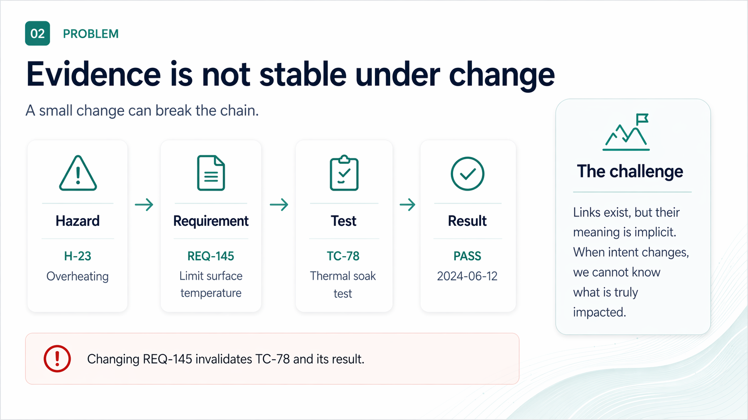

Slide 4
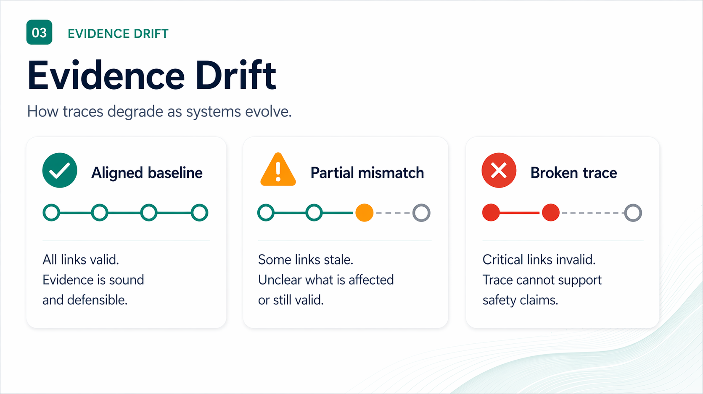

Slide 5
05
WHY IT MATTERS
Drift is expensive — and quiet
Unverified change is the silent driver of recalls, rework, and audit findings.
21%
~40%
DAYS
↻
FDA recalls
Rework cost
Audit time
Lost confidence
Software & traceability flagged in roughly one-fifth of Class II/III recalls (FDA MAUDE, 2023).
Late-stage requirement and risk rework absorbs 30–45% of typical V&V budgets.
Reconstructing a single broken trace before audit: days, not minutes.
Each silent break weakens the safety case the next reviewer reads.
The cost is not the link. It is the doubt every broken link injects into the case.
MEMO ONTOLOGY · INCOSE 2026
05 / 27

Slide 6
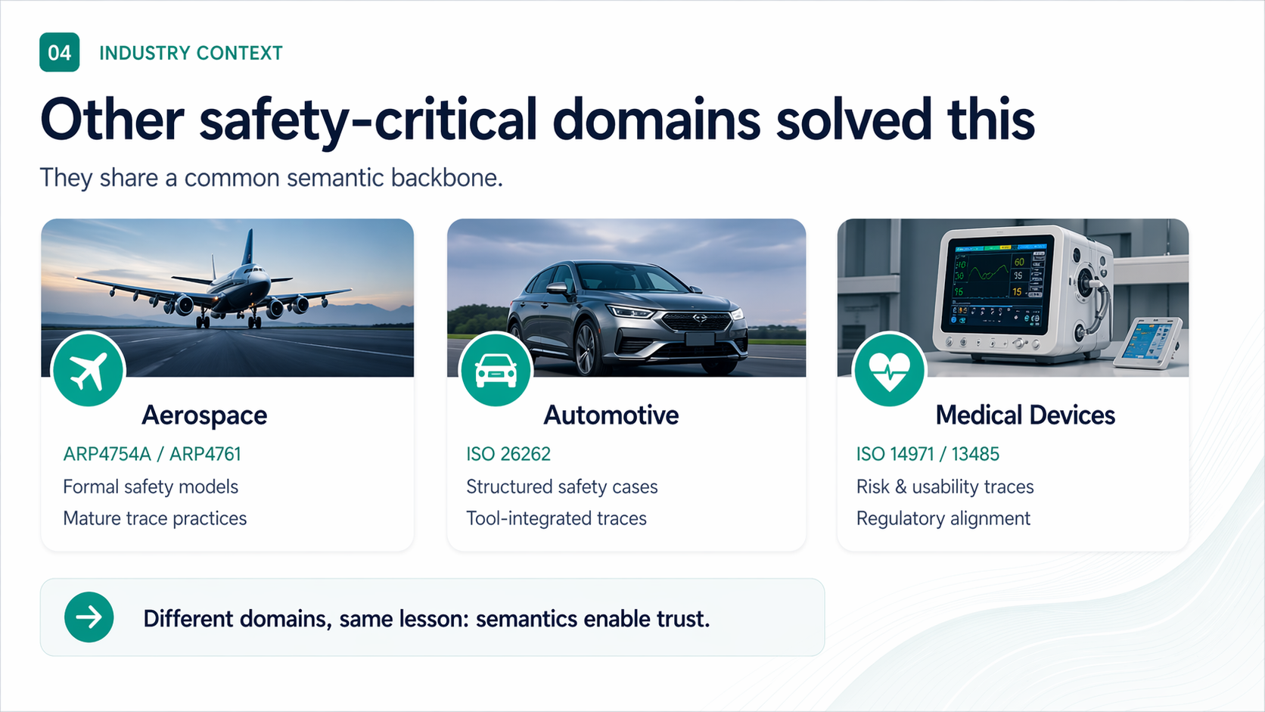

Slide 7
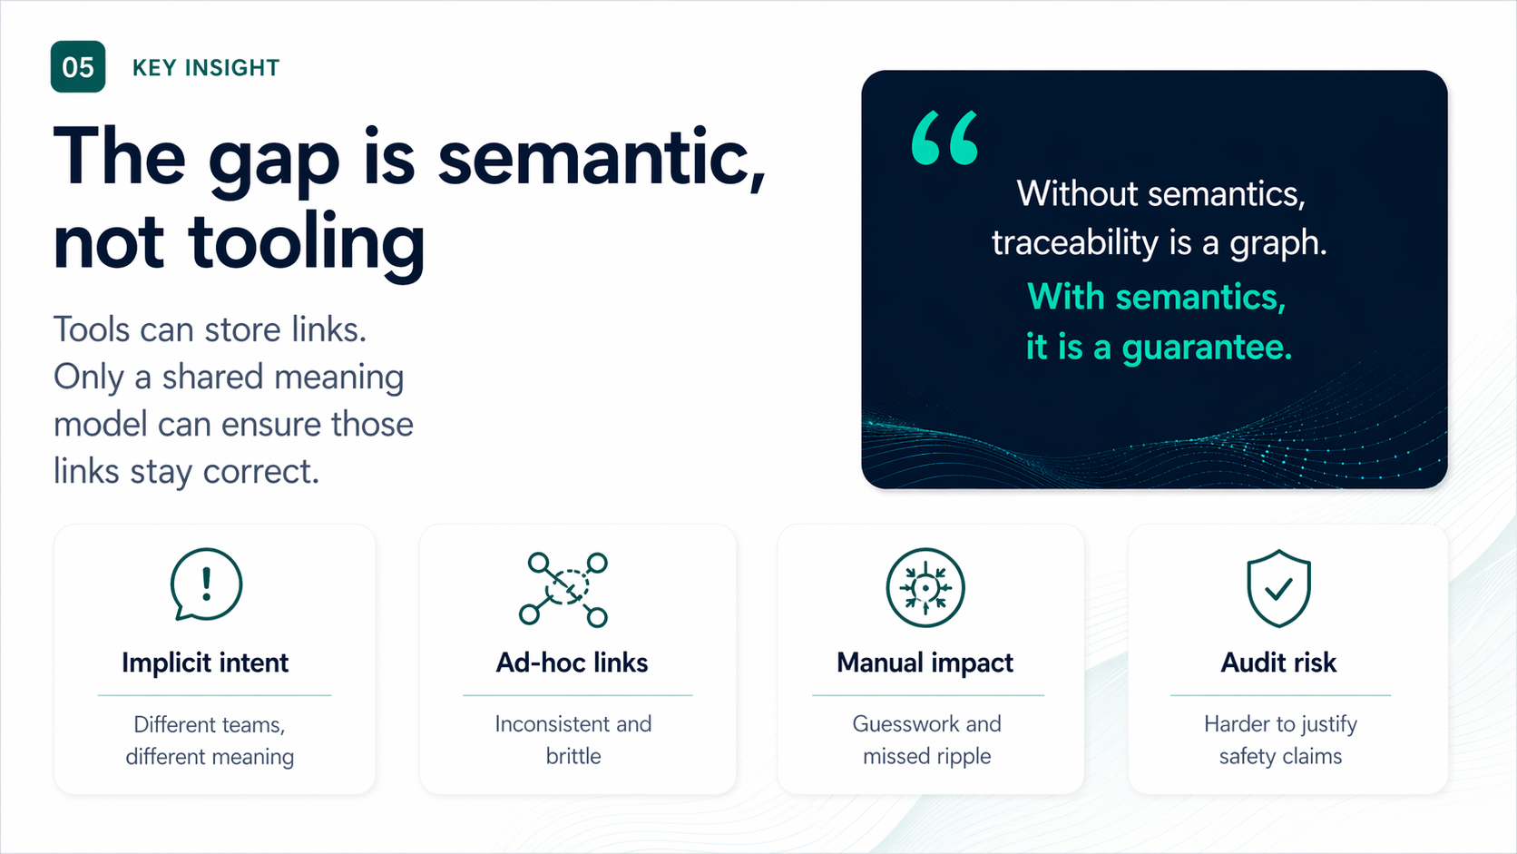

Slide 8
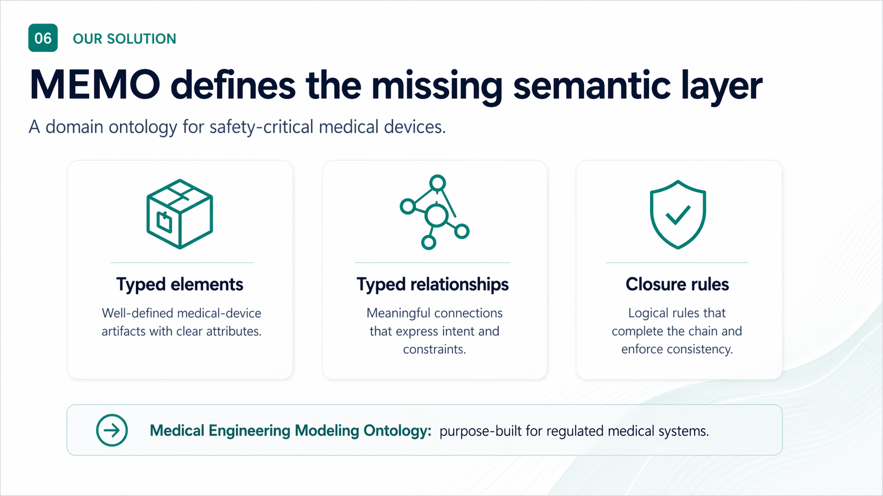

Slide 9
09
FRAMING · INCOSE
Built on what you already practice
MEMO is not a new methodology. It is a SysML v2 ontology underneath the methodologies your teams use.
ISO
MBSE
v2
ISO/IEC/IEEE 42010
Arcadia-inspired layering
SysML v2 source
Concerns → Viewpoints → Views → Models. md::viewpoints + md::views supply the typed elements that views reference.
Operational → Logical → Physical → Behavior, with risk and assurance as peers — not after-thoughts.
All kinds, links, viewpoints, methodology in SysML v2. Single coherent namespace md::. Single release version.
Position. MEMO sits between the standards (ISO 14971, IEC 62304, IEC 81001-5-1) and the modeling tools — a domain ontology, not a tool stack.
MEMO ONTOLOGY · INCOSE 2026
09 / 27

Slide 10
10
STORYLINE
Architecture-centered MEMO loop
Behavior
+ contracts
modes, properties
Use MEMO as an iterative engineering loop — not a one-way checklist.
CONTEXT
Assurance
verification
Architecture
stable design backbone
Risk
hazard chains
VIEWS / DOCUMENTS
stakeholders, care setting, intended use
RMF · SDD · V&V · compiled views
Requirements
needs + obligations
Practitioner sequence. Architecture → behavior/contracts → risk → requirements + assurance, iterate back through architecture.
MEMO ONTOLOGY · INCOSE 2026
10 / 27

Slide 11
11
MEMO PACKAGE
One namespace. One release. md::
MEMO ships as a single SysML v2 package — md::library — versioned 1.0.0. Layers are sub-packages, not separate libraries.
medical_device_library.sysml
Single namespace
package md::library {
public import md::core::*; // abstract bases, enums, links
public import md::manifest::release::*; // version, changelog
public import md::architecture::context::*;
public import md::architecture::requirements::*;
public import md::architecture::functions::*;
public import md::architecture::behavior::*;
public import md::architecture::logical_structure::*;
public import md::architecture::software_structure::*;
public import md::architecture::hardware_structure::*;
public import md::architecture::risk::*;
public import md::architecture::cybersecurity::*;
public import md::architecture::assurance::*;
public import md::viewpoints::*; // reusable selection intent
public import md::views::*; // model-driven content
public import md::compliance::artifacts::*;
public import md::methodology::*; // profiles, rules, gates
}
md:: spans every layer. No MEMO_Ontology_*. Imports are short and predictable.
Single release version
1.0.0 covers core, architecture, methodology, viewpoints, views, compliance, examples.
Layers ≠ libraries
Architecture sub-packages are layers. Viewpoints + views are first-class libraries.
Source-of-truth
Ontology stays the source of truth; methodology guides without owning viewpoints.
MEMO ONTOLOGY · INCOSE 2026
11 / 27

Slide 12
12
TOP-LEVEL STRUCTURE
Seven sub-packages under md::
Each sub-package is a focused library. Architecture is decomposed into 13 ontology layers.
md::core
abstract bases · enumerations · semantic links
common · enumerations · relationships
md::architecture
13 ontology layers — what the device is
context · requirements · functions · behavior · logical_structure · logical_interfaces · software_structure · hardware_structure · physical_interfaces · constraints · risk · cybersecurity · assurance
md::methodology
how to apply the ontology
core · profiles · viewpoints · rules · patterns · workflow · gates
md::viewpoints
reusable selection intent
core · default_viewpoints
md::views
model-driven content + presentation
core · document_views
md::compliance
controlled artifacts + document views
artifacts · document_views
md::examples::gpca
worked example — GPCA infusion pump
architecture · behavior_modes · behavior_subsystems · interfaces · requirements · risk · cybersecurity · verification · formal_behavior · methodology · trace · views · document_views
MEMO ONTOLOGY · INCOSE 2026
12 / 27

Slide 13
13
md::core
Abstract bases, enumerations, semantic links
The whole ontology specializes a small set of bases. Enums encode categorical attributes. Links carry typed semantics.
core/md_common.sysml
core/md_enumerations.sysml + md_relationships.sysml
package md::core::common {
part def IdentifiedElement {
attribute id : String;
attribute name : String;
attribute description : String;
}
part def TraceableElement :> IdentifiedElement {
attribute rationale : String;
attribute sourceReference : String;
}
part def ArchitectureElement :> TraceableElement;
part def VerifiableElement :> TraceableElement;
part def EvidenceElement :> TraceableElement;
part def InterfaceElement :> TraceableElement;
part def RequirementDriver :> TraceableElement;
}
package md::core::enumerations {
enum def ConcernKind { safety; usability; cybersecurity;
performance; privacy; regulatory; }
enum def SafetyClassKind { none; A; B; C; }
enum def HazardTypeKind { overdose; underdose; occlusion;
freeFlow; airInLine; reverseDelivery; … }
enum def ThreatCategoryKind { spoofing; tampering; …;
informationDisclosure; elevationOfPrivilege; }
}
package md::core::relationships {
part def SemanticLink :> TraceableElement;
part def RequirementSatisfactionLink :> SemanticLink;
part def VerificationLink :> SemanticLink;
…
}
28+ enums. ConcernKind · CriticalityKind · SafetyClassKind · HazardTypeKind · RiskControlKind · ThreatCategoryKind · CyberControlKind · AudienceKind · WorkflowStageKind · DocumentViewKind …
MEMO ONTOLOGY · INCOSE 2026
13 / 27

Slide 14
14
md::architecture · LAYERS
Thirteen ontology layers under md::architecture
Each layer is a sub-package. Layers progress from intent and need to solution and evidence; risk and cybersecurity are peers.
context
Actor, UseContext
requirements
StakeholderNeed, Requirement, SystemRequirement, SoftwareRequirement, HardwareRequirement
functions
LogicalFunction, LogicalFlow, DataDefinition, ControlDefinition
behavior
BehaviorMachine, ModeState, Transition, Contract, AssumeProperty, GuaranteeProperty
logical_structure
LogicalComponent
logical_interfaces
LogicalInterface (domain · kind · pattern)
software_structure
SoftwareSystem, SoftwareComponent (period, deadline, WCET, scheduling)
hardware_structure
HardwareAssembly
physical_interfaces
PhysicalInterface, PortBinding
constraints
ConstraintDefinition (timing, resource, env)
risk
Hazard, RiskBeforeMitigation, RiskAfterMitigation, RiskMatrix, RiskControl
cybersecurity
CybersecurityAsset, AttackSurface, Threat, Vulnerability, Mitigation
assurance
VerificationCase, TestArtifact, Evidence
Reading. Cybersecurity is a peer to safety/software/hardware/assurance — modeled as ontology layer, not bolted on later.
MEMO ONTOLOGY · INCOSE 2026
14 / 27

Slide 15
15
ARCH · CONTEXT + REQUIREMENTS
Stakeholders, intended use, requirements as kinds
Specialize abstract bases. Attributes carry the regulator-relevant fields.
architecture/md_context.sysml
architecture/md_requirements.sysml
package md::architecture::context {
part def Actor :> TraceableElement {
attribute actorKind : String;
attribute trainingLevel : String;
}
part def UseContext :> TraceableElement {
attribute careSetting : String;
attribute environment : String;
attribute jurisdiction : String;
attribute connectedUse : Boolean;
}
}
package md::architecture::requirements {
requirement def StakeholderNeed :> RequirementDriver {
attribute statement : String;
attribute priority : String;
}
requirement def Requirement :> VerifiableElement {
attribute statement : String;
attribute sourceKind :
RequirementSourceKind;
attribute concernKind :
ConcernKind;
attribute status :
RequirementStatusKind;
attribute acceptanceCriteria : String;
attribute assumptionSummary : String;
attribute guaranteeSummary : String;
}
requirement def SoftwareRequirement :> Requirement {
attribute safetyClass :
SafetyClassKind;
}
}
SysML idiom. Requirements use SysML v2 requirement def — they are first-class verifiable elements, not docstring fields on parts.
MEMO ONTOLOGY · INCOSE 2026
15 / 27

Slide 16
16
ARCH · FUNCTIONS + BEHAVIOR
Functions, modes, contracts — assume / guarantee built in
Behavior carries formal properties. Contracts attach to architecture elements and feed model checking.
architecture/md_functions.sysml
architecture/md_behavior.sysml
package md::architecture::functions {
part def LogicalFunction :> ArchitectureElement {
attribute functionCategory : String;
attribute trigger : String;
attribute concernKind :
ConcernKind;
attribute criticality :
CriticalityKind;
}
part def LogicalFlow :> ArchitectureElement {
attribute flowKind :
FlowKind;
attribute direction :
DirectionKind;
attribute latencyBudgetMs : Real;
attribute integrityLevel : String;
}
}
package md::architecture::behavior {
part def BehaviorMachine :> ArchitectureElement;
part def ModeState :> ArchitectureElement;
part def Transition :> ArchitectureElement {
attribute trigger : String;
attribute guardSummary : String;
attribute effectSummary : String;
attribute sameStepCritical: Boolean;
}
part def BehaviorProperty :> VerifiableElement {
attribute propertyKind :
BehaviorPropertyKind;
attribute languageKind :
PropertyLanguageKind;
attribute formalExpression : String;
}
part def AssumeProperty :> BehaviorProperty;
part def GuaranteeProperty :> BehaviorProperty;
part def Contract :> VerifiableElement;
}
Properties carry language. AGREE-like, LTL-like, CTL-like — property language is captured, so model checkers can target the right ones.
MEMO ONTOLOGY · INCOSE 2026
16 / 27

Slide 17
17
ARCH · RISK + CYBERSECURITY
Safety and security as peer ontology layers
Hazard chain on one side, threat chain on the other — both feed the same RequirementDriver / VerifiableElement contract.
architecture/md_risk.sysml
architecture/md_cybersecurity.sysml
package md::architecture::risk {
part def Hazard :> TraceableElement {
attribute hazardType :
HazardTypeKind;
attribute foreseeable : Boolean;
}
part def RiskBeforeMitigation :> Risk {
attribute foreseeableMisuseIncluded : Boolean;
}
part def RiskAfterMitigation :> Risk {
attribute residualAcceptability : String;
attribute benefitRiskRequired : Boolean;
}
part def RiskControl :> VerifiableElement {
attribute controlKind :
RiskControlKind;
}
}
package md::architecture::cybersecurity {
part def CybersecurityAsset :> ArchitectureElement {
attribute assetKind :
AssetKind;
attribute confidentialityNeed : String;
attribute integrityNeed : String;
attribute availabilityNeed : String;
attribute safetyRelevant : Boolean;
}
part def AttackSurface :> TraceableElement {
attribute entryPointKind :
InterfaceKind;
attribute exposureLevel : String;
attribute authenticationExpected : Boolean;
}
part def Threat :> RequirementDriver {
attribute threatCategory :
ThreatCategoryKind;
attribute attackVector : String;
attribute strideCategory :
ThreatCategoryKind;
}
}
Why peers. Threat :> RequirementDriver — exactly like Risk. Same downstream machinery generates security requirements and verification.
MEMO ONTOLOGY · INCOSE 2026
17 / 27

Slide 18
18
TYPED SEMANTIC LINKS
Links carry roles — not just direction
Every link is a SemanticLink subtype with named part roles. Linker checks kind on each end.
core/md_relationships.sysml
Requirement
RequirementSourceLink · RequirementSatisfactionLink
package md::core::relationships {
part def SemanticLink :> TraceableElement {
attribute linkStatus :
LinkStatusKind;
}
part def RequirementSourceLink :> SemanticLink {
attribute sourceRole : String;
part sourceDriver :
RequirementDriver;
part targetRequirement:
VerifiableElement;
}
part def FunctionAllocationLink :> SemanticLink {
part function :
ArchitectureElement;
part allocatedElement :
ArchitectureElement;
}
part def VerificationLink :> SemanticLink {
part verificationTarget :
VerifiableElement;
part verificationCase :
VerifiableElement;
}
}
Function
FunctionAllocationLink
Interface
InterfaceRealizationLink · TrustBoundaryCrossingLink
Verification
VerificationLink · EvidenceProductionLink · DocumentInclusionLink
Risk
RiskTraceLink (initiates · leadsTo · canCause · resultsIn · aggregates …)
Cyber
AssetThreatLink · ThreatVulnerabilityLink · CyberSafetyTraceLink
Execution
ExecutionOrderLink (sameStepRequired)
Methodology
MethodologyBindingLink
MEMO ONTOLOGY · INCOSE 2026
18 / 27

Slide 19
19
md::methodology
Methodology shapes how the ontology is applied
Definitions select rigor, viewpoints, rules, patterns, gates. Resolved methodologies bind to a project.
methodology/md_profiles.sysml
core
MethodologyDefinition · ResolvedMethodology · ProjectMethodBinding
package md::methodology::profiles {
part mdCoreLibrary : MethodologyLibrary {
attribute id =
"METHLIB-001";
attribute name =
"MedicalDeviceMethodologyLibrary";
attribute version =
"0.1";
}
part mdLightDefaultDefinition : MethodologyDefinition {
attribute description =
"Light default methodology around the
ontology for smaller or early project use."
;
}
part mdLightDefaultResolved : ResolvedMethodology {
attribute rigor =
MethodRigorKind::lightweight;
}
part riskView : Viewpoint {
attribute purpose =
"Focus on risk chain, controls,
verification, residual risk."
;
attribute audience =
AudienceKind::safetyEngineer;
attribute stage =
WorkflowStageKind::risk;
}
}
profiles
instances: light, balanced, formal
viewpoints
default viewpoints per audience/stage
rules
ViewRule (required · recommended · forbidden)
patterns
ModelingPattern — recurring shapes
workflow
WorkflowStage sequencing
gates
ReviewGate, exit criteria
MEMO ONTOLOGY · INCOSE 2026
19 / 27

Slide 20
20
md::viewpoints + md::views
Viewpoints declare intent. Views bind it to content.
First-class libraries — not buried under methodology or compliance. Selection queries are explicit.
viewpoints/md_viewpoint_core.sysml
views/md_view_core.sysml
package md::viewpoints::core {
part def Viewpoint :> DocumentedElement {
attribute purpose : String;
attribute audience :
AudienceKind[*];
attribute stage :
WorkflowStageKind;
attribute outputKind :
ViewOutputKind[*];
attribute presentationKind :
PresentationKind[*];
attribute concern :
ConcernKind[*];
attribute includedLayers : String[*];
attribute allowedElementKinds : String[*];
attribute allowedRelationshipKinds : String[*];
attribute filterExpression : String;
}
}
package md::views::core {
part def ViewSelectionQuery :> TraceableElement {
attribute includeElementKinds : String[*];
attribute includeRelationshipKinds : String[*];
attribute includeLayers : String[*];
attribute includeConcerns :
ConcernKind[*];
}
part def View :> DocumentedElement {
part viewpoint :
Viewpoint;
ref exposesElement :
TraceableElement[*];
ref exposesRelationship :
SemanticLink[*];
part selectionQuery : ViewSelectionQuery[*];
}
part def DiagramView :> View;
part def DocumentBackedView :> View {
attribute version : String;
attribute lifecycleState :
LifecycleStateKind;
}
}
Separation. Viewpoint = intent (audience, stage, allowed kinds). View = bound content (selection query, exposed elements, presentation).
MEMO ONTOLOGY · INCOSE 2026
20 / 27

Slide 21
21
EXTENSION
Extend through methodology profiles
Pick rigor. Pick viewpoints. Pick rules. Bind to project. The ontology stays unchanged.
1
Pick rigor
rigor = lightweight
| balanced
| formal
MethodRigorKind
2
Pick viewpoints
audience = safetyEngineer
stage = risk
Viewpoint instances
3
Author rules
elementTypeName = "Hazard"
relationTypeName = "RiskTrace"
strength = required
ViewRule instances
4
Bind to project
projectName = "GPCA Pump"
resolvedMethodology = ...
ProjectMethodBinding
5
Add domain kinds
part def InfusionMode :>
ModeState { ... }
your own md::* package
Rule. Add packages and methodology profiles. Don't edit core. Methodology guides without owning viewpoints.
MEMO ONTOLOGY · INCOSE 2026
21 / 27

Slide 22
22
WORKED EXAMPLE · GPCA
Meet GPCA — md::examples::gpca
Generic Patient-Controlled Analgesia infusion pump. Public-domain U. Minnesota CriSys benchmark, IEC 62304 Class C.
WHY GPCA
md::examples::gpca::*
U. Minnesota CriSys benchmark
Public REQ catalogue (REQ 1–86)
IEC 62304 Class C software
Full ISO 14971 hazard chain published
Cited across FDA, NIH, INCOSE literature
requirements
needs · system & software requirements
architecture
hardware assemblies + software components
interfaces
logical + physical interfaces
behavior_modes
16-state hierarchical mode machine
behavior_subsystems
function decomposition per subsystem
formal_behavior
Contracts · AGREE-like · LTL properties
risk
hazard chain + RiskControl + residual eval
WHAT WE MODELED
cybersecurity
threat model + STRIDE scenarios + controls
Stakeholders, intended use, user needs
Hierarchical mode machine OFF/IDLE/PAUSED/BASAL/SQUARE/PATIENT_BOLUS
Software components TLM · Alarm · InfusionMgr · 5+ more
Hazard chain + lockout RiskControl + benefit-risk eval
AGREE-like guarantees + LTL temporal properties
verification
VerificationCase · TestArtifact · Evidence
trace
all SemanticLink instances across layers
views, document_views
DiagramView + DocumentBackedView (RMF, SDD, V&V)
methodology
ProjectMethodBinding for GPCA
MEMO ONTOLOGY · INCOSE 2026
22 / 27

Slide 23
23
GPCA · ARCHITECTURE + REQUIREMENTS
Software components and the requirements they satisfy
Real instances — not pseudo-code. SafetyClassKind::C is an enum; periodMs / WCET are typed; statements are full SysML.
examples/gpca/gpca_architecture.sysml
examples/gpca/gpca_requirements.sysml
package md::examples::gpca::architecture {
part tlm : SoftwareComponent {
attribute id =
"SW-001";
attribute name =
"Top_Level_Mode";
attribute responsibility =
"Ensure ON/OFF, startup/shutdown checks";
attribute safetyClass =
SafetyClassKind::C;
attribute periodMs =
20.0;
attribute deadlineMs =
20.0;
attribute wcetMs =
2.0;
attribute schedulingPolicy =
fixedPriorityPreemptive;
}
part alarm : SoftwareComponent { /* SW-003 · Class C */ }
part infusionMgr: SoftwareComponent { /* SW-005 · Class C */ }
}
package md::examples::gpca::requirements {
requirement needSafeTherapy : StakeholderNeed {
attribute id =
"NEED-001";
attribute statement =
"Support safe patient-controlled
analgesic infusion therapy."
;
attribute priority =
"high";
}
requirement reqLockout : SoftwareRequirement {
attribute id =
"REQ-025";
attribute statement =
"Ignore patient bolus requests that
violate lockout or max bolus."
;
attribute sourceKind =
RequirementSourceKind::risk;
attribute concernKind =
ConcernKind::safety;
attribute safetyClass =
SafetyClassKind::C;
}
}
MEMO ONTOLOGY · INCOSE 2026
23 / 27

Slide 24
24
GPCA · RISK
Hazard → Sequence → Situation → Harm → Risk → Control → Residual
Six-link chain expressed as RiskTraceLink instances. Each node is typed; severity, probability, acceptability are enums.
examples/gpca/gpca_risk.sysml
CHAIN
package md::examples::gpca::risk {
part overdoseHazard : Hazard {
attribute hazardType =
HazardTypeKind::overdose;
attribute foreseeable =
true;
}
part seqFrequentBolus : SequenceOfEvents;
part hsExcessInfusion : HazardousSituation;
part harmRespiratoryDepression : Harm {
attribute criticality =
CriticalityKind::catastrophic;
}
part lockoutControl : RiskControl {
attribute controlKind =
RiskControlKind::inherentSafeDesign;
}
part riskBefore : RiskBeforeMitigation {
attribute riskLevel =
"High";
attribute acceptability =
"Unacceptable";
}
part riskAfter : RiskAfterMitigation;
part residualEval: OverallResidualRiskEvaluation;
}
Hazard
overdoseHazard
↓
Sequence
seqFrequentBolus
↓
Situation
hsExcessInfusion
↓
Harm
harmRespiratoryDepression
↓
Control
lockoutControl
↓
Residual
riskAfter / residualEval
MEMO ONTOLOGY · INCOSE 2026
24 / 27

Slide 25
25
GPCA · TRACE
Traceability is data — not a matrix
Every link is a typed instance with status. The RMF view, V&V matrix, and impact analysis all read the same SemanticLink instances.
examples/gpca/gpca_trace.sysml
ONE CLOSED THREAD
package md::examples::gpca::trace {
// Need → Requirement
part linkNeedToModeReq : RequirementSourceLink {
attribute sourceRole =
"stakeholder need";
part sourceDriver = needSafeTherapy;
part targetRequirement= reqSingleMode;
}
// Risk → Software Requirement
part linkRiskToLockoutReq : RequirementSourceLink {
attribute sourceRole =
"risk driver";
part sourceDriver = riskBefore;
part targetRequirement= reqLockout;
}
// Requirement → Component
part linkReqToIM : RequirementSatisfactionLink {
part requirement = reqLockout;
part satisfyingElement = infusionMgr;
}
// Requirement → VerificationCase
part linkVerifyLockoutReq : VerificationLink {
part verificationTarget = reqLockout;
part verificationCase = vcLockout;
}
// VerificationCase → Evidence
part linkEvidenceProduction : EvidenceProductionLink {
part producer = vcLockout;
part producedEvidence= evidenceLockout;
}
// Same-step execution constraint
part orderAlarmBeforeIM : ExecutionOrderLink {
attribute sameStepRequired = true;
part predecessor = alarm;
part successor = infusionMgr;
}
}
Need
needSafeTherapy
↓
Requirement
reqLockout
↓
Component
infusionMgr
↓
Risk control
lockoutControl
↓
Verification
vcLockout
↓
Evidence
evidenceLockout
↓
Document
rmfView
MEMO ONTOLOGY · INCOSE 2026
25 / 27

Slide 26
26
ADOPTION STRATEGY
Three horizons, one trajectory
Adoption-first roadmap. Earn trust, then grow scope.
NOW · 2026
H1
2026–2027
H2
2027+
H3
Prove the backbone
Compile compliance
Ecosystem & assurance
open md:: package 1.0.0 (core, architecture, methodology, viewpoints, views, compliance)
GPCA worked example as proof artifact
SysML v2 source, CLI + viewer
seed adoption with one design partner per modality
auto-compiled DocumentBackedView (RMF, SDD, V&V) from one model
typed-link impact analysis & stale-evidence detection
extra layers: AI/ML, alarms, usability
PLM & ALM export adapters
device-specific methodology profiles
auditor-readable assurance cases
cross-domain bridges to ARP4761 / ISO 26262 patterns
community-governed ontology evolution
Sequence. Unified model first, then compliance outputs, then ecosystem — never the other way around.
MEMO ONTOLOGY · INCOSE 2026
26 / 27

Slide 27
27
NEXT STEP
Adopt the
semantic backbone.
Build safer medical devices. Prove it with confidence.
FASTER CHANGES
STRONGER CASES
BETTER QUALITY
with lower risk
with for regulators
with less rework
GET INVOLVED
M
MEMO
md:: 1.0.0 · Open source · SysML v2 · ISO 42010 aligned · INCOSE Medical SE WG

