Slide 1
Lenin and Stalin on Russian TV
Forecasting historical references in a television archive
Sofya Kupcha, Ksenia Paltseva, Timofey Mingalev
Forecasting problem
Forecast specification
How many references to Lenin and Stalin
will appear on four federal TV channels
over the next 31 days?
TARGET VARIABLES
Daily counts of mentions and archive
records with at least one mention
Why should we care?
HORIZON AND INFORMATION CUTOFF
Study political narratives through historical references.
Track changes over time and compare channels.
Build a profile of editorial framing and examine
possible propagandistic uses of historical figures.
3 Oct - 2 Nov 2026: 31 days
Information available through 2 October
FORECAST SHAPE
Predictive distributions for integer counts;
means and 80% / 95% predictive intervals
Mention counts alone do not measure news quality or establish that a message is propaganda.
01
Notes:
0:00-1:00. Introduce the forecasting problem before discussing models. We predict how often Lenin and Stalin will be referred to in four federal television channels over the next 31 days. We care because references to historical figures can form part of political narratives. We want to track changes over time, compare editorial framing across channels, and examine possible propagandistic uses of these references. A probabilistic forecast provides a benchmark for unusual frequency relative to recurring calendar patterns. This is a motivation for analysis, not a finding that the measured references constitute propaganda. Mention counts alone do not measure news quality; that would require contextual content analysis and separate validation. It does not explain political causes or measure audience exposure. We forecast daily mentions and daily archive records containing at least one mention, separately for each person and channel. The horizon is 3 October through 2 November, with information frozen at 2 October. The forecast object is a predictive distribution of integer counts, summarized by means and 80 and 95 percent predictive intervals. Monthly totals are derived from complete joint trajectories.
Sources: output/forecast_v2/README.md; analysis/forecast_v2.py. Course: L1 forecast objects, L2 posterior predictive distributions.

Slide 2
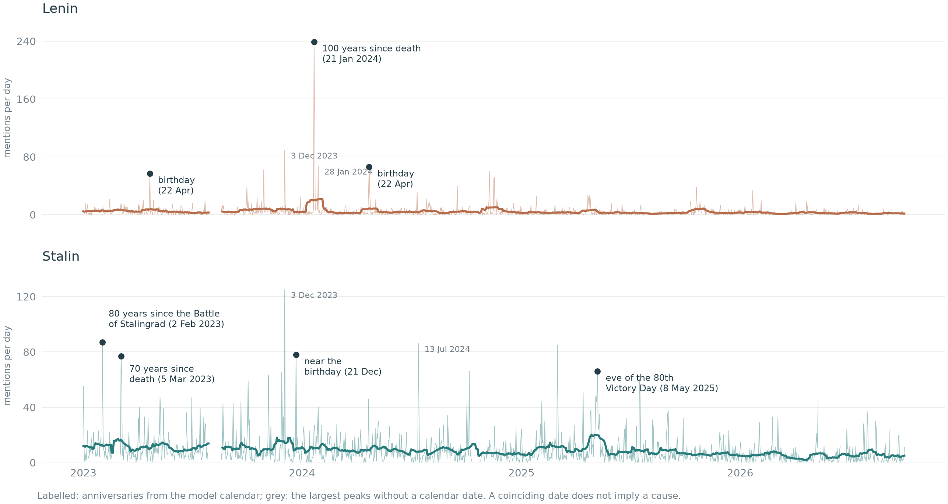
Data: outcomes and forecasting information
GDELT broadcast transcripts, Jan 2023 - Oct 2026; Channel One, NTV, Russia 1 and Russia 24
Outcomes
Mentions and records with
at least one mention
2 figures × 4 channels
× 2 targets = 16 series
Predictor information
Past archive counts
Channel and time trend
Month and weekday
Known anniversary dates
5,334 / 5,484
observed channel-days
Archive gaps are not zeros
Names are screened by context to distinguish person references from named objects and other people.
02
Notes:
1:00-2:15. These are the original history_peaks plots generated by the project code: daily mention totals for fully observed four-channel days, a 28-day mean, and annotated historical peaks. Outcomes come from GDELT archive transcripts and metadata. We count occurrences of person references and archive records containing at least one such reference; repeated mentions can increase the first target without increasing the second. Predictive information consists of past outcomes and archive volume, channel, time trend, calendar month, weekday, and known anniversary dates. No observations after the forecast origin are used to fit that origin. Future archive volume is forecast rather than supplied as observed. The coverage count is 5,334 observed channel-days out of 5,484. Missing archive days are excluded and are not interpreted as zero mentions. Context rules screen named objects and other people, but independent manual precision/recall remains unestablished.
Sources: data/cleaned/tv_daily_targets.csv.gz; analysis/project_figures.py, history_peaks_figure; analysis/joint_count_models.py. Original English history_peaks image is unchanged.

Slide 3
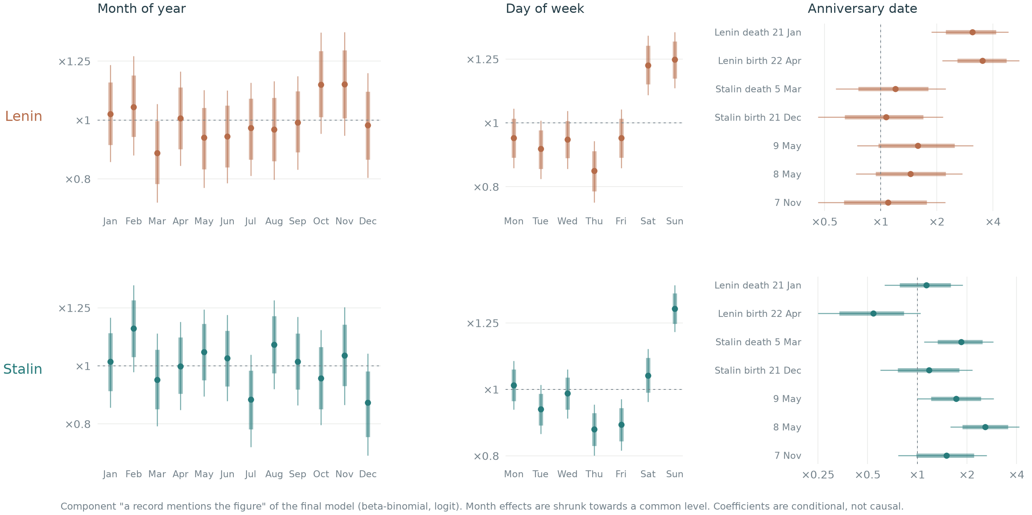
Models and the calendar patterns they capture
M1 is the baseline; M3HR extends M3 with partial pooling and a shared calendar-month effect
Models compared
Final-model posterior calendar effects
M1
Constant rates
Poisson / Binomial baseline
M2
Overdispersion
Allows bursty daily counts
M3
Calendar + trend
Month, weekday, anniversaries
M4
Dynamic level
M3 + random-walk levels
M3HR
Final model
M3 + estimated shrinkage
+ shared month effect
Odds multipliers for a record mentioning each figure.
1 = no effect; bands show 80% and 95% posterior intervals.
Shared structure: predict archive volume, records with a mention, then total mentions. Monthly intervals use joint trajectories.
03
Notes:
2:15-3:55. The left-hand comparison identifies the baseline and what each model adds. M1 uses constant conjugate rates; M2 adds negative-binomial and beta-binomial overdispersion. M3 adds channel and calendar effects and a trend. M4 adds random-walk levels with a particle filter. M3HR extends M3, not M4, by estimating the shrinkage scale for month-of-year coefficients and adding a random calendar-month effect shared across days and channels within each component. The right-hand plot is the original calendar_effects output from the project code. It shows posterior effects in the beta-binomial component for whether an archive record mentions a figure. Each effect is an odds multiplier, with 1 indicating no effect, and thick and thin intervals showing 80 and 95 percent posterior credible intervals. These parameter intervals are different from the predictive intervals on later slides. Distinguish the month-of-year patterns, weekday patterns and anniversary effects. For Lenin, death and birth anniversaries have the strongest effects; for Stalin, 8 May is prominent. These associations are conditional on other model covariates, not causal effects. Month-of-year coefficients are partially pooled. All models preserve the linked count constraints; the final posterior is sampled by HMC. Monthly forecast intervals are formed by summing complete simulated paths.
Sources: analysis/project_figures.py, calendar_effects_figure; analysis/forecast_v2.py; output/forecast_v2/README.md. The original English figure is embedded unchanged from presentation2_english.pptx, slide 6. Course L3-L5.

Slide 4
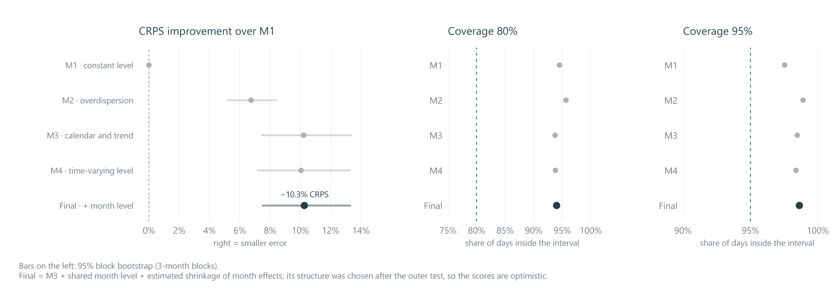
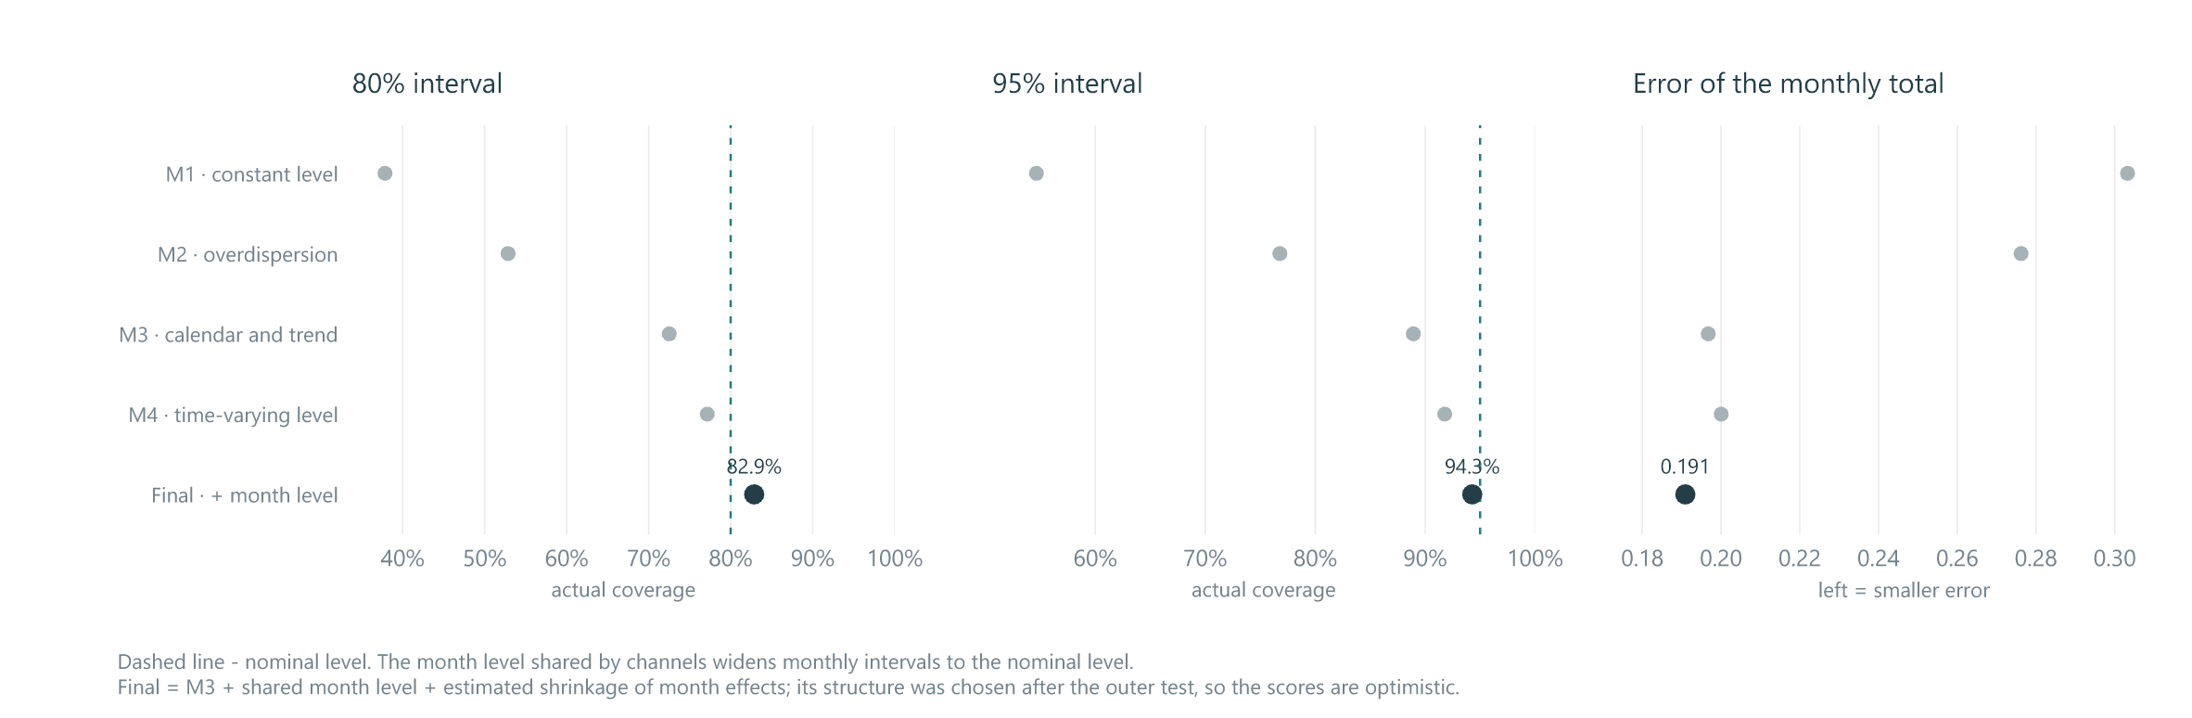
Backtesting results: daily accuracy and monthly uncertainty
21 expanding-window test months, Jan 2025 - Sep 2026; models use the same observations
Daily distributions
10.3% lower CRPS
than baseline M1
Only 0.046% below M3.
Most gain comes from
calendar effects.
Monthly totals
2.96% lower CRPS
than M3
80% coverage: 82.9%
95% coverage: 94.3%
04
Notes:
3:55-5:30. The two original figures compare daily predictive distributions and monthly sums. Top: backtest_quality shows daily CRPS improvement relative to M1 with 95 percent block-bootstrap intervals and daily coverage. The final model improves daily CRPS by 10.3 percent relative to M1, with bootstrap interval 7.5-13.3 percent. Relative to M3, however, the daily score improves by only 0.046 percent. The calendar accounts for most of the daily gain. Daily intervals remain conservative. Bottom: monthly_coverage shows nominal-versus-actual interval coverage and scaled CRPS of monthly totals. M3HR improves monthly scaled CRPS from 0.196740 to 0.190925, or 2.96 percent. Coverage moves from 72.5 to 82.9 percent at nominal 80 and from 88.9 to 94.3 at nominal 95. Monthly sums benefit from a shared calendar-month effect, because dependence across days does not average away. Wider intervals alone are not sufficient; CRPS also matters. There are 280 dependent complete series-month totals, not 280 independent experiments. The final model was chosen after test inspection, so its incremental improvements are exploratory.
Sources: original quality_figure and monthly_coverage_figure in analysis/project_figures.py; output/forecast_v2/decisions.json; output/forecast_v2/README.md. Both English source images are unchanged.

Slide 5
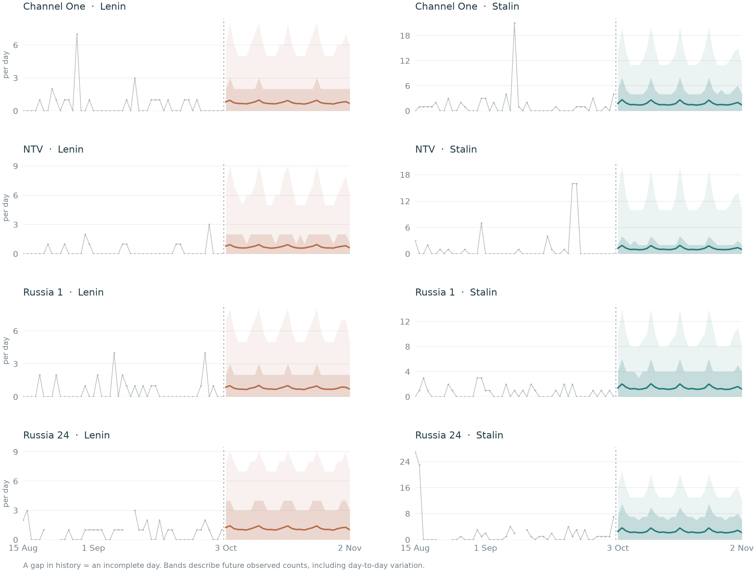
Daily forecast: mentions on each channel
M3HR, 3 Oct - 2 Nov 2026; predictive distributions for daily mention counts
What is shown?
Grey: observed history
Line: predictive mean
Bands: 80% and 95%
predictive intervals
How to read it
Small daily means coexist
with occasional bursts.
Intervals include daily count
variation and parameter
uncertainty.
Conclusion: daily accuracy is stable; monthly uncertainty improves. Validate M3HR on new forecast origins.
05
Notes:
5:30-6:25. The original daily_mentions figure shows one panel for each channel and person, with observations from 15 August, a 31-day predictive mean, and 80 and 95 percent predictive bands. These are future-count intervals, not credible intervals for the mean. Gaps in history mean incomplete archive days. The low means and wider upper bands represent rare bursts rather than a smooth deterministic path. Weekday patterns appear in the forecast, but the exact future spikes cannot be known. The forecast uses only information through 2 October. The final monthly intervals on the following slide are obtained by summing simulated trajectories, not adding daily interval endpoints. Our conclusion is that M3 provides almost all the daily accuracy gain over M1. M3HR adds learned partial pooling and a shared month effect, which improve the historical representation of monthly uncertainty. Its incremental test gains remain exploratory because it was selected after viewing the test. Subsequent forecast origins and observed outcomes are the next independent check.
Sources: analysis/project_figures.py, daily_figure for mentions; analysis/forecast_v2.py; output/forecast_v2/README.md. The English daily_mentions figure is unchanged from presentation2_english.pptx, slide 11.

Slide 6
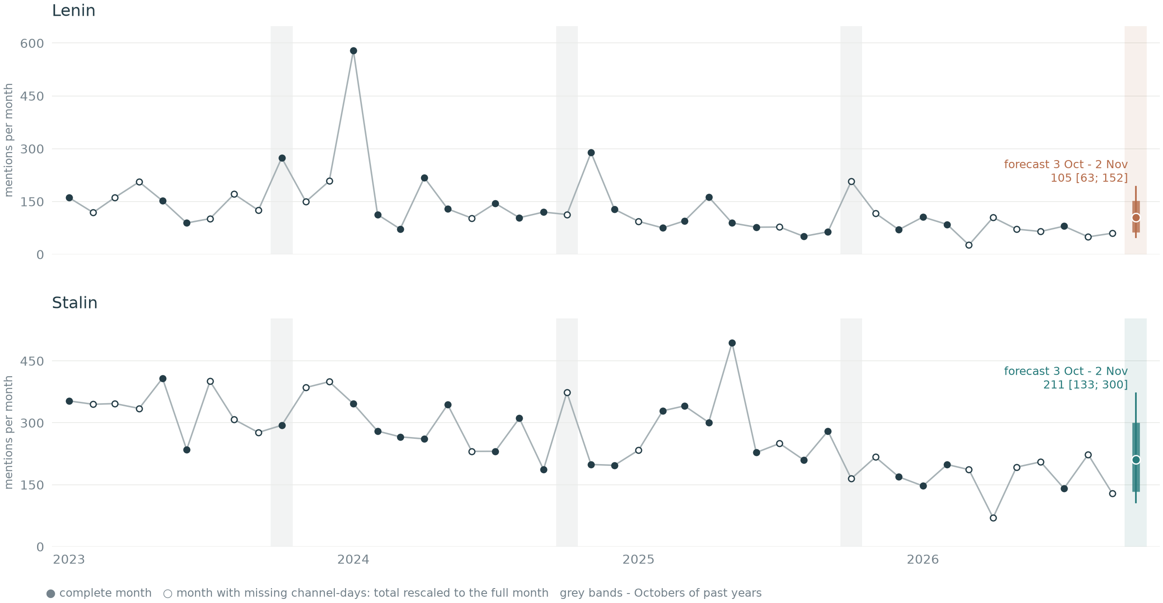
M3HR forecast: 3 October - 2 November 2026
Mentions, sum of four channels; point: predictive mean, thick line: 80%, thin line: 95%
Lenin
105
mentions over 31 days
80%: 63-152
95%: 49-192
Stalin
211
mentions over 31 days
80%: 133-300
95%: 107-371
Daily quality is largely unchanged; monthly uncertainty is better represented. Check future forecast origins.
06
Notes:
6:25-7:10. The original history_forecast figure places the final forecast beside historical monthly totals. The future horizon is 31 days, not exactly a calendar month. Means are 104.6 mentions of Lenin and 211.2 of Stalin, rounded to 105 and 211. The 80 percent intervals are 63-152 and 133-300, and the 95 percent intervals 49-192 and 107-371. Hollow historical points are months with missing channel-days, rescaled to full-month equivalents for this descriptive chart. Grey bands mark past Octobers. The forecast includes uncertainty in future archive volume and comes from joint trajectories. Since 1-2 October are already observed before the cutoff, the shared month effect can use them without looking into the forecast horizon. These are predictive intervals for future counts, not uncertainty intervals for a mean parameter. Our conclusion is modest daily gains beyond M3 and better represented monthly uncertainty, with exploratory evidence because the final structure was selected after viewing the test. Validate on new forecast origins and observed outcomes.
Sources: analysis/project_figures.py, history_forecast_figure; output/forecast_v2/forecast_month_v2.csv, v2_final; output/forecast_v2/README.md. Figure unchanged from presentation2_english.pptx, slide 4. Course L2 and L5.

Slide 7
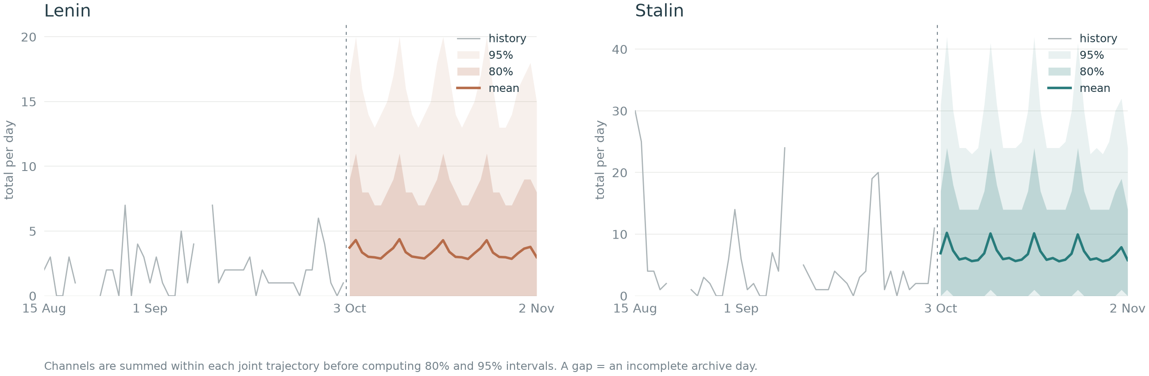
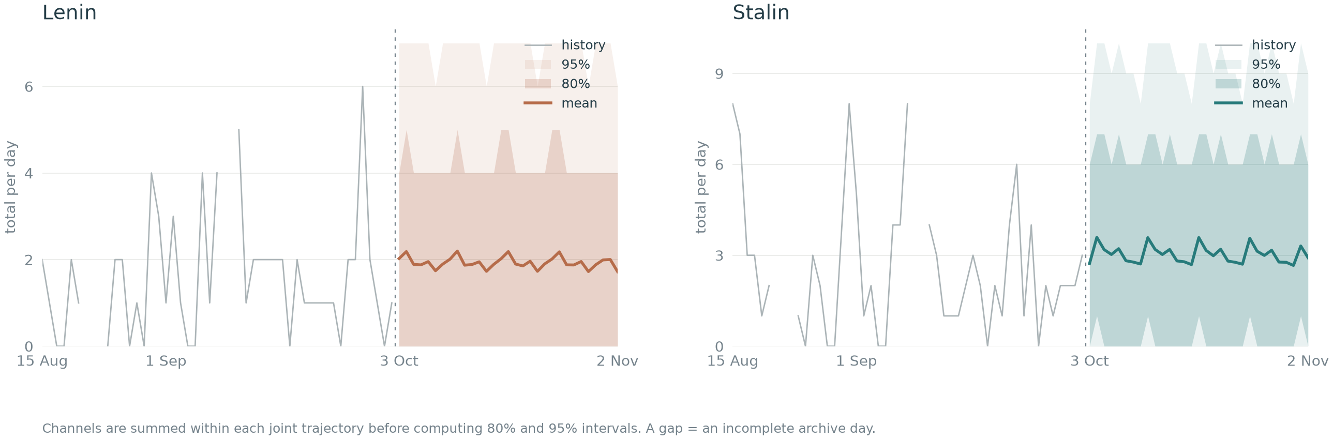
Daily totals across all four channels
M3HR, 3 Oct - 2 Nov 2026; mean and 80% / 95% predictive intervals
All mentions
Daily sum across channels.
Left: Lenin
Right: Stalin
Records with
a mention
The second target counts
each archive record once,
even with repeated mentions.
Channels are summed within each joint trajectory before calculating predictive intervals.
07
Notes:
7:10-8:00. Sum the four channels within each joint predictive path, then compute means and quantiles. The top figure forecasts all mentions; the bottom forecasts archive records containing at least one mention. In each figure Lenin is on the left and Stalin on the right. Grey is observed history on fully observed four-channel days; gaps are not zeros. Colored lines are predictive means, with 80 and 95 percent predictive intervals. These are future observed-count intervals. They include uncertainty and dependence across channels; adding channel quantiles would be incorrect. The forecast horizon is 3 October to 2 November, with information through 2 October. Source: analysis/project_figures.py, aggregate_daily_paths and daily_total_figure; final_paths_M3HR.npz, rebuilt with convergence checks. These final-model refit means differ from the earlier saved monthly means by less than 0.075 percent; Stalin mentions 80 percent lower monthly bound is 134 rather than 133, a sampling/platform difference. Original historical test metrics remain unchanged.

