Slide 1
FINAL PRESENTATION · CMS TEAM PROJECT · TU DRESDEN
Moderating the Emotional Tone
of a Generated Data Story
An agent that reads a data story and pulls its tone back to what the evidence supports -
measured against 25 stories our own team wrote from the same tables.
Mahmoud Elsamadony · Ahmed Okasha · Ahmed Elsaadani · Ahmed Saleh
Supervisors: Susmita Khadse, Julián Méndez · Chair: Prof. Dr. Raimund Dachselt (IMLD)
Notes:
SPEAKER 1 - Mahmoud [0:15] running total 0:15 ~40 words
Good afternoon. We turn a public-health table into a written story. The part we
want to defend today is the second agent: it reads that story and pulls the
emotional tone back to what the evidence supports.
Four parts, then a live demo.
DELIVERY: do not read the names, they are on the slide. Go straight to the
sentence about the second agent.

Slide 2
AGENDA
Four parts, then the system running
01
The research, and the problem it found
The one claim
A second agent can pull a generated data story's tone back to what the evidence supports -
without losing the numbers,
and at a cost in readability we can put a number on.
Everything else in this talk exists to make that measurable.
Mahmoud
02
What we built, and how we measure it
Okasha
03
What the reader sees, and how we chose the pair
Elsaadani
04
The result, the agent, and the system
Saleh
LIVE DEMO · the pipeline running locally · 3:30
AI-Powered Data Storytelling · CMS Team Project · TU Dresden · SoSe 2026
2
Notes:
SPEAKER 1 - Mahmoud [0:20] running total 0:35 ~38 words
Four parts. What the research told us and the problem it exposed. What we built
and how we measure it. What a reader sees, and how we picked the model pair.
Then the result and the system itself, and we finish live in the app.
DELIVERY: fifteen seconds. Read the four part names, point at the claim on the
right, move on. Do not explain the claim here - the whole talk is the
explanation.

Slide 3
PART 1 OF 4
The research, and the problem it found
Mahmoud
The research
What we built
What the reader sees
The result
Notes:
SPEAKER 1 - Mahmoud [0:05] running total 0:40 ~15 words
First: what the field already does, and the gap we found in it.
DELIVERY: one line, then move. A divider is a beat, not a slide to present.

Slide 4
THE RESEARCH
Three systems we did not just cite - we re-ran them
Kasner and Dušek, ACL 2024
Are open models faithful?
Their reference-free method marks every span of generated text that the source table does not support.
What we did: We re-ran it on modern open models. A 12B model left a semantic error in about 18% of outputs, where the paper reported over 80%. A 4B model regressed to 52%.
Recency and size both matter - and today's open models are already fairly faithful at stating data.
DataTales, 2025
Which kinds of claim are hard?
A benchmark for data narration that scores a story per operation: lookup, comparison, trend, rate of change, causal.
What we did: We reproduced a 30-report slice. Reading operations climb steeply with scale - rate of change went 43% to 89% from a 4B to a 12B model.
Stating a number is not the hard part. Explaining it is.
DataNarrative, EMNLP 2024
What architecture works?
One agent writes the story, a second agent verifies it at every step, beating single-LLM baselines.
What we did: We rebuilt the two-agent generate-and-verify loop, which is the structural basis of our own pipeline.
The second-agent pattern works. Ours swaps its factual verifier for a tone moderator.
Put together: open models already state data fairly faithfully, and every critic agent in this literature checks facts. So another fact-checker is not the gap.
AI-Powered Data Storytelling · CMS Team Project · TU Dresden · SoSe 2026
4
Notes:
SPEAKER 1 - Mahmoud [0:35] running total 1:15 ~100 words
We surveyed the field, and the report lists it. These are the three we re-ran
ourselves, because they shaped what we built.
Kasner and Dušek: are open models faithful? Re-running their method, a 12B model
left an error in about 18 percent of outputs where the paper reported over 80.
DataTales: which claims are hard? Stating a number is not the hard part.
Explaining it is.
DataNarrative gave us the architecture - one agent writes, a second checks.
Together, that is the bar at the bottom. Another fact-checker is not the gap.
DELIVERY: three cards, one sentence each, then the bottom bar. If asked about
the wider survey, it is in the interim report.

Slide 5
THE PROBLEM
Everyone checks the facts. Nobody checks the tone.
▪ The critic is always a fact-checker.
That is what our survey found, without exception. No published system moderates the affective tone of a data narrative.
▪ But framing moves the reader on its own.
Hullman and Diakopoulos show editorial framing significantly changes how the same chart is read. Tone is not decoration; it is part of the claim.
▪ So a story can be fully correct and still mislead.
Both sentences on the right are true to the table. A fact-checker passes both. Only one of them is honest about what the data says.
EVERY NUMBER BELOW IS CORRECT
“The world faces a catastrophic resurgence as a deadly disease roars back.”
A fact-checker passes this. It cites nothing false.
“Cases rose for a third year while coverage stalled near 84%, below the 95% herd-immunity threshold.”
Same table. Same facts. A different reader reaction.
AI-Powered Data Storytelling · CMS Team Project · TU Dresden · SoSe 2026
5
Notes:
SPEAKER 1 - Mahmoud [0:30] running total 1:45 ~98 words >>> HAND TO OKASHA
So here is the problem we noticed.
The critic is always a fact-checker. But Hullman and Diakopoulos showed framing
alone significantly changes how people read the same chart. Tone is part of the
claim.
[POINT] Both sentences are true to the table. A fact-checker passes both. One
catastrophises, one is calibrated, and nothing in the literature tells them
apart.
Okasha will show you what we built for that.
DELIVERY: read both quotes out loud, slowly. This is the motivation and it lands
in ten seconds if you actually perform the contrast.

Slide 6
PART 2 OF 4
What we built, and how we measure it
Okasha
The research
What we built
What the reader sees
The result
Notes:
SPEAKER 2 - Okasha [0:05] running total 1:50 ~15 words
Thank you. I will take the system itself, and then how we put a number on tone.
DELIVERY: your first words as a new speaker. Say them to the room, not the
screen.

Slide 7
OUR FIX
One generator, one agentic moderator, one independent judge
1 GENERATE
llama3.1:8b
Writes the first-draft story from an evidence pack built out of the table.
2 THE AGENTIC ROLE - ONE MODEL, THREE JOBS
gemma4:31b
3 JUDGE
Claude Opus
Rates each story blind. Evaluation only - not part of the product loop.
Moderates tone
rewrites the framing, keeps the numbers ← the contribution
Fact-checks
every stated number back against the table
Selects the charts
ranks figures the table can honestly carry
Two datasets, because tone fails both ways.
Measles × MCV1 coverage (9,959 rows, 1980-2024) invites alarmism. WHO child mortality invites the opposite failure, false reassurance, where the agent must keep the inequality and the COVID reversal visible.
Same model, separate stages
The moderator is the agentic role here, so the agentic reading of a table belongs to it too. The stages stay separate, so a tone number is still measuring one change - and one 19-23 GB load is paid per run instead of per stage.
AI-Powered Data Storytelling · CMS Team Project · TU Dresden · SoSe 2026
7
Notes:
SPEAKER 2 - Okasha [0:33] running total 2:23 ~82 words
Three roles, but only two local models.
A generator writes the draft. Then the moderator - the agentic role here - does
three jobs on the same weights: it rewrites the tone, that is our contribution,
it fact-checks every number, and it picks the charts.
Same model, separate stages. That matters twice: a tone number still measures
one change, and we pay one twenty-gigabyte model load per run instead of three.
Claude Opus judges, and only judges.
DELIVERY: "one model, three jobs" is the line. Do not call chart selection a
fourth model - it is not.

Slide 8
THE INSTRUMENT
Two axes, and both ends of each are failures
The judge rates every story 1 to 5 on alarmism, and separately 1 to 5 on optimism.
A 5 catastrophises. A 1 is flat and hides real stakes. Only the middle is calibrated - so this is not a “lower is better” scale, and an agent that simply drains the feeling out of a story scores badly too.
Blinding cost us something.
An earlier version showed the judge both stories in one call, labelled before and after, always in that order. That names the treatment to the rater. Each story is now scored alone, which doubles the calls and gives up the direct comparison - the price of a rating that was not told which story is the treatment.
ALARMISM
3 rubric
1 flat
human 2.0
5 extreme
OPTIMISM
3 rubric
1 flat
human 2.5
5 extreme
The rubric calls 3 calibrated. Our human writers sit at 2.0 and 2.5, so the human band - not the rubric midpoint - is the target we report against.
AI-Powered Data Storytelling · CMS Team Project · TU Dresden · SoSe 2026
8
Notes:
SPEAKER 2 - Okasha [0:33] running total 2:56 ~95 words
To measure tone you need a scale. Every story gets two: alarmism and optimism,
one to five each.
Both ends are failures. Five catastrophises, one is flat and hides real stakes.
So an agent cannot win by draining the feeling out of a story.
Two honest notes. The rubric calls three calibrated, but our human writers sit
at 2.0 and 2.5, so
the human band is what we report against.
And blinding cost us: scoring each story alone doubles the calls.
DELIVERY: "both ends are failures" must land. Pause after it. Point at the blue
human marks on the second note.

Slide 9
METRICS · PART 1
What we measure about the system
Tone - the contribution
An LLM judge, blind, one story per call. The only family that needs a model.
Alarmism 1-5 flat ↔ catastrophising
Optimism 1-5 bleak ↔ false reassurance
Emotive spans removed count, per run
Similarity to the human baseline
How close the wording lands to the 25 stories we wrote by hand.
chrF++ character n-grams; our ranking metric
BLEU 1-4, ROUGE-L n-gram and longest-common-subsequence overlap
METEOR, unigram F1 stem and synonym aware
Faithfulness - computed, no model, free
Did the rewrite keep the facts? Runs on every story automatically.
Numeric retention share of the raw story's figures that survive
Added unsupported figures the moderator introduced
Groundedness stated numbers the table actually supports
Rewrite intensity how much text changed at all
Trend selection does the story's window agree with the whole series
Analytical operations - from the DataTales re-run
Not every claim is equally hard, so we score accuracy per kind of claim.
lookup reading a single value off the table
comparison ranking two values against each other
trend which way a series moves across a window
rate of change how steeply it moves
causal why it moved - the hardest, and the one we treat with most caution
“Trend” appears twice: trend selection (bottom left) is a cherry-picking check on one story; trend (bottom right) is an accuracy category from the benchmark.
AI-Powered Data Storytelling · CMS Team Project · TU Dresden · SoSe 2026
9
Notes:
SPEAKER 2 - Okasha [0:28] running total 3:24 ~70 words >>> HAND TO ELSAADANI
Four families of metric, and only the first one needs a model.
Tone is the contribution and it is judged. Faithfulness is computed in code, for
free, including a cherry-picking check on the window the story chose. Similarity
is against our human stories. The operation accuracies come from DataTales.
Careful: two of these share the word trend. The footnote says which is which.
Elsaadani takes the reader-facing half.
DELIVERY: do NOT read the metric names. Name the four families and the fact
that three of them cost nothing to compute. The slide is the handout.

Slide 10
PART 3 OF 4
What the reader sees, and how we chose the pair
Elsaadani
The research
What we built
What the reader sees
The result
Notes:
SPEAKER 3 - Elsaadani [0:05] running total 3:29 ~15 words
My half: what a reader is actually shown, and how we picked the model pair.
DELIVERY: a beat, then straight into the next slide.

Slide 11
METRICS · PART 2
What the reader is shown, and why
In the app, next to the story
These exist so a reader can audit the rewrite instead of trusting it.
Alarmism rating where this story sits on the scale
Human tone band ±0.5 around the human author's own rating
Numbing / catastrophising which end it failed toward
Emotive span the exact words the moderator removed
Verified / flagged / corrected what the fact-check did to each number
Designed, not yet run
The brief allows metrics or a user study. We chose metrics and went deep.
Trust does the reader believe the story
Engagement does it hold attention
Readability is it clear and easy to follow
Human-vs-LLM preference which story readers prefer, and why
The split that matters
Part 1 answers “is the system any good”. It is aggregated over runs and nobody reading a story ever sees it.
Part 2 answers “should I believe this particular story”. It is per-story, visible in the interface, and it is the reason the app shows a diff rather than just a cleaner paragraph.
Same underlying numbers in places. Different job.
The edit taxonomy
Every change the moderator made, classified - so the diff is readable.
Intensity how hard the wording pushes
Framing what the sentence is made to be about
Overreach a claim beyond what the table shows
Grounding a claim tied back to a number
AI-Powered Data Storytelling · CMS Team Project · TU Dresden · SoSe 2026
11
Notes:
SPEAKER 3 - Elsaadani [0:24] running total 3:53 ~60 words
Not every metric is for us. These are for the reader.
The app shows the tone rating, the human band, and every emotive span the
moderator removed, classified by kind. That is why the interface shows a diff
rather than a cleaner paragraph - a reader can audit the rewrite.
The user-study axes are designed and not run.
DELIVERY: this sets up the demo. Say "you will see these in a moment".

Slide 12
CHOOSING THE PAIR
Four steps from fourteen candidates to one pipeline
01
Build the grid
Vary the generator against a fixed moderator, then the moderator against a fixed generator. L-shaped, not factorial - so the best × best cell is never assumed, it has to be run.
02
Score every run the same way
Blind Opus rating on both tone axes, plus the computed faithfulness metrics. Same dataset throughout, so the comparison is not rewarded for drawing an easy table.
03
Tone does not decide it
Six combinations land on exactly 2.0 alarmism. A tie on the headline metric is a real result: the moderator is doing its job regardless of who wrote the draft.
04
Break the tie on faithfulness, then repeat it
Rank the tied cells on how many of the raw story's figures survive. Then run the top two five times each at distinct seeds, because a single run cannot separate a model from a draft.
Step 4 is the one we nearly skipped, and it is the step that changed the answer.
AI-Powered Data Storytelling · CMS Team Project · TU Dresden · SoSe 2026
12
Notes:
SPEAKER 3 - Elsaadani [0:28] running total 4:21 ~65 words
How we actually chose the pair, in four steps.
Build a grid of generator and moderator combinations. Score every run the same
way, on the same dataset. Tone does not decide it - six land on exactly 2.0.
So break the tie on faithfulness, then repeat the top two at different seeds,
because one run cannot separate a model from a draft.
The next two slides are steps three and four.
DELIVERY: this is the method slide. Say the four steps, then let the two figures
carry the evidence.

Slide 13
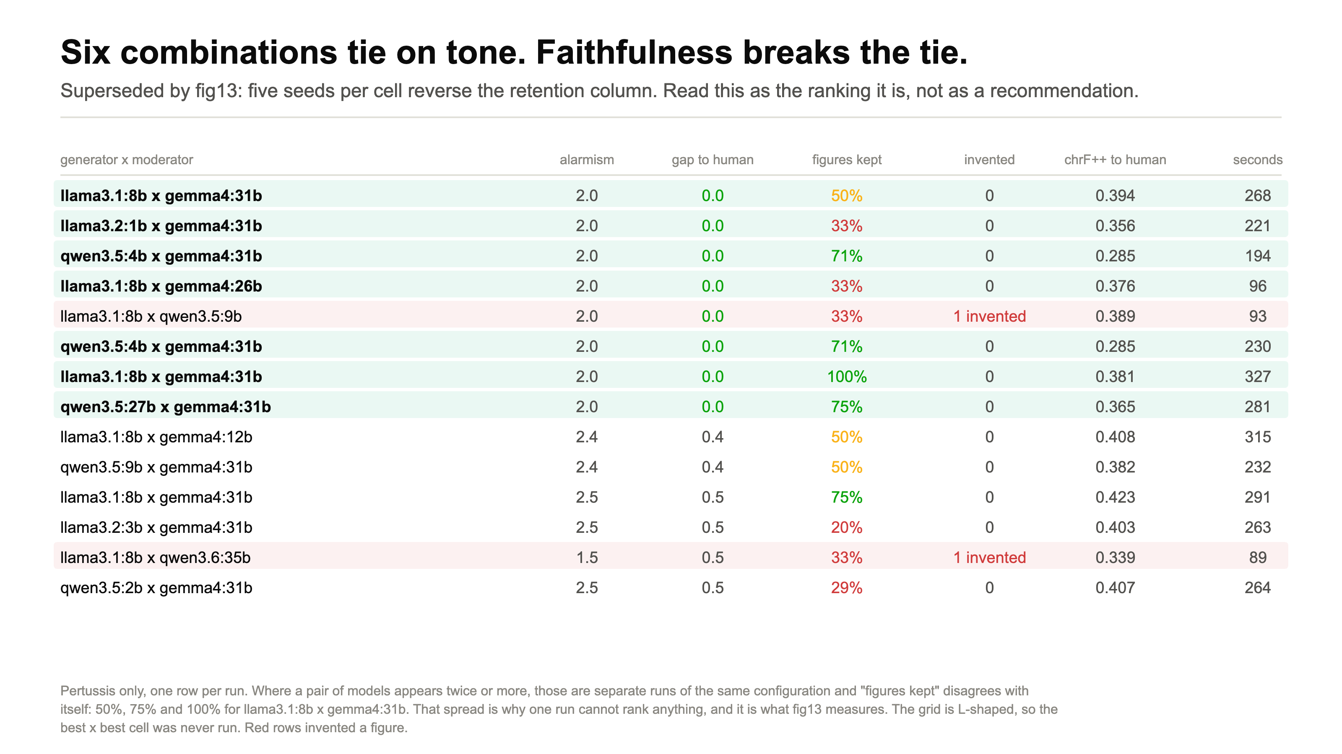
Notes:
SPEAKER 3 - Elsaadani [0:20] running total 4:41 ~50 words
Step three. Fourteen runs. The green rows all tie on tone at exactly 2.0, so we
rank them on the "figures kept" column instead.
Now look at the three rows that read llama3.1:8b times gemma4:31b. Same models,
three separate runs: 50 percent, 75 percent, 100 percent.
DELIVERY: point at those three rows. That is the moment the audience should
distrust the table, and it sets up the next slide.

Slide 14
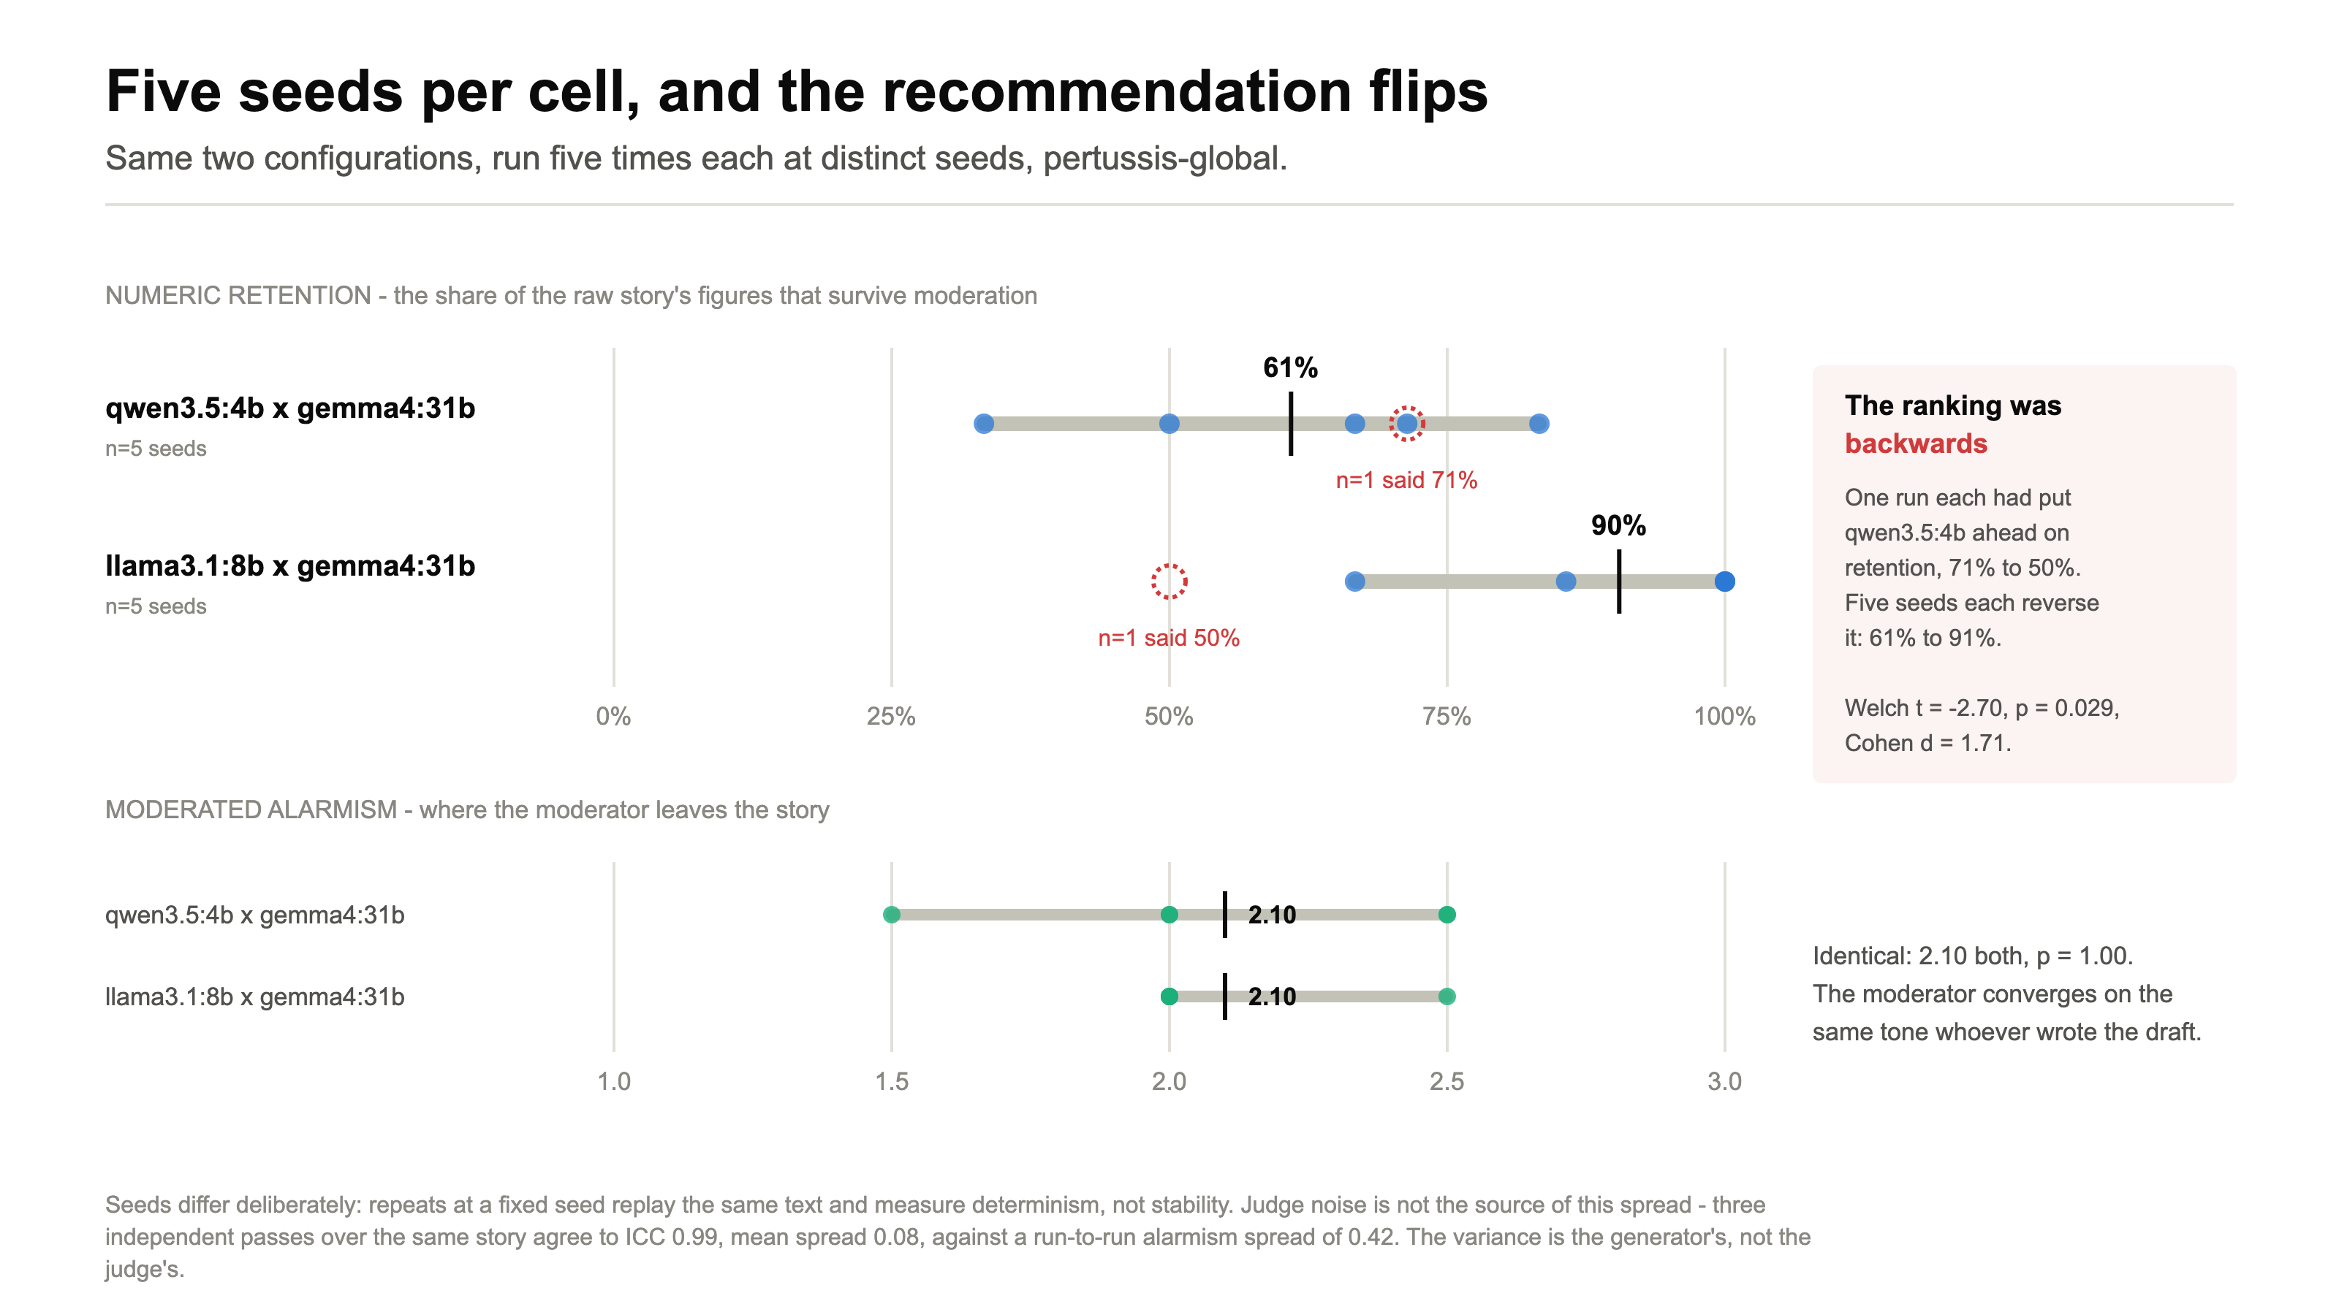
Notes:
SPEAKER 3 - Elsaadani [0:35] running total 5:16 ~80 words >>> HAND TO RAMADAN
Step four. Both configurations, five runs each, at distinct seeds.
It reverses. Qwen averages 61%, llama
averages 90%. Welch t of minus 2.70,
p of 0.029. Our recommendation had been backwards, and one run per cell was
never going to show us that.
So we ship llama3.1:8b generating and gemma4:31b moderating.
And the lower half is the more interesting finding: moderated tone is 2.10
either way. The moderator converges on the same tone whoever wrote the draft.
DELIVERY: "our recommendation had been backwards" is the line. Say it plainly.

Slide 15
PART 4 OF 4
The result, the agent, and the system
Saleh
The research
What we built
What the reader sees
The result
Notes:
SPEAKER 4 - Saleh [0:05] running total 5:21 ~15 words
Last part: where that lands against a person, and how the agent works inside.
DELIVERY: a beat. Then fig9 is the payoff slide of the whole talk.

Slide 16
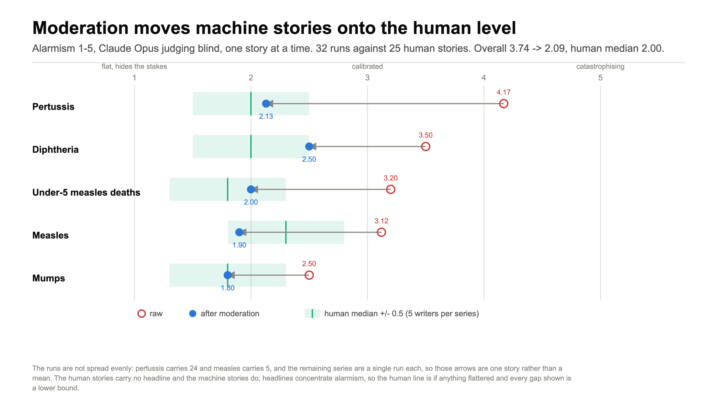
Notes:
SPEAKER 4 - Saleh [0:38] running total 5:59 ~105 words
This is the result. We wrote 25 stories by hand from the same
evidence packs, before seeing any machine output. The green band is where those
human writers sit.
Red is raw, blue is after moderation. On every one of the five series the arrow
lands on or inside the human band.
Overall 3.74 to 2.09,
against a human median of 2.00, over
32 runs with a human counterpart.
The caveat is on the slide rather than hidden: our human stories carry no
headline and the machine ones do, so every gap is a lower bound.
DELIVERY: say the three numbers slowly, then stop talking.

Slide 17
THE TOOL SURFACE
Seven tools, not seventeen chart types
Grouped by the reader's job, with the geometry in an enum - a two-level choice a local model can make reliably.
CHART TOOLS (7) - each returns a ChartPayload
READ TOOLS (3) - what makes it an agent, not a classifier
plot_trend_over_time
line, area (+ stack, indexed, emphasis)
describe_dataset
dimensions, measures, span, row count, missingness, and the magnitude ratio between measures
plot_magnitude
bar, lollipop, heatmap
plot_change
dumbbell, slope, bump
get_series
a ChartFrame for one measure, grouped, filtered and aggregated as asked
plot_relationship
scatter, connectedScatter, parallelCoordinates
plot_geographic
choropleth, bivariateChoropleth
check_comparability
whether a per-capita denominator exists - and whether it is needed
plot_distribution
beeswarm, box, ridgeline
show_headline
statTile
Without the read tools the model picks a form blind from a prompt string. With them it can discover that two measures differ by 100× and derive that it needs an indexed transform.
The form enum is documented with the validator's own rule text, so a tool description cannot drift from the rule it promises.
Defined in docs/CHART_CONTRACT.md and pinned by the generated docs/chart-schema.json. Today the selector makes one structured call; the tool loop is the next step.
AI-Powered Data Storytelling · CMS Team Project · TU Dresden · SoSe 2026
17
Notes:
SPEAKER 4 - Saleh [0:40] running total 6:39 ~100 words
How the model actually decides which figures to draw.
Seventeen flat chart types is past what a local model picks reliably. So the
contract groups them into seven tools by the reader's job - trend over time,
magnitude, change, relationship, geographic, distribution, headline - and puts
the geometry in an enum inside each. That is a two-level decision, and it is one
a local model makes well.
The three read tools on the right are what make this an agent rather than a
classifier. Without them the model picks a form blind from a prompt string. With
them it can look at the table first, find that two measures differ by a hundred
times, and derive that it needs an indexed transform.
DELIVERY: name the seven tools as a group, do not read them one by one. Spend
the time on the read tools - that is the interesting half. If asked whether the
MCP server is running: it is not, the selector makes one structured call today
and the tool loop is the next step.

Slide 18
THE WHOLE SYSTEM
Table in, audited story out - on one laptop
Table
9,959 rows
›
Evidence pack
computed
›
Raw story
llama3.1:8b
›
Moderated
gemma4:31b
›
Fact-check
same model
›
Charts
same model
›
Judged
Opus, blind
teal = the three stages that run on the moderator model
LIVE DEMO · 3:30
Table → chosen figures → raw story → moderated story → the human story beside it
localhost:3000 · Django on :8000 · llama3.1:8b and gemma4:31b on Ollama. No API call anywhere in the generation path.
Notes:
SPEAKER 4 - Saleh [0:21] running total 7:00 ~50 words >>> DEMO
That is the whole system. A table becomes an evidence pack, a local model writes
the story, and the moderator model rewrites the tone, checks the numbers and
picks the figures. Opus judges it blind.
Everything except the judge runs on this laptop.
Let me show you.
DELIVERY: 20 seconds, then switch. The browser should ALREADY be open on the
dataset page. Never click Generate and wait - see SPEAKER-SCRIPT.md.

Slide 19
What we can defend
Human tone level - and what it cost
Three numbers: where the tone lands, whether the ruler holds, and what the rewrite gave up.
THE RESULT
THE INSTRUMENT
THE COST
3.74 → 2.09
0.991
12/20
alarmism, raw to moderated, over 32 runs. Human median 2.00.
ICC over 3 blind passes: the judge agrees with itself, so the move above is real.
blind pairs where the unmoderated story read better as writing.
Not claimed: a judge panel, a user study, or a controlled writer design. One judge family, 25 stories, five writer slots.
Every number here is read from the experiment files at build time, so the slides cannot drift from the data.
AI-Powered Data Storytelling · CMS Team Project · TU Dresden · SoSe 2026
19
Notes:
CLOSING - whoever finishes the demo [0:15]
One sentence: a second agent can move a generated data story onto the tone level
of a person writing from the same table, without losing the numbers, and at a
cost in readability we can put a number on.
What we are not claiming is on the slide. One judge family, no user study, and a
human baseline written by five writer slots rather than a controlled design.
DELIVERY: read the limits line rather than skipping it. Volunteering it is what
makes the rest credible. Q&A prep is at the end of SPEAKER-SCRIPT.md.

Slide 20
Thank you
Questions?
Mahmoud Elsamadony · Ahmed Okasha · Ahmed Elsaadani · Ahmed Saleh
Supervisors: Susmita Khadse, Julián Méndez · Chair: Prof. Dr. Raimund Dachselt (IMLD)
github.com/memoelsamadony/ai-powered-data-storytelling
Notes:
QUESTIONS - all four speakers stay at the front
Leave this slide up for the whole Q&A. It holds the names and the repository
link, which is what anyone wanting to follow up needs.
The four questions to expect, with answers, are at the end of
presentation/SPEAKER-SCRIPT.md. Read them on the way in. Short forms:
- Only one judge? Yes, and slide 19 says so. 0.991 is self-consistency, not
inter-rater. Two independent methods agree though: the scalar scores and the
blind pairwise verdicts.
- Why no user study? The brief allows metrics or a user study. We chose metrics
and went deep: reliability, repeats, a significance test.
- Why not just prompt the generator to be calm? Because a separate pass is
measurable on its own, and because the moderator lands on 2.10 whichever
generator wrote the draft.
- Is 2.09 against a human 2.00 just noise? Essentially yes, and that is the
claim: it lands on the human level. The judge's own disagreement is 0.08.
DELIVERY: whoever is nearest the laptop takes questions first, then hand to
whoever owns that section. Nobody answers over anybody.

