Slide 1

Medical Information Storytelling Tone Regulation
An Agentic Approach to Moderating the Emotional Tone of Data Narratives
Interim Presentation · CMS Team Project · TU Dresden · Summer Term 2026
Mahmoud Elsamadony · Ahmed Okasha · Ahmed Elsaadani · Ahmed Ramadan
Supervisors: Susmita Khadse, Julián Méndez · Chair: Prof. Dr. Raimund Dachselt (IMLD)
Notes:
Welcome. We are the AI-Powered Data Storytelling team. Our project turns data into a written story — and, as our novel contribution, an agent that moderates the emotional TONE of that story. Four parts: literature, dataset & idea, models & implementation, and the web application. Each of the four of us takes one part. [~20s]

Slide 2

Table of Contents
This presentation walks through our research motivation, prior work, dataset, system design, and the path ahead.
01
Introduction
What is AI-powered data storytelling and why does emotional tone matter?
02
Literature Review
Key papers: DataNarrative, DataTales, and open LLM benchmarking for data-to-text.
03
Dataset
Measles cases × vaccination coverage — a high-stakes real-world narrative.
04
Pipeline
The three-stage agentic pipeline and a novel tone-moderation contribution.
05
Results
Comparing the results of our pipeline to strong models like CLAUDE Opus and compute relevant metrics
06
Web Application
The full pipeline integrated into a user-friendly web application

Slide 3
Introduction
AI-Powered Data Storytelling · CMS Team Project · TU Dresden · SoSe 2026
Notes:
Speaker 1 takes over. One line: we surveyed AI / agentic data-story tools and found one thing nobody does. [~10s]

Slide 4
Medical Data Storytelling
Our idea is to:
Transform medical datasets into user stories that humans can easily read, interpret and understand
Display visualizations that shows the user patterns and trends about the data
Connect to the user using an emotional tone
Year | Cases | Vacc.
2020 | 600k | 550k
2021 | 800k | 600k
2022 | 900k | 650k
Measles cases has been steadily rising from 2020 to 2022 while vaccinations fail to cover the amount of cases
AI-Powered Data Storytelling · CMS Team Project · TU Dresden · SoSe 2026
Notes:
Define data storytelling in one line. Hullman & Diakopoulos prove framing changes how people read data — that is the scientific justification for moderating tone. Then the key gap that motivates everything: existing agentic checks are about facts, never tone. [~1.5 min]

Slide 5
Motivation and Research Gap
The research in AI storytelling is focused on getting the facts correct 100%
Sometimes the facts can be correct but the tone used to deliver the message could indicate the wrong idea
We are trying to bridge this gap by adjusting the tone to be proportional to the evidence
Fact:
Measles cases increased by 20% and coverage remains insufficient
AI:
The world is facing a catastrophic health crisis as there is a huge resurgence
AI-Powered Data Storytelling · CMS Team Project · TU Dresden · SoSe 2026
Notes:
Define data storytelling in one line. Hullman & Diakopoulos prove framing changes how people read data — that is the scientific justification for moderating tone. Then the key gap that motivates everything: existing agentic checks are about facts, never tone. [~1.5 min]

Slide 6
Literature Research
What the field does — and the gap we found
AI-Powered Data Storytelling · CMS Team Project · TU Dresden · SoSe 2026
Notes:
Speaker 1 takes over. One line: we surveyed AI / agentic data-story tools and found one thing nobody does. [~10s]

Slide 7
Literature Research
Prior work in automatic data narration
Paper | Core Contribution
DataNarrative Islam, Laskar, Parvez, Hoque & Joty | End-to-end pipeline generating visualizations + narrative text from structured tabular data using 2 agents: generator and verifier on the steps: reflection generation, outline generation and finally story generation
DataTales Yang, Liu & Kan | Emphasizes the importance of extracting insights, patterns and outliers from the dataset before feeding it to the LLM because LLMs are weak at extracting patterns and trends but good at generating coherent text.
Beyond Traditional Benchmarks Kasner & Dušek | Introduces a benchmark for evaluating the semantic accuracy of LLMs in Data-to-Text Generation tasks. LLMs can generate fluent, coherent, and human-like text from structured data, they frequently make semantic and factual errors. Their results highlight that linguistic quality does not necessarily imply factual correctness, making semantic reliability a major challenge for data-driven text generation.
6
AI-Powered Data Storytelling · CMS Team Project · TU Dresden · SoSe 2026
Notes:
Define data storytelling in one line. Hullman & Diakopoulos prove framing changes how people read data — that is the scientific justification for moderating tone. Then the key gap that motivates everything: existing agentic checks are about facts, never tone. [~1.5 min]

Slide 8
Dataset & Idea
The data we chose, and the core idea
AI-Powered Data Storytelling · CMS Team Project · TU Dresden · SoSe 2026
7
Notes:
Speaker 2. We picked a dataset whose natural failure mode is exactly what our agent must fix. [~10s]

Slide 9
PART 2 — Dataset & Idea
Two datasets — one for each direction of tone
Our main idea is a tone agent — and tone fails in two ways, so we use two datasets on purpose.
PRIMARY · Measles × MCV1 vaccination coverage — natural tone: alarmism / fear.
The agent must pull an over-alarmist story DOWN without losing the real urgency.
SECONDARY · WHO Global Health Observatory — child mortality & life expectancy — over-optimism.
It must keep a "good-news" story HONEST: preserve the inequality and the COVID reversal.
Together they prove the agent calibrates BOTH ways — and edits the measured story only lightly.
AI-Powered Data Storytelling · CMS Team Project · TU Dresden · SoSe 2026
8

Slide 10
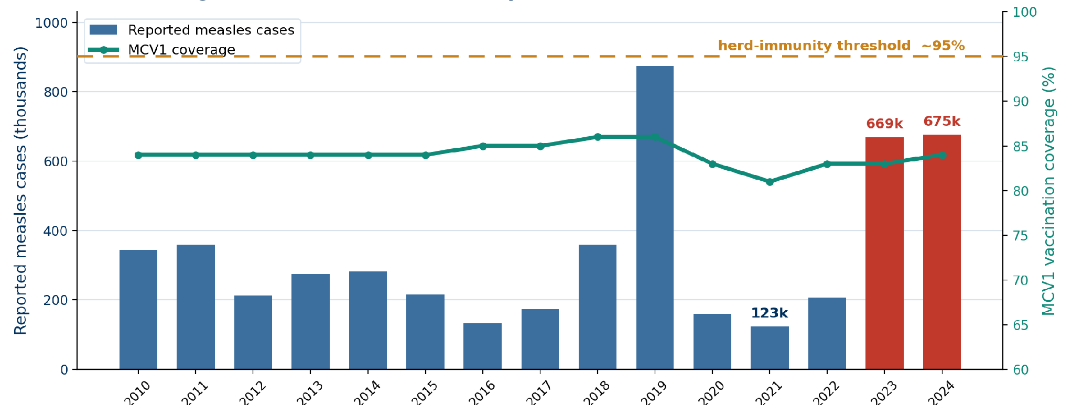
PART 2 — Dataset & Idea
Dataset: Measles × Vaccination
Insight: Herd Immunity Gap
Merged OWID/WHO cases & WUENIC MCV1 coverage. Coverage stalled below ~95% threshold → cases rebounded. This dataset serves as our primary test for alarmism moderation.
AI-Powered Data Storytelling · CMS Team Project · TU Dresden · SoSe 2026
9
Notes:
Explain the join in one breath: two public tables merged on country + year, plus population. The chart is the whole premise — coverage stalls below the 95% herd line and cases rebound (669k in 2023, 676k in 2024). That is why we picked it: alarmism is the natural way this story goes wrong, exactly what the moderator must catch. [~1.5 min]

Slide 11
PART 2 — Dataset & Idea
The idea: an emotional-tone moderation agent
▪ Most systems miss the emotional feel of a story → our focus.
▪ Process: First AI writes → Second AI fixes the tone → Quick fact check.
▪ Same data, two different moods
– “a deadly disease ROARS back” (scary / alarmist)
– “cases rose as coverage stalled” (balanced / calm)
▪ Test: Compare human stories to AI fixed stories for trust and quality.
AI-Powered Data Storytelling · CMS Team Project · TU Dresden · SoSe 2026
10
Notes:
This is the heart of the project. The agent reads the generated story and recalibrates tone while keeping the facts. The two-tone line makes it concrete — same data, very different reader reaction. The human-vs-LLM comparison is how we evaluate. [~1.5 min]

Slide 12
Models & Implementation
What we built — and what it produced
AI-Powered Data Storytelling · CMS Team Project · TU Dresden · SoSe 2026
11
Notes:
Speaker 3. Everything here runs locally, and the real run gave us a result that shaped the design. [~10s]

Slide 13
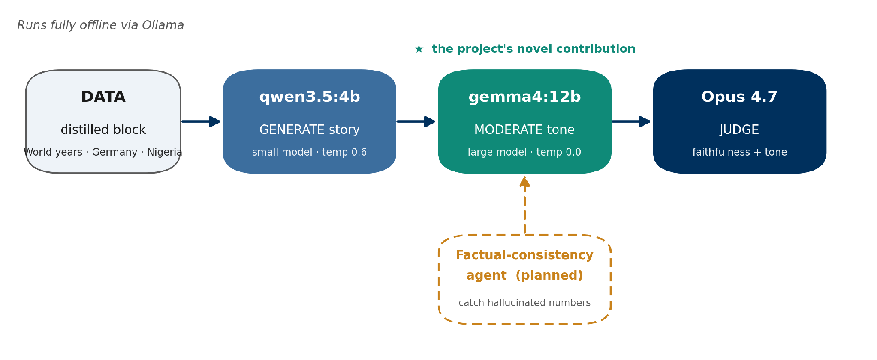
PART 3 — Models & Implementation
Our three-stage pipeline
Grounded by our reproductions: Quintd faithfulness (gemma 18 % vs the paper's > 80 %) and DataTales causal operation 0 % for both models → modern open models are fairly faithful, so TONE (not facts) is our novelty.
AI-Powered Data Storytelling · CMS Team Project · TU Dresden · SoSe 2026
12
Notes:
Three local stages: qwen generates, gemma moderates the tone, Opus judges. The dashed box is the factual-consistency agent we plan to add. The reproductions are why we trust the setup and why tone is the novelty: open models are already fairly faithful, but causal reasoning stays hard. [~1.5 min]

Slide 14
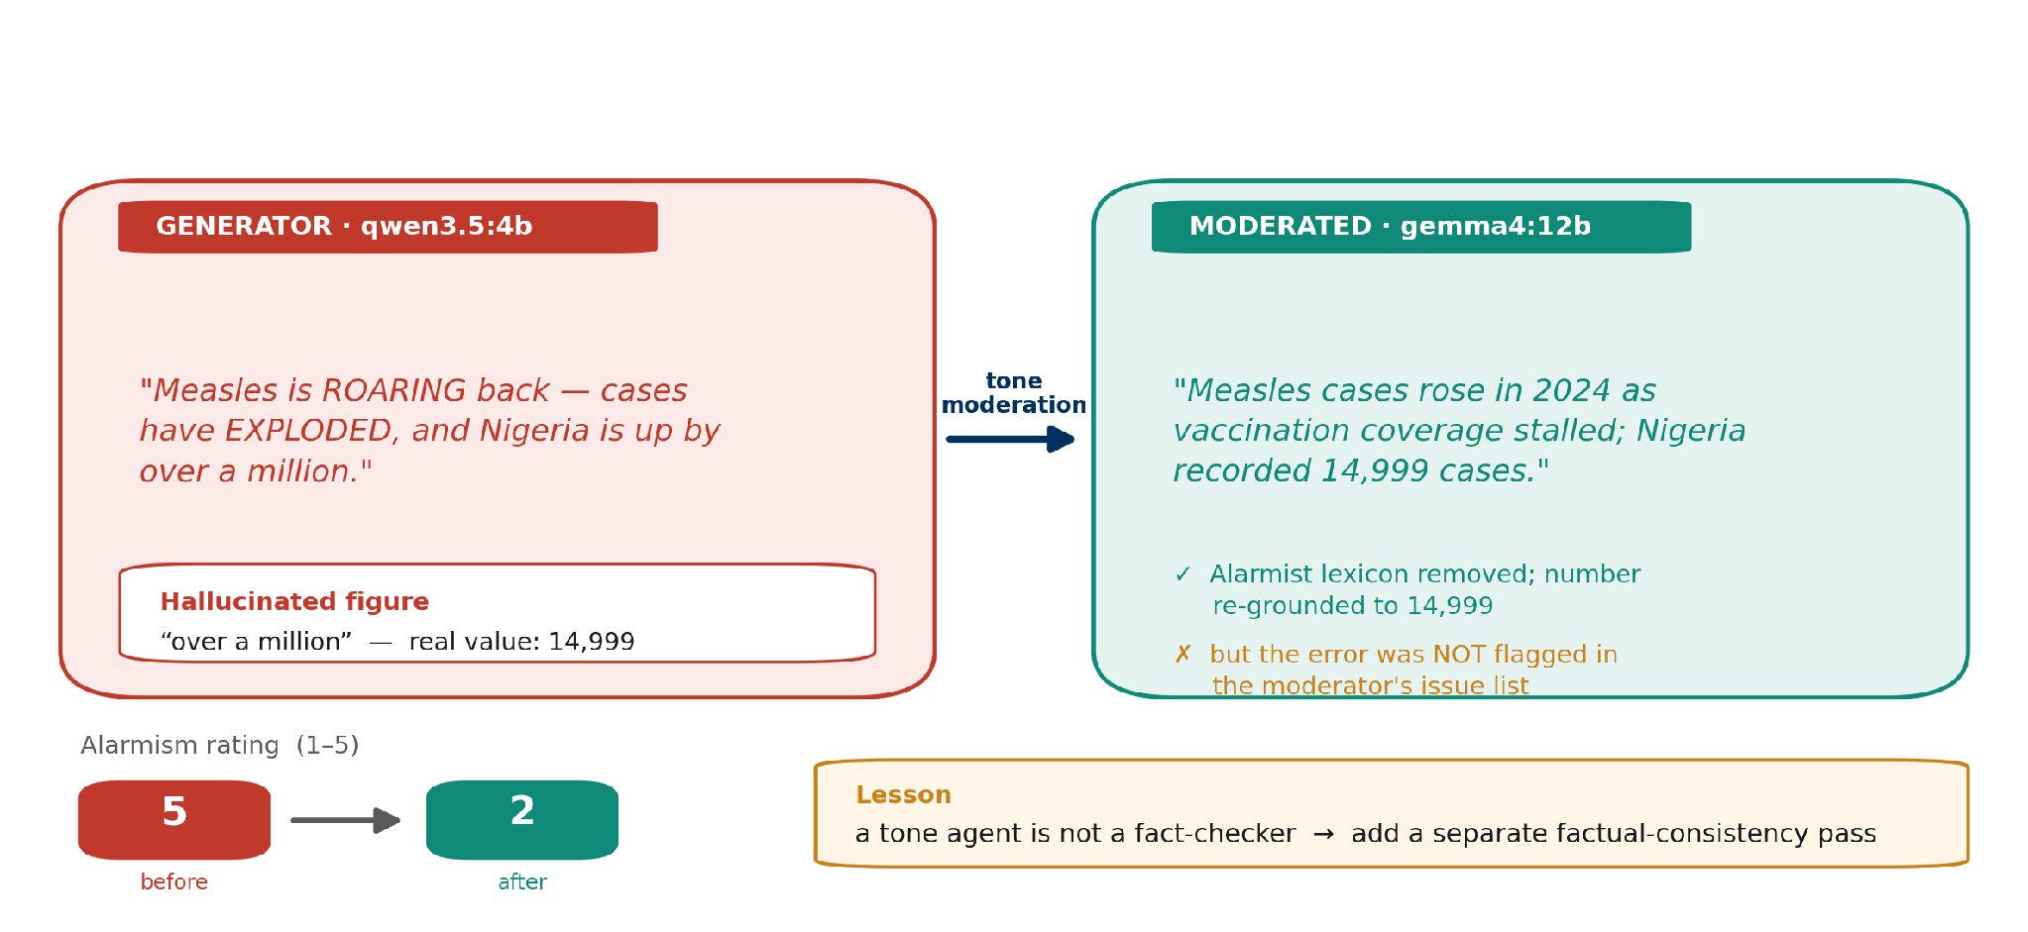
PART 3 — Models & Implementation
What the pipeline produced — a real run
One real run on the measles data: the moderator stripped the alarmism and silently corrected the hallucinated number — but never flagged it. A tone agent is not a fact-checker.
AI-Powered Data Storytelling · CMS Team Project · TU Dresden · SoSe 2026
13
Notes:
This is the most compelling slide — a real run on real data. The generator was fluent but alarmist AND hallucinated 'over a million' (real value 14,999). The moderator fixed the tone and accidentally the number but did not flag it. That gap is itself a result: it tells us to add a separate factual-consistency pass. [~1.5 min]

Slide 15
PART 3 — Models & Implementation
Evaluation metrics
Faithfulness
% of outputs with ≥ 1 semantic error; % of stated numbers correct.
Analytical correctness
Per-operation accuracy (lookup, comparison, trend, rate, causal — causal is hardest).
Tone calibration (NOVEL)
Alarmism 1–5 before vs after + emotive spans removed; faithfulness re-checked.
User study
Trust, engagement, readability, human-vs-LLM preference.
AI-Powered Data Storytelling · CMS Team Project · TU Dresden · SoSe 2026
14
Notes:
These metrics come straight from our reproductions, extended to the tone task. The novel pair is the tone-calibration delta plus the faithfulness re-check that confirms the edit kept the facts. The user study answers the human-vs-LLM question. [~1 min]

Slide 16
Results
Testing of our pipeline output with LLMs and computing relevant prompts
AI-Powered Data Storytelling · CMS Team Project · TU Dresden · SoSe 2026
15
Notes:
Speaker 4. The interface where a reader sees the data, both stories, and what the moderator changed. [~10s]

Slide 17
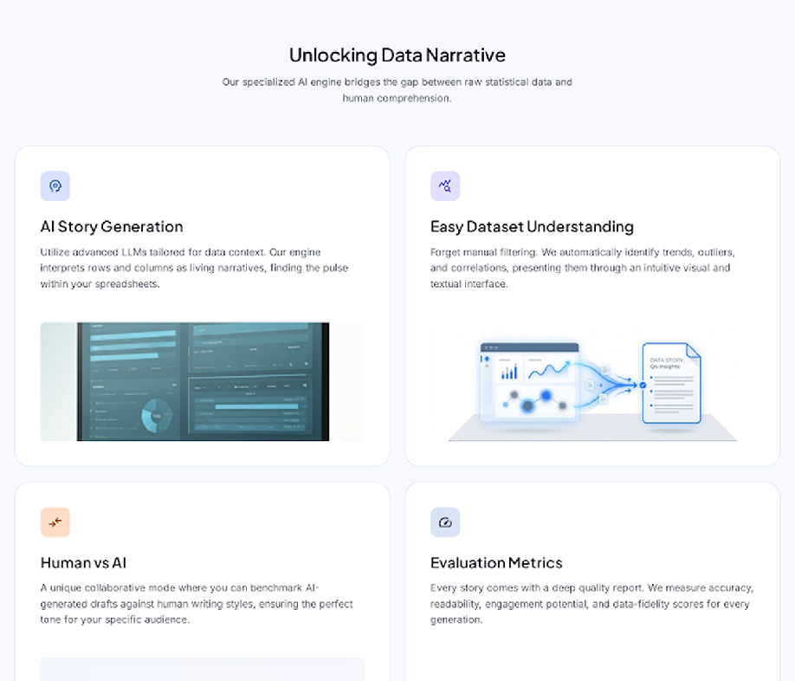
PART 4 — Web Application
Home page
Hero & Vision
Display the title and the core mission/main idea of the web application.
Feature Overview
Comprehensive explanation of the platform's unique offerings and key features.
Call to Action
Direct navigation via a primary button to the core story generation workflow.
AI-Powered Data Storytelling · CMS Team Project · TU Dresden · SoSe 2026
16
Notes:
Present the interface as three panels: see the data, read both stories side by side, and inspect what the moderator changed. We already built a working dashboard ('Red Pen') during the reproduction — this design extends it. [~1.5 min]

Slide 18
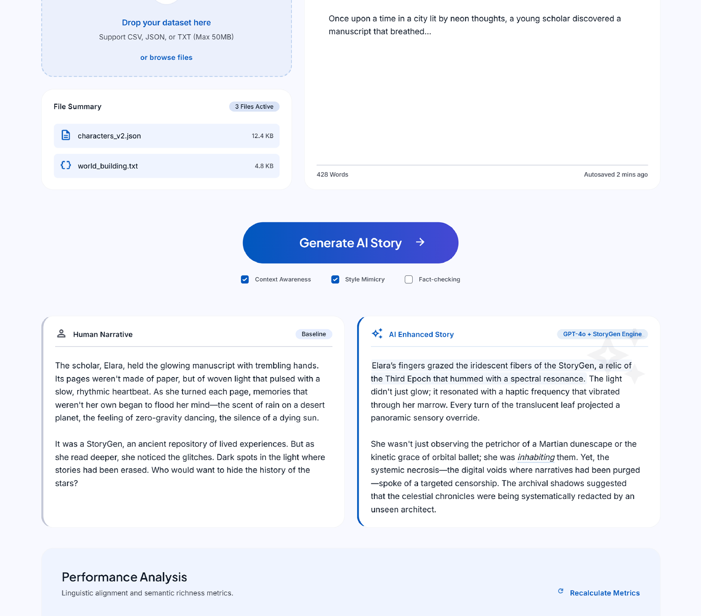
PART 4 — Web Application
Story Generation Page
Dataset Upload
Allows you to upload the dataset that you want to generate the story from.
Story Drafting & Import
Allows you to write a story about a dataset or import a text or docx file that has a human written story.
Performance Analysis
Compares both the stories and produces output metrics like BLEU, ROGUE, METEOR score and so on.
AI-Powered Data Storytelling · CMS Team Project · TU Dresden · SoSe 2026
17
Notes:
Present the interface as three panels: see the data, read both stories side by side, and inspect what the moderator changed. We already built a working dashboard ('Red Pen') during the reproduction — this design extends it. [~1.5 min]

Slide 19
Future Work
Remaining tasks for finishing the project
AI-Powered Data Storytelling · CMS Team Project · TU Dresden · SoSe 2026
18
Notes:
Speaker 4. The interface where a reader sees the data, both stories, and what the moderator changed. [~10s]

Slide 20
Future Work
Methodology: Decide on the best pipeline to generate realistic, human-like stories.
Metrics: Explore advanced metrics to quantify AI-generated story quality.
Frontend: Implement the full design of the web application interface.
Backend: Connect Python methodologies to the frontend for a functional app.
Scalability: Scale models to handle larger and more complex datasets.
AI-Powered Data Storytelling · CMS Team Project · TU Dresden · SoSe 2026
19
Notes:
These metrics come straight from our reproductions, extended to the tone task. The novel pair is the tone-calibration delta plus the faithfulness re-check that confirms the edit kept the facts. The user study answers the human-vs-LLM question. [~1 min]

Slide 21

Thank You!
Questions & Feedback are welcome
AI-Powered Data Storytelling · CMS Team Project · TU Dresden · SoSe 2026

