Slide 1

Widgets In Flutter
By Yasir Nawaz

Slide 2
Introduction of Drawer
The mobile apps that use Material Design have two primary options for navigation. These navigations are Tabs and Drawers.
A drawer is an alternative option for tabs because sometimes the mobile apps do not have sufficient space to support tabs.
A drawer is an invisible side screen. It is a sliding left menu that generally contains important links in the application and occupies half of the screen when displayed.

Slide 3
Introduction of Drawer
Let us see how the drawer works in a Flutter. Flutter uses a drawer widget to create a sliding left menu layout with a Material Design widget. The following steps are required to use a drawer in the app.
  Add drawer in scaffold widget
  Populate the drawer by adding content
  Close the drawer.

Slide 4
Add A Drawer In Your Screen
In the main.dart file, create a drawer in the scaffold widget as the code given below.
Scaffold(
drawer: Drawer(
child: // Populate the Drawer by adding content in the next step.
)
);

Slide 5
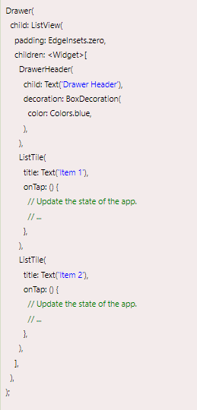
Populate Your Drawer With Items
Next, we need to add content in the drawer. In this example, we are going to use the Listview widget that allows the users to scroll through the drawer if the content does not fit in the screen supports. The following code explains it more clearly.

Slide 6
Close Your Drawer
Finally, close the drawer. We can do this by using the navigator.
Next you need to ad onTap function on listview items.
Add Navigator.pop(context); inside in above function.

Slide 7
Add A Drawer Header
To provide an account header in your drawer you need to add an item called Drawer Header.
DrawerHeader(
child: Text('Drawer Header'),
decoration: BoxDecoration(
color: Colors.blue,
),
),

Slide 8
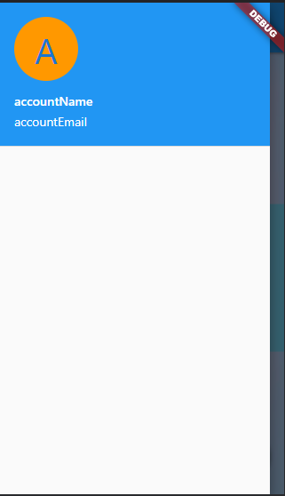
Add A Drawer Header
To add user accounts drawer header .
UerAccountsDrawerHeader(
accountName: Text("accountName"),
accountEmail: Text("accountEmail"),
currentAccountPicture: CircleAvatar(
backgroundColor: Colors.orange,
child: Text(
"A",
style: TextStyle(fontSize: 40.0),
),
))

