Slide 1
IDDS: Rules-based Expert Systems
Based on a presentation by Mark Ponsen in 02/21/05
References:
Artificial Intelligence: A Modern Approach by Russell & Norvig, chapter 10
Knowledge-Based Systems in Business Workshop (2003), by Aronson
http://www.aaai.org/AITopics/html/expert.html

Slide 2

What is an Expert System
Web definition: A computer program that contains expert knowledge about a particular problem, often in the form of a set of if-then rules, that is able to solve problems at a level equivalent or greater than human experts
Expert System was Most Popular Applied AI Technology (and still in used in a particular niche market: Computer Games!!!)

Slide 3
Building Expert Systems
Objective of an expert system
  To transfer expertise from human experts to a computer system and
  Then on to other humans (non-experts)
Activities
  Knowledge acquisition
  Knowledge representation
  Knowledge inferencing
  Knowledge transfer to the user

Slide 4
Human Experts Behaviors
Expert Systems are not necessarily used to replace human experts. They can be used to make their knowledge and experience more widely available (e.g., allowing non experts to work better).
Recognize and formulating the problem
Solve problems quickly and properly
Explain the solution
Learn from experience
Restructure knowledge
Break rules
Determine relevance

Slide 5
There exists Expert Systems that
… diagnose human illnesses
… make financial forecasts
… schedule routes for delivery vehicles
… decide the strategy in Age of Empires
… decide strategy in Wargus
…

Slide 6
Categories of Expert Systems
Category Problem addressed
Prediction Inferring likely consequences of given situations
Diagnosis Inferring system malfunctions from observations, a type of interpretation
Design Configuring objects under constraints, such as med orders
Planning Developing plans to achieve goals (care plans)
Monitoring Comparing observations to plans, flagging exceptions
Debugging Prescribing remedies for malfunctions (treatment)
Repair Administer a prescribed remedy
Instruction Diagnosing, debugging, and correcting student performance
Control Interpreting, predicting, repairing, and monitoring system behavior
* Examples are related to a deployed medical Expert System

Slide 7
Important Expert System Components
User
Interface
A facility for the user to interact with the Expert System
Inference
Engine
Reasoning (Thinking). Makes logical deductions based upon the knowledge in the KB.
Knowledge
Base
Contains the domain knowledge

Slide 8
All Expert System Components
To be classified as an ‘expert system’, the system must be able to explain the reasoning process. That’s the difference with knowledge based systems
Knowledge Base
Inference Engine
User Interface
Working Memory / Blackboard / Workplace
  A global database of facts used by the system
Knowledge Acquisition Facility
  An (automatic) way to acquire knowledge
Explanation Facility
  Explains reasoning of the system to the user

Slide 9
Knowledge Base
The knowledge base contains the domain knowledge necessary for understanding, formulating, and solving problems
Two Basic Knowledge Base Elements
  Facts: Factual knowledge is that knowledge of the task domain that is widely shared, typically found in textbooks or journals, and commonly agreed upon by those knowledgeable in the particular field.
  Heuristics: Heuristic knowledge is the less strictly defined, relies more on empirical data, more judgmental knowledge of performance
Fact: Amsterdam is the capital of the Netherlands.
Not a fact: New England Patriots have the best team in the NFL
Heuristic: If New England Patriots win Super Bowl for 3rd straight time, they are probably the best

Slide 10
Knowledge Acquisition Methods
Manual (Interviews)
  Knowledge engineer interviews domain expert(s)
Semiautomatic (Expert-driven)
Automatic (Computer Aided)
Most Common Knowledge Acquisition: Face-to-face Interviews

Slide 11
Knowledge Representation
Knowledge Representation deals with the formal modeling of expert knowledge in a computer program.
Important knowledge representation schemas:
  Production Rules (Expert systems that represent domain knowledge using production rules are called rule-based expert systems)
  Frames
  Semantic objects
Knowledge Representation Must Support:
  Acquiring (new) knowledge
  Retrieving knowledge
  Reasoning with knowledge
Notes:
After acquiring, the domain knowledge must be formalized and organized so it can be used for reasoning.

Slide 12
Production Rules
Condition-Action Pairs:
  A RULE consists of an IF part and a THEN part (also called a condition and an action). if the IF part of the rule is satisfied; consequently, the THEN part can be concluded, or its problem-solving action taken.
Rules represent a model of actual human behavior
Rules represent an autonomous chunk of expertise
When combined, these chunks can lead to new conclusions

Slide 13
Advantages & Limitations of Rules
Advantage
  Easy to understand (natural form of knowledge)
  Easy to derive inference and explanations
  Easy to modify and maintain
Limitations
  Complex knowledge requires many rules
  Search limitations in systems with many rules
  Maintaining rule-based systems is difficult because of inter-dependencies between rules

Slide 14
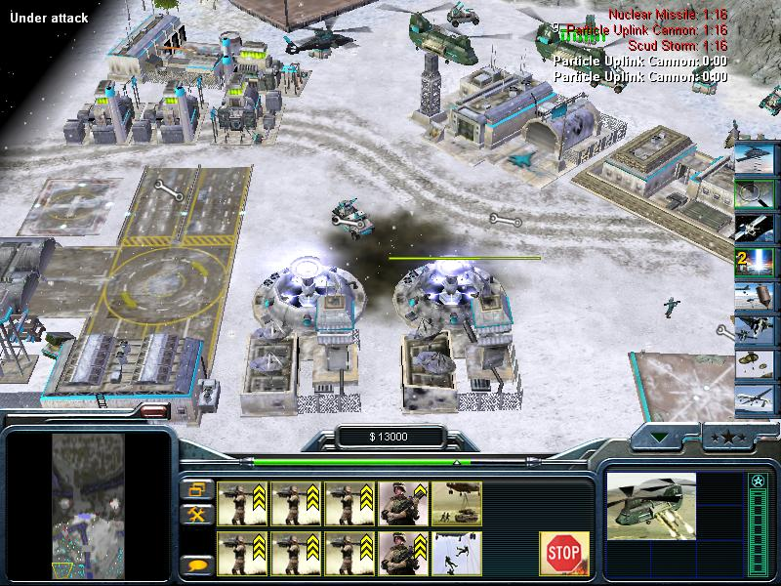
Demonstration of Rule-Based Expert Systems
Command & Conquer Generals

Slide 15
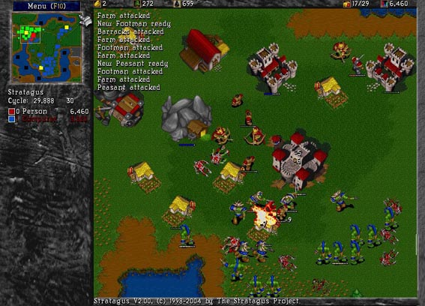
My own Expert System in Wargus

Slide 16
Rules in Wargus
{ id = 1,
name = "build townhall",
preconditions = {hasTownhall(),hasBarracks()},
actions = {
function() return AiNeed(AiCityCenter()) end,
function() return AiSet(AiWorker(), 1) end, function() return AiWait(AiCityCenter()) end,
function() return AiSet(AiWorker(), 15) end, function() return AiNeed(AiBarracks()) end,
}
},
{ id = 2,
name = "build blacksmith",
preconditions = {hasTownhall(),hasBarracks()},
etc.

Slide 17
Question: how would you encode domain knowledge for Wargus?
‘Study’ strategy guides for Warcraft 2 (manual)
Run machine learning experiments to discover new strong rules (automatic)
Allow experts (i.e., hardcore gamers) to add rules (semi-automatic)

Slide 18
Inference Mechanisms
Examine the knowledge base to answer questions, solve problems or make decisions within the domain
Inference mechanism types:
  Theorem provers or logic programming language (e.g., Prolog)
  Production systems (rule-based)
  Frame Systems and semantic networks
  Description Logic systems

Slide 19
Inference Engine in Rule-Based Systems
Inferencing with Rules:
  Check every rule in the knowledge base in a forward (Forward Chaining) or backward (Backward Chaining ) direction
  Firing a rule: When all of the rule's hypotheses (the “IF parts”) are satisfied
  Continues until no more rules can fire, or until a goal is achieved

Slide 20
Forward Chaining Systems
Forward-chaining systems (data-driven) simply fire rules whenever the rules’ IF parts are satisfied.
A forward-chaining rule based system contains two basic components:
  A collection of rules. Rules represent possible actions to take when specified conditions hold on items in the working memory.
  A collection of facts or assumptions that the rules operate on (working memory). The rules actions continuously update (adding or deleting facts) the working memory

Slide 21
Forward Chaining Operations
The execution cycle is
  Match phase: Examine the rules to find one whose IF part is satisfied by the current contents of Working memory (the current state)
  Conflict resolution phase: Out of all ‘matched’ rules, decide which rule to execute (Specificity, Recency, Fired Rules)
  Act phase: Fire applicable rule by adding to Working Memory the facts that are specified in the rule’s THEN part (changing the current state)
  Repeat until there are no rules which apply.
Notes:
Specificity - The rule applied is usually the most specific rule, or the rule that matches the most facts.
Recency - The rule applied is the rule that matches the most recently derived facts.
Fired Rules - Involves not applying rules that have already been used.

Slide 22
Forward Chaining Example
Rules
IF (ownTownhalls < 1)
THEN ADD (ownTownhalls ++)
IF (ownTownhalls > 0)
AND (ownBarracks > 0)
AND (ownLumbermills < 1)
THEN ADD (ownLumberMills ++)
IF (ownTownhalls > 0)
AND (ownBarracks > 0)
AND (ownBlacksmith < 1)
THEN ADD (ownBlacksmiths ++)
Working Memory
(ownTownhalls = 0)
(ownBarracks = 1)
(ownLumbermill = 0)
(ownBlacksmith = 0)
(ownTownhalls = 1)
(ownBarracks = 1)
(ownLumbermill = 0)
(ownBlacksmith = 0)
(ownTownhalls = 1)
(ownBarracks = 1)
(ownLumbermill = 1)
(ownBlacksmith = 1)
(ownTownhalls = 1)
(ownBarracks = 1)
(ownLumbermill = 1)
(ownBlacksmith = 0)
Rule 2 & 3 apply, assume we select 2
Only Rule 1 applies
No Rules Apply. Done!
Only Rule 3 applies

Slide 23
Backward Chaining Systems
Backward-chaining (goal-driven) systems start from a potential conclusion (hypothesis), then seek evidence that supports (or contradicts) it
A backward-chaining rule based system contains three basic components:
  A collection of rules. Rules represent possible actions to take when specified conditions hold on items in the working memory.
  A collection of facts or assumptions that the rules operate on (working memory). The rules actions continuously update (adding or deleting facts) the working memory
  A stack of goals, where a goal is simply a statement of something that the rules need to determine

Slide 24
Backward Chaining Operations
The execution cycle is
  Start with goal state
  Check the conclusions of the rules to find all rules that can satisfy the top goal on the stack
  Select one of these rules; the preconditions of the selected rule will be set as new goals on the goal stack
  System terminates if goal stack is empty

Slide 25
Backward Chaining example
Question: Does my Wargus opponent own a town hall?
Statement: My Wargus opponent owns a town hall.
Rule: If my Wargus opponent owns a lumber mill or black smith or barracks, then he owns a town hall.
Backward Chaining:
Check the rule base to see what has to be “true” for my opponent to own a town hall. If my Wargus opponent either owns a barracks, blacksmith or lumber mill, then we may conclude that he has a town hall.

Slide 26
Explanation facilities
Explain the reasoning process: why it asked some question, and how it reached some conclusion
System: Is there gas in the fuel tank?
User: Yes.
System: Is it true that the engine turns over?
User: No.
System Is it true that the lights come on?
User: Why?
System: I am trying to prove: problem with battery. It has been established that it is not the case that the engine turns over. Therefore if it is not the case that the lights come on then there is a problem with battery.
Is it true that the lights come on?
User: No.
System: I conclude that there is a problem with the battery.
User: How?
System: This follows from Rule 2:
IF NOT engine_turns_over AND ...

Slide 27
Why explain the reasoning process
  Provides the user with a means of understanding the system behavior
  People do not always accept the answers of an expert without some form of justification (especially if the expert is a machine!)
  Presenting the chain of reasoning constructed by the system which is important in explaining the success or failure of the reasoning process

Slide 28
Expert Systems Benefits
Helps preserve knowledge
Helps if expertise is scarce, expensive, or unavailable
Helps if under time and pressure constraints
  Improved Decision Quality
  Increased Output and Productivity
Helps in training new employees
  Intelligent tutor (lecture non-experts)
  Knowledge Transfer to Remote Locations

Slide 29
Problems and Limitations of
Expert Systems
Knowledge is not always readily available
Expertise can be hard to extract from humans
Expert Systems work well only in a narrow domain of knowledge
Knowledge engineers are rare and expensive
Expert Systems are expensive to design & maintain
Lack of trust by end-users (we are still dealing with a computer)
Inability to learn

Slide 30
Some Expert System Tools
PROLOG
  A logic programming language that uses backward chaining.
CLIPS –
  NASA took the forward chaining capabilities and syntax of ART and introduced the "C Language Integrated Production System" (i.e., CLIPS) into the public domain.
OPS5
  First AI language used for Production System (XCON)
EMYCIN,
  Is an expert shell for knowledge representation, reasoning, and explanation
MOLE
  A knowledge acquisition tools for acquiring and maintaining domain knowledge
Clips was
used in the Microsoft game “Ages of Empires”

Slide 31
Some Expert System Examples
MYCIN (1972-80)
  MYCIN is an interactive program that diagnoses certain infectious diseases, prescribes antimicrobial therapy, and can explain its reasoning in detail
PROSPECTOR
  Provides advice on mineral exploration
XCON
  configure VAX computers
DENDRAL (1965-83)
  rule-based expert systems that analyzes molecular structure. Using a plan-generate-test search paradigm and data from mass spectrometry and other sources, DENDRAL proposes plausible candidate structures for new or unknown chemical compounds.

