Slide 1

Pandas – Part 1

Slide 2
Pandas
We will use pandas to:
Read in data from Excel.
Manipulate data in spreadsheet.
Visualize data (we will also use another Python package called ggplot to do this).
Filter and aggregate data from spreadsheet using SQL

Slide 3
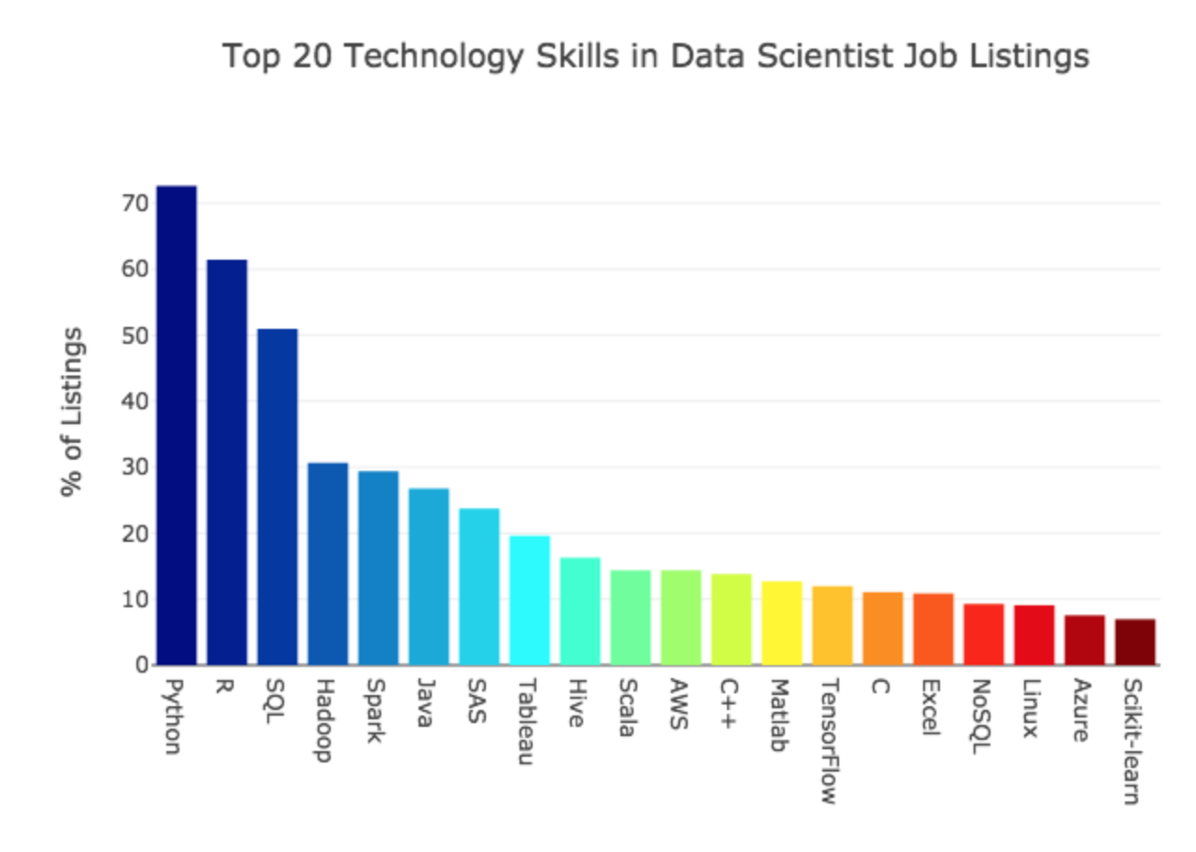
Motivation

Slide 4
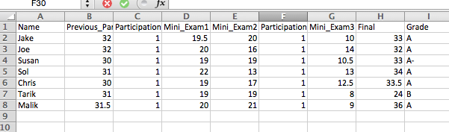
Reading in Data From Excel
I have the following data saved in the file “Grades_Short.csv”:
Let’s see how we read this data into pandas:

Slide 5
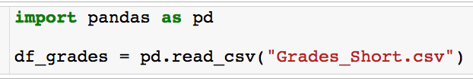
Reading in Data From Excel
I have the following data saved in the file “Grades_Short.csv”:
Before you use pandas you must import it. Anytime you use pandas put this line as the top of your code.
Let’s see how we read this data into pandas:

Slide 6
Reading in Data From Excel
I have the following data saved in the file “Grades_Short.csv”:
Reading the data into a variable called df_grades.
Let’s see how we read this data into pandas:
Built in read_csv method
Path to file

Slide 7

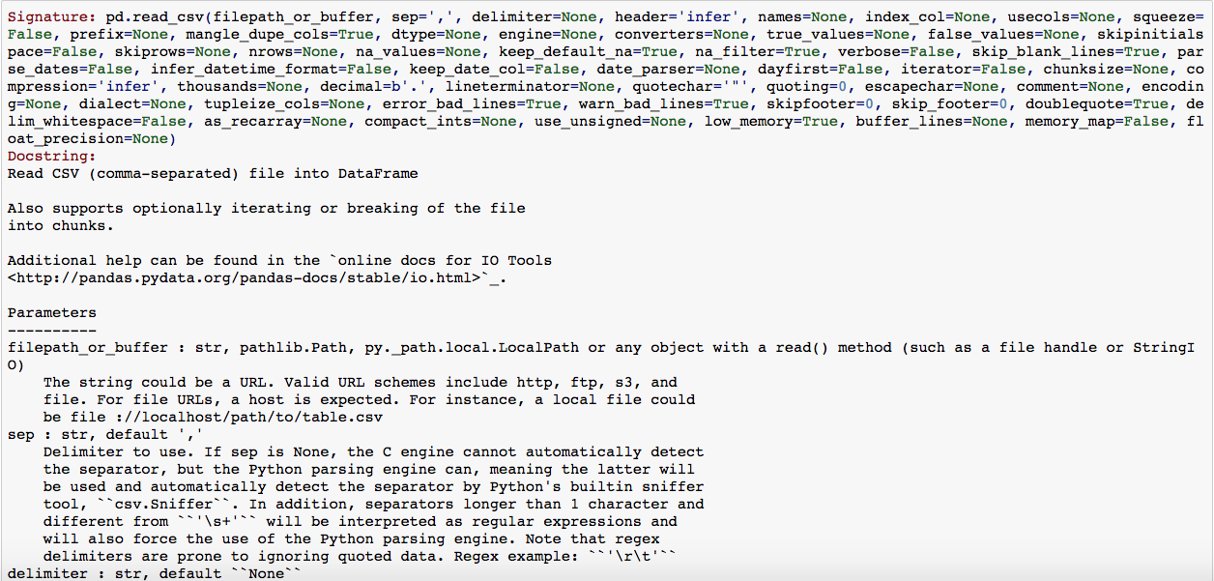
Pandas – read_csv
Always specify the input name (order of inputs only matters if you don’t)

Slide 8
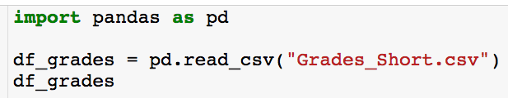
Reading in Data From Excel
So, what is df_grades and how does it store the data?
Typing the name of any variable at the end of a code cell will display the contents of the variable.

Slide 9
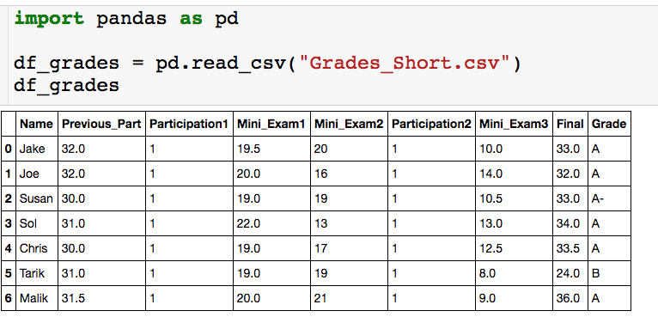
Reading in Data From Excel
So, what is df_grades and how does it store the data?
df_grades is a pandas dataframe.
The data is stored in a tabular format very similar to excel.

Slide 10
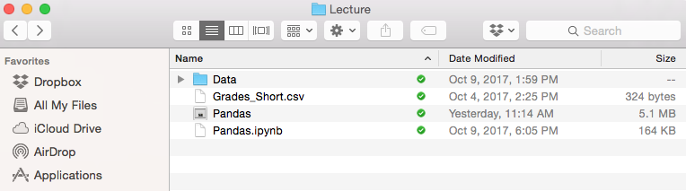
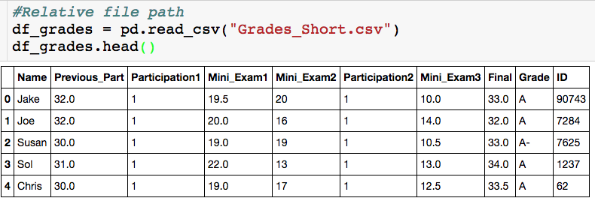
Reading in Data From Excel
Data file
Jupyter notebook

Slide 11
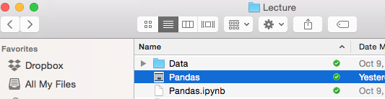
Reading in Data From Excel
Now Grades_Short.csv is in Data Folder
Jupyter notebook

Slide 12
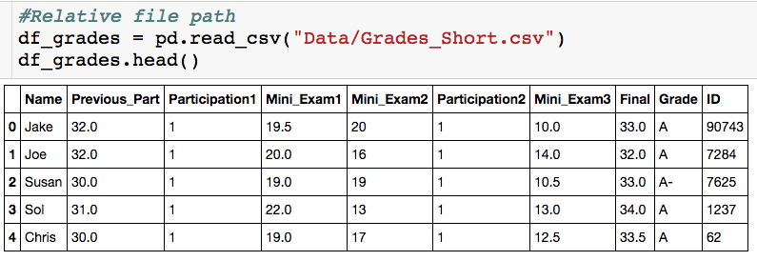
Reading in Data From Excel
Now Grades_Short.csv is in Data Folder
Jupyter Notebook
“/” separates directories

Slide 13
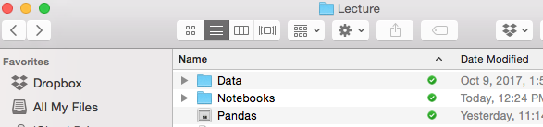
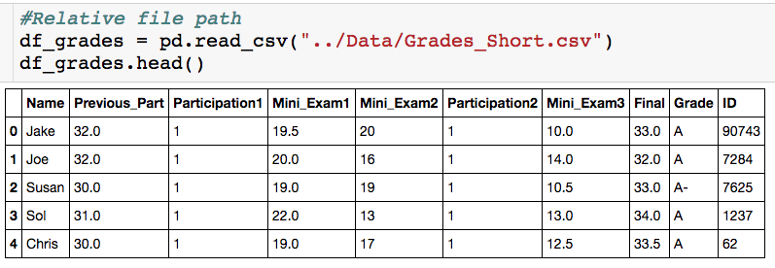
Reading in Data From Excel
Now Grades_Short.csv is in Data Folder
Jupyter notebook in folder Notebooks
“..” = go back one directory

Slide 14
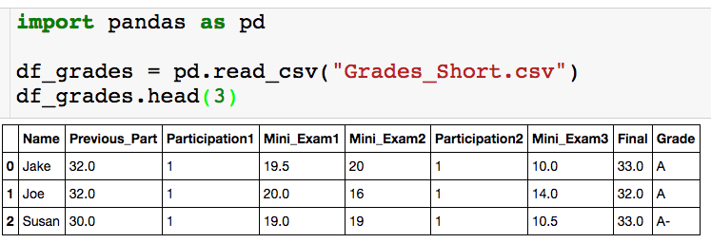
The head() Method
Using the head() method
If the data is really large you don’t want to print out the entire dataframe to your output.
The head(n) method outputs the first n rows of the data frame. If n is not supplied, the default is the first 5 rows.
I like to run the head() method after I read in the dataframe to check that everything got read in correctly.
There is also a tail(n) method that returns the last n rows of the dataframe

Slide 15
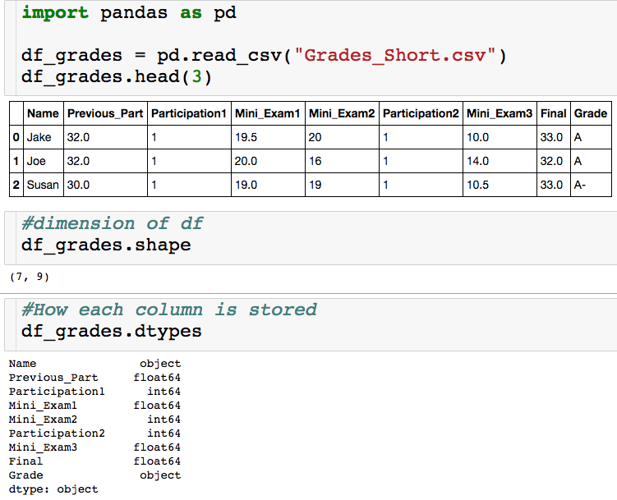
Basic Features
Think of this as a list
object = string
float64 = decimal
int64 = integer

Slide 16
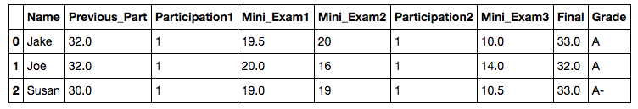
Basic Features
column names
row names = index

Slide 17
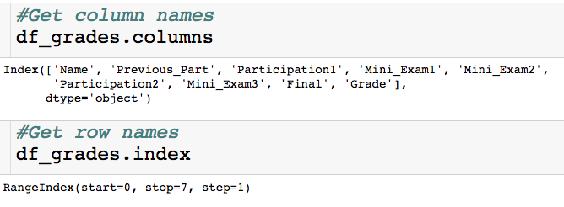
Basic Features
column names
row names = index

Slide 18
Basic Features
column names
row names = index
Pandas defaults to have the index be the row number and it will automatically recognize that the first row is the column names.
We will discuss later why you would want the index to be something other than the row numbers.
Next we discuss how to pick out various pieces of the dataframe.

Slide 19
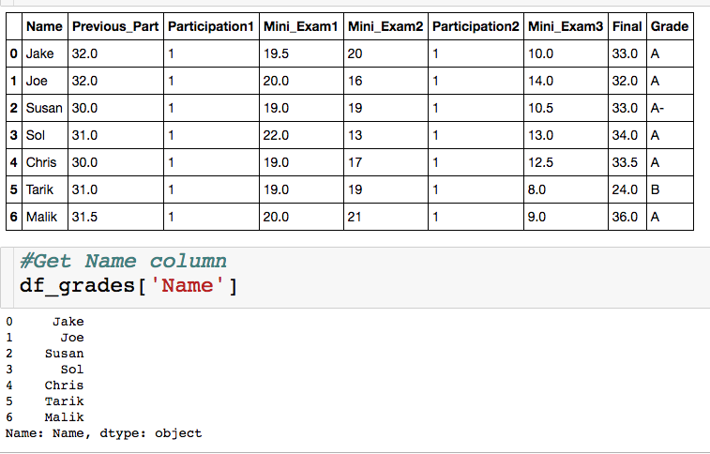
Selecting a Single Column
Between square brackets, the column must be given as a string
Outputs column as a series
A series is a one dimensional dataframe..more on this in the slicing section

Slide 20
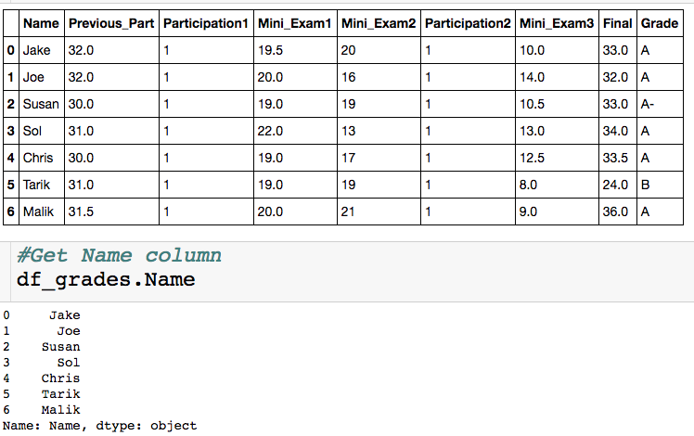
Selecting a Single Column
Exactly equivalent way to get Name column
+ : don’t have to type brackets or quotes
-: won’t generalize to selecting multiple columns,, won’t work if column names have spaces, can’t create new columns this way

Slide 21
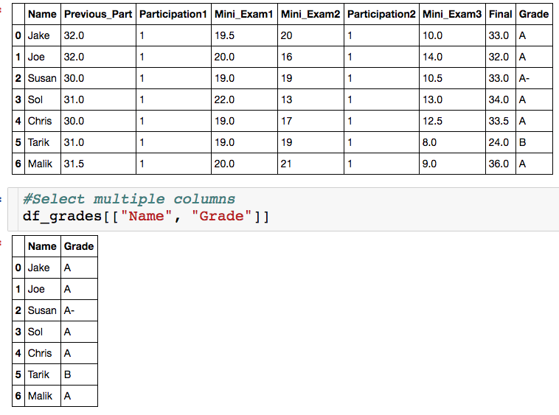
Selecting Multiple Columns
List of strings, which correspond to column names.
You can select as many column as you want.
Column don’t have to be contiguous.

Slide 22
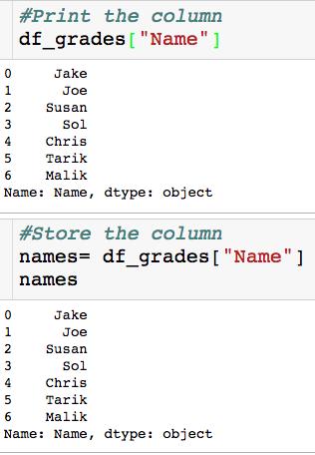
Storing Result
Why store a slice?
We might want/have to do our analysis is steps.
Less error prone
More readable
The variable name stores a series

Slide 23
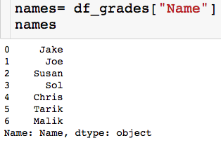
Slicing a Series
Slice/index through the index, which is usually numbers

Slide 24

Slicing a Series
Slice/index through the index, which is usually numbers
Picking out single element

Slide 25
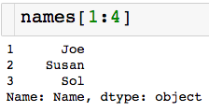
Slicing a Series
Slice/index through the index, which is usually numbers
Picking out single element
Contiguous slice
non_inclusive

Slide 26
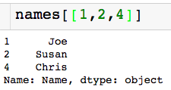
Slicing a Series
Slice/index through the index, which is usually numbers
Picking out single element
Contiguous slice
Arbitrary slice

Slide 27
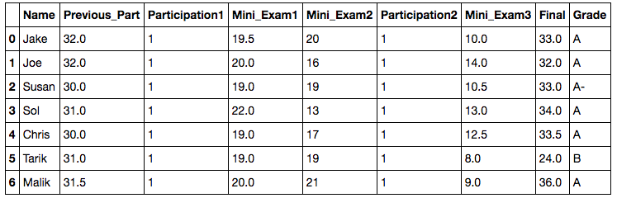
Slicing a Data Frame
There are a few ways to pick slice a data frame, we will use the .loc method.
Access elements through the index labels column names
We will see how to change both of these labels later on

Slide 28

Slicing a Data Frame
Pick a single value out.
Column name (string)
Index label (number)

Slide 29
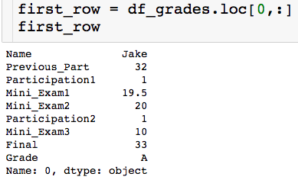
Slicing a Data Frame
Pick out entire row:
“pick out all columns”
first_row is a series

Slide 30
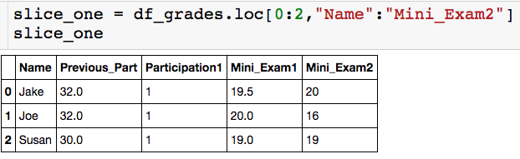
Slicing a Data Frame
Pick out contiguous chunk:
Endpoints are inclusive!

Slide 31
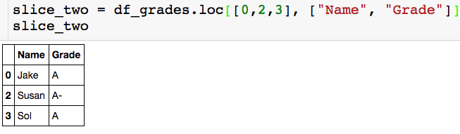
Slicing a Data Frame
Pick out arbitrary chunk:

Slide 32
Pandas – Part 2

Slide 33
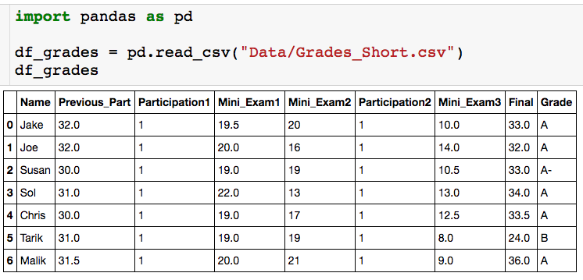
Built in Functions
How do I compute the average score on the final?

Slide 34
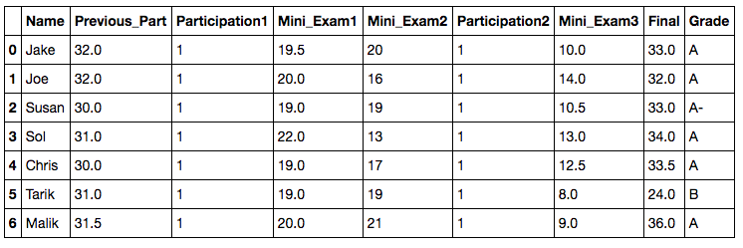
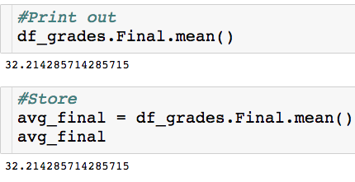
Built in Functions
How do I compute the average score on the final?
Built in mean() method

Slide 35

Built in Functions
How do I compute the highest Mini Exam 1 score?

Slide 36
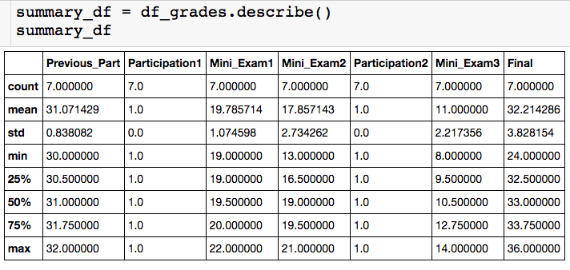
Built in Functions
I can actually get all key stats for numeric columns at once with the describe() method:
summary_df is a dataframe!

Slide 37
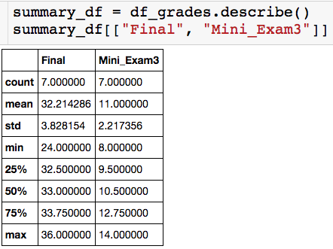
Built in Functions
I can actually get all key stats for numeric columns at once with the describe() method:

Slide 38
Built in Functions
I can actually get all key stats for numeric columns at once with the describe() method:
Notice here the index is not row numbers…

Slide 39
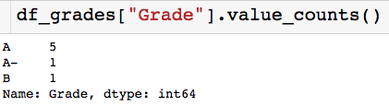
Built in Functions
Other useful built in methods:
value_count(): Gives a count of the number of times each unique value apears in the column. Returns a series where indices are the unique column values.

Slide 40
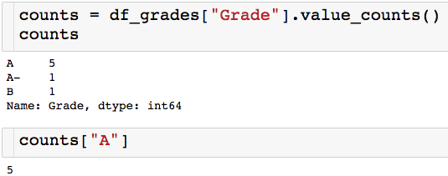
Built in Functions
Other useful built in methods:
value_count(): Gives a count of the number of times each unique value appears in the column. Returns a series where indices are the unique column values.

Slide 41
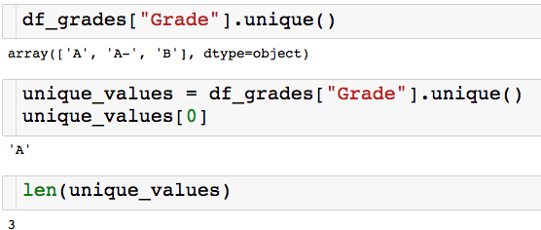
Built in Functions
Other useful built in methods:
unique(): Returns an array of all of the unique values.

Slide 42
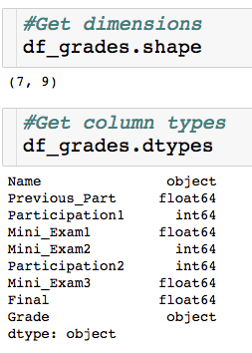
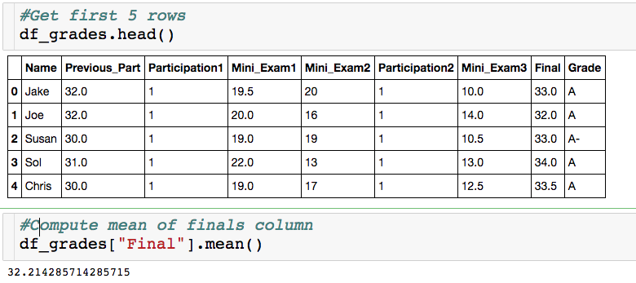
Attributes vs. Methods
When do I a put a ()?

Slide 43
Attributes vs. Methods
When do I a put a ()?
dataframe attributes
dataframe methods

Slide 44
Attributes vs. Methods
When do I a put a ()?
dataframe attributes
dataframe methods
Require computation for output
Features of dataframe

Slide 45
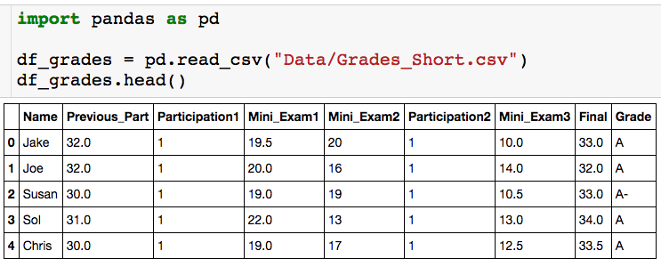
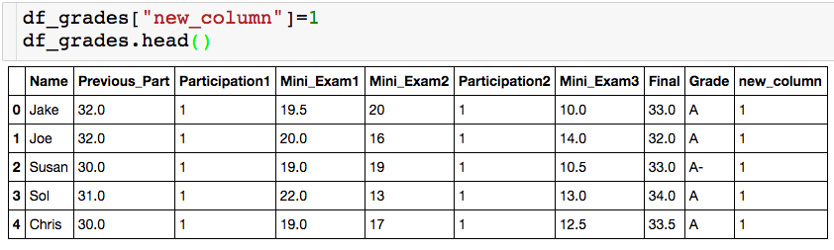
Creating New Columns
Let’s create a useless new column of all 1s:

Slide 46
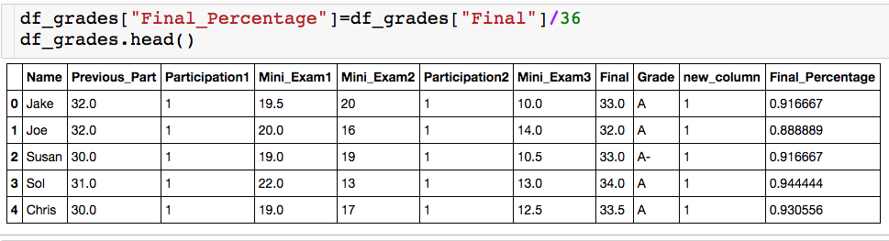
Creating New Columns
We can also create column as function of other column. The Final was worth 36 points, let’s create a column for each student’s percentage.

Slide 47
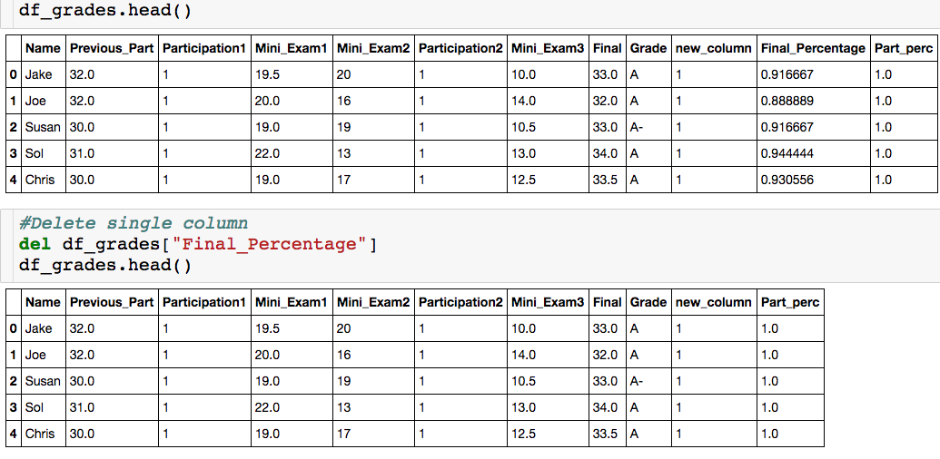
Deleting Columns

Slide 48
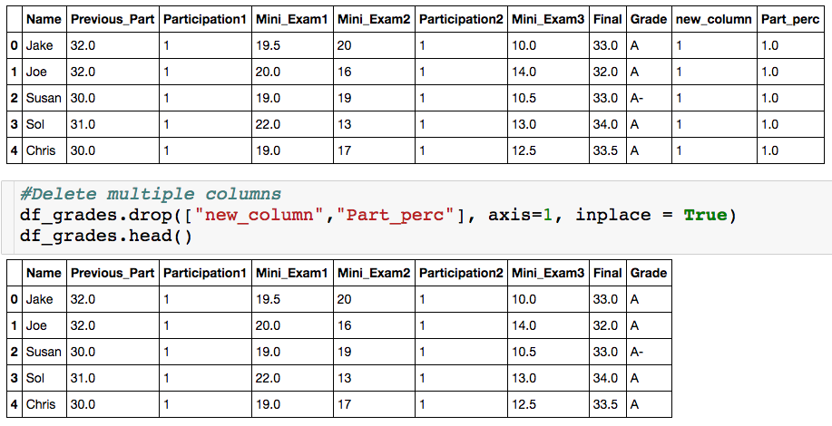
Deleting Columns

Slide 49

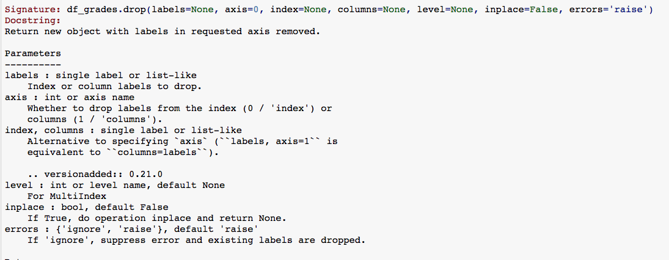
Deleting Columns

Slide 50
The Drop Method
List of column of index label

Slide 51
The Drop Method
List of column of index label
axis = 1 – delete specified columns
axis = 0 – delete specified rows

Slide 52
The Drop Method
inplace = True– change df_grades
inplace = False – return dataframe with specified columns deleted, do not change df_grades
List of column of index label
axis = 1 – delete specified columns
axis = 0 – delete specified rows

Slide 53
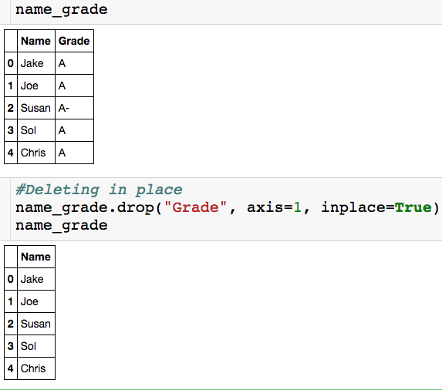
The Drop Method - inplace
The column “Grade” is removed from name_grade

Slide 54
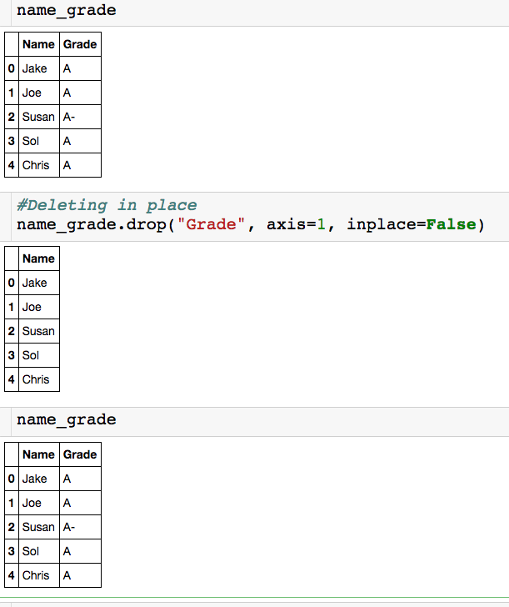
The Drop Method - inplace
Just returns a dataframe with “Grade” deleted.
The dataframe name_grade is unchanged.

Slide 55
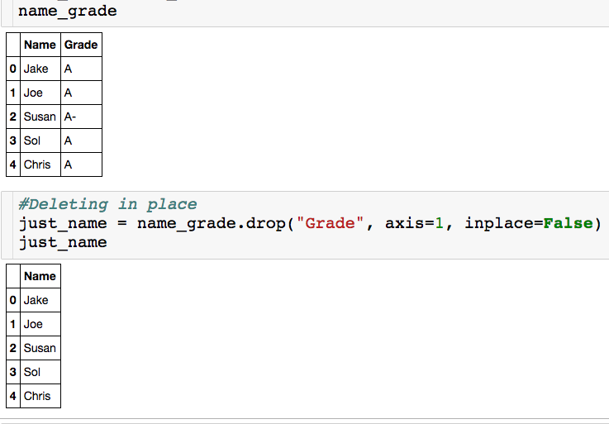
The Drop Method - inplace
Have to store the result in a variable to use the dataframe with “Grade” deleted.

Slide 56
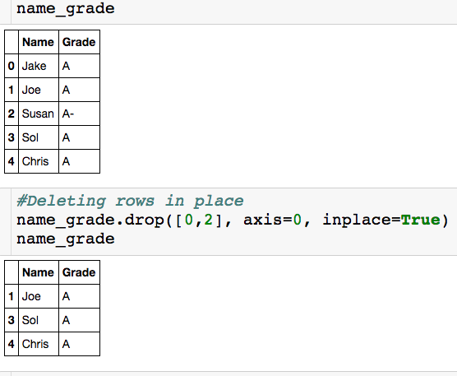
The Drop Method - axis
List of index labels to be deleted

Slide 57
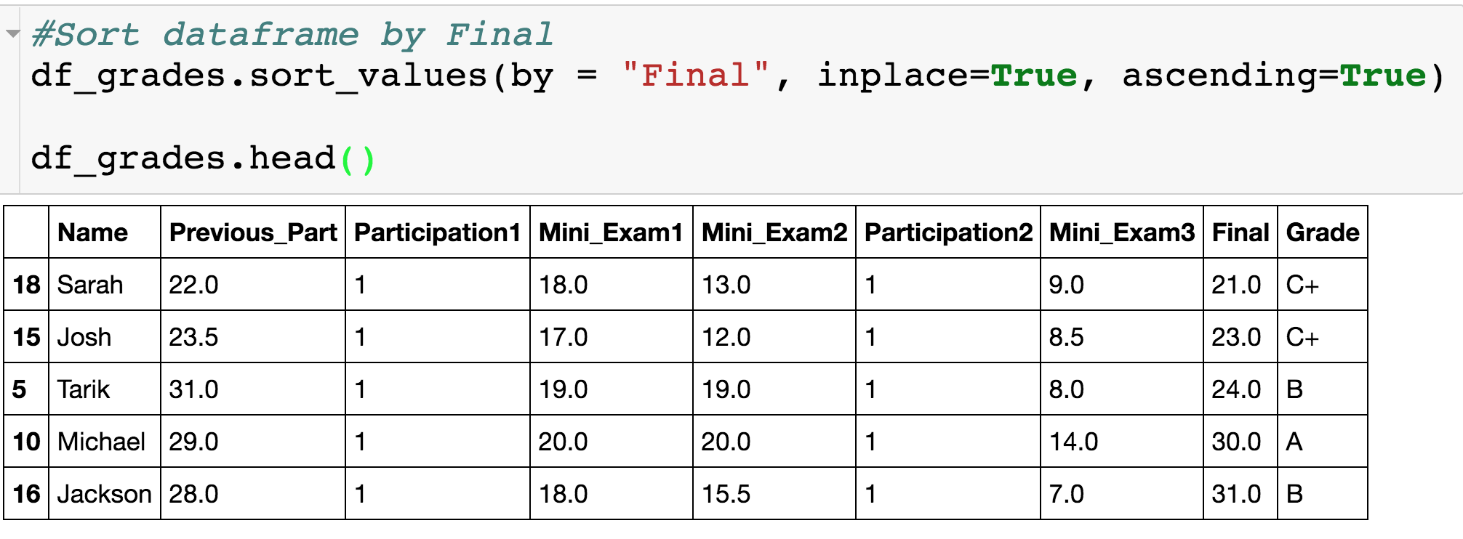
Sorting Dataframes

Slide 58

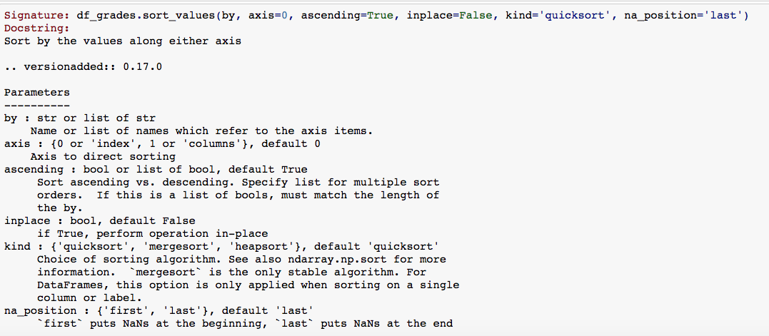
Sorting Dataframes

Slide 59
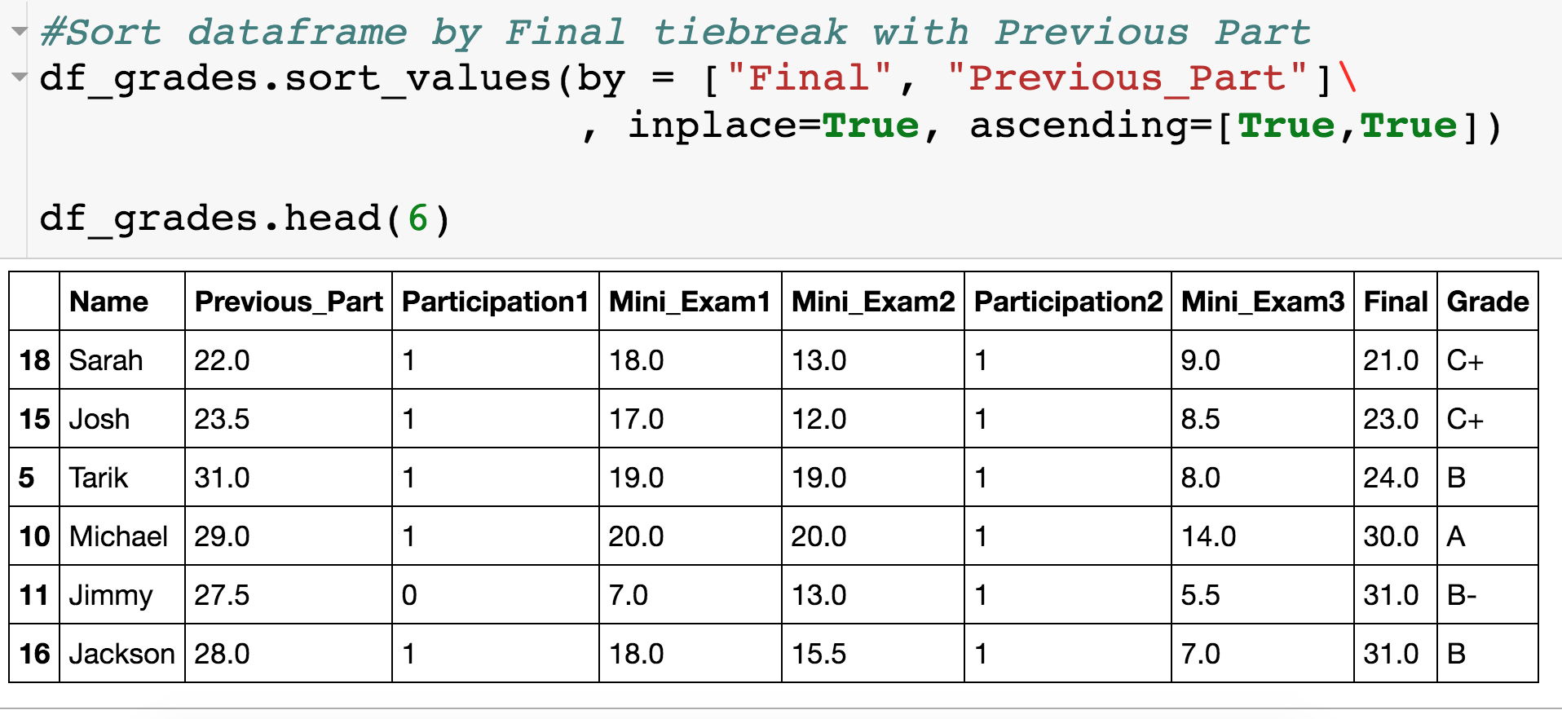
Sorting Dataframes

Slide 60

Parking Ticket Data
I have the following data saved in the file “Parking.csv”:

Slide 61

Parking Ticket Data
I have the following data saved in the file “Parking.csv”:
Let’s see what happens when we read in the data
Unwanted column

Slide 62
Parking Ticket Data
I have the following data saved in the file “Parking.csv”:
Let’s see what happens when we read in the data
Unwanted column

Slide 63

Pandas – read_csv

Slide 64

Parking Ticket Data
I have the following data saved in the file “Parking.csv”:
Let’s see what happens when we read in the data
Specifies which column in the file should be the index col.

Slide 65

Parking Ticket Data
All columns are stored as strings!

Slide 66
Parking Ticket Data
All columns are stored as strings!
Two options to convert Issue_Date column to datetime:
Tell pandas Issue_Date is a datetime when reading in the data.
Convert the column after having read in the data.

Slide 67

Pandas – read_csv

Slide 68

Converting to Datetime
Option 1:
Now Issue_Date is stored as a datetime!

Slide 69
Converting to Datetime
Option 1:
List of column names that you want read in as datetimes.
Pandas usually just figures out format.
Now Issue_Date is stored as a datetime!

Slide 70

Converting to Datetime
Option 2:
Wrap column in to_datetime() built in function

Slide 71

Timestamp Attributes

Slide 72


Timestamp Attributes

Slide 73

Creating New Columns from Datetime Column
Need .dt if we are applying datetime attributes to a series.

Slide 74
Pandas – Part 3

Slide 75

Changing Column Names

Slide 76

Changing Column Names

Slide 77


Changing Column Names

Slide 78
Changing Column Names
“curly” brackets around new column name assignments

Slide 79
Changing Column Names
“old_column_name”: “new_column_name”

Slide 80
Changing Column Names
inplace = False (default) returns a new dataframe (df_grades is unaltered) with updated column names.

Slide 81

Changing Column Names

Slide 82

Concatenating DataFrames - Stacked
Let’s say you had separate csv files with the info for the students who got an A and everyone else, but you want to analyze everything together.

Slide 83
Concatenating DataFrames - Stacked
List of dataframes to concatenate

Slide 84


Concatenating DataFrames - Stacked

Slide 85
Concatenating DataFrames - Stacked
axis = 0 (default) – combine the two dataframes by stacking them on top of each other. Set axis =1 to stack side by side.

Slide 86

Concatenating DataFrames - Stacked
# of columns has to match
What is going to happen to index?

Slide 87

Concatenating DataFrames - Stacked
We got a repeated index, which is not good!
We will eventually see how to “reset” the index.
We can also correct this when we concatenate.

Slide 88
Concatenating DataFrames - Stacked

Slide 89

Concatenating DataFrames - Stacked
Notice the ignore_index input!

Slide 90

Using the Index
The index in this case is row numbers.
What if I want to quickly see Joe’s row?
I have to look up what row Joe is in.
Instead, I can make the index the column name.

Slide 91

Using the Index
Column that will become index (make sure this is unique).

Slide 92


Set_index

Slide 93
Using the Index
Modify df_grades

Slide 94

Using the Index
The index is now the name column!

Slide 95

Using the Index

Slide 96

Using the Index
Want to make new ID column the index

Slide 97

Using the Index
This accomplishes the task but we lose the name column.

Slide 98

Using the Index

Slide 99

Resetting Index
How do I go back to having row numbers?

Slide 100


Resetting Index

Slide 101


Using the Index
reset_index() will make your index row numbers again.
Useful when manipulating dataframes and index can get messed up

Slide 102


Missing Data
Not that different columns have different indicators for missing data.

Slide 103

Missing Data
We can replace the missing data with a true NaN (right now everything is just a string).

Slide 104

Missing Data
List of strings specifying which values are missing.

Slide 105


Missing Data

Slide 106

Missing Data
List of strings specifying which values are missing.
Special NaN value (from numpy package), which is not a string.

Slide 107

Missing Data
We know “NaN” and “not available” are missing data points, but what about -1?

Slide 108
Missing Data
We know “NaN” and “not available” are missing data points, but what about -1?
For the Participation1 column the -1 is probably missing data.
For the Temp column, the -1 is likely not missing data, since -1 is a valid temperature.
For each column, we can specify exactly which values correspond to missing data.

Slide 109
Missing Data
Curly brackets

Slide 110
Missing Data
Column name as string
NaN value

Slide 111
Missing Data
Column name as string
NaN value
“For column Participation1, replace all -1s with a NaN.”

Slide 112

Missing Data
Notice that the -1 was replaced only in Participation1 column

Slide 113
Comparing Approaches
Approach 1:
Does a global search and replace in all columns.
Approach 2:
Allows you to specify column by column the values that should be replaced with NaN.

Slide 114
Benefiting of Having NaNs
Have common symbol for where there is missing data
Good for you and good for others looking at your code/data
These entries will be ignored if you try to compute means of columns with NaNs.
We can easily get rid of column/rows with missing data
We can easily replace the missing values with the mean of the column, for example.

Slide 115


Isnull() Method
The isnull() method lets you check where the NaNs are:

Slide 116

Isnull() Method
The isnull() method lets you check where the NaNs are:

Slide 117

Dropna() Method
How do I get rid of all rows with NaN?

Slide 118

Dropna() Method
How do I get rid of all rows with NaN?
Setting axis = 1 would drop all columns with an NaN

Slide 119


Dropna() Method

Slide 120

Fillna() Method
Rather than getting rid of rows/columns, we fill the “holes” in a number of ways.

Slide 121


Fillna() Method

Slide 122

Fillna() Method
Rather than getting rid of rows/columns, we fill the “holes” in a number of ways.

