Slide 1
Intro. to Data Visualization Simple Graphs in Python using
matplotlib and pyplot
By Mr. Yasir Nawaz

Slide 2
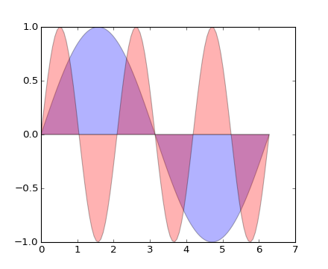
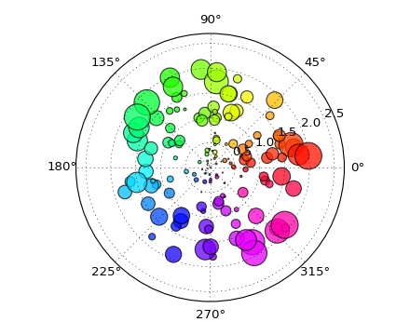
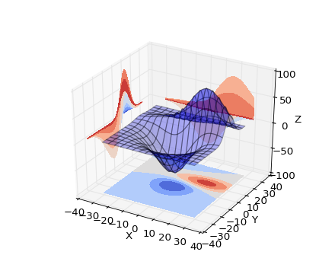
What is data visualization?
Data visualization is the graphical representation of information and data.
Can be achieved using visual elements like figures, charts, graphs, maps, and more.
Data visualization tools provide a way to present these figures and graphs.
Often, it is essential to analyze massive amounts of information and make data-driven decisions.
converting complex data into an easy to understand representation.

Slide 3
Matplotlib
Matplotlib is one of the most powerful tools for data visualization in Python.
Matplotlib is an incredibly powerful (and beautiful!) 2-D plotting library.
It is easy to use and provides a huge number of examples for tackling unique problems
In order to get matplotlib into your script,
first you need to import it, for example:
import matplotlib.pyplot as plt
However, if it is not installed, you may need to install it:
Easiest way to install matplotlib is using pip.
Type the following command in the command prompt (cmd) or your Linux shell;
pip install matplotlib
Note that you may need to run the above cmd as an administrator

Slide 4
matplotlib
Strives to emulate MATLAB
matplotlib.pyplot is a collection of command style functions that make matplotlib work like MATLAB.
Each pyplot function makes some change to the figure:
e.g.,
creates a figure,
creates a plotting area in the figure,
plots some lines in the plotting area,
decorates the plot with labels, etc.
Note that various states are preserved across function calls
Whenever you plot with matplotlib, the two main code lines should be considered:
Type of graph
this is where you define a bar chart, line chart, etc.
Show the graph
this is to display the graph

Slide 5
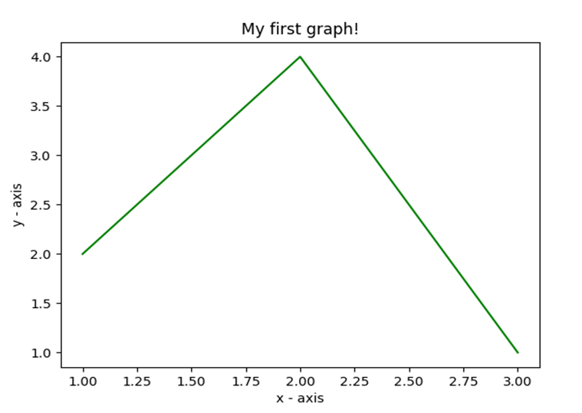
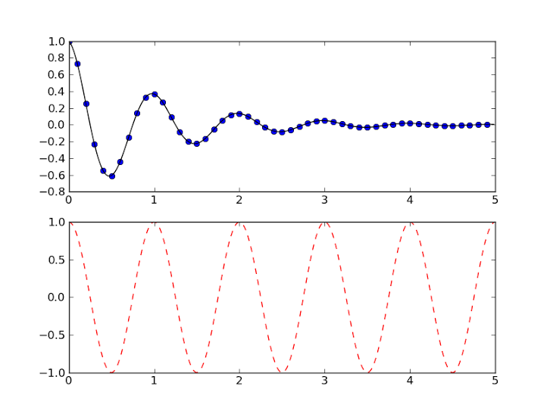
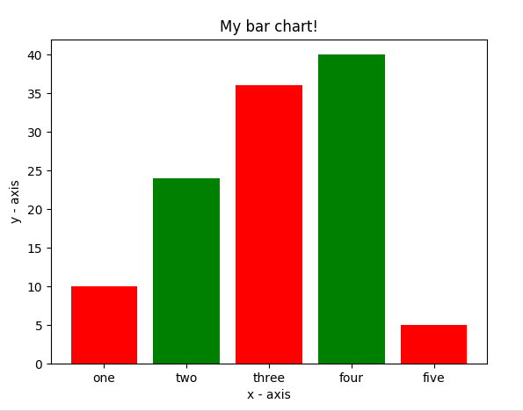
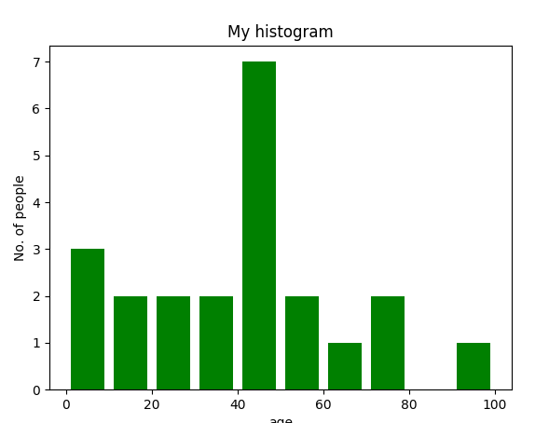
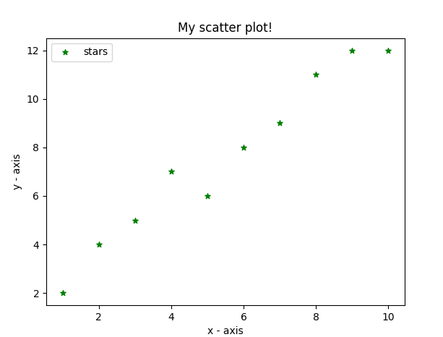
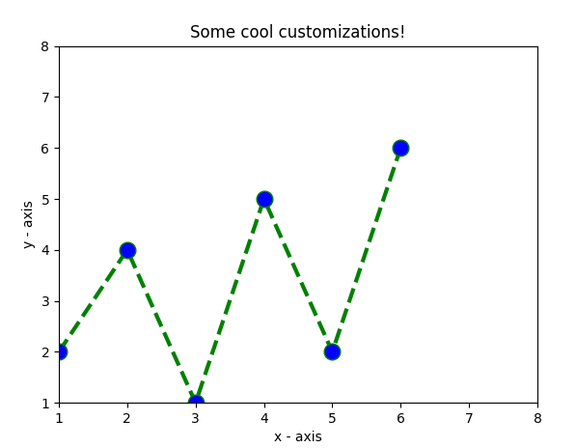
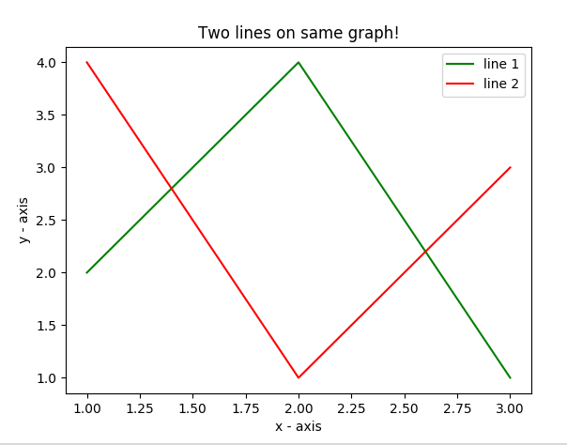
E.g. Matplotlib
Matplotlib allows you to make easy things
You can generate plots, histograms, power spectra, bar charts, errorcharts, scatterplots, etc., with just a few lines of code.

Slide 6
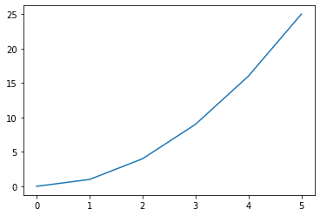
Line Graphs
import matplotlib.pyplot as plt
#create data for plotting x_values = [0, 1, 2, 3, 4, 5 ] y_values = [0, 1, 4, 9, 16,25]
#the default graph style for plot is a line plt.plot(x_values, y_values)
#display the graph plt.show()

Slide 7
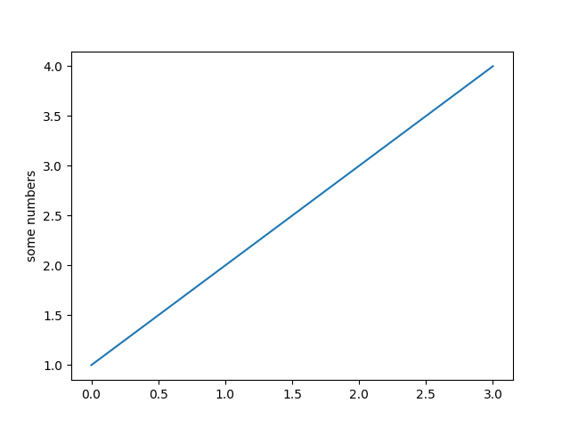
More on Line Graph
Note: if you provide a single list or array to the plot() command,
then matplotlib assumes it is a sequence of y values, and
automatically generates the x values for you.
Since python ranges start with 0, the default x vector has the same length as y but starts with 0.
Hence the x data are[0, 1, 2, 3].
import matplotlib.pyplot as plt
plt.plot([1, 2, 3, 4])
plt.ylabel('some numbers')
plt.show()

Slide 8
pyplot
text() : adds text in an arbitrary location
xlabel(): adds text to the x-axis
ylabel(): adds text to the y-axis
title() : adds title to the plot
clear() : removes all plots from the axes.
savefig(): saves your figure to a file
legend() : shows a legend on the plot
All methods are available on pyplot and on the axes instance generally.

Slide 9
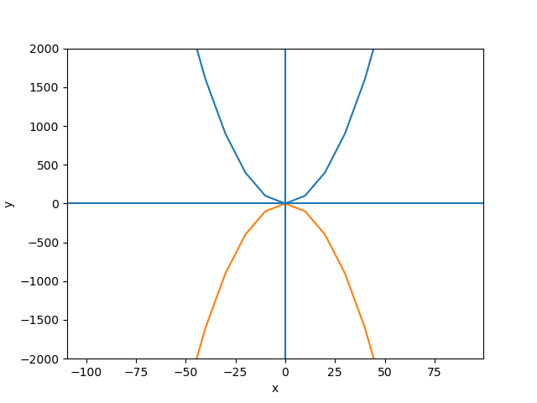
import matplotlib.pyplot as plt
y1 =[]
y2 =[]
x = range(-100,100,10)
for i in x: y1.append(i**2)
for i in x: y2.append(-i**2)
plt.plot(x, y1)
plt.plot(x, y2)
plt.xlabel("x")
plt.ylabel("y")
plt.ylim(-2000, 2000)
plt.axhline(0) # horizontal line
plt.axvline(0) # vertical line
plt.savefig("quad.png")
plt.show()
Incrementally modify the figure.
Save your figure to a file
Show it on the screen

Slide 10
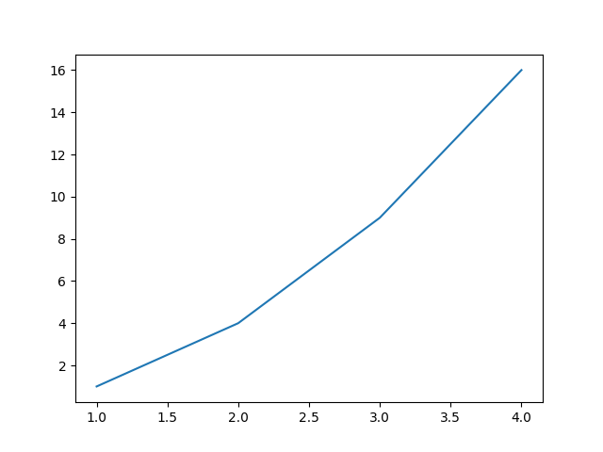
Plot
import matplotlib.pyplot as plt
x = [1, 2, 3, 4]
y = [1, 4, 9, 16]
plt.plot(x, y)
no return value?
We are operating on a “hidden” variable representing the figure.
This is a terrible, terrible trick.
Its only purpose is to pander to MATLAB users.
I’ll show you how this works in the next lecture

Slide 11

Simple line
# importing the required module
import matplotlib.pyplot as plt
# x axis values
x = [1,2,3]
# corresponding y axis values
y = [2,4,1]
# plotting the points
plt.plot(x, y)
# naming the x axis
plt.xlabel('x - axis')
# naming the y axis
plt.ylabel('y - axis')
# giving a title to my graph
plt.title('My first graph!')
# function to show the plot
plt.show()
Define the x-axis and corresponding y-axis values as lists.
Plot them on canvas using .plot() function.
Give a name to x-axis and y-axis using .xlabel() and .ylabel() functions.
Give a title to your plot using .title() function.
Finally, to view your plot, we use .show() function.

Slide 12
Simple 2 lines
import matplotlib.pyplot as plt
# line 1 points
x1 = [1,2,3]
y1 = [2,4,1]
# plotting the line 1 points
plt.plot(x1, y1, label="line 1")
# line 2 points
x2 = [1,2,3]
y2 = [4,1,3]
# plotting the line 2 points
plt.plot(x2, y2, label = "line 2")
# naming the x axis
plt.xlabel('x - axis')
# naming the y axis
plt.ylabel('y - axis')
# giving a title to my graph
plt.title('Two lines on same graph!')
# show a legend on the plot
plt.legend()
# function to show the plot
plt.show()
Here, we plot two lines on same graph. We differentiate between them by giving them a name(label) which is passed as an argument of .plot() function.
The small rectangular box giving information about type of line and its color is called legend. We can add a legend to our plot using .legend() function.

Slide 13
Customization of Plots
import matplotlib.pyplot as plt
# x axis values
x = [1,2,3,4,5,6]
# corresponding y axis values
y = [2,4,1,5,2,6]
# plotting the points
plt.plot(x, y, color='green', linestyle='dashed', linewidth = 3,
marker='o', markerfacecolor='blue', markersize=12)
# setting x and y axis range
plt.ylim(1,8)
plt.xlim(1,8)
# naming the x axis
plt.xlabel('x - axis')
# naming the y axis
plt.ylabel('y - axis')
# giving a title to my graph
plt.title('Some cool customizations!')
# function to show the plot
plt.show()

Slide 14
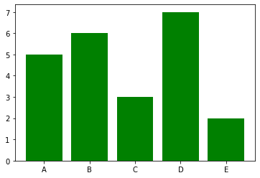
Bar graphs
import matplotlib.pyplot as plt
#Create data for plotting
values = [5, 6, 3, 7, 2]
names = ["A", "B", "C", "D", "E"]
plt.bar(names, values, color="green")
plt.show()
When using a bar graph, the change in code will be from plt.plot() to plt.bar() changes it into a bar chart.

Slide 15
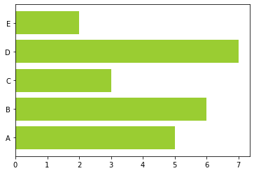
Bar graphs
We can also flip the bar graph horizontally with the following
import matplotlib.pyplot as plt
#Create data for plotting values = [5,6,3,7,2] names = ["A", "B", "C", "D", "E"]
# Adding an "h" after bar will flip the graph plt.barh(names, values, color="yellowgreen") plt.show()

Slide 16
Bar Chart
import matplotlib.pyplot as plt
# heights of bars
height = [10, 24, 36, 40, 5]
# labels for bars
names = ['one','two','three','four','five']
# plotting a bar chart
c1 =['red', 'green']
c2 =['b', 'g'] # we can use this for color
plt.bar(left, height, width=0.8, color=c1)
# naming the x-axis
plt.xlabel('x - axis')
# naming the y-axis
plt.ylabel('y - axis')
# plot title
plt.title('My bar chart!')
# function to show the plot
plt.show()
Here, we use plt.bar() function to plot a bar chart.
you can also give some name to x-axis coordinates by defining tick_labels

Slide 17
Histogram
import matplotlib.pyplot as plt
# frequencies
ages=[2,5,70,40,30,45,50,45,43,40,44,60,7,13,57,18,90,77,32,21,20,40]
# setting the ranges and no. of intervals
range = (0, 100)
bins = 10
# plotting a histogram
plt.hist(ages, bins, range, color='green',histtype='bar',rwidth=0.8)
# x-axis label
plt.xlabel('age')
# frequency label
plt.ylabel('No. of people')
# plot title
plt.title('My histogram')
# function to show the plot
plt.show()

Slide 18
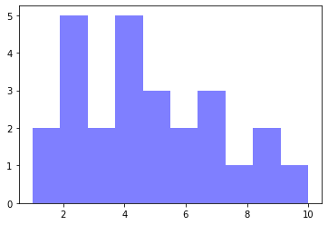
Histograms
import matplotlib.pyplot as plt
#generate fake data
x = [2,1,6,4,2,4,8,9,4,2,4,10,6,4,5,7,7,3,2,7,5,3,5,9,2,1]
#plot for a histogram
plt.hist(x, bins = 10, color='blue', alpha=0.5)
plt.show()
Looking at the code snippet, I added two new arguments:
Bins — is an argument specific to a histogram and allows the user to customize how many bins they want.
Alpha — is an argument that displays the level of transparency of the data points.

Slide 19
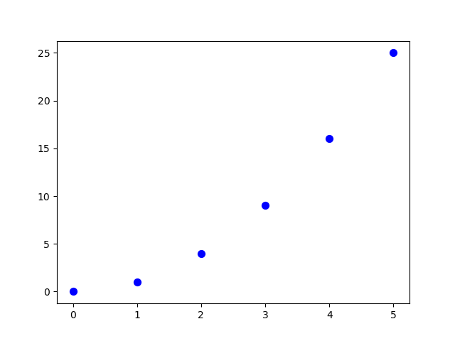
Scatter Plots
import matplotlib.pyplot as plt
#create data for plotting
x_values = [0,1,2,3,4,5] y_values = [0,1,4,9,16,25]
plt.scatter(x_values, y_values, s=30, color=“blue") plt.show()
Can you see the pattern? Now the code changed from plt.bar() to plt.scatter().

Slide 20
Scatter plot
import matplotlib.pyplot as plt
# x-axis values
x = [1,2,3,4,5,6,7,8,9,10]
# y-axis values
y = [2,4,5,7,6,8,9,11,12,12]
# plotting points as a scatter plot
plt.scatter(x, y, label= "stars", color="green", marker="*", s=30)
# x-axis label
plt.xlabel('x - axis')
# frequency label
plt.ylabel('y - axis')
# plot title
plt.title('My scatter plot!')
# showing legend
plt.legend()
# function to show the plot
plt.show()

Slide 21
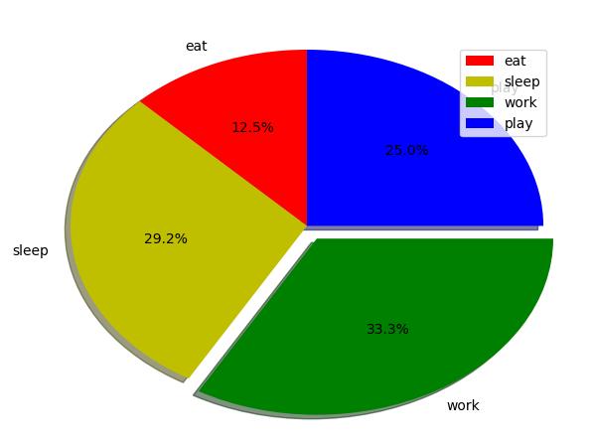
Pie-chart
import matplotlib.pyplot as plt
# defining labels
activities = ['eat', 'sleep', 'work', 'play']
# portion covered by each label
slices = [3, 7, 8, 6]
# color for each label
colors = ['r', 'y', 'g', 'b']
# plotting the pie chart
plt.pie(slices, labels = activities, colors=colors,
startangle=90, shadow = True, explode = (0, 0, 0.1, 0),
radius = 1.2, autopct = '%1.1f%%')
# plotting legend
plt.legend()
# showing the plot
plt.show()

Slide 22
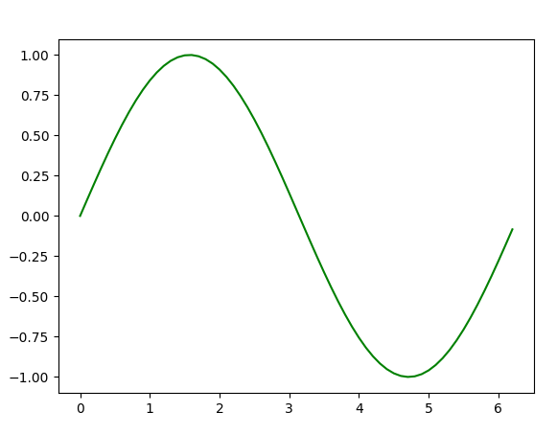
Plotting curves of given equation
# importing the required modules
import matplotlib.pyplot as plt
import numpy as np
# setting the x - coordinates
x = np.arange(0, 2*(np.pi), 0.1)
# setting the corresponding y - coordinates
y = np.sin(x)
# potting the points
plt.plot(x, y)
# function to show the plot
plt.show()
Examples taken from:
Graph Plotting in Python | Set 1

Slide 23
Summary
We just scratched the surface of the power of matplotlib.
You can read more and find how you can create more colorful, detailed, and vibrant graphs.
There are a lot more graphs available in the matplotlib library as well as other popular libraries available in python, including:
seaborn
https://seaborn.pydata.org/
pandas plot (pandas.DataFrame.plot)
https://pandas.pydata.org/pandas-docs/stable/reference/api/pandas.DataFrame.plot.html
plotly (Plotly Python Open Source Graphing Library)
https://plotly.com/python/

Slide 24
References
Matplotlib: Visualization with Python
https://matplotlib.org/index.html
matplotlib.pyplot
https://matplotlib.org/3.2.1/api/pyplot_summary.html
Tutorials
https://matplotlib.org/tutorials/index.html
Gallery & Examples
https://matplotlib.org/gallery/index.html
Videos
https://www.youtube.com/watch?v=3Fp1zn5ao2M&feature=plcp
Book: Mastering matplotlib
https://www.packtpub.com/big-data-and-business-intelligence/mastering-matplotlib

