Slide 1
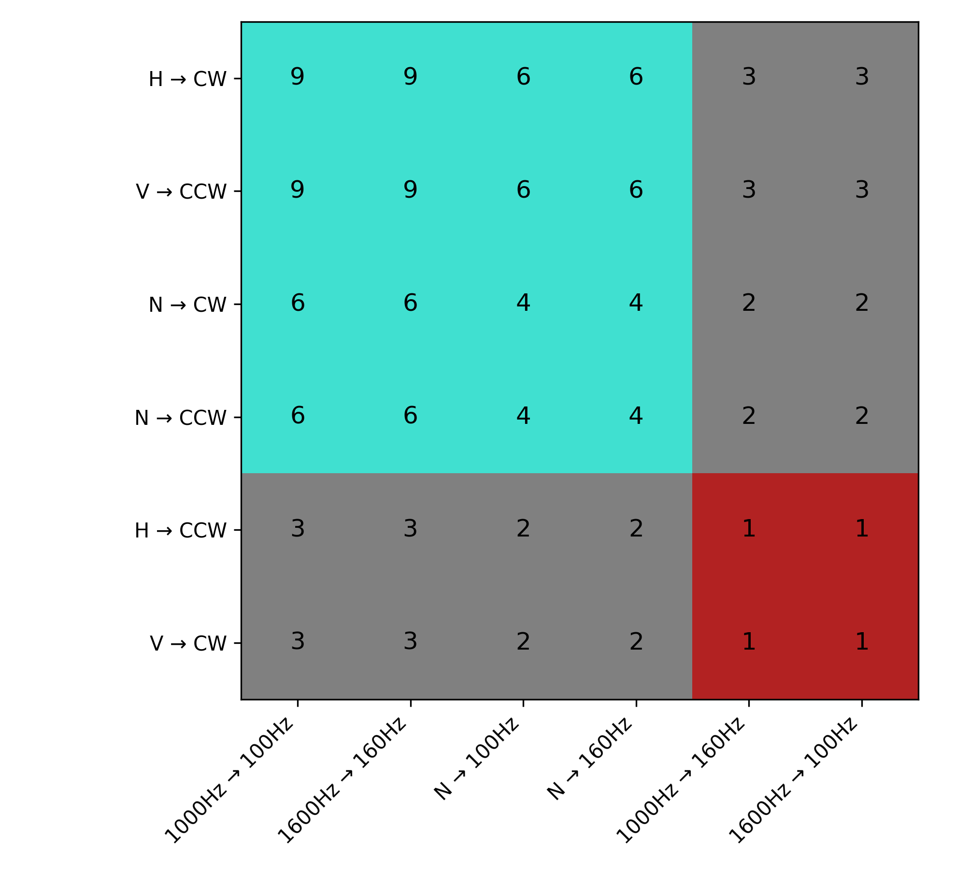
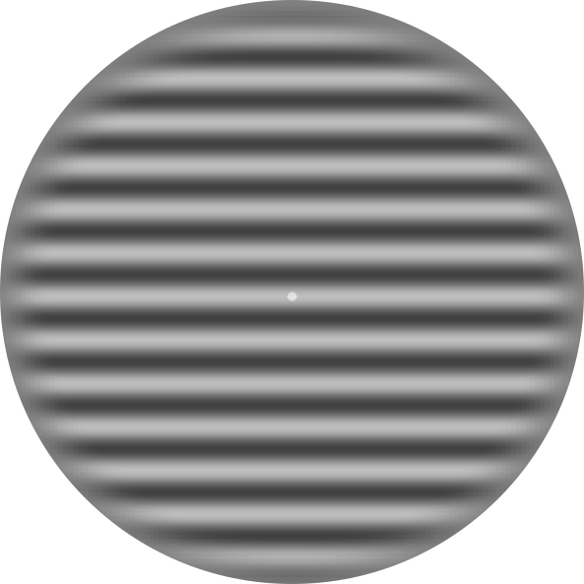

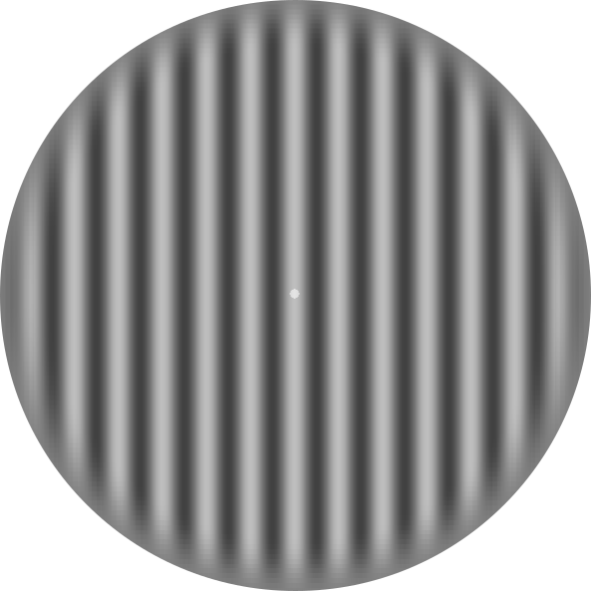

36
36
24
24
12
12
144
36
36
24
N
24
12
12

Slide 2
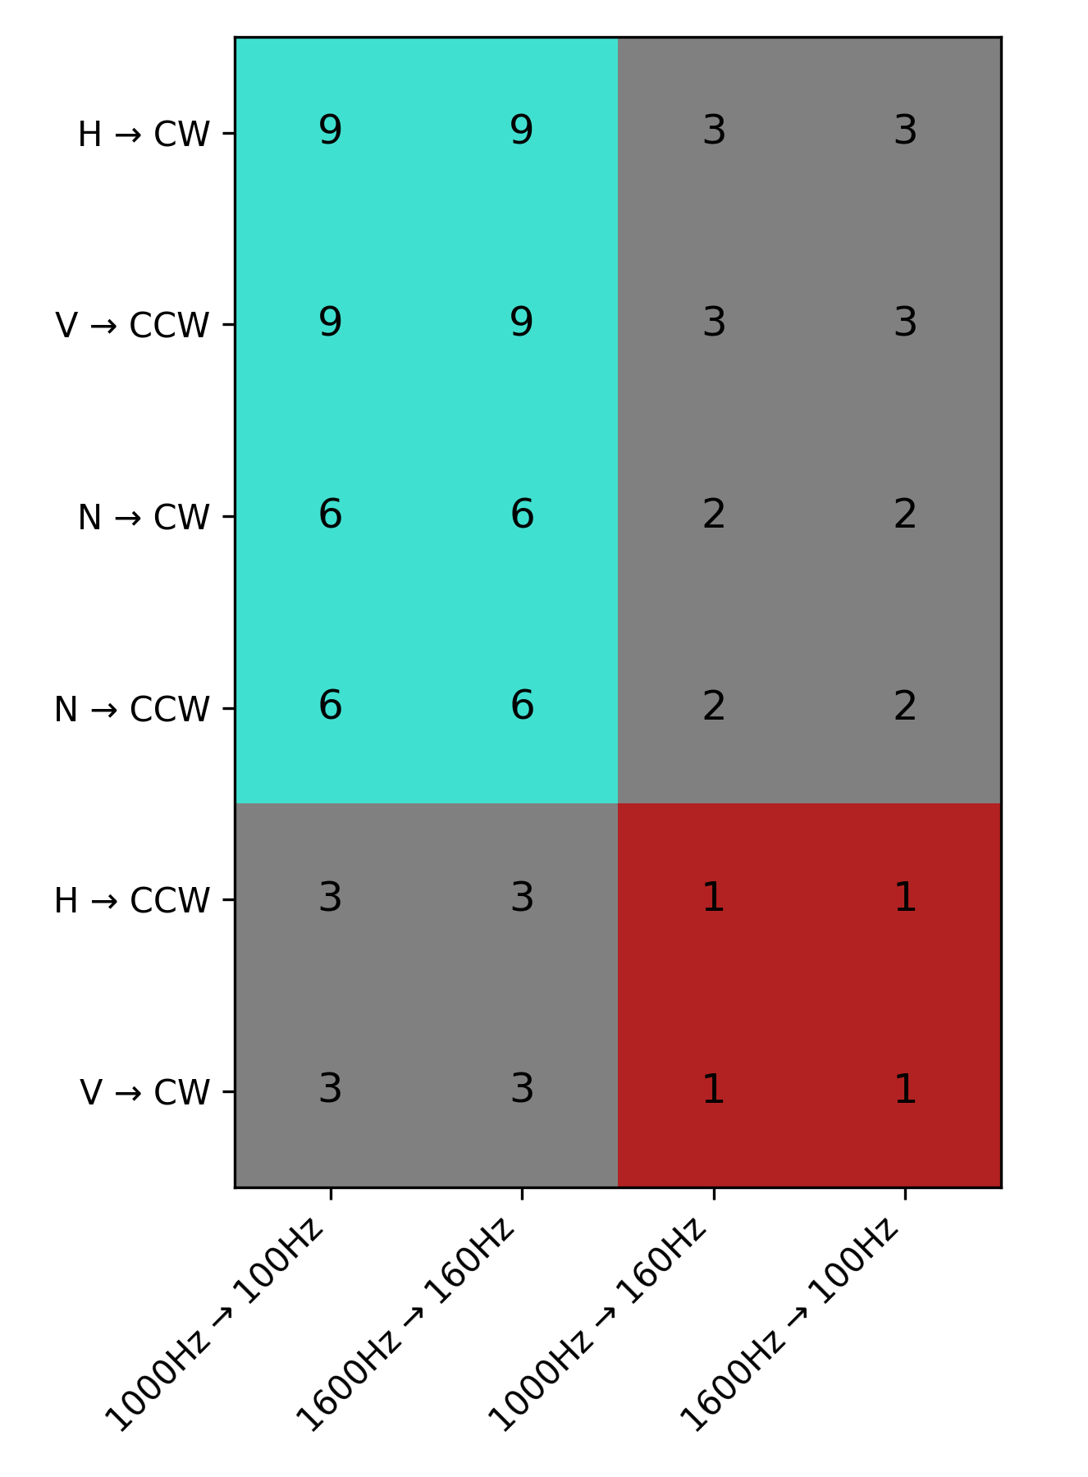
36
36
12
12
96
24
24
Problem: although proportions of visual and auditory EXP vs UEX remain balanced (.75), overall, auditory EXP are more likely than visual EXP (36/96 = .375 vs 24/96 = .25).
Same with UEX (12/96 = .125 vs 8/96 = .083)
16
16
8
8

