Slide 1

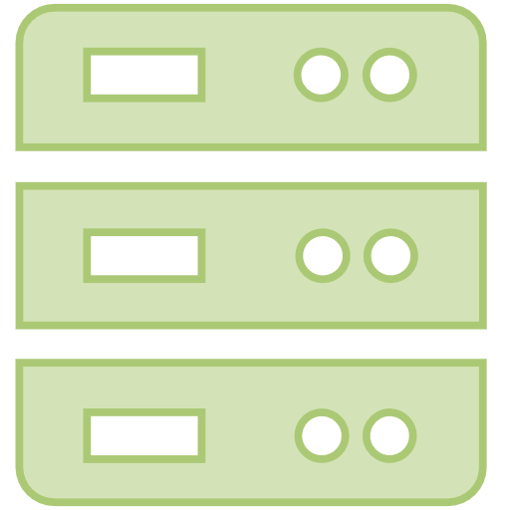








Registration Authority
Attester
RA Service
Relying party
Registration
$$Registration request$$
$vst_{G}$、$Aux$
Attestation
$$Attestation request$$
$$report$$
$$σ、vst_{G}$$
$$σ、vst_{G}$$
Open(Optional)
$$Traceability request$$
$$ID$$

Slide 2
Attester
DAA Issuer
Verifier
Join Protocol
Credential request
DAA Credential
Sign Protocol
Group Public Key
Randomized credential
Verify result
Open(Optional)
Contested credential
Identity Traceability

