Slide 1
Principal Component Analysis
Analytics
2023

Slide 2
What is it? Why?
PCA is a technique for reducing the dimension of an n x p data matrix X
Accuracy decrease while dimension increases
Create simpler models

Slide 3
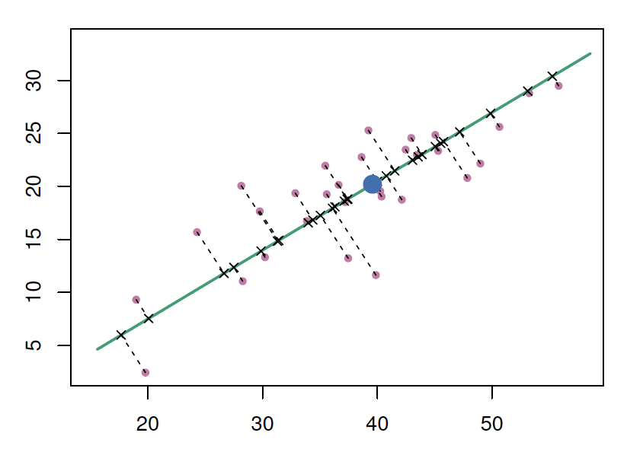
Principal Component Analysis
VA y
VA x

Slide 4
Principal Component Analysis
Principal Component 1
- Defines the line that is closest to all n of the observations
VA y
VA x

Slide 5
Principal Component Analysis
Principal Component 1
- Defines the line that is closest to all n of the observations
VA y
VA x

Slide 6
Principal Component Analysis
Principal Component 1
- Defines the line that is closest to all n of the observations
- Distances are represented using the black dashed line segments.
VA y
VA x

Slide 7
Principal Component Analysis
Principal Component 1
- Defines the line that is closest to all n of the observations
- Distances are represented using the black dashed line segments.
- 1st Component Line minimizes the sum of the squared perpendicular distances between each point and the line.
- Principal Component Scores
VA y
VA x

Slide 8
Principal Component Analysis
Principal Component 1
- Defines the line that is closest to all n of the observations
- Distances are represented using the black dashed line segments.
- 1st Component Line minimizes the sum of the squared perpendicular distances between each point and the line.
- Principal Component Scores
- The first principal component direction of the data is that along which the observations vary the most.
VA y
VA x

Slide 9
Principal Component Analysis
Condition: The second principal component PC2 is a linear combination of the variables (Vax y Vaz) that is uncorrelated with Z1
Principal Component 1
- Defines the line that is closest to all n of the observations
- Distances are represented using the black dashed line segments.
- 1st Component Line minimizes the sum of the squared perpendicular distances between each point and the line.
- Principal Component Scores
- The first principal component direction of the data is that along which the observations vary the most.
VA y
VA x

Slide 10
Principal Component Analysis
Condition: The second principal component PC2 is a linear combination of the variables (Vax y Vaz) that is uncorrelated with Z1
Principal Component 1
- Defines the line that is closest to all n of the observations
- Distances are represented using the black dashed line segments.
- 1st Component Line minimizes the sum of the squared perpendicular distances between each point and the line.
- Principal Component Scores
- The first principal component direction of the data is that along which the observations vary the most.
Principal Component 2
- The direction must be perpendicular, or orthogonal, to the PC1 direction.
VA y
VA x

Slide 11
Principal Component Analysis
Condition: The second principal component PC2 is a linear combination of the variables (Vax y Vaz) that is uncorrelated with Z1
Principal Component 1
- Defines the line that is closest to all n of the observations
- Distances are represented using the black dashed line segments.
- 1st Component Line minimizes the sum of the squared perpendicular distances between each point and the line.
- Principal Component Scores
- The first principal component direction of the data is that along which the observations vary the most.
Principal Component 2
- The direction must be perpendicular, or orthogonal, to the PC1 direction.
VA y
VA x

Slide 12
Principal Component Analysis
Condition: The second principal component PC2 is a linear combination of the variables (Vax y Vaz) that is uncorrelated with Z1
Principal Component 1
- Defines the line that is closest to all n of the observations
- Distances are represented using the black dashed line segments.
- 1st Component Line minimizes the sum of the squared perpendicular distances between each point and the line.
- Principal Component Scores
- The first principal component direction of the data is that along which the observations vary the most.
Principal Component 2
- The direction must be perpendicular, or orthogonal, to the PC1 direction.
- Distances are represented using the black dashed line segments.
VA y
VA x

Slide 13
Principal Component Analysis
Condition: The second principal component PC2 is a linear combination of the variables (Vax y Vaz) that is uncorrelated with Z1
Principal Component 1
- Defines the line that is closest to all n of the observations
- Distances are represented using the black dashed line segments.
- 1st Component Line minimizes the sum of the squared perpendicular distances between each point and the line.
- Principal Component Scores
- The first principal component direction of the data is that along which the observations vary the most.
Principal Component 2
- The direction must be perpendicular, or orthogonal, to the PC1 direction.
- Distances are represented using the black dashed line segments.
- Principal Component 2 Scores
VA y
VA x

Slide 14
Principal Component Analysis
Condition: The second principal component PC2 is a linear combination of the variables (Vax y Vaz) that is uncorrelated with Z1
Principal Component 1
- Defines the line that is closest to all n of the observations
- Distances are represented using the black dashed line segments.
- 1st Component Line minimizes the sum of the squared perpendicular distances between each point and the line.
- Principal Component Scores
- The first principal component direction of the data is that along which the observations vary the most.
Principal Component 2
- The direction must be perpendicular, or orthogonal, to the PC1 direction.
- Distances are represented using the black dashed line segments.
Principal Component 2 Scores
- PC2 variation
VA y
VA x

Slide 15
Principal Component Analysis
Example

Slide 16
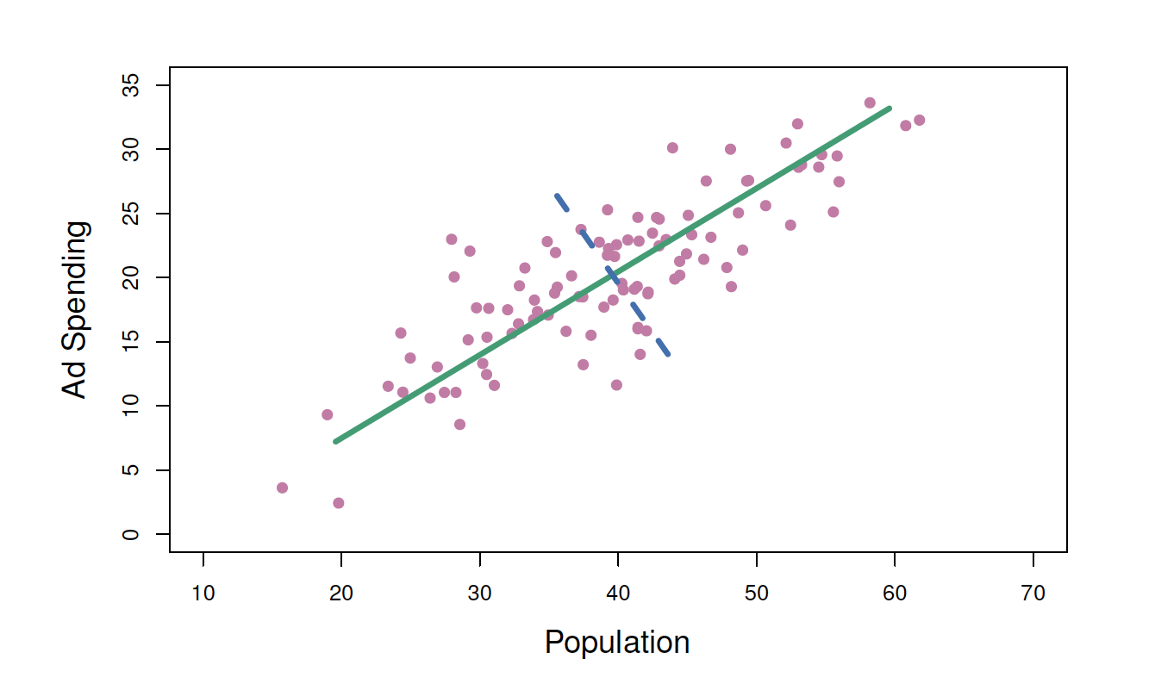
Principal Component Analysis Example

Slide 17
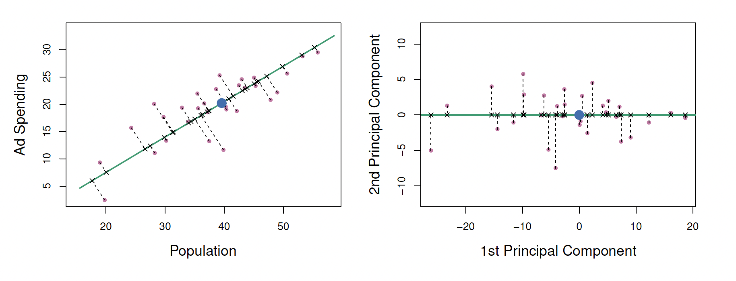
Principal Component Analysis 1st & 2nd PC

Slide 18
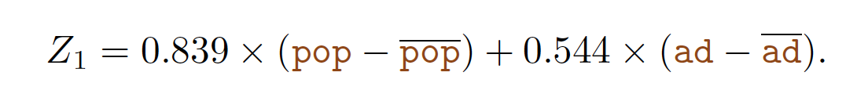
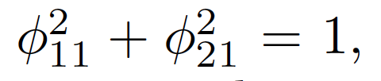
Principal Component Analysis 1st & 2nd PC
PC loadings
Linear combination that maximazes variance in the form
Variable mean

Slide 19
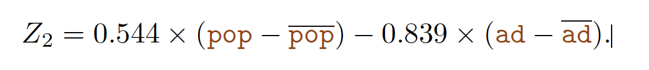
Principal Component Analysis 1st & 2nd PC
PC loadings
Linear combination that maximazes variance in the form
Variable mean
Linear combination that maximazes variance in the form

Slide 20
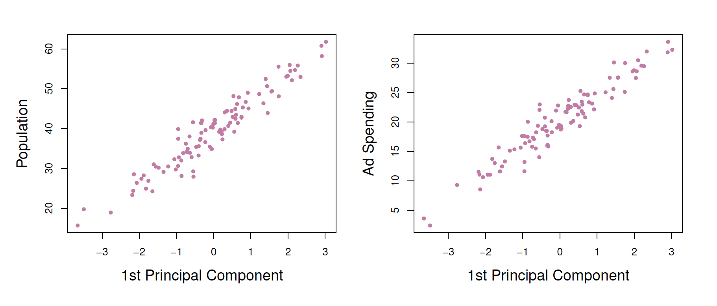
Principal Component Analysis 1st PC vs predictors
The 1st PC and the predictors have approximately a linear relationship.

Slide 21
Principal Component Analysis 1st PC vs predictors
The first principal component appears to capture most of the information contained in the predictors.

Slide 22
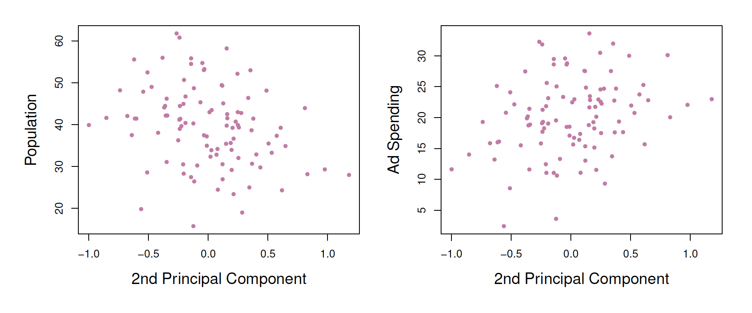
Principal Component Analysis 2nd PC vs predictors
The fact that the second principal component scores are much closer to zero indicates that this component captures far less information.

Slide 23
Principal Component Analysis 2nd PC vs predictors
There is little relationship between the second principal component and these two predictors,

Slide 24
PCA
Jupyter Example

