Slide 1
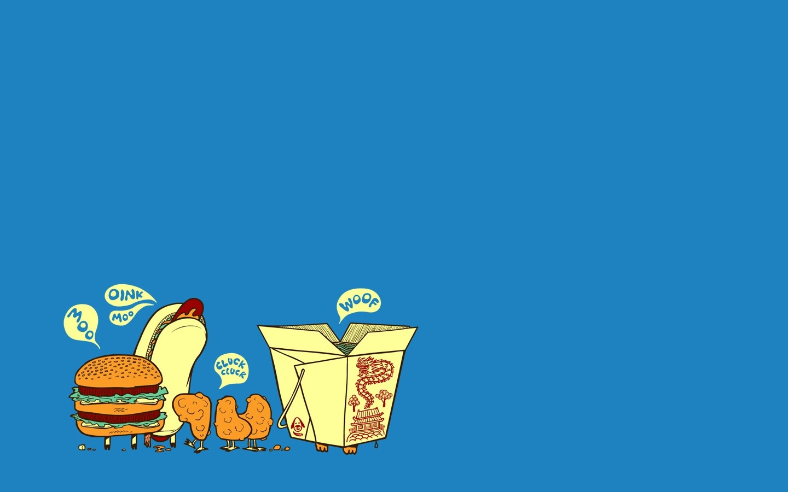
Foodee
-- Created By
Sambriddhi Mainali
Qiong Yu
Tarika Bedse

Slide 2
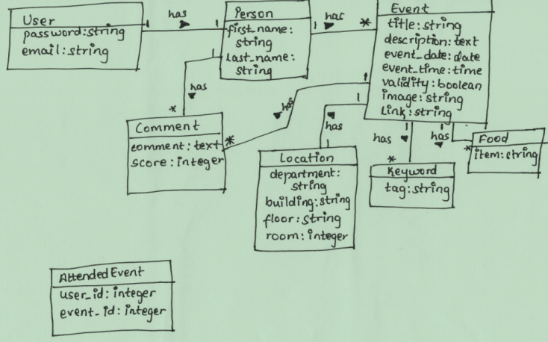

Slide 3
1-1 realtionship

Slide 4
1-n relationship

Slide 5
Validation
Event:
Title: string, present, no special character and number
Description: text, present
Event_date: date, present
Event_time: time, present
Validity: bool, realtime calculate
Image: optional
Link: optional
Keyword:
Tag: string, present, no number and special characters
Location:
Department: present, no special character and number
Building: present, no special character and number
Floor: present, no special character and number
Room: optional, integer only

Slide 7
1-1 relationship

Slide 8
1-n relationship

Slide 9
n-n relationship

Slide 10
Validation
Person:
First_name: present, no special character and number allowed, length: 3-20
Last_name: present, no special character and number allowed , length: 3-20
Food:
Item: string, present, no number and special characters , length: 3-20
Attended_Event:
User_id: present, integer
Event_id: present, integer

Slide 11
Tarika Bedse

Slide 12
1-n relationship
Tarika Bedse

Slide 13
1-n relationship
Tarika Bedse

Slide 14
Validation
User:
Password: present, at least 6 chars, with 1 number, 1 upper case
Email: present, unique, domain name should be “@memphis.edu”
Comment:
Comment: present
Score: present, in 1 to 10, integer
Tarika Bedse

