Slide 1
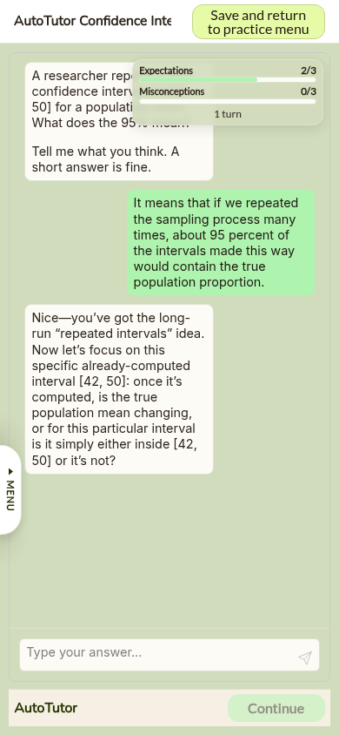
LLM AUTOTUTOR
AutoTutor 2.0 keeps the tutoring policy explicit while letting the LLM handle language.
Each learner turn is scored against authored expectations and misconceptions, routed through a planner, then realized as a tutor message.
Learner turn
Score
Select target
Tutor move
learner question
answer from authored content
misconception
repair: hint -> prompt -> assertion
expectation
pump / hint / prompt / assertion
completion
final answer prompt -> summary
Real mobile AutoTutor session: progress updates after scoring and planning.
Implemented locally in MoFaCTS as a configurable unit type with persisted turn state.
01 / 02

Slide 2
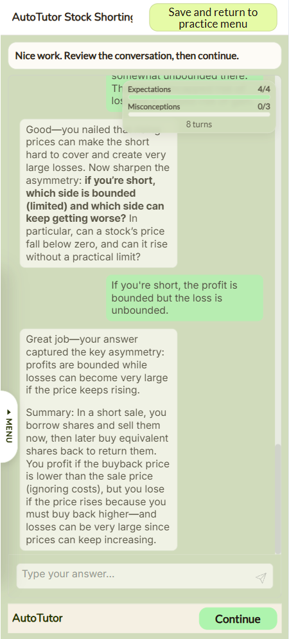
MOFACTS INTEGRATION
The research idea becomes a deployable, resumable learning unit.
MoFaCTS separates authored pedagogy from app infrastructure: the planner owns tutoring decisions; the app owns launch, LLM calls, history, and resume.
AUTHORED TDF
resume
Script and runtime settings
expectations, misconceptions, prompts, graduation
progress
coverage thresholds, max turns, model and temperature
LEARNING COMPONENT
AutoTutor planner and state contracts
cost cap
score merge -> target selection -> move selection
saved state, saved history, and end-state semantics
MOFACTS APP
Svelte/Meteor runtime shell
mobile chat UI, OpenRouter calls, session publication
canonical history persistence and resume reconstruction
Completion, summary, and progress in the real mobile learner surface.
02 / 02

