Slide 1
Box Plots
Visualizing Outliers & Differences in Distribution Between Groups

Slide 2
Q&A Activity: Review
What is the mean of a set of data?
What is the median of a set of data?
Notes:
Ask the question.
Learners type their answer into a Discord text channel, but don’t hit enter yet.
After a few seconds, have everyone hit enter on the count of 3.

Slide 3
Q&A Activity: Review
What is the mean of a set of data?
What is the median of a set of data?
Mean is the average of all the values, i.e. (sum / count).
Median is the middle value in the sorted data.
Notes:
Ask the question.
Learners type their answer into a Discord text channel, but don’t hit enter yet.
After a few seconds, have everyone hit enter on the count of 3.

Slide 4
Q&A Activity: Review
What is a quartile?
Notes:
Ask the question.
Learners type their answer into a Discord text channel, but don’t hit enter yet.
After a few seconds, have everyone hit enter on the count of 3.

Slide 5
Q&A Activity: Review
What is a quartile?
4 groups of equal size into which a set of sorted data can be divided.
Q0 (0) – 0% of values are less than or equal to this number (min)
Q1 (0.25) – 25% of values are less than or equal to this number
Q2 (0.5) – 50% of values are less than or equal to this number (median)
Q3 (0.75) – 75% of values are less than or equal to this number
Q4 (1) – 100% of values are less than or equal to this number (max)
Notes:
Ask the question.
Learners type their answer into a Discord text channel, but don’t hit enter yet.
After a few seconds, have everyone hit enter on the count of 3.

Slide 6
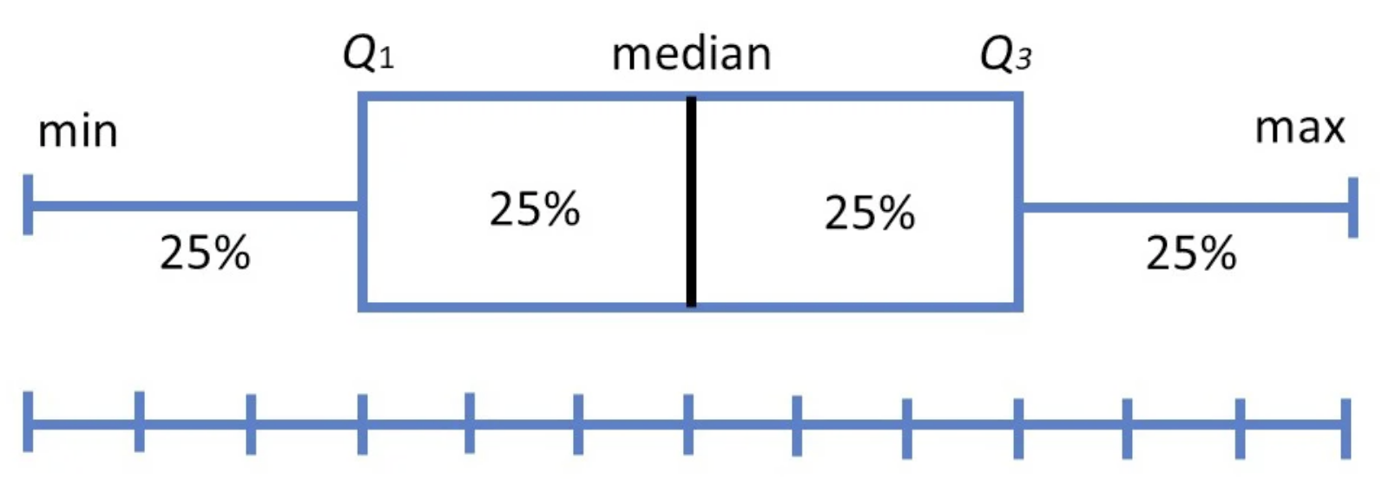
Box Plots
This is an example of a box plot.
The interquartile range or IQR (Q1 to Q3) contains 50% of the data.
Here the range of each quartile is the same but usually it won’t be.
0
3
6
9
12

Slide 7
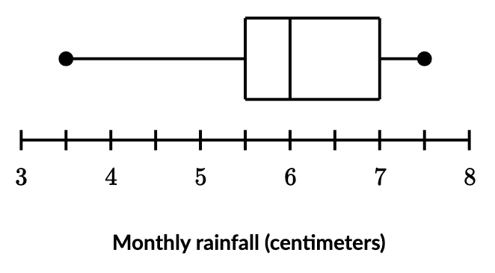
Q&A Activity: Reading Box Plots
What is the min value?
What is the max value?
What is the median value?
What is the value of Q1?
What is the value of Q3?
What is the IQR?
What is the range?

Slide 8
Q&A Activity: Reading Box Plots
What is the min value? 3.5
What is the max value? 7.5
What is the median value? 6
What is the value of Q1? 5.5
What is the value of Q3? 7
What is the IQR? 7 – 5.5 = 1.5
What is the range? 7.5 – 3.5 = 4

Slide 9
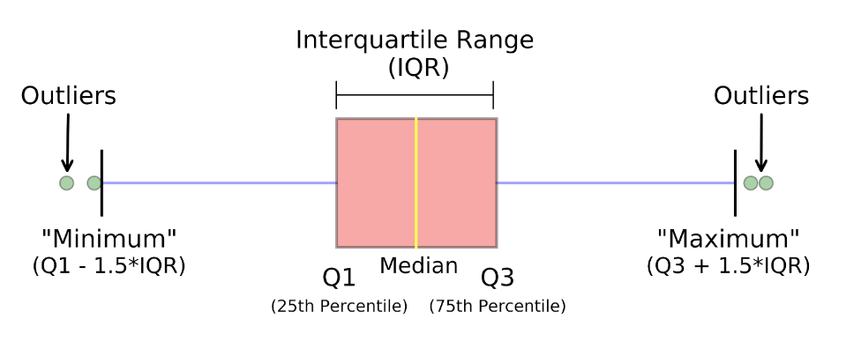
Outliers
Sometimes the range is ridiculously large compared to the IQR.
This may indicate we have outliers so we redefine “minimum” and “maximum” based on the IQR according to these formula.
Notes:
The pictured spreadsheet is just an example of what a spreadsheet looks like in case there’s any confusion.
Learners take 4 minutes to think of their answers and to make notes.
In random order, each learner shares something they came up with.

Slide 10
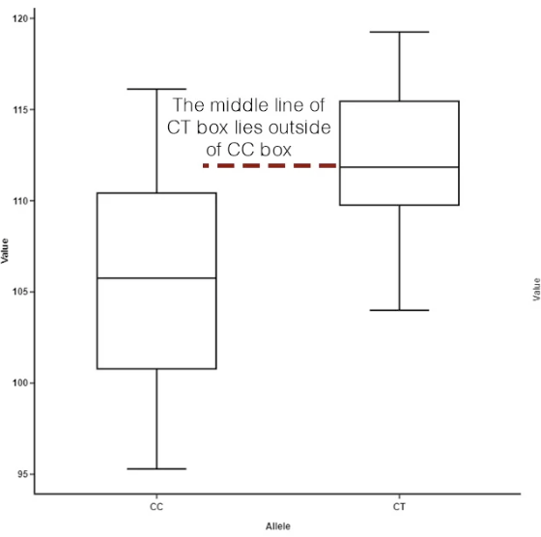
Comparing Distributions
When you have multiple categories in your dataset, you can use box plots to compare the values of one variable for each category.
Compare different metrics:
Medians
IQR and whisker ranges
Outliers
Skewness

Slide 11
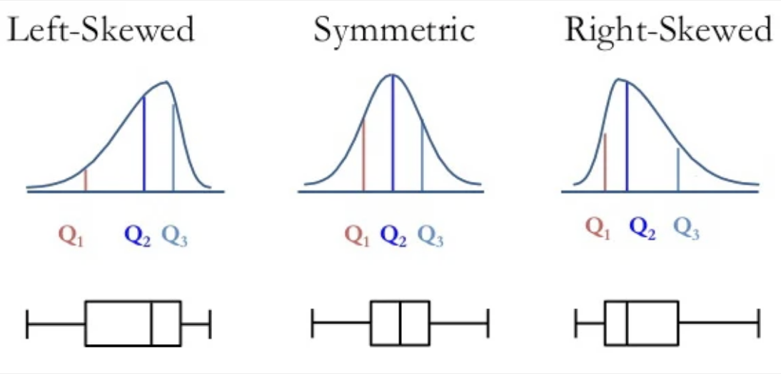
Skewness
Skewness is a way to describe the symmetry of a distribution.
Consider the position of the median and the size of the tail.
Symmetric distribution is also called a normal distribution.

Slide 12
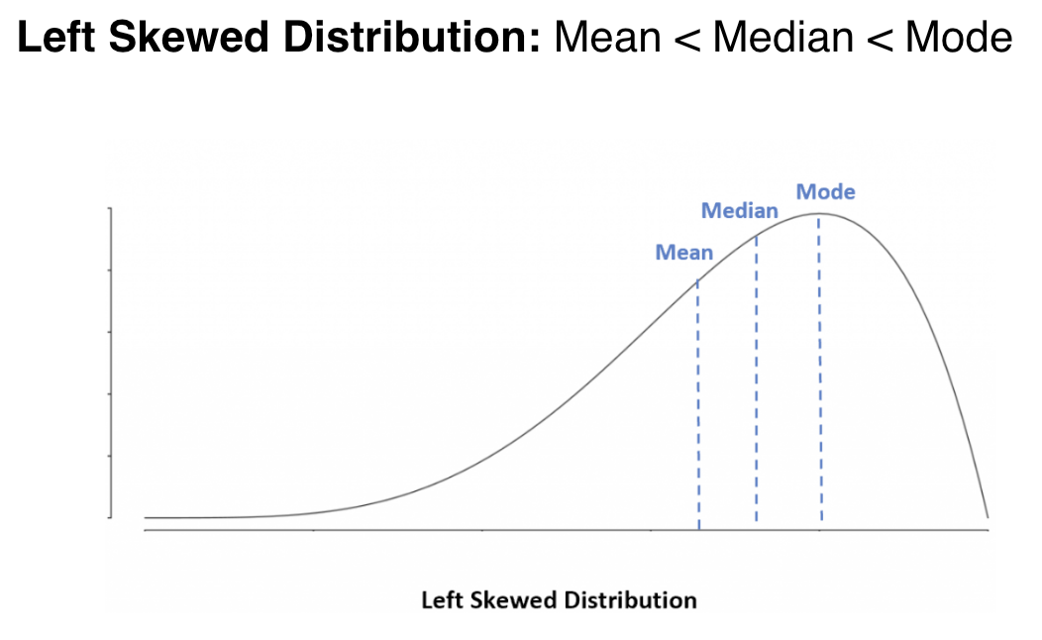
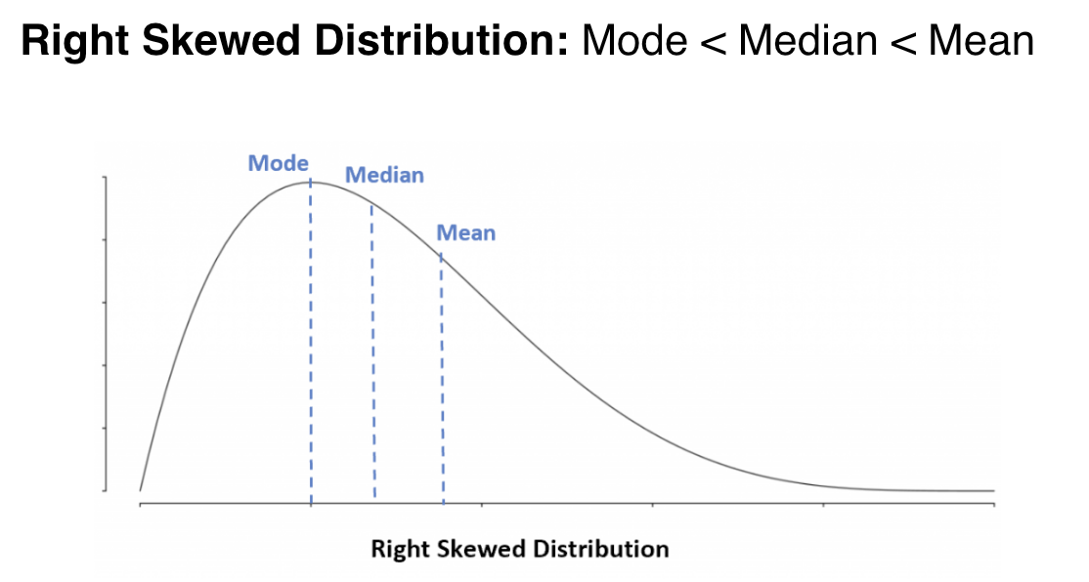
Skewness
You can also use the position of the mean and median to determine skew.

Slide 13
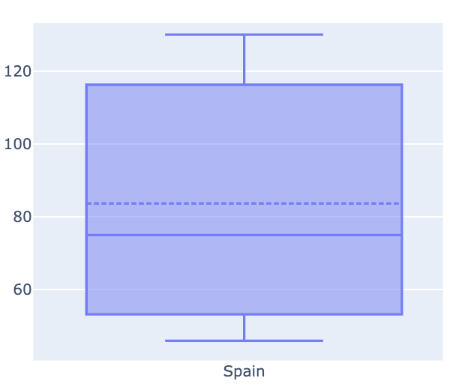
Skewness
We can also draw the mean on the box plot.
Median is represented by the solid line.
Mean is represented by the dotted line.

Slide 14
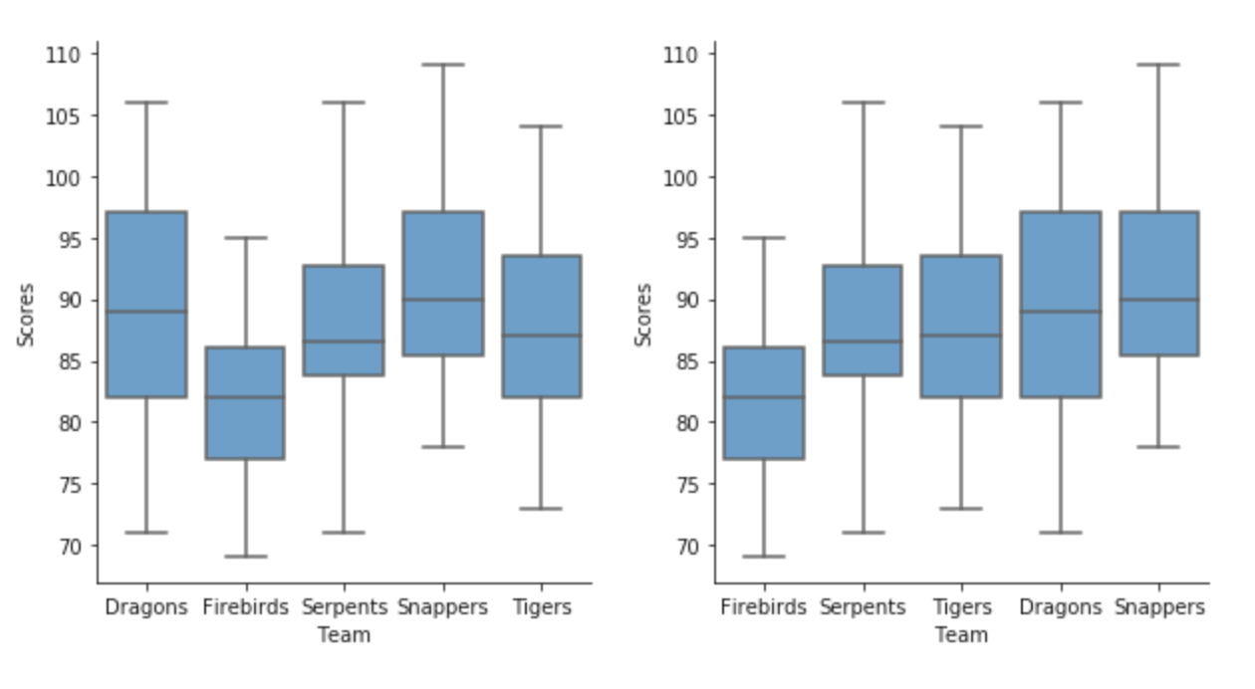
Ordering Categories in Box Plots
Sorting the categories by the median value can improve readability.

Slide 15
How-to: Make Box Plots in Jupyter
Read CSV Data into Pandas Dataframe
Import Pandas Library
Read CSV data and Save in Variable
Display Dataframe Contents
Generate Plotly Box Plot
Import Plotly Express Library
Set Columns as x and y
Set Additional Plot Options (Category Order)
Generate Chart (with Means)

Slide 16
Summary
Quartiles & IQR
Box Plots
Outliers
Skewness
Ordering Plots
Plotly Box Plots in Jupyter

