Slide 1
Getting Familiar with Discord

Slide 2
Objective
After this session, you should be able to do the following using Discord:
Join a voice call
Write a message in a text channel
Share your screen whenever you need help
Share a proper screenshot of your problem
Ping a faculty member for help in discord
Ping a mentor for help in the pod
DM your mentor
Download: https://discord.com/download

Slide 3
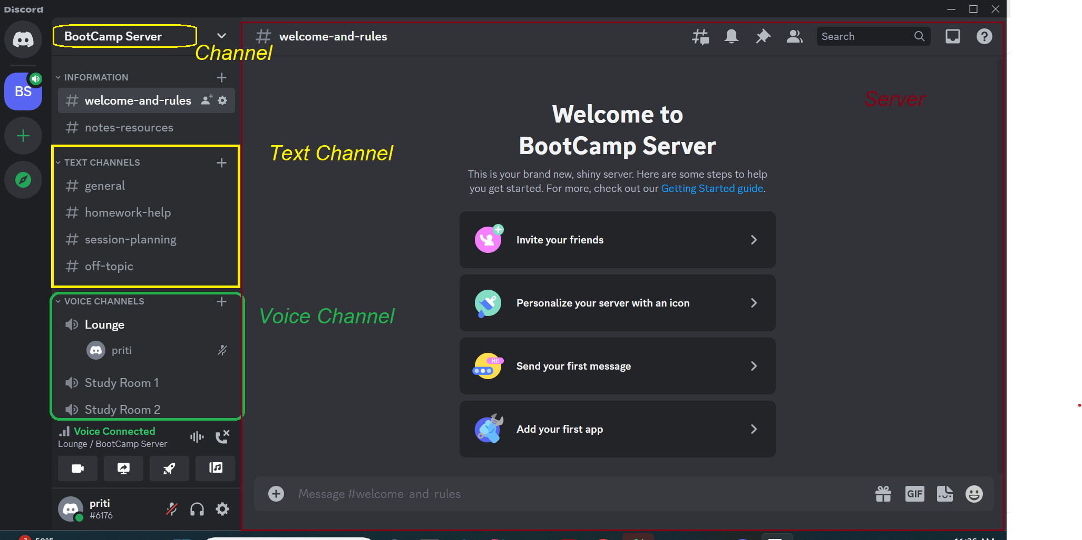
Discord Channel

Slide 4
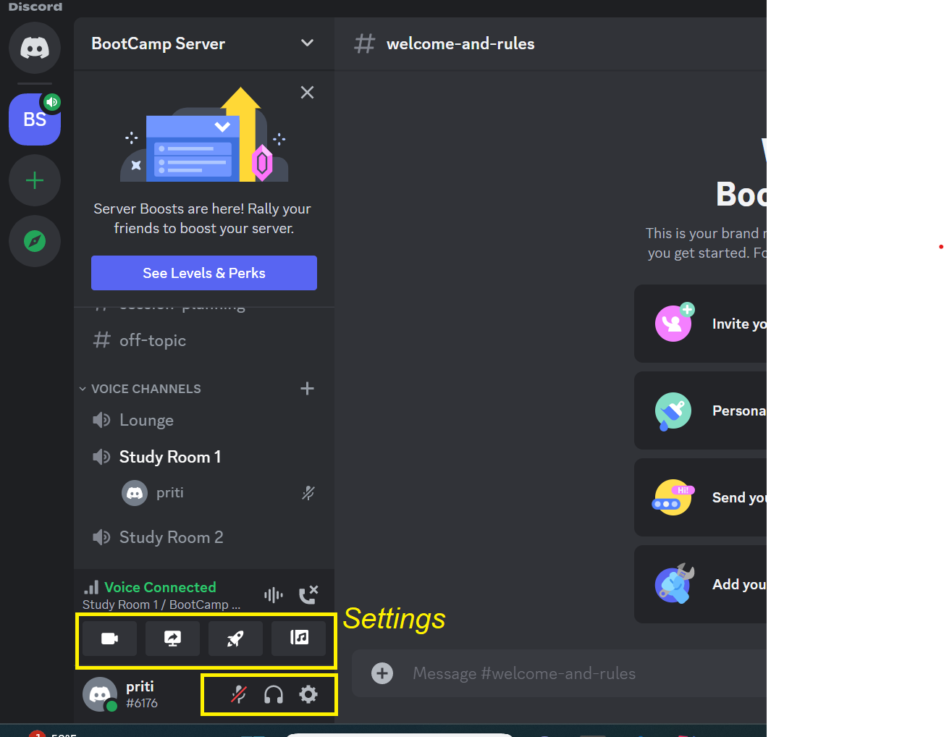
Join a Voice Call
Join a Voice Channel by clicking in the channel you wish to join
The setting to mute/unmute, turn on/off your camera, speaker option etc is right beside/above your username

Slide 5
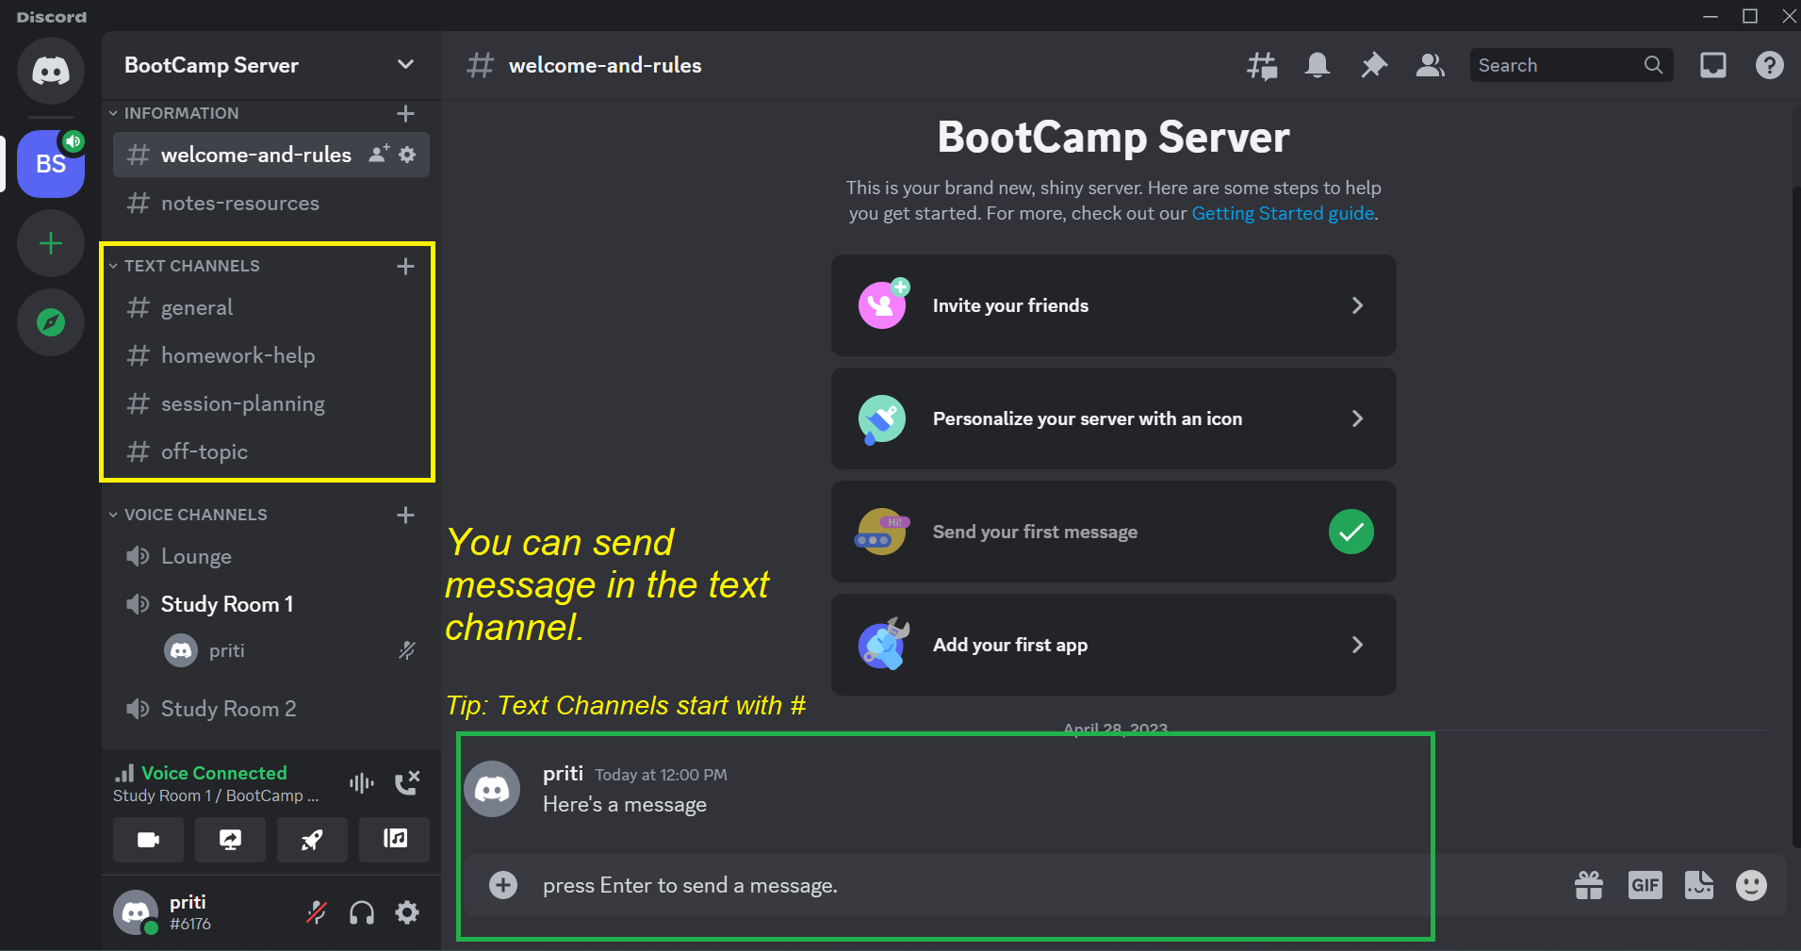
Write a message

Slide 6
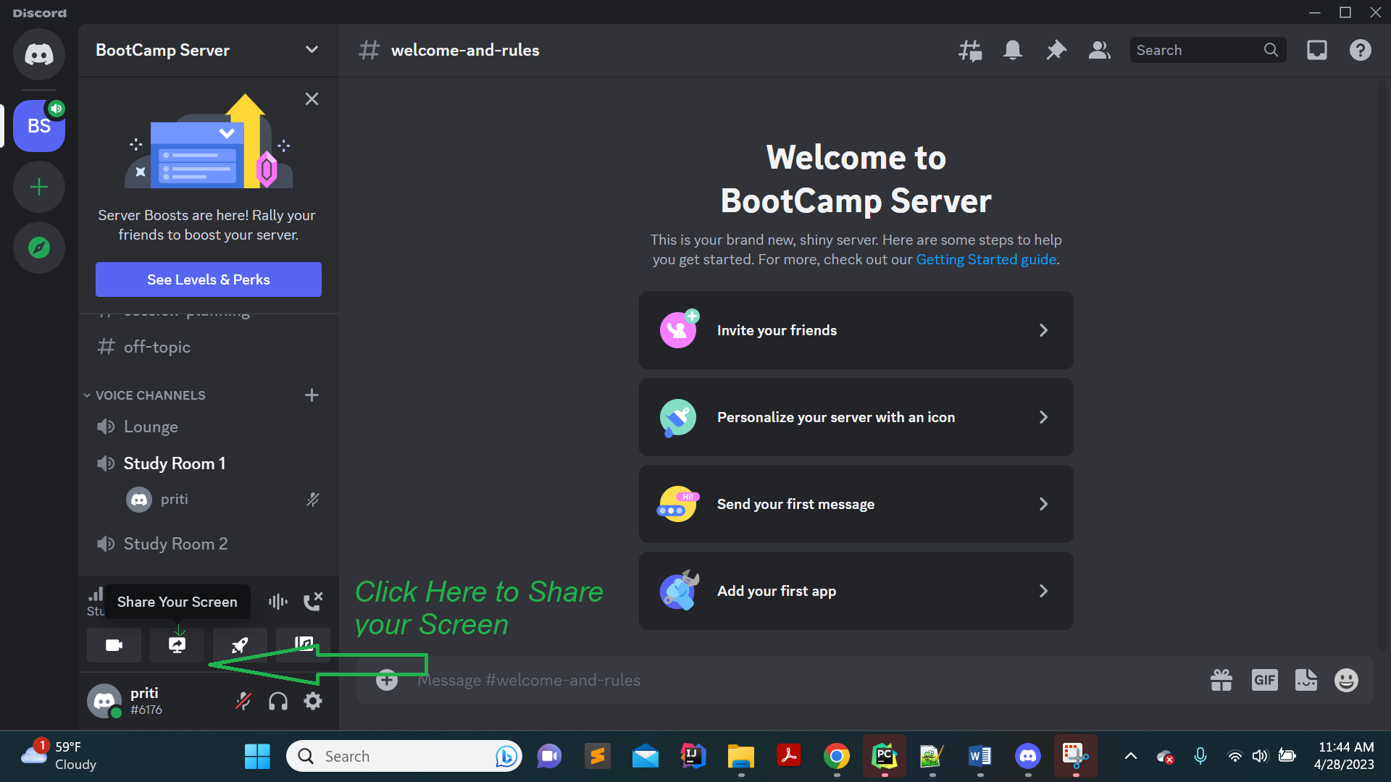
Share your screen (1)

Slide 7
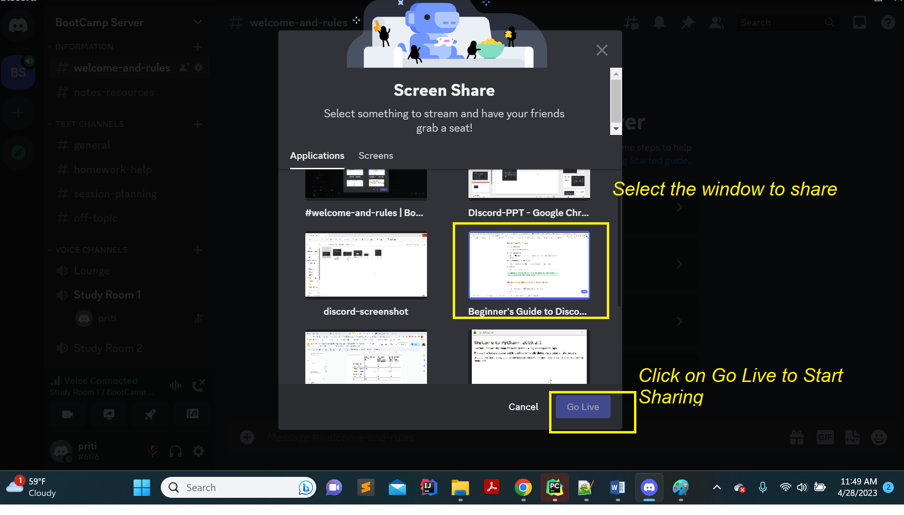
Share your screen (2)

Slide 8
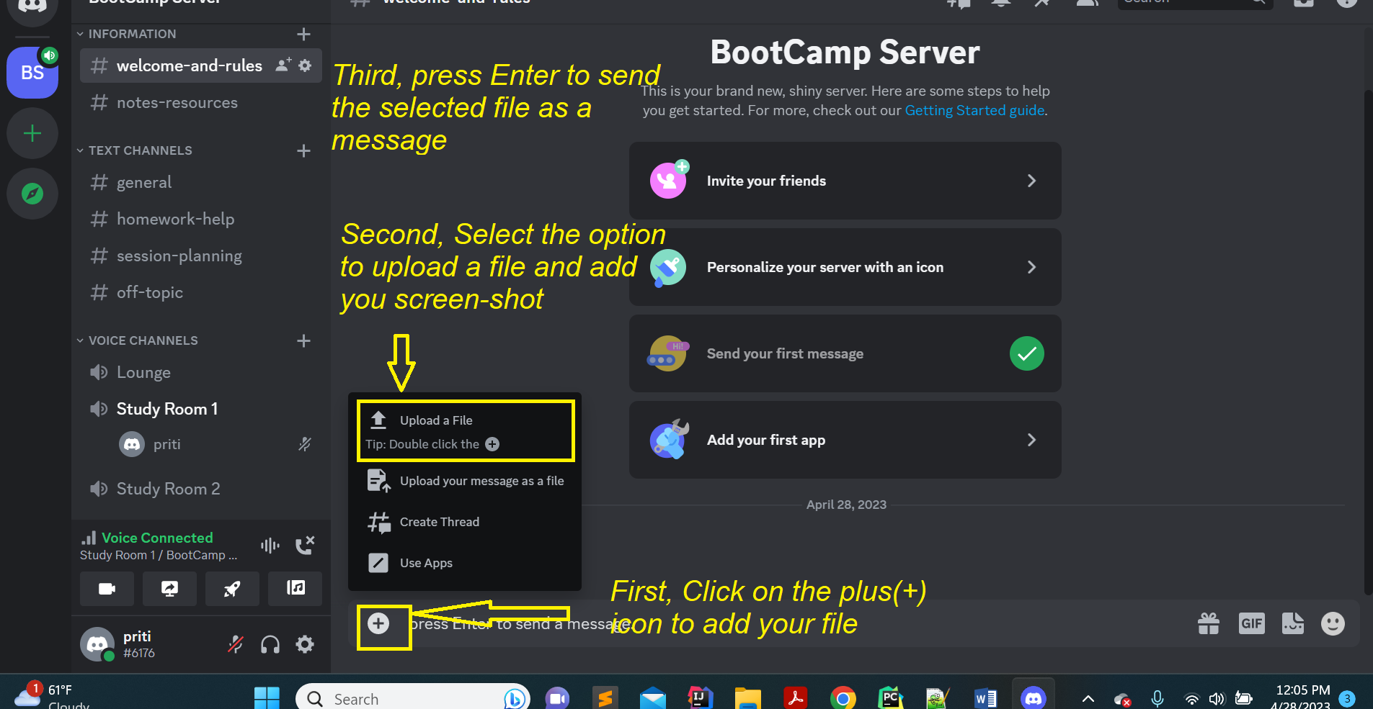
Share a Screenshot of your problem

Slide 9
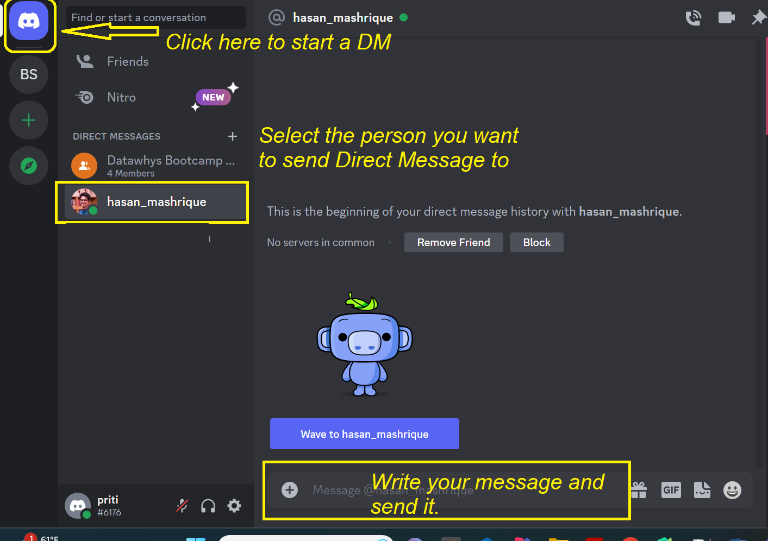
Ping for help

Slide 10
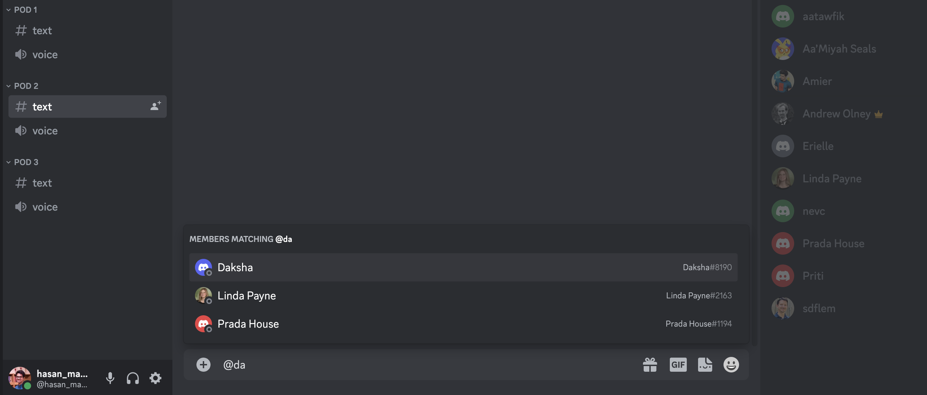
Mention mentors in the channels:

Slide 11
Activity
Introduce yourself in the voice channel, also turn on your video, while you introduce yourself.
Hi! ...

Slide 12
Activity
2. Explain different components of discord by joining a channel with RAs, one at a time.

Slide 13
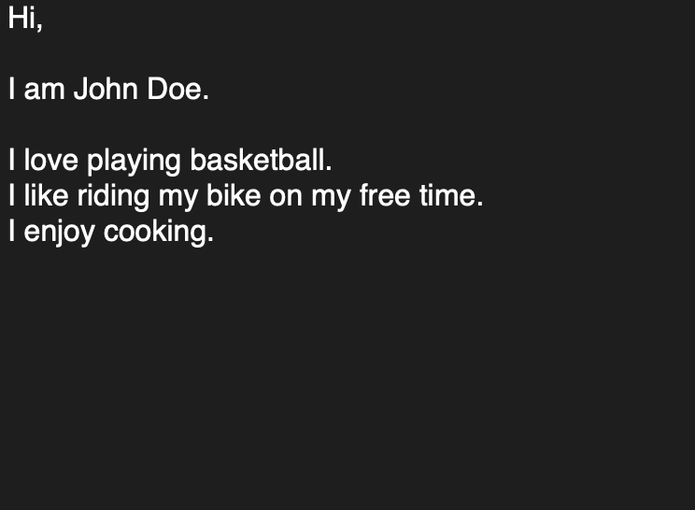
Activity
3. Share your screen with your name and two truth and a lie about yourself in a text editor.

Slide 14
Activity
4. Share a screenshot with your name and two truth and a lie about yourself in the text editor (Channe:#….)
or
Share the screenshot with your name and a short introduction.

Slide 15
Activity
5. Ping (@) your RA : Drop a greeting message to your RA in your pod
6. Ping your RA with a DM(direct message)

Slide 16
Activity ???
Step 1: Get users in a Discord voice channel
Step 2: Have interns introduce themselves in the general channel when they join
Step 3: Get interns into general discord voice channel
Step 4: Separate RAs into different discord channels
Step 5: Thinkshare: what parts of the discord do you think does what? UI questiong... (Give 5 minutes then tell them to share – call out people if you have to)
Step 6: Give a tour of the discord (explain all channels, where they will be posting, etc.)
Step 7: Have each pod name their group and send a custom emoji/mascot
Step 8: Have each intern turn on their video
Step 9: Have each intern share their screen
Step 10: Have each intern share a screenshot of their screen
Step 11: Have them upload an image/file/whatever they want
Step 12: Have each intern ping (@) their RA
Step 13: Have each intern ping ( @ ) their pod
Step 14: Have each intern DM their RA

Slide 17
Reference
https://support.discord.com/hc/en-us/articles/360045138571-Beginner-s-Guide-to-Discord

