Slide 1
Filtering
How We Find Desired Information from Dataset

Slide 2
Filtering
In general, filtering means throwing out irrelevant stuff (could be harmful) from something. For example, water filtering, air filtering, etc.
Similarly in data science, filtering means-
Refining datasets into simply what a user needs
Excluding other data that are irrelevant or sensitive
Different types of strategies can be used to filter out data depending on the user's needs.

Slide 3
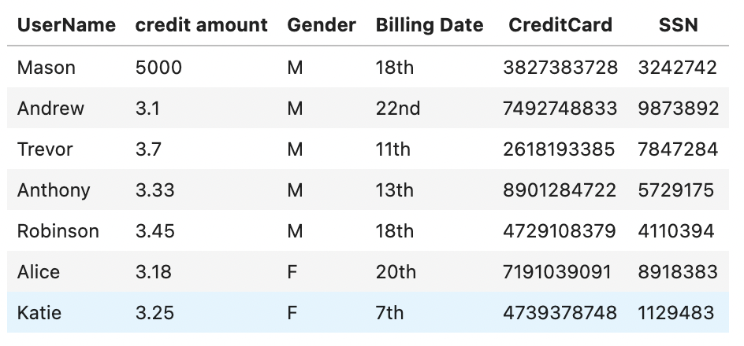
Filtering
A real world example of filtering can be preventing access to sensitive information.
For example, a data filter may remove Social Security numbers or credit card numbers from client data before an employee can start working on them.

Slide 4
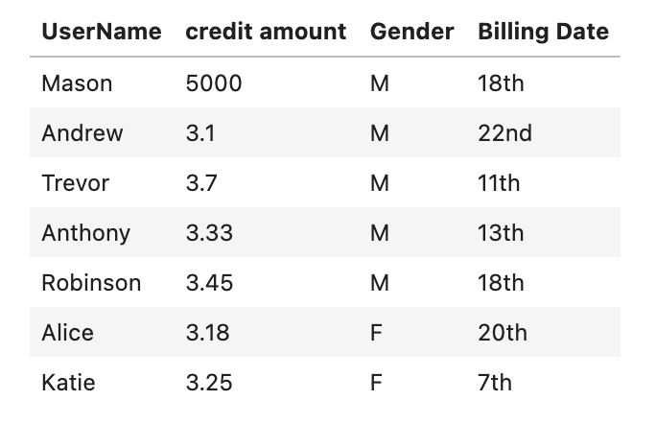
Filtering
After filtering, this data will be sent to an employee as shown

Slide 5
The Need for Filtering Data in a Dataset
Keep the Relevant Data:
In data science, a lot of the time data scientists have to work with huge datasets.
But for a specific analysis, not all data is important to use. In those cases, filtering is very helpful.
It also helps you focus on specific data rather than looking at the huge dataset all the time.

Slide 6
The Need for Filtering Data in a Dataset
Example:
Suppose you have a population dataset where individual population data are stored like age, height, weight, hair_color, eye_color, and BMI.
You are asked to find out how a person's height changes with respect to their age.
For this scenario, you actually don't need any other information except the height and age columns. So, we can just keep the height, age columns and do further analysis.

Slide 7
Discussion Activity
Suppose we have some data on GPA, GRE and gender.
We want to see the student's performance based on gender (male/female).
GRE | GPA | Gender
316 | 3.4 | M
308 | 3.1 | M
327 | 3.7 | F
310 | 3.33 | F
305 | 3.45 | M
322 | 3.18 | F
316 | 3.25 | M
300 | 3.4 | F
310 | 3.6 | F

Slide 8
Discussion Activity
- What is the average GRE score in both the gender groups? Which group has a better average score?
- What is the average GPA in both the gender groups? Which group has a better average GPA?
GRE | GPA | Gender
316 | 3.4 | M
308 | 3.1 | M
327 | 3.7 | F
310 | 3.33 | F
305 | 3.45 | M
322 | 3.18 | F
316 | 3.25 | M
300 | 3.4 | F
310 | 3.6 | F

Slide 9
Discussion Activity
- What is the maximum GPA from the males?
- What is the minimum GRE score among the females?
GRE | GPA | Gender
316 | 3.4 | M
308 | 3.1 | M
327 | 3.7 | F
310 | 3.33 | F
305 | 3.45 | M
322 | 3.18 | F
316 | 3.25 | M
300 | 3.4 | F
310 | 3.6 | F

Slide 10
How to Filter a Dataset
Read CSV Data into Pandas Dataframe
Import Pandas Library
Read CSV data and Save in Variable
Display Dataframe Contents
Filter Data Based on Requirement
Look at all the features (columns)
Keep the features (columns) which are required
Filter data as per requirement

Slide 11
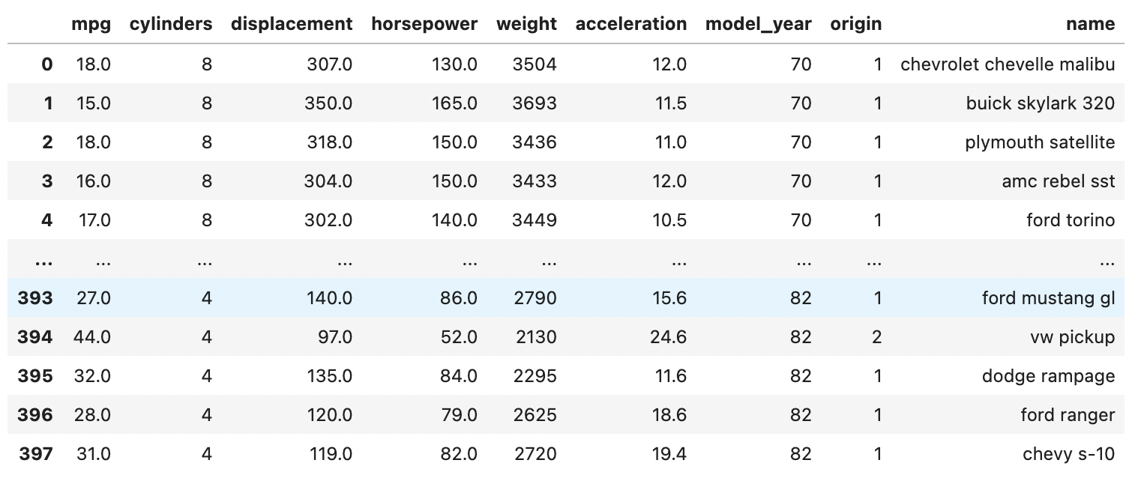
Filering in Jupyter Lab and Blockly
Suppose we want to find the cars which:
have only 4 cylinders
name is "toyota corolla"
model_year is after 1980

Slide 12
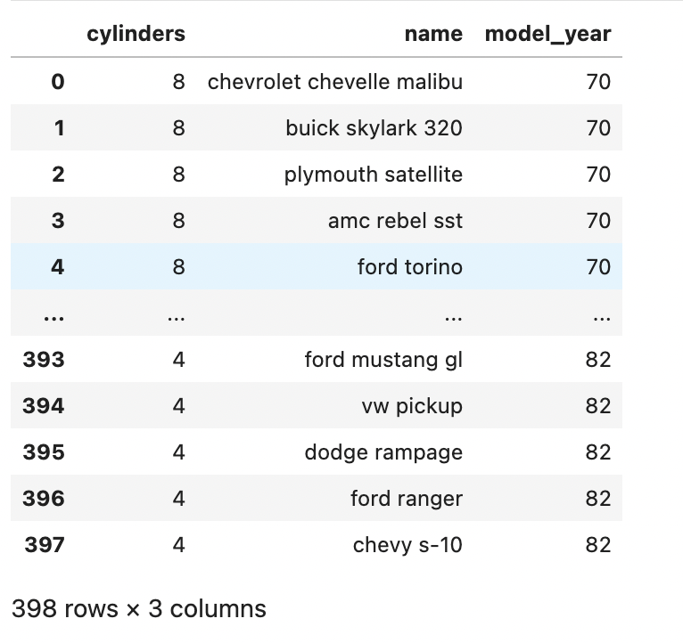
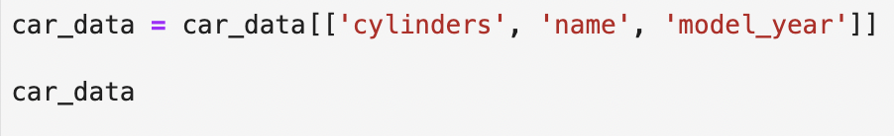
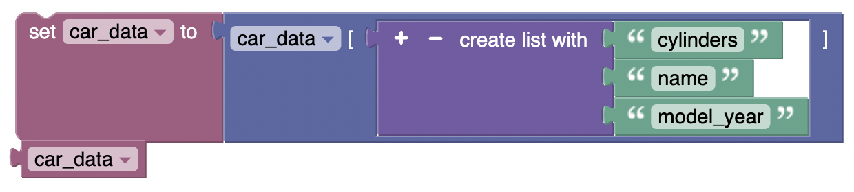
Filtering in Jupyter Lab and Blockly
Filter the required features from the dataset

Slide 13
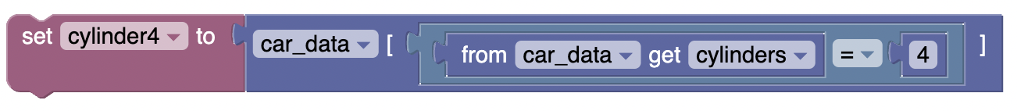
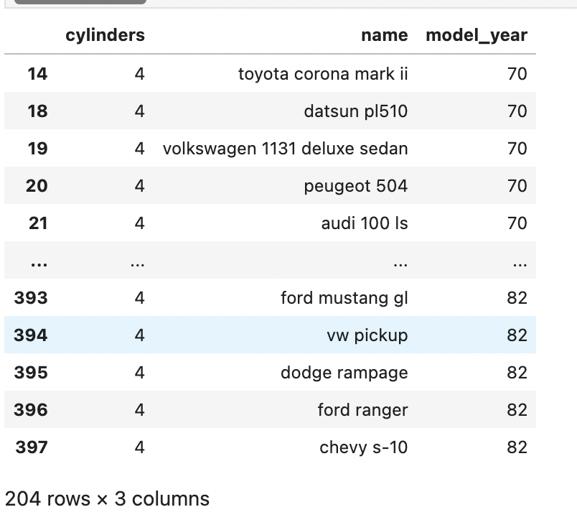


Filtering in Jupyter Lab and Blockly
Filter the cars with 4 cylinders

Slide 14

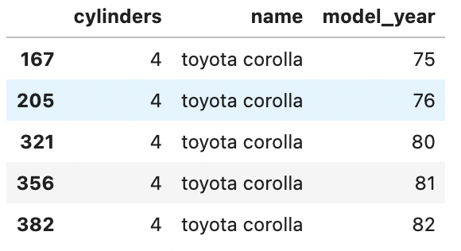

Filtering in Jupyter Lab and Blockly
Filter the cars which name is "toyota corolla"

Slide 15
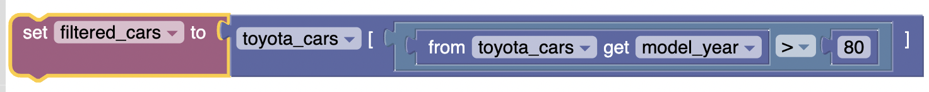
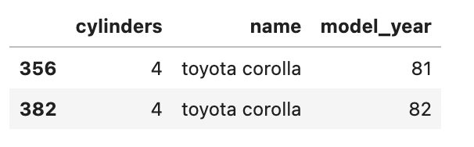


Filtering in Jupyter Lab and Blockly
Filter the cars which model_year is after 1980 (in our model_year column 80 represents 1980)
Finally found 2 cars out of 398

Slide 16
Summary:
Initial list contained 398 cars.
After filtering by our requirements, we have a list of only 2 cars with the required features.
By using filtering in a big dataset, we can more easily find the data we care about

Slide 17
Reference notebook:
FilterData_Ex.ipynb

